Slide 1
MongoDB Introduction
Amarjeet Singh
(Technical Architect)

Slide 2
Introduction to MongoDB

Slide 3
A bit of history

Slide 4
Introduction to MongoDB
MongoDB is a NoSQL database which stores the data in form of key-value pairs. It is an Open Source, Document Database which provides high performance and scalability along with data modelling and data management of huge sets of data in an enterprise application.
MongoDB also provides the feature of Auto-Scaling. Since, MongoDB is a cross platform database and can be installed across different platforms like Windows, Linux etc.

Slide 5
What is Document based storage?
A Document is nothing but a data structure with name-value pairs like in JSON.
It is very easy to map any custom Object of any programming language with a MongoDB Document. For example : Student object has attributes name, rollno and subjects, where subjects is a List.

Slide 6
Key Features of MongoDB
Apart from most of the NoSQL default features, MongoDB does bring in some more, very important and useful features :
MongoDB provides high performance. Input/Output operations are lesser than relational databases due to support of embedded documents(data models) and Select queries are also faster as Indexes in MongoDB supports faster queries.

Slide 7
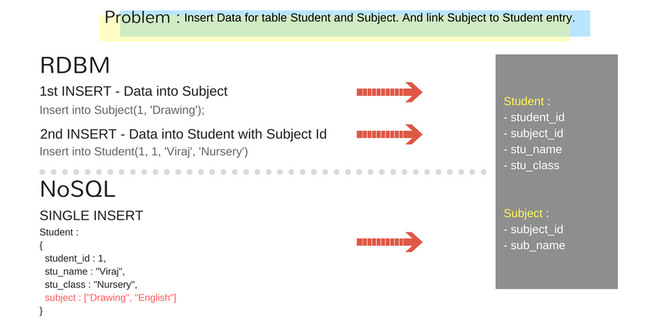
RDBMS Vs MongoDB

Slide 8
MongoDB has a rich Query Language, supporting all the major CRUD operations. The Query Language also provides good Text Search and Aggregation features.
Auto Replication feature of MongoDB leads to High Availability. It provides an automatic failover mechanism, as data is restored through backup(replica) copy if server fails.
Sharding is a major feature of MongoDB. Horizontal Scalability is possible due to sharding.
MongoDB supports multiple Storage Engines. When we save data in form of documents(NoSQL) or tables(RDBMS) who saves the data? It's the Storage Engine. Storage Engines manages how data is saved in memory and on disk.

Slide 9
Organizations that use MongoDB
Adobe
LinkedIn
McAfee
FourSquare
eBay
MetLife
SAP

Slide 10
MongoDB philosophy
Keep functionality when we can (key/value stores are great, but we need more)
Non-relational (no joins) makes scaling horizontally practical
Document data models are good
Database technology should run anywhere virtualized, cloud, metal, etc
Notes:
By reducing transactional semantics the db provides, one can still solve an interesting set of problems where performance is very important, and horizontal scaling then becomes easier.

Slide 11
Under the hood
Written in C++
Runs nearly everywhere
Data serialized to BSON
Extensive use of memory-mapped files i.e. read-through write-through memory caching.

Slide 12
Database Landscape
Memcached
MongoDB
Scalability & Performance
RDBMS
Depth of Functionality

Slide 13
“
MongoDB has the best features of key/value stores, document databases and relational databases in one.
John Nunemaker

Slide 14
Relational made normalized data look like this
Category
Name
Url
User
Article
Tag
Name
Slug
Publish date
Text
Name
Email Address
Name
Url
Comment
Comment
Date
Author

Slide 15
Document databases make normalized data look like this
Article
Name
Slug
Publish date
Text
Author
User
Name
Email Address
Comment[]
Comment
Date
Author
Tag[]
Value
Category[]
Value

Slide 16
But we’ve been using a relational database for 40 years!

Slide 17
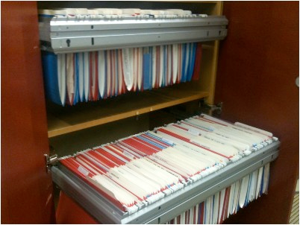
How do people store documents in real life?

Slide 18
Think about a doctors office
There’s two ways they could organize their files

Slide 19
Each document type in it’s own drawer
MRIs
X-rays
Lab
Invoices
Index
1
1
1
1
1
1
1
1
History
Medications
Lab
Forms

Slide 20
Group related records
. . .
Patient 1
Patient 2
Patient 3
Vendor 1
Vendor 2
Vendor 3

Slide 21
Databases work the same way
Relational
Document
Patient 1
Vendor 1
Article
Category
Name
Slug
Publish date
Text
Author
Name
Url
User
Name
Email Address
User
Article
Tag
Comment[]
Name
Email Address
Name
Slug
Publish date
Text
Name
Url
Comment
Date
Author
Comment
Tag[]
Comment
Date
Author
Value
Category[]
Value

Slide 22
Terminology
RDBMS |  | Mongo
Table, View | ➜ | Collection
Row | ➜ | Document
Index | ➜ | Index
Join | ➜ | Embedded Document
Foreign Key | ➜ | Reference
Partition | ➜ | Shard

Slide 23
MongoDB Use Cases

Slide 24

CMS / Blog
Needs:
Business needed modern data store for rapid development and scale
Solution:
Use PHP & MongoDB
Results:
Real time statistics
All data, images, etc stored together easy access, easy deployment, easy high availability
No need for complex migrations
Enabled very rapid development and growth

Slide 25

Photo Meta-Data
Problem:
Business needed more flexibility than Oracle could deliver
Solution:
Use MongoDB instead of Oracle
Results:
Developed application in one sprint cycle
500% cost reduction compared to Oracle
900% performance improvement compared to Oracle

Slide 26

Customer Analytics
Problem:
Deal with massive data volume across all customer sites
Solution:
Use MongoDB to replace Google Analytics / Omniture options
Results:
Less than one week to build prototype and prove business case
Rapid deployment of new features

Slide 27

Archiving
Why MongoDB:
Existing application built on MySQL
Lots of friction with RDBMS based archive storage
Needed more scalable archive storage backend
Solution:
Keep MySQL for active data (100mil)
MongoDB for archive (2+ billion)
Results:
No more alter table statements taking over 2 months to run
Sharding fixed vertical scale problem
Very happily looking at other places to use MongoDB

Slide 28

Online Dictionary
Problem:
MySQL could not scale to handle their 5B+ documents
Solution:
Switched from MySQL to MongoDB
Results:
Massive simplification of code base
Eliminated need for external caching system
20x performance improvement over MySQL

Slide 29

E-commerce
Problem:
Multi-vertical E-commerce impossible to model (efficiently) in RDBMS
Solution:
Switched from MySQL to MongoDB
Results:
Massive simplification of code base
Rapidly build, halving time to market (and cost)
Eliminated need for external caching system
50x+ performance improvement over MySQL

Slide 30
Tons more
MongoDB casts a wide net
people keep coming up with
new and brilliant ways to use it

