Slide 1

SANT LONGOWAL INSTITUTE OF ENGG.& TECH
DEPARTMENT OF ELECTRICAL ENGINEERING
SEMINAR PROJECT ON
SUBSTATION PROTECTION DEVICE
REPRESENTED BY- AMARJEET KUMAR
REG. NO- GEE/1740720
DATE-16/06/2021

Slide 2
INDEX
ABSTRACT
INTRODUCTION
THREE PHASE DIAGRAM OF PROTECTION
COMPONENTS OF PROTECTION SYSTEM
CURRENT TRANSFORMER (CT)
POTENTIAL TRAMSFORMER (PT)
PROTECTIVE RELAY
CIRCUIT BREAKER (CB)
LIGHTNING ARRESTER (LA)
ISOLATOR
CONCLUSION

Slide 3
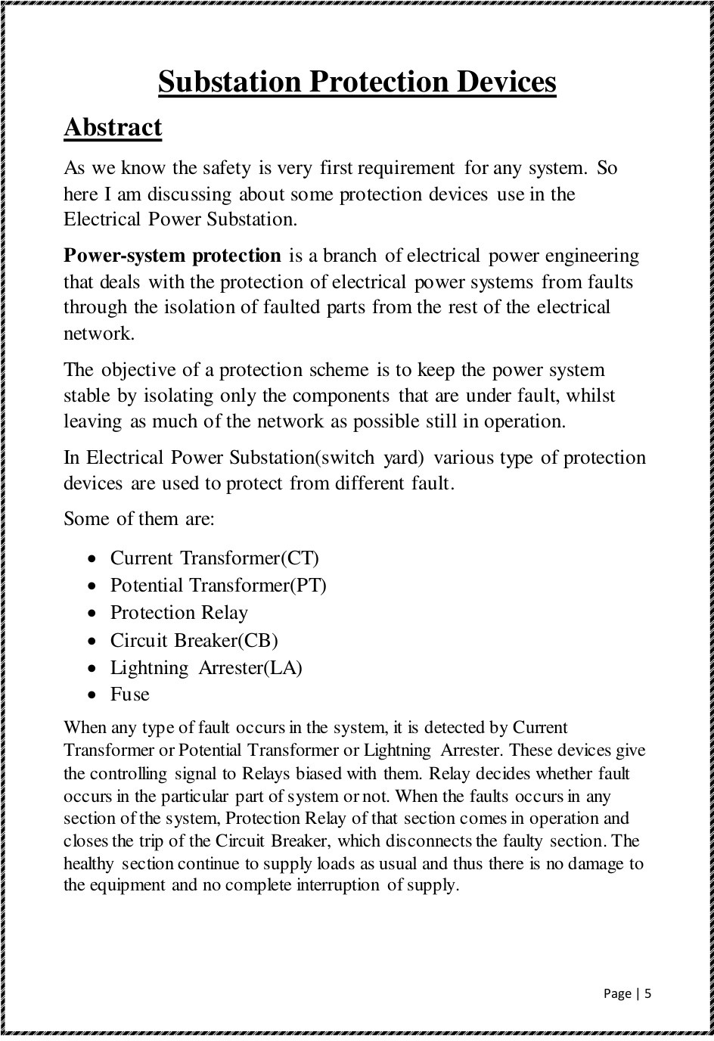

Slide 4
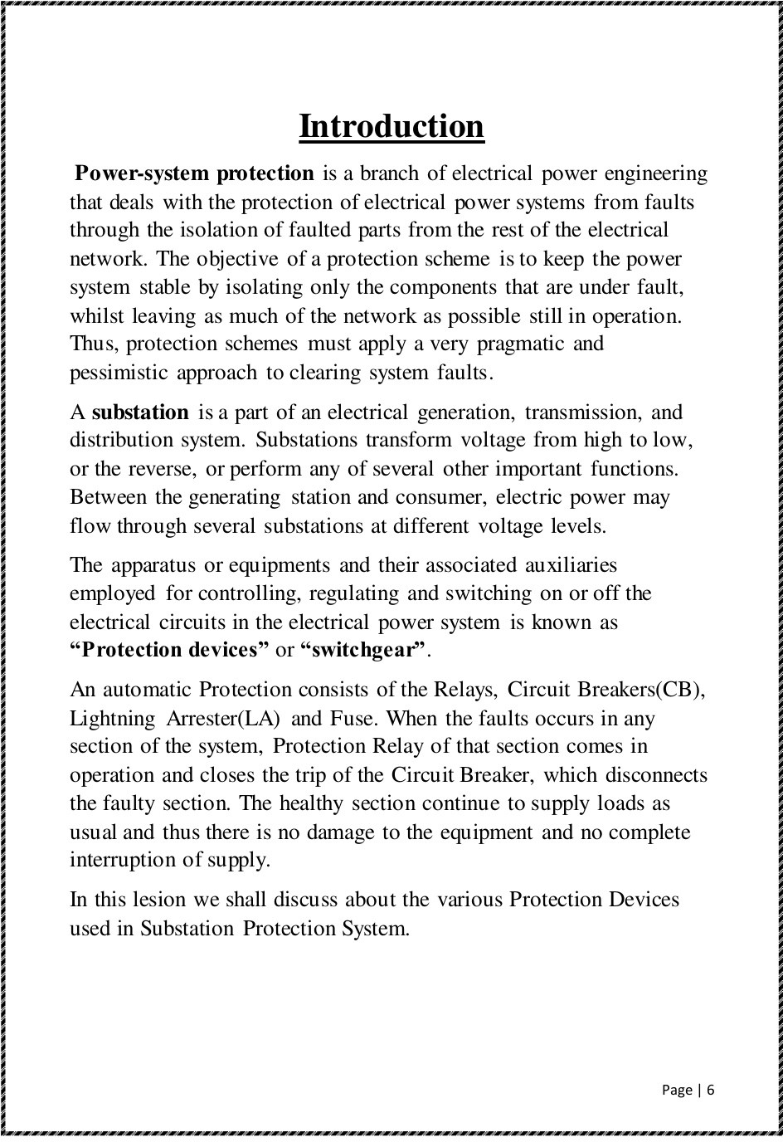

Slide 5
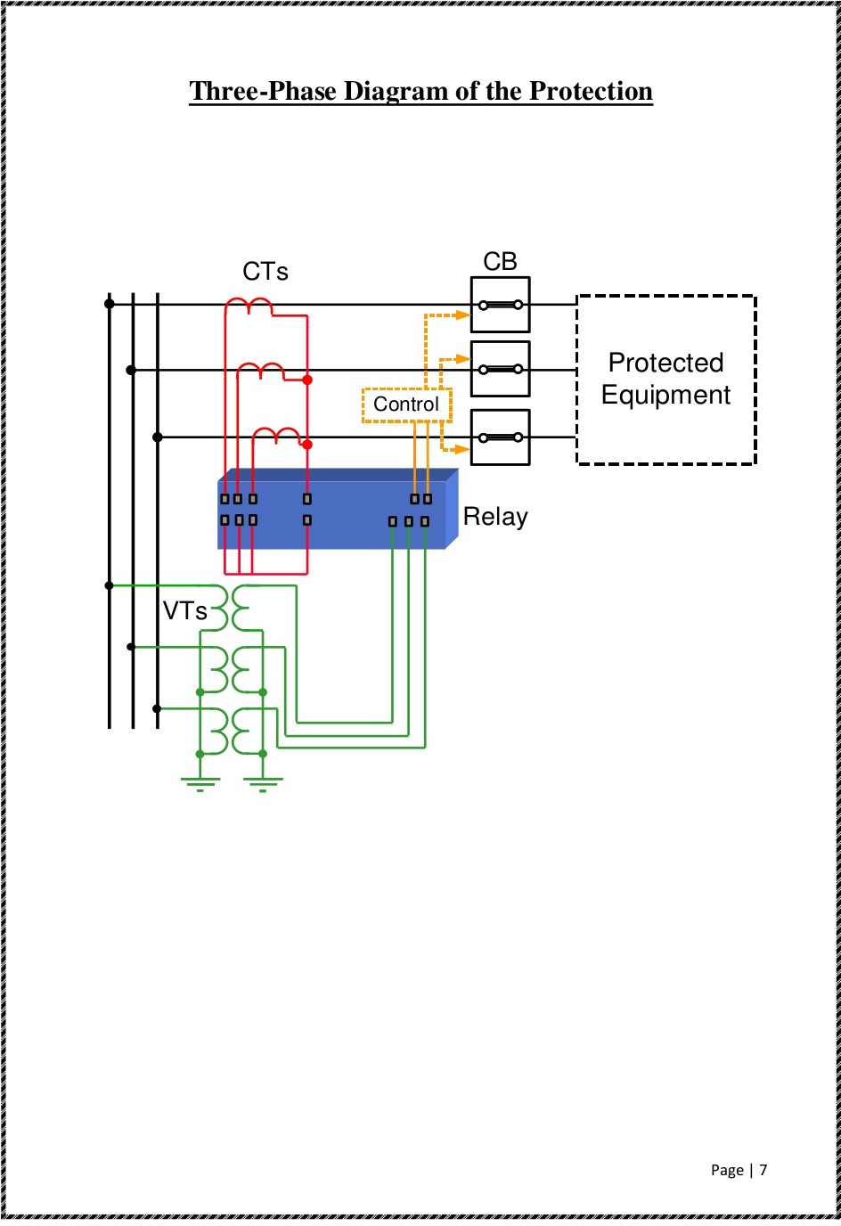

Slide 6
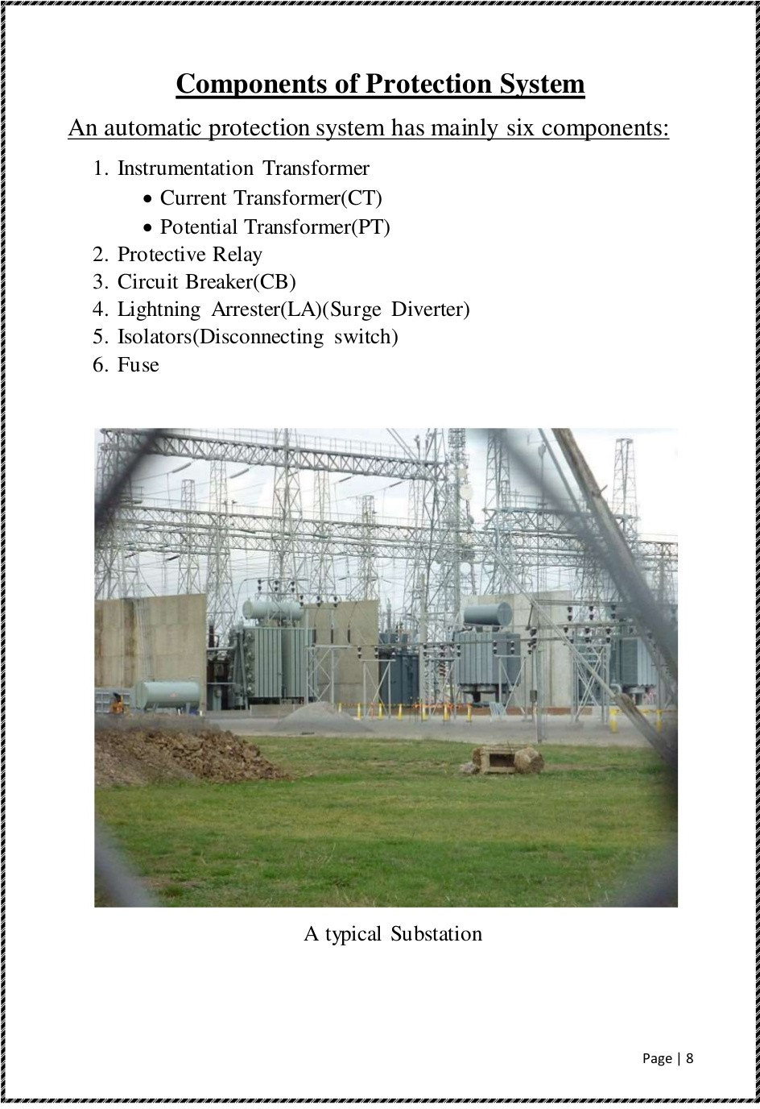

Slide 7
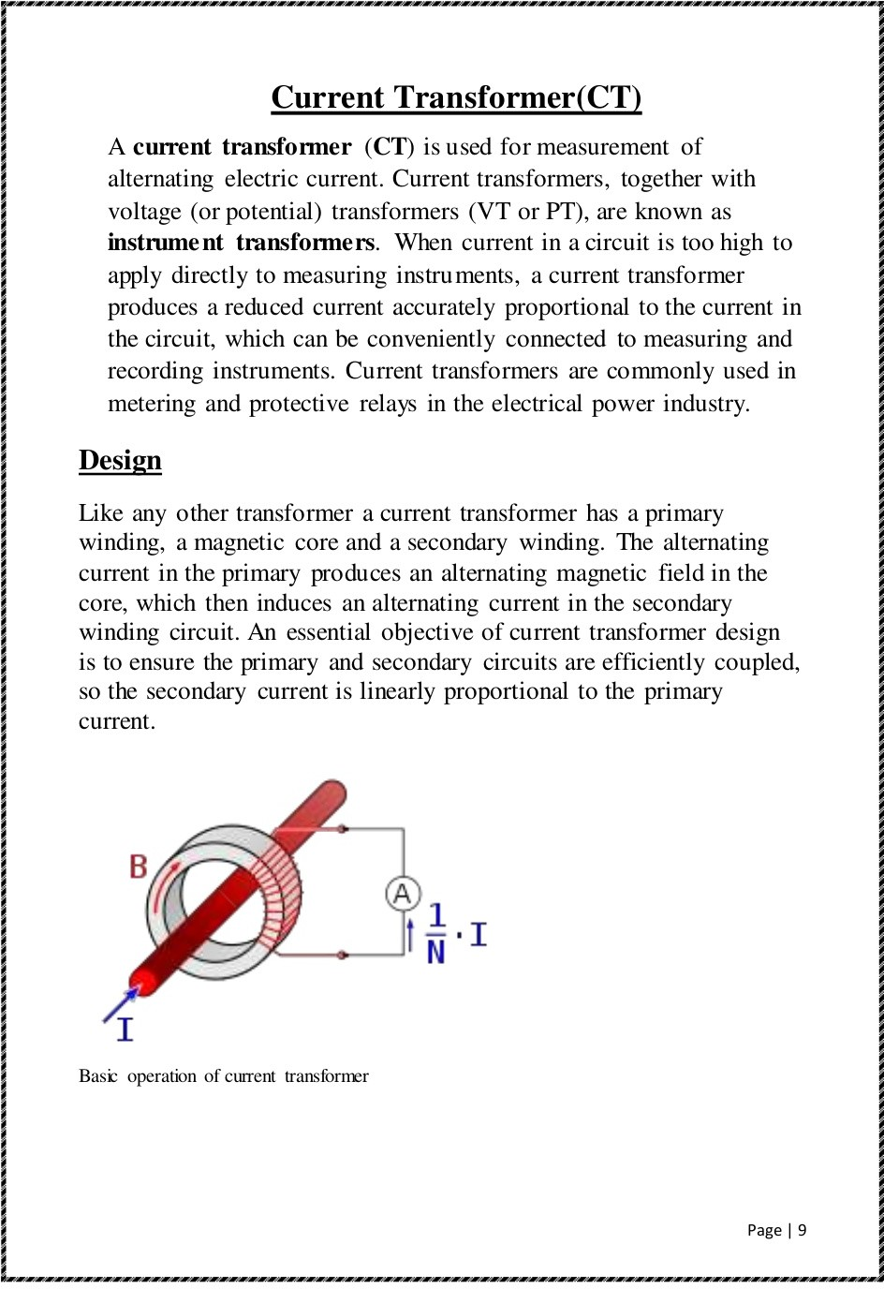

Slide 8
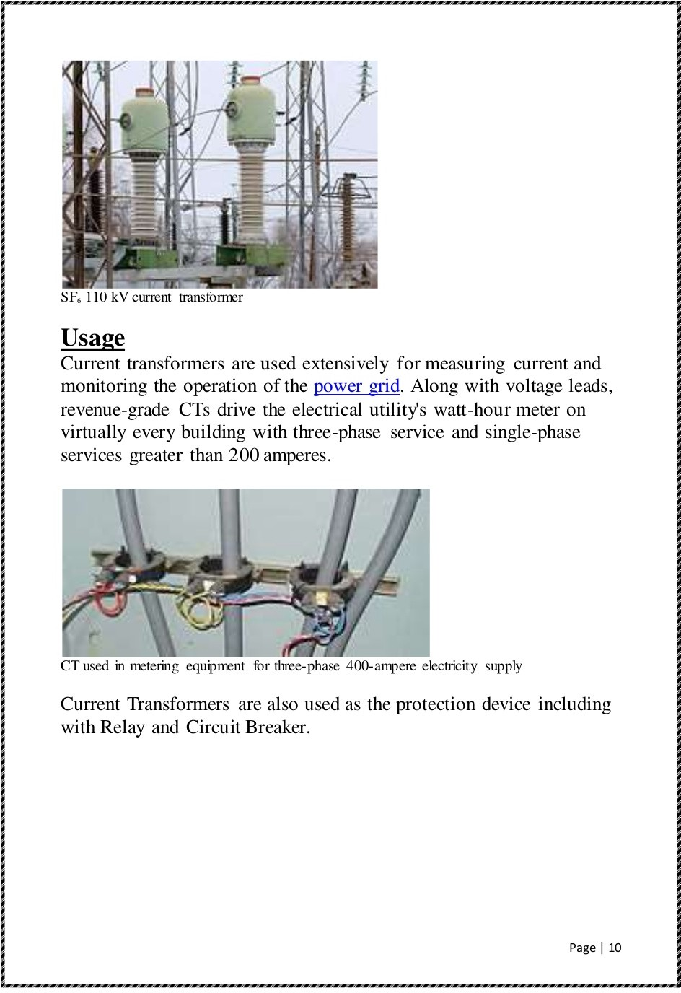

Slide 9
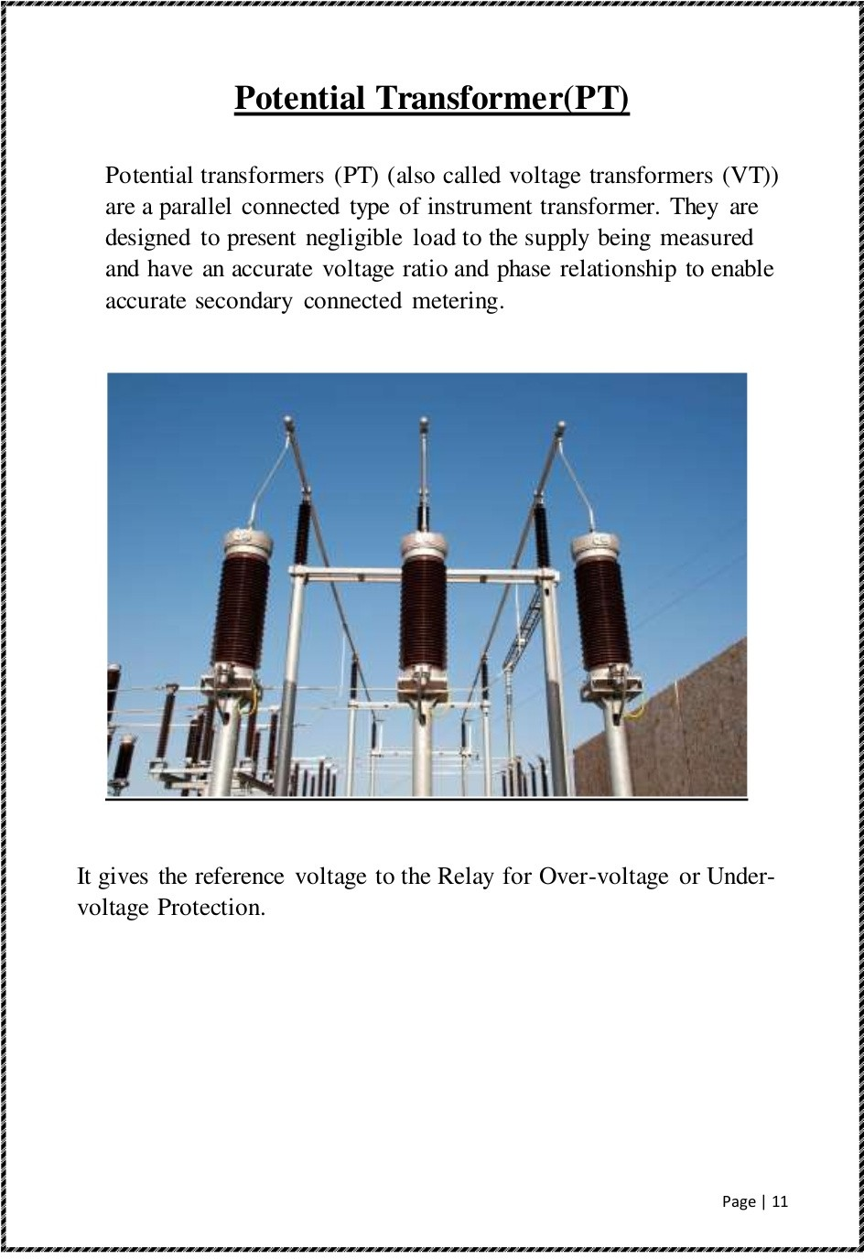

Slide 10
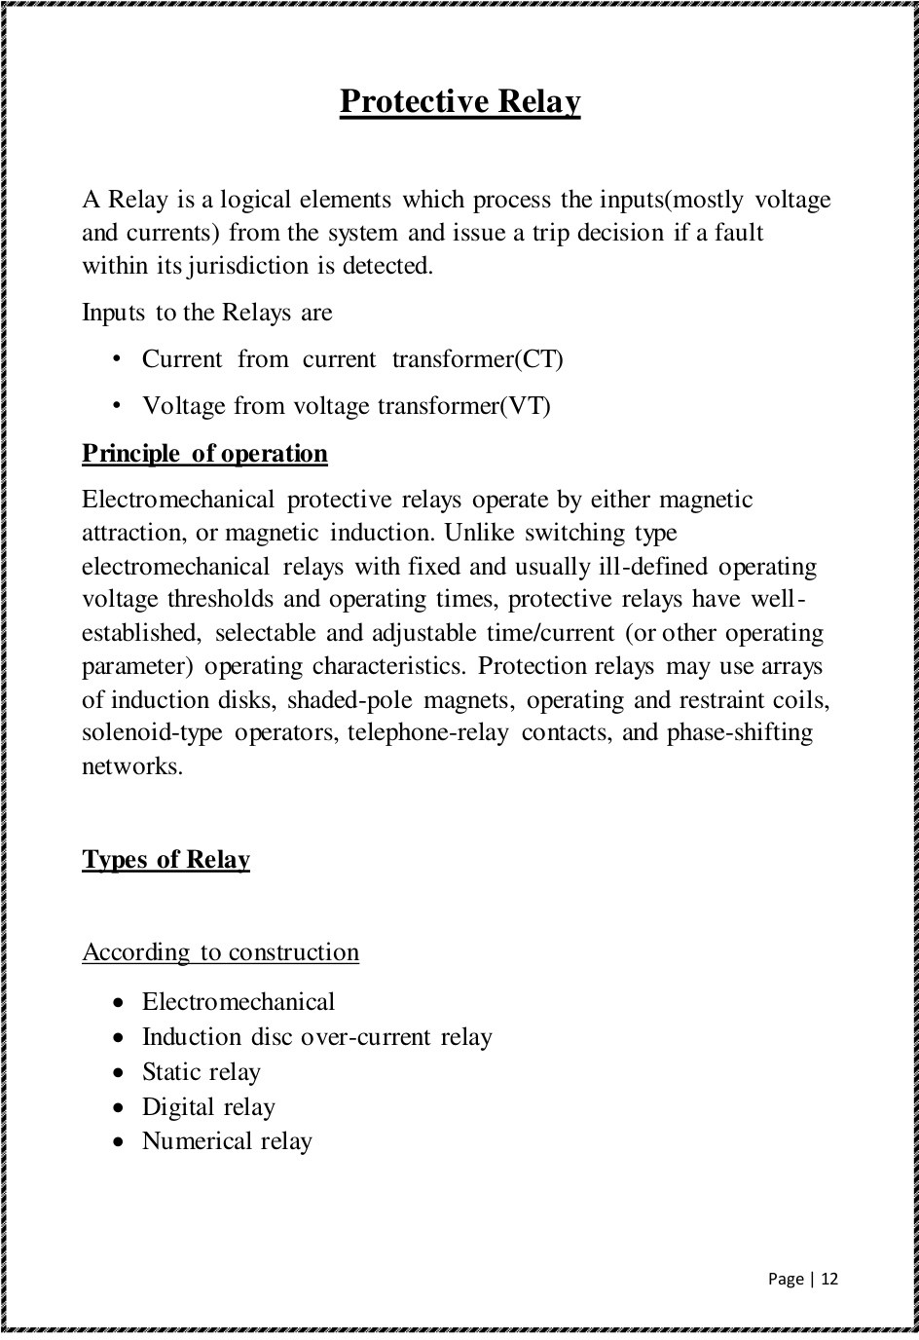

Slide 11
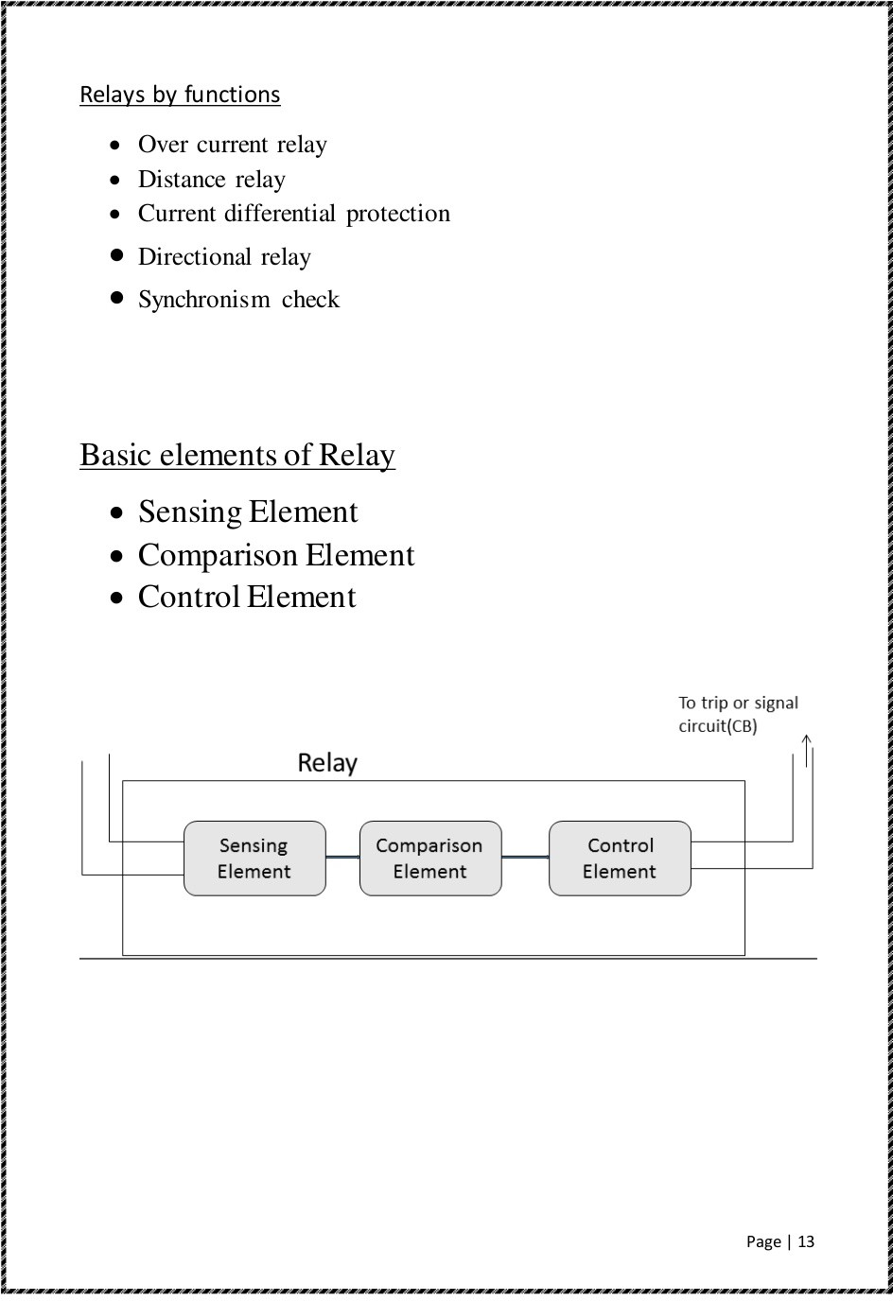

Slide 12
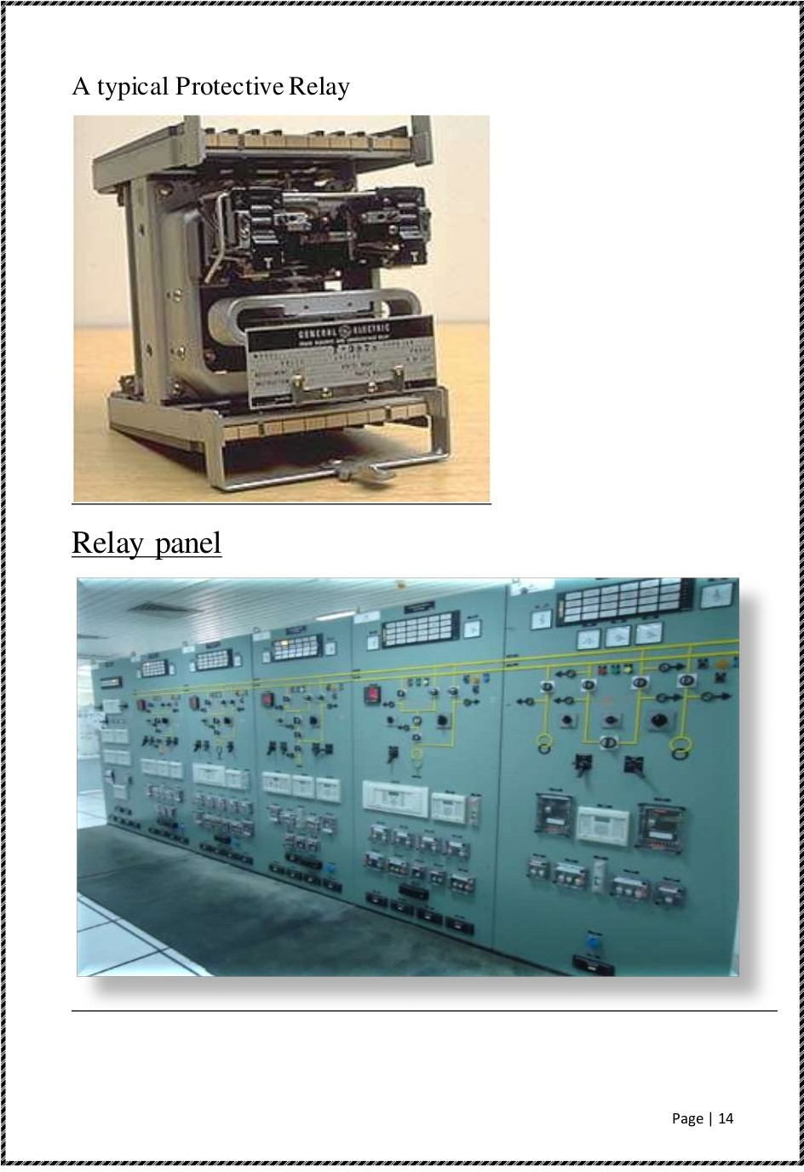

Slide 13
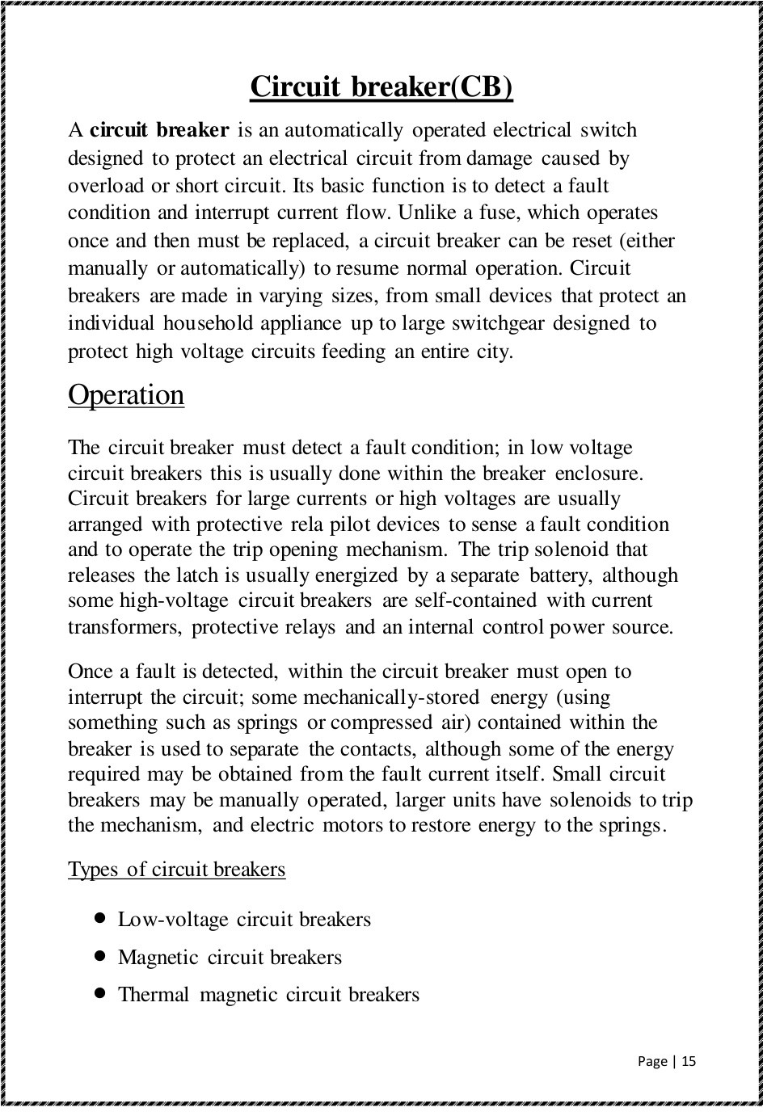

Slide 14
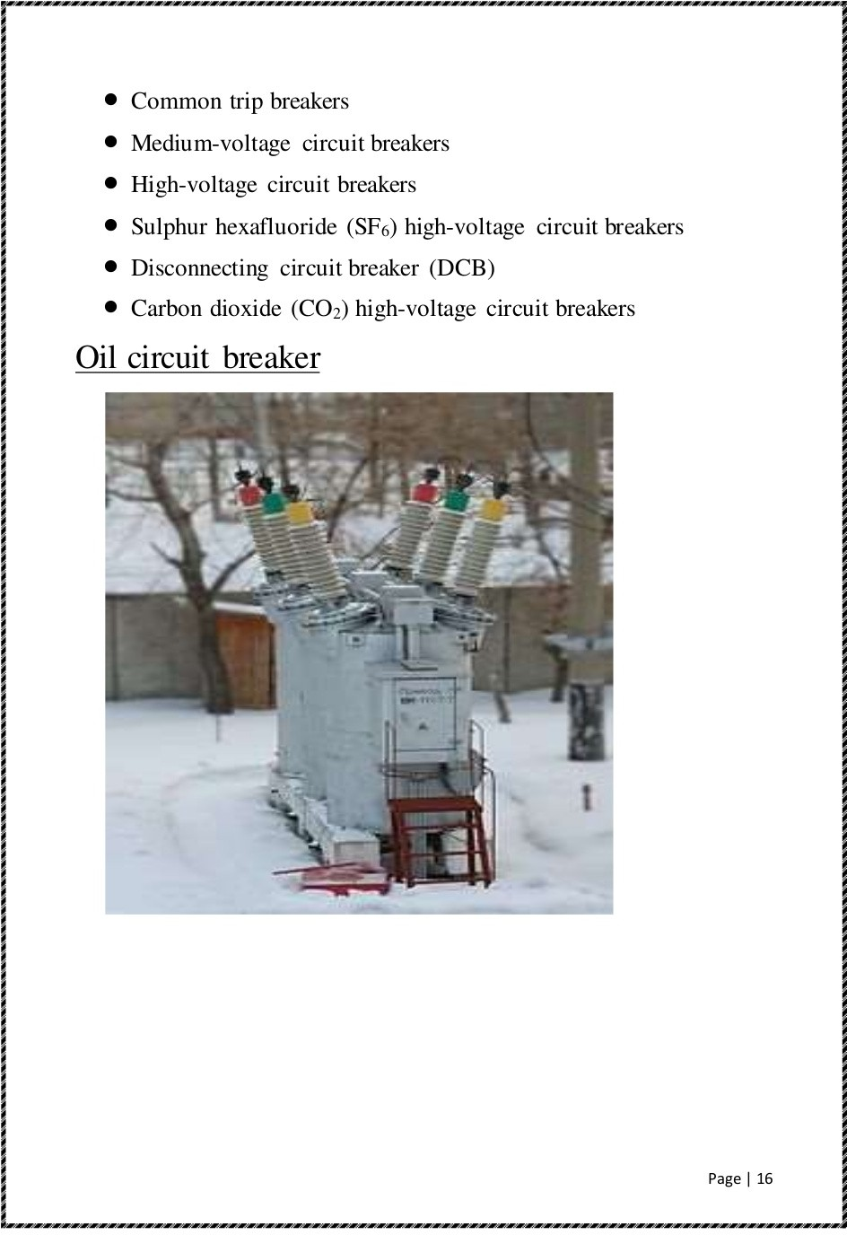

Slide 15
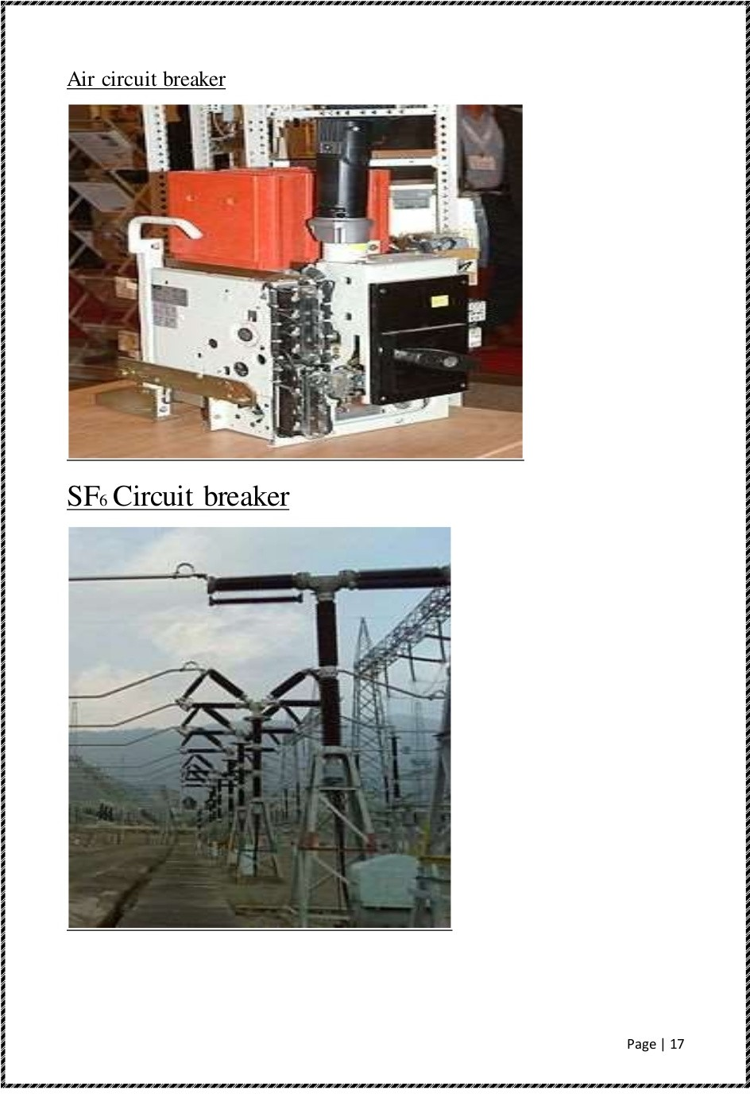

Slide 16
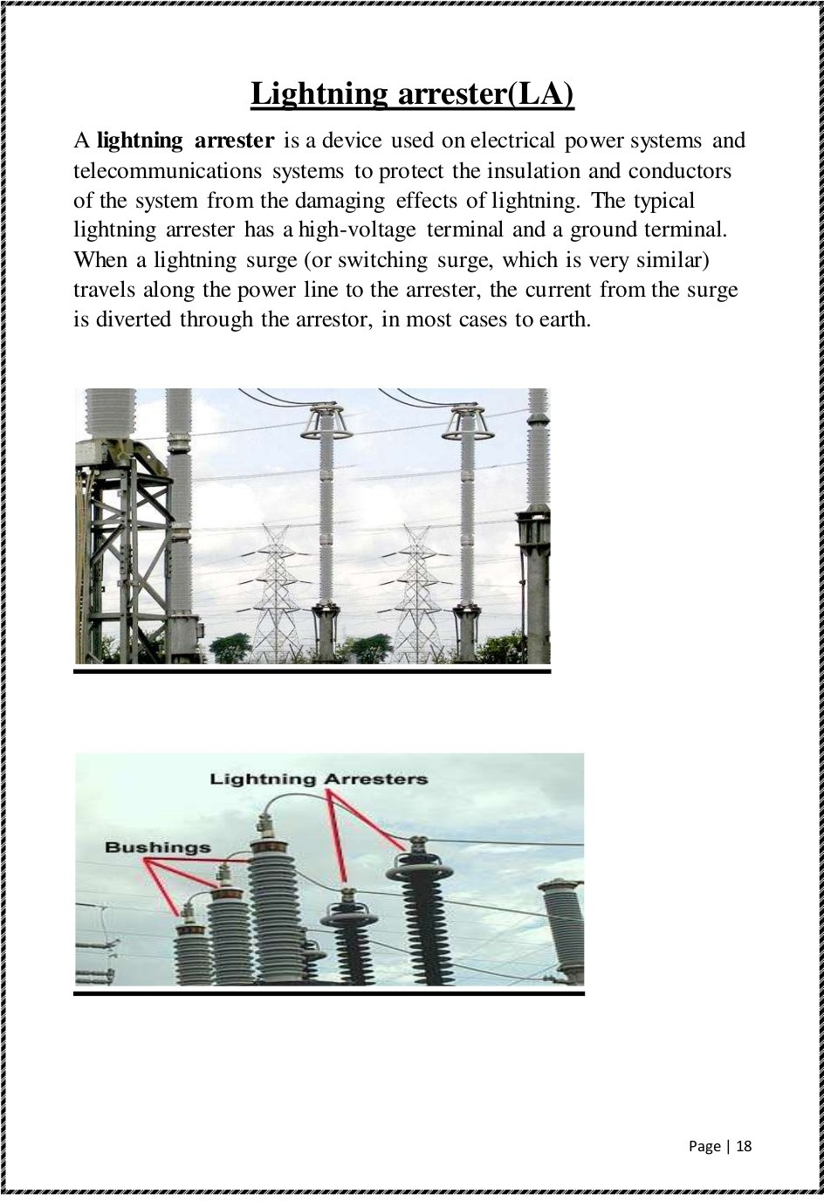

Slide 17
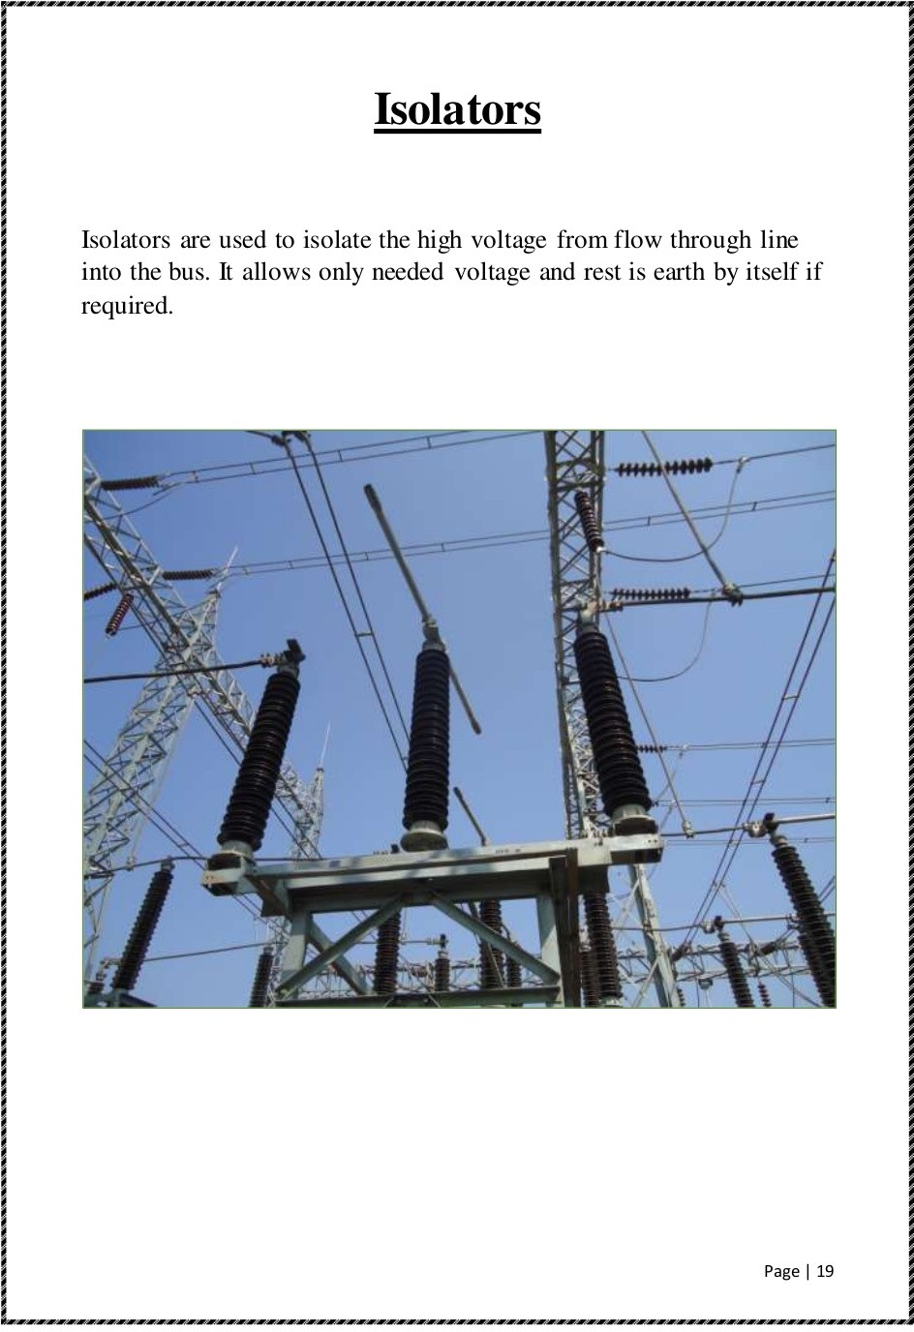

Slide 18
