Slide 1

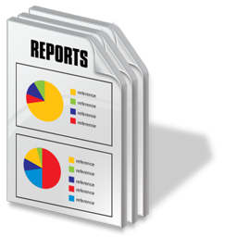
Cannabis Solution Team

Slide 2
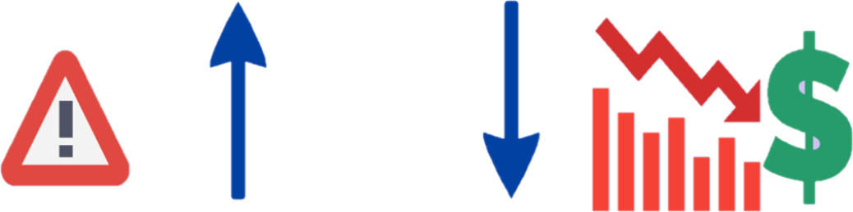
Illegal cannabis poses health and safety risks for Canadians.
How can we better leverage the cannabis tracking system to prevent and detect inversion /diversion of cannabis in/out of legal supply chain
Legal Cannabis Market
Illegal Cannabis Market

Slide 3







Licence Holders
Health Canada

Slide 4




Licence Holders
Health Canada

Slide 5
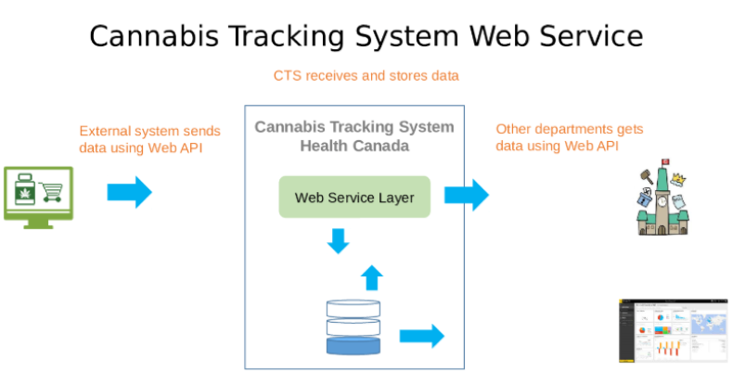

Slide 6


Slide 7
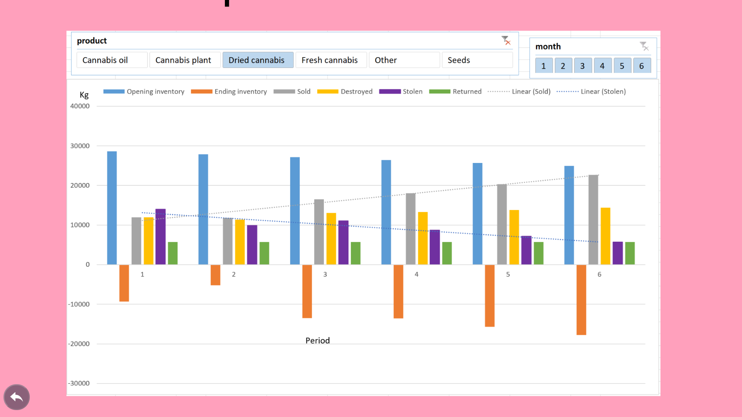

Slide 8
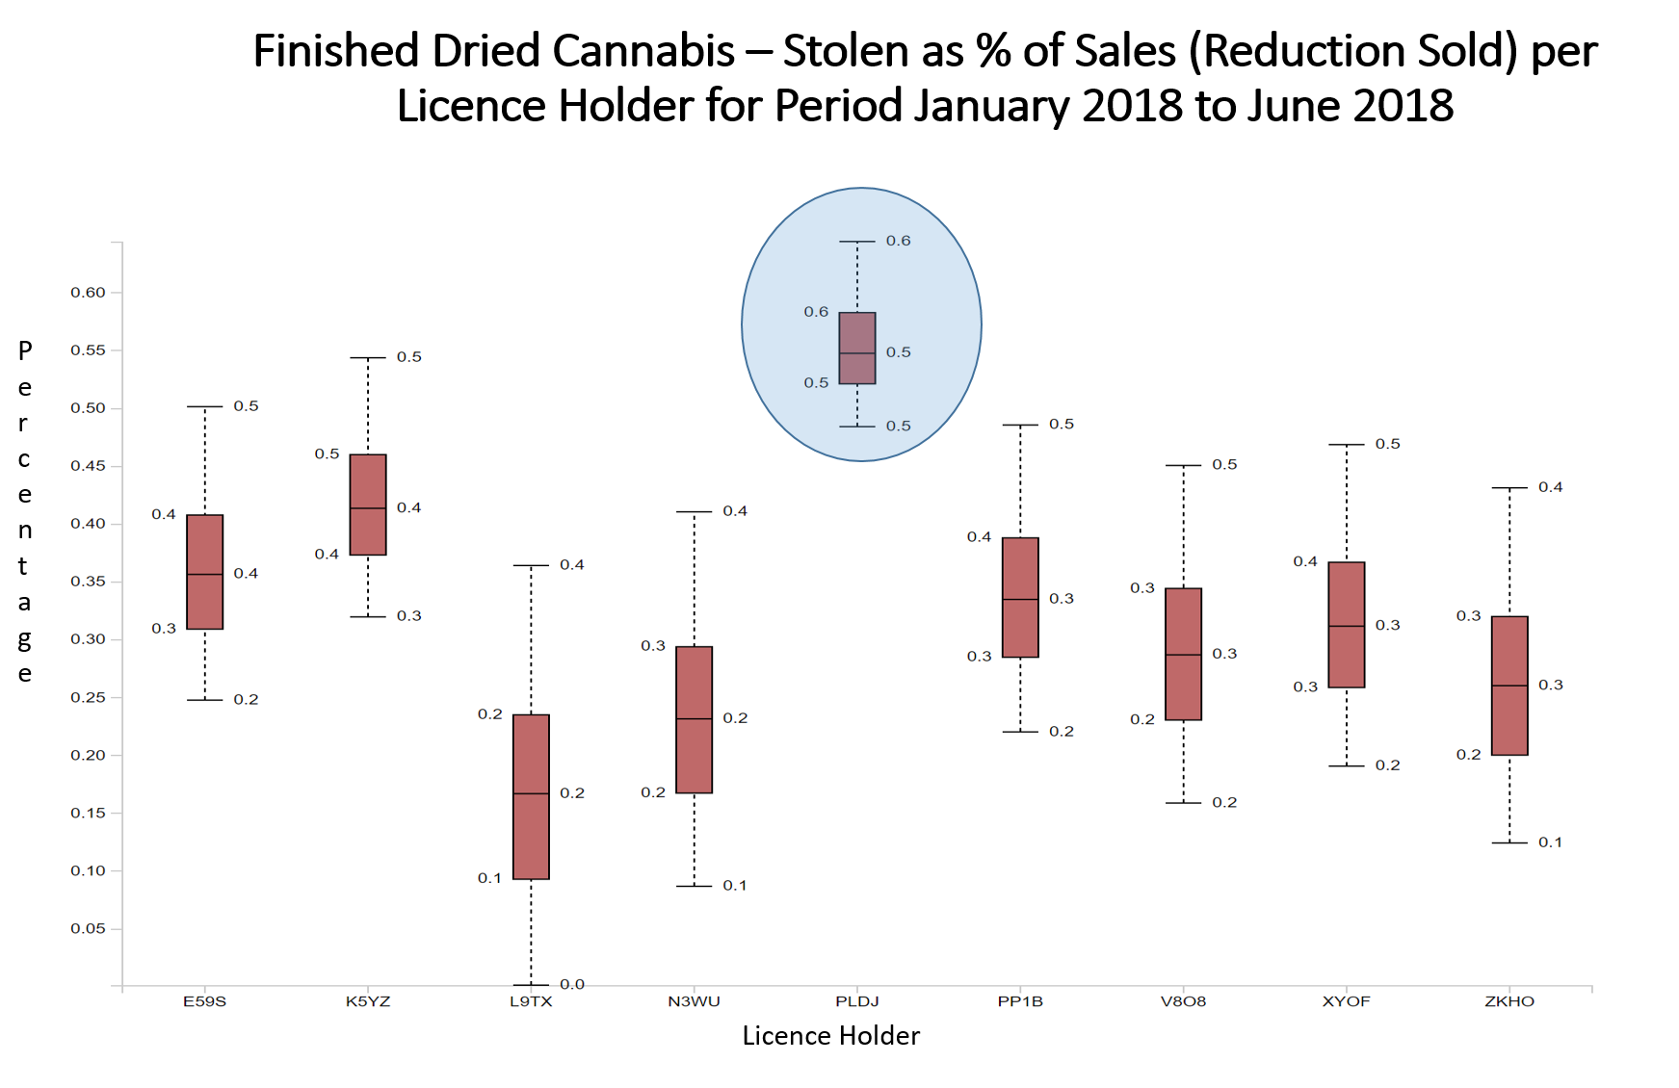

Slide 9
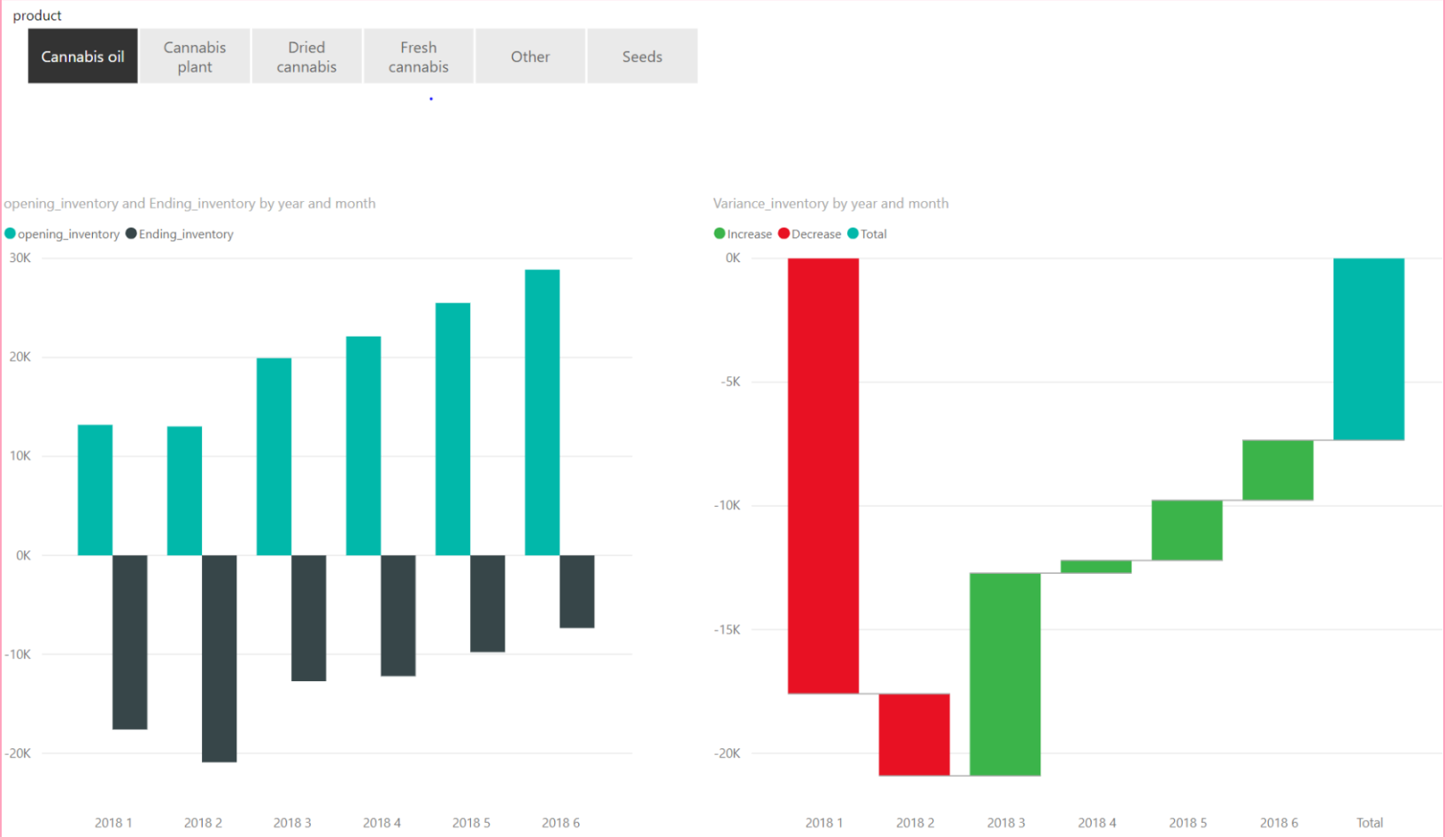

Slide 10


Stronger legal framework
Meaningful insights
Reliable, scalable, secure solution
Gather data once
share to all

Slide 11
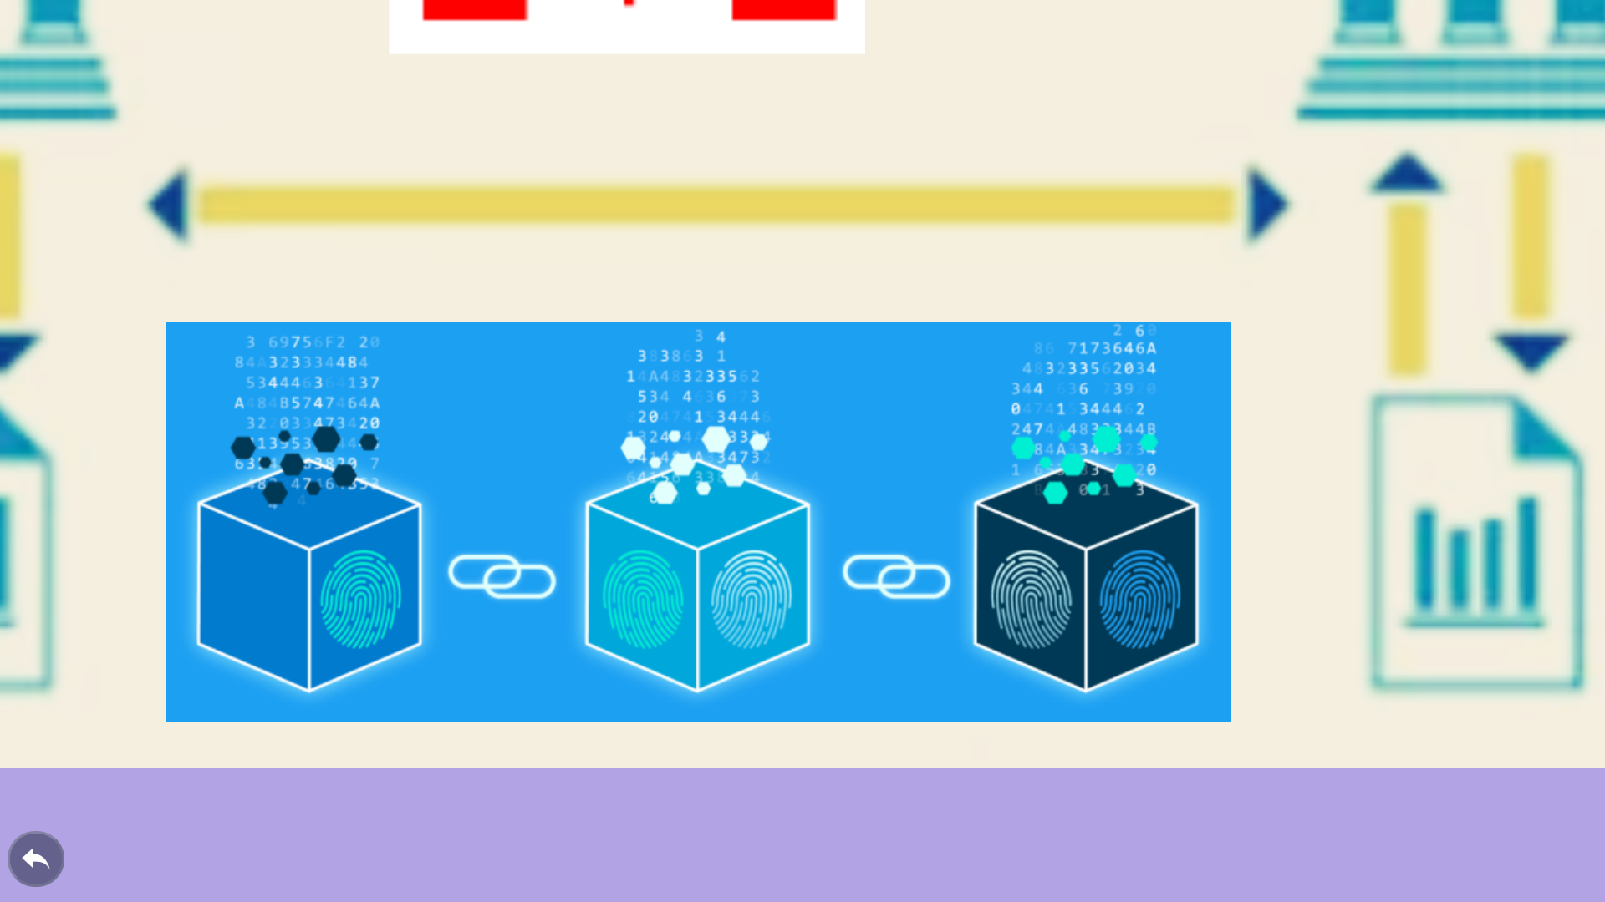
Future Vision

