Slide 1

AgentShield progress report
17 September – 11 October 2026
Frontend
Backend
Database
Existing UI + Manager views
Express API + control checks
PostgreSQL + Prisma
01
Notes:
The frontend prototype existed at the start. Over the reporting period, we connected it to an Express backend and PostgreSQL through Prisma. We added role-specific Manager screens, persisted request/review/execution history, and backend enforcement. The API owns the decisions; the dashboard displays saved results. Current Manager features include an automatic pending-request queue and editable, versioned refund policy limits. This is a local refund simulator, with no real money movement.
Sources: docs/IMPLEMENTATION_GUIDE.md sections 1–5, 10, 12 and 18, inspected 11 October 2026. Illustration generated with the built-in imagegen tool for this deck. It is conceptual artwork, not a screenshot. Prompt: restrained 3D laptop/server/database composition, navy and emerald on off-white, connected cables, no text or logos. Asset: build/progress-deck/architecture.png.

Slide 2
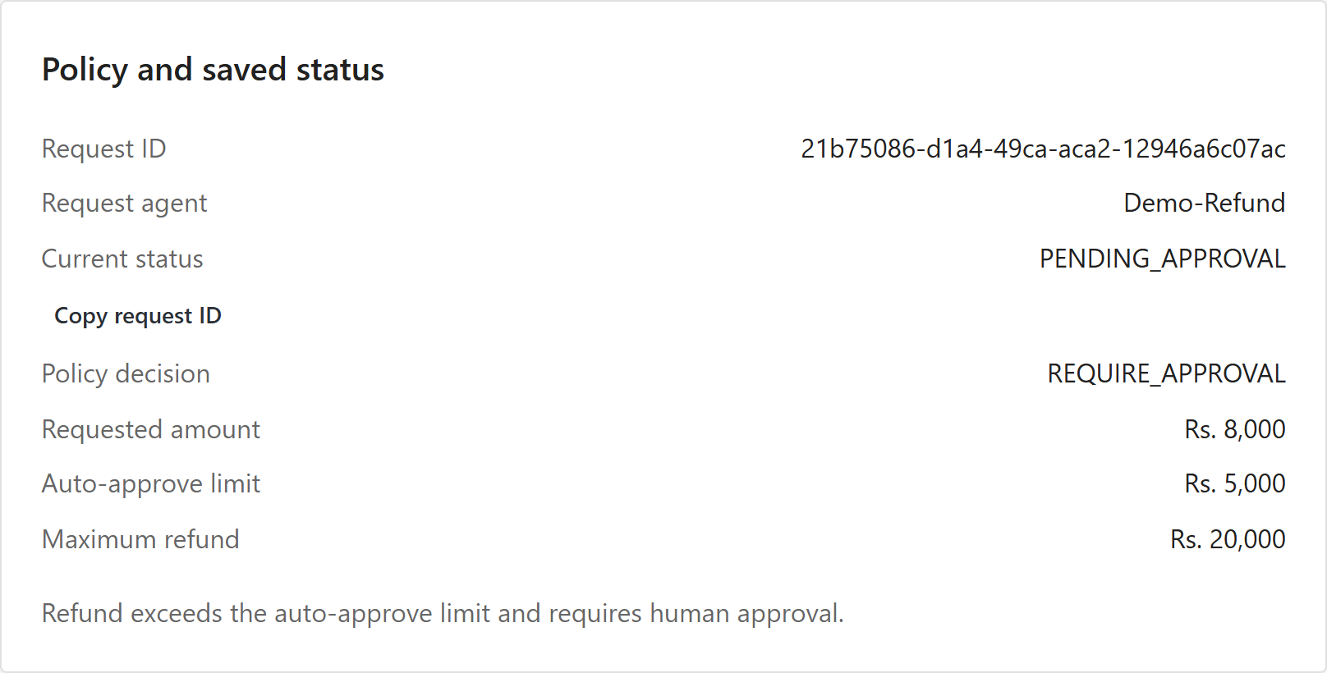
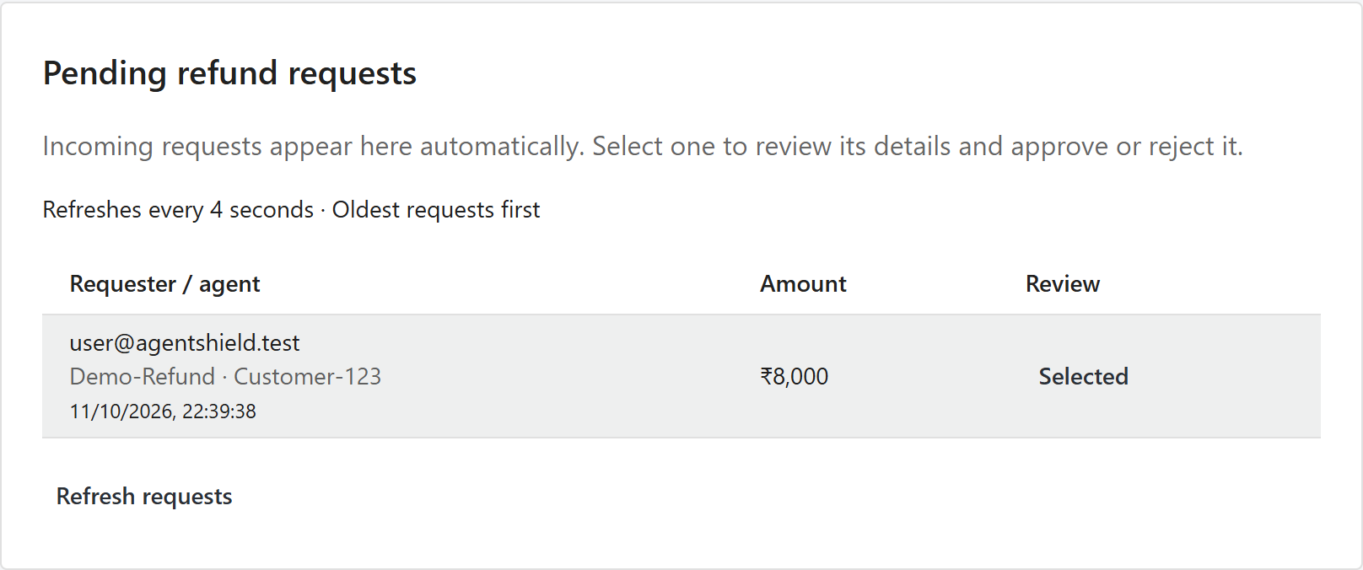
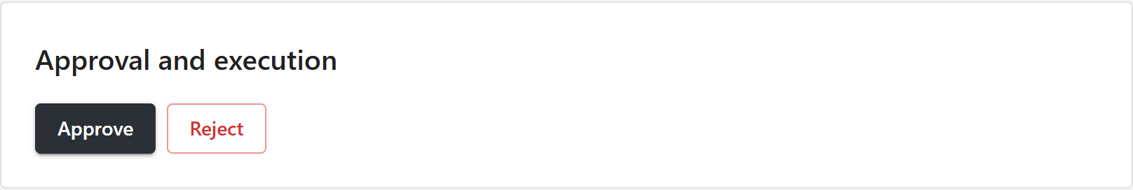
User and Manager approval flow
An INR 8,000 refund requires human review
01 User submits
02 Manager reviews
Login + registered agent permissions
Queue + customizable refund limits
Approval saves exact details. Execution rechecks access.
02
Notes:
Explain the two authenticated roles. The User submits through an active owned registered agent with REFUND permission. A pending request appears automatically in the Manager queue, which polls every four seconds. The Manager selects Review, then Approve or Reject. Approval stores the reviewer and an exact snapshot of agent, action, target, amount and currency. Manager/Admin can also customize current policy limits; only new requests use updated limits, and saved policy snapshots retain their original version. Defaults: up to INR 5,000 ALLOW, above 5,000 through 20,000 REQUIRE_APPROVAL, above 20,000 BLOCK. Execution compares exact approved details and rechecks current agent ownership/status/permission. JWT HttpOnly cookies, database sessions, bcrypt and CSRF protect the API.
Sources: docs/IMPLEMENTATION_GUIDE.md sections 6–10 and 2026-10-11 queue/policy verification. Screenshots: current React application captured on 11 October using a disposable database and INR 8,000 fixture, without changing development accounts or requests. Actual source components: src/App.jsx, PendingRequests.jsx and PolicySettings.jsx.

Slide 3
Implementation and verification progress
Policy, storage, approvals and access controls now connect
Backend test suite growth
110
backend tests
Build and browser flows
verified
Local refund simulator
6 migrations
Real payments and other tools
remain future work
Saved requests + receipts + audit
03
Notes:
This chart shows recorded backend suite size, not a measured rate of security or production readiness. The 18 September record shows 12 tests, 9 October execution slice shows 37, 10 October permission slice shows 97, and the current suite has 110. Latest documented validation: 13 focused policy/queue tests passed; the broad suite passed 109/110, then the corrected old spy assertion passed its targeted rerun. All 110 have passing results across those runs, not a newly claimed single full-suite run. Frontend build passed and browser checks verified User/Manager flows, queue and policy edits. Six additive migrations now cover persistence, execution, identity, agents, permissions and refund settings.
Production PostgreSQL multi-connection lock competition remains untested. Independent agent credentials, approval expiry/revocation, email/file tools, AI classification, audit search and production deployment remain future work. Audit is append-only through the API, not immutable against database administration.
Source: docs/IMPLEMENTATION_GUIDE.md verification record and implementation history, read 11 October 2026; backend/prisma/migrations directory.

