Slide 1
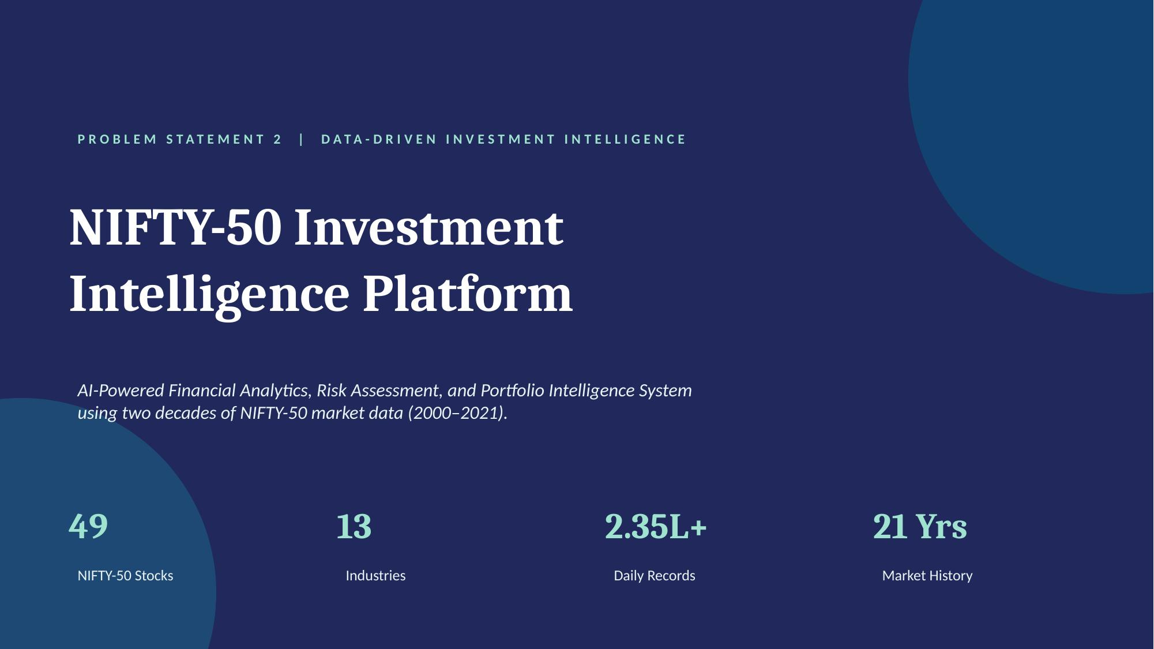

Slide 2
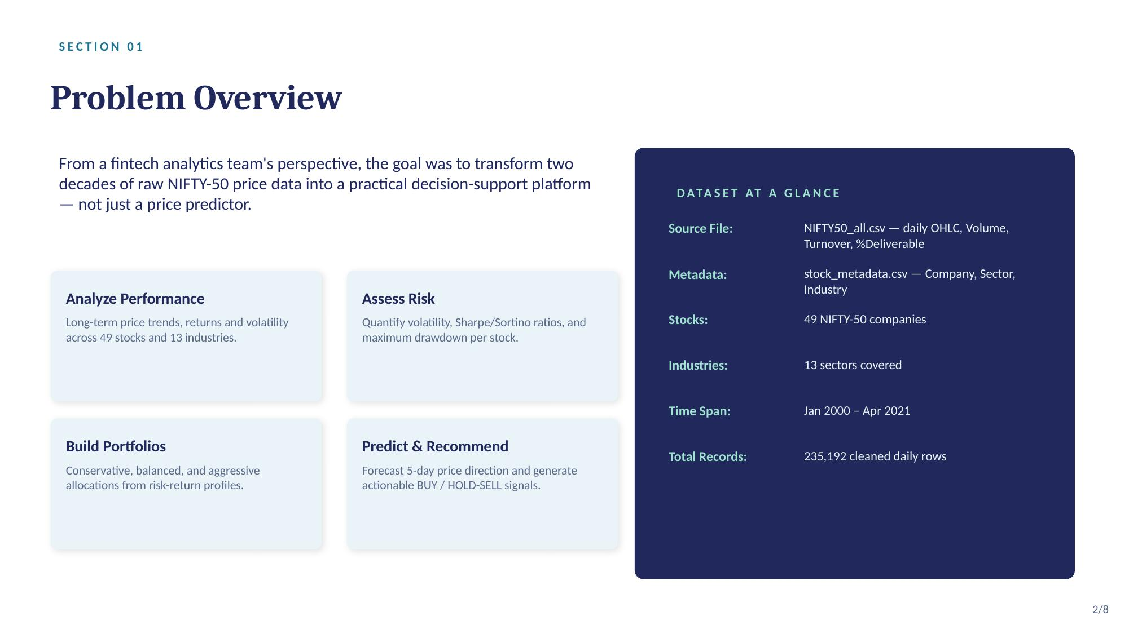

Slide 3
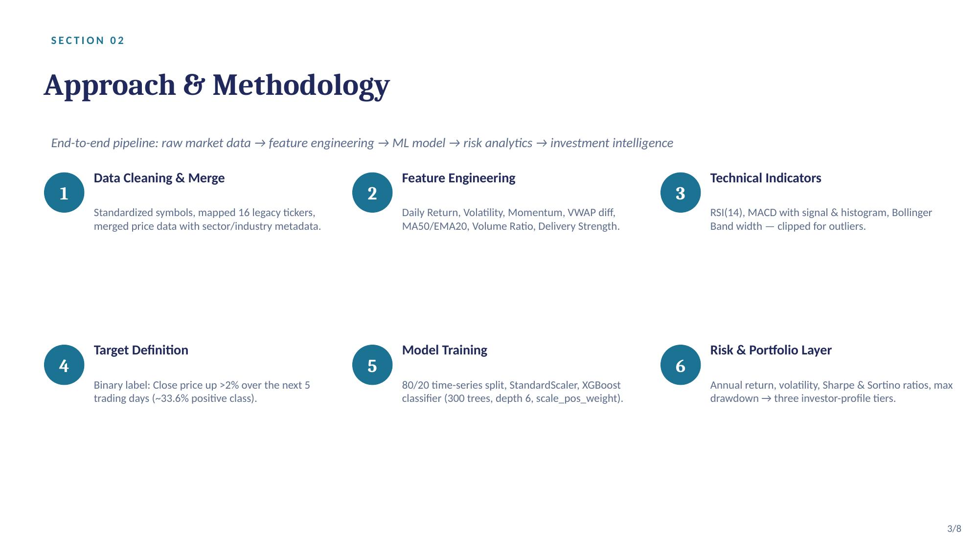

Slide 4
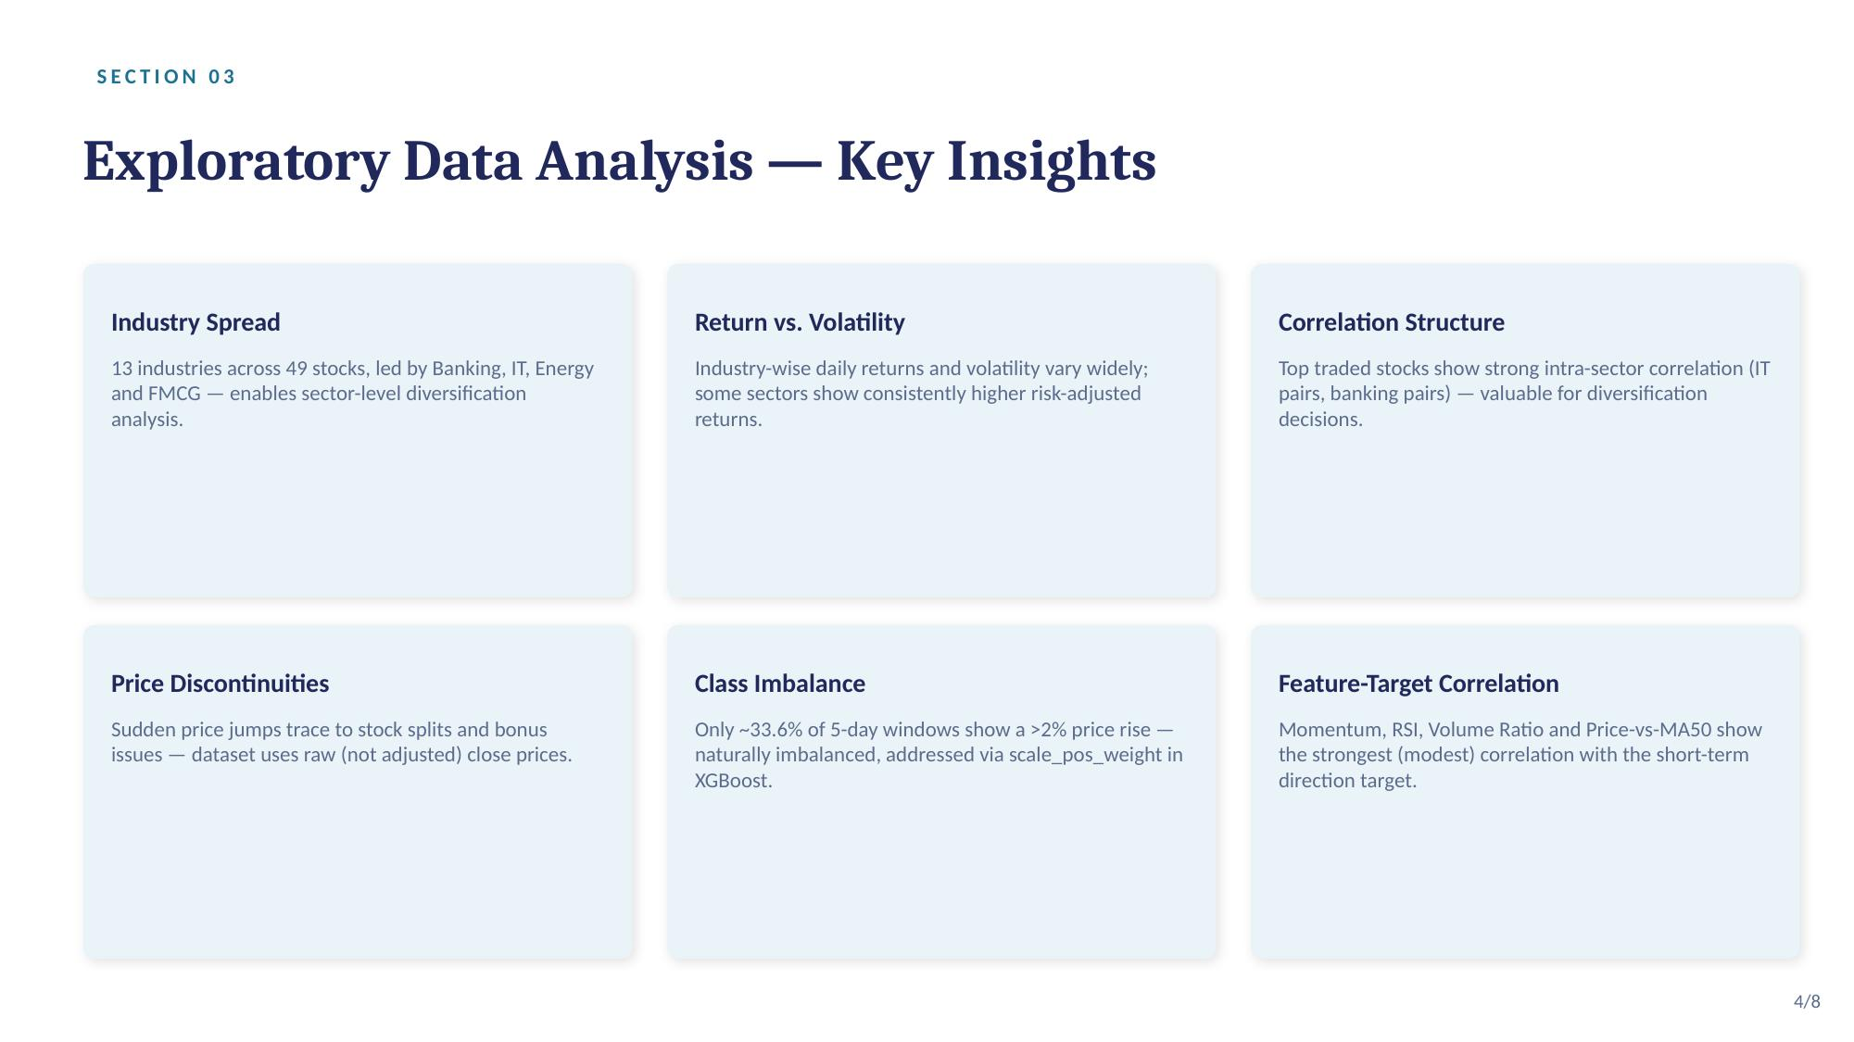
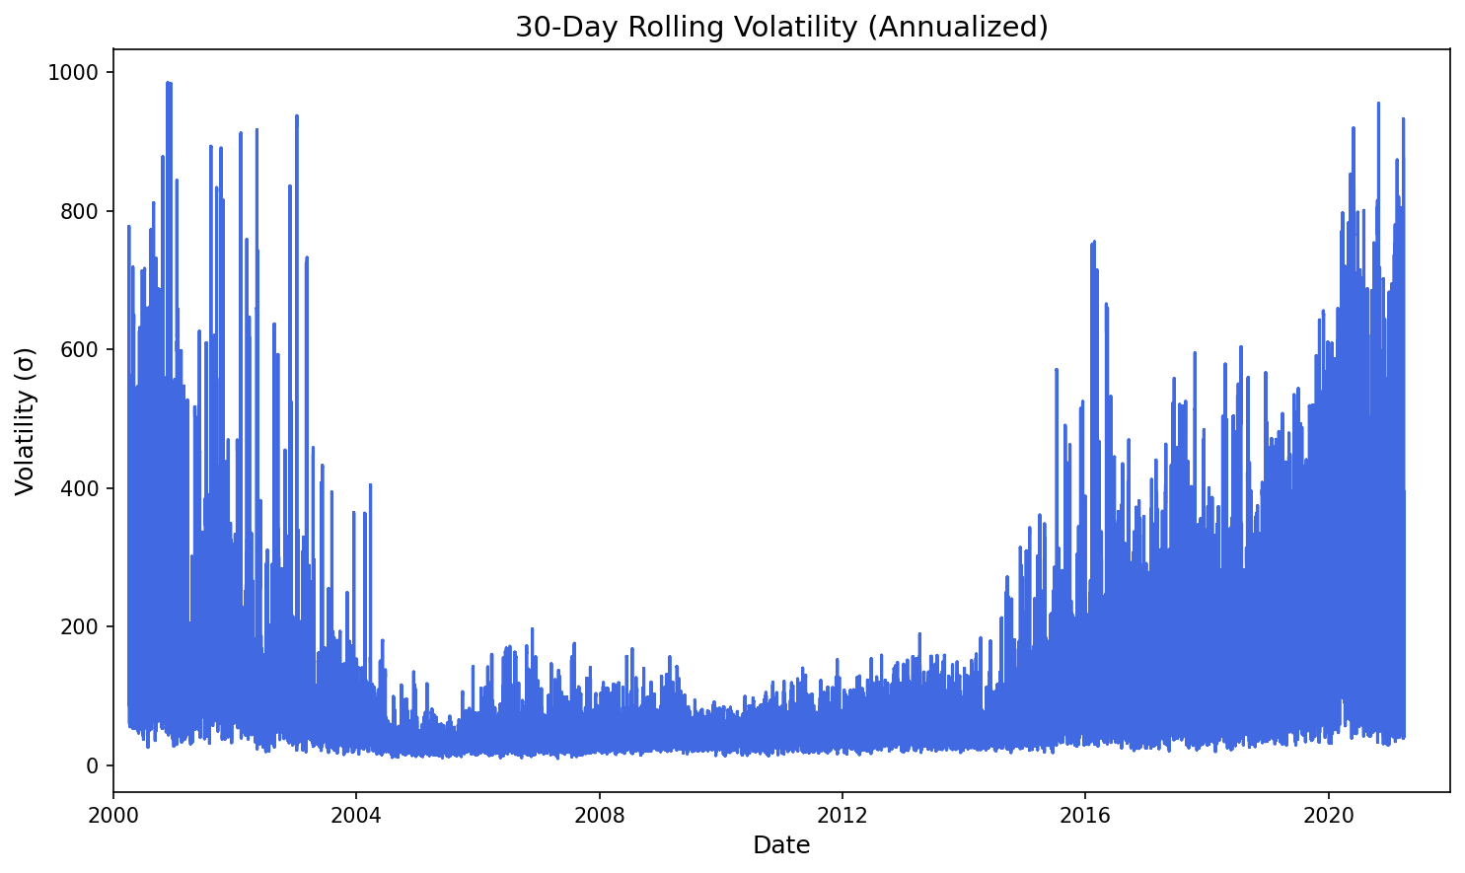
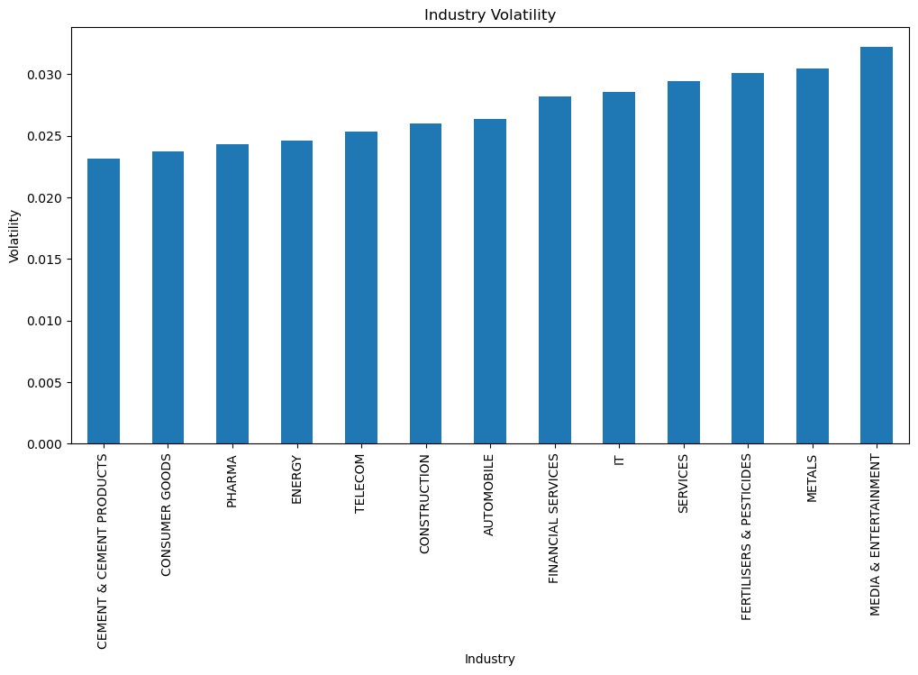

Slide 5
SECTION 04
ML Model — XGBoost Results
Binary classifier: will a stock's close price rise >2% over next 5 trading days?
56.2%
44.6%
40.5%
0.54
Accuracy
Precision
Recall
ROC-AUC
Correctly classified signals
True BUY signals of predicted BUYs
Captured positive windows
Discrimination ability score
Model Configuration
Top Features (by Importance)
Key Limitations
XGBoost Classifier
300 trees · depth 6
learning_rate = 0.03
scale_pos_weight = 2 (handles imbalance)
80/20 time-series split
1. Momentum (10-day price change)
2. RSI (14-period)
3. Volume Ratio (vs 20-day MA)
4. Price vs MA50
5. Rolling Volatility
~33.6% positive class — imbalanced
Price discontinuities from unadjusted splits
No macro / news signals included
Past performance ≠ future returns
Predictions are directional, not exact
5/8

Slide 6
SECTION 05 | RISK ANALYTICS
Risk Analytics — Portfolio Profiles
Sharpe · Sortino · Max Drawdown — three investor tiers derived from risk-return metrics
Low Risk
Moderate Risk
High Risk
Conservative
Balanced
Aggressive
Stocks:
Low Volatility
Stocks:
Mixed Profile
Stocks:
High Momentum
Avg Sharpe:
0.55–0.80
Avg Sharpe:
0.80–1.20
Avg Sharpe:
> 1.20
Max Drawdown:
< 25%
Max Drawdown:
25–40%
Max Drawdown:
> 40%
Annual Volatility:
< 18%
Annual Volatility:
18–28%
Annual Volatility:
> 28%
Capital preservation focus. Stocks with stable returns and low drawdown — FMCG, Pharma, select IT.
Risk-return balance. Blend of growth and defensive stocks across Banking, IT and Energy.
Maximum return pursuit. High-momentum, high-volatility stocks for long horizon investors.
5.0%
~1.8
~2.4
49
Risk-Free Rate
Best Sharpe
Best Sortino
Stocks Analyzed
6/8

Slide 7
SECTION 06
Backtesting & Investment Signals
Strategy validation vs buy-and-hold benchmark · Actionable BUY / HOLD-SELL signals
Backtest Methodology
Investment Signal System
Rolling window: buy when model predicts BUY (≥threshold), hold until sell signal or 5 days. Compare cumulative return vs passive buy-and-hold over 2000–2021 period.
BUY
Model confidence ≥ 0.6
Stock predicted to rise >2% in 5 days. Enter position.
Strategy vs Buy-and-Hold
Model-filtered entries reduce drawdown exposure. In high-volatility periods (2008, 2020), signal filtering avoids the worst declines — though some upside is also missed.
HOLD
Model confidence 0.4–0.6
Ambiguous signal. Hold existing position, no new entry.
Cumulative Return Insight
SELL
Model confidence < 0.4
Price discontinuities (unadjusted splits/bonuses) inflate raw cumulative return curves. Comparative trends remain directionally valid for strategy evaluation.
Downward pressure predicted. Exit or avoid entry.
7/8

Slide 8
CONCLUSIONS
Key Takeaways
What the platform delivers — and where to go next
01
Full-Stack Pipeline
02
Practical ML Application
03
Risk-Aware Portfolios
From raw OHLC CSVs to actionable BUY/HOLD-SELL signals — cleaning, feature engineering, ML, risk analytics, and portfolio construction in one notebook.
XGBoost with ROC-AUC 0.54 and 56.2% accuracy — not a perfect predictor, but a meaningful signal layer that improves risk-adjusted entries.
Three investor profiles (Conservative / Balanced / Aggressive) built from Sharpe, Sortino, and max drawdown — not just returns.
04
Explainable AI
05
Future Scope
06
Limitations Acknowledged
Feature importance reveals Momentum, RSI, and Volume Ratio drive predictions — giving analysts a model they can interrogate and trust.
Add macro indicators, sentiment signals, adjusted close prices, and live data feed for real-time recommendation updates.
Unadjusted prices, no macro context, class imbalance — documented honestly. Model is a decision-support tool, not a trading oracle.
8/8

