Slide 1
BenchMark Generation
- Using Attributed Graph Grammar

Slide 2
Process of Benchmark Generation
Firstly, step by step of whole Benchmark Generation will be explained here :-
Sub-circuits Extraction :-
All possible sub-circuits are extracted from ISCAS-85 benchmark circuits; with size varying from 5 gates – 30 gates.
After extraction; we will count the frequency of a particular kind of circuit across the complete data-base of extracted sub-circuits using graph isomorphism.
Depending on frequency of occurrence, we will select or segregate the sub-circuits which are used in various benchmarks among ISCAS-85. For example; if a particular sub-circuit is used or occurred in 3-4 benchmarks in the ISCAS-85; it will be selected.
After segregation; we will have frequently used sub-circuits which will be served as inputs for generation of larger circuits.

Slide 3
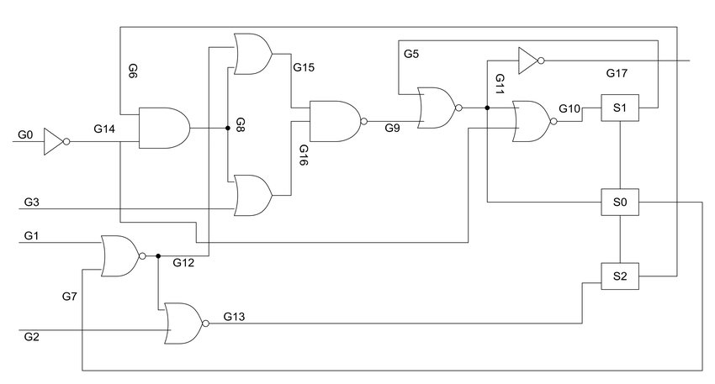
Example of Extraction
Extraction (3 Nodes) :-
G0 → G14 → G8 (2)
G0 → G14 → G10 → S1
G0 → G14 → G6
Only connected versions of sub-circuits on the basis of no. of Gates to be extracted using graphs predecessors and successors commands and stacks. Such that 100% extraction will be possible

Slide 4
Process of Benchmark Generation
Sub-circuits Selection :-
The sub-circuits which are extracted and filtered will be sorted into folders based on no. of inputs and outputs.
User can select from these sub-circuits for generation of larger circuits.
Once, the selection of sub-circuits are done. Automation script will be used; to see what inter-connect sequence between two possible sub-circuits is the best such that the possible connection won’t get optimized. So, here dc-compiler is used to see the optimization level between two sub-circuits.
So, after each iteration; the best possible inter-connect sequence between two particular sub-circuits will be stored in form of dictionary such that the same sequence can be used for rule generation.
While calculating inter-connect sequence; I will also calculate the average optimization factor provided by each sub-circuit such that based on the optimization factor, I will use those sub-circuits in weighted manner in generation of larger circuits.
This process is done only once whenever sub-circuits are selected. Once they are selected and kept the same; then this whole process need not to be performed for further steps.

Slide 5
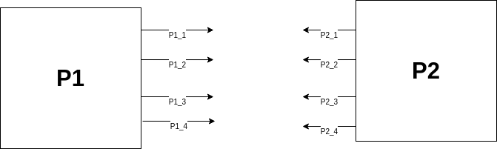
Example of inter-connection of sub-circuits
Inter-connection Selection process : -
A B C
P1_1 → P2_4 P1_1 → P2_4 P1_1 → P2_3
P1_2 → P2_2 P1_2 → P2_1 P1_2 → P2_4
P1_3 → P2_1 P1_3 → P2_3 P1_3 → P2_1
P1_4 → P2_3 P1_4 → P2_2 P1_4 → P2_2
Optimization – 60% Optimization – 20% Optimization – 30%
In this case; the interconnection sequence B will be selected for connected P1 & P2.

Slide 6
Process of Benchmark Generation
Rule Generation :-
The user needs to provide inputs for customized circuits:-
No. of gates
No. of levels (Note :- Level here is targeted as levels between the sub-circuits; it doesn’t consider the levels inside the sub-circuit)
No. of inputs
Sub-circuits which are to be imitated (already selected in previous step)
After those inputs are taken; rules will be generated in the specified high level language based on the sub-circuits selected and the inter-connect sequence which was recorded previously.

Slide 7
Process of Benchmark Generation
Rule Generation (Contd.) :-
Rules Generated :-
Rule to connect input ports to each sub-circuits.
Rule to connect one sub-circuit to another sub-circuit.
Rule to clear the hook nodes.
Rule to make a particular sub-circuit to be available for connection.
Rule to change the hook nodes attributes.
All these rules will be written automatically for the given sub-circuits in form of specifically developed high level language.

Slide 8
Example of Rules

Slide 9
Process of Benchmark Generation
Rule Sequence :-
The sequence will be developed in order to see how the attributed graph grammar rules should be implemented in which order and also how many times a particular rule need to be applied.
Starting from zero level, for each level; rule sequence will be generated. The rule application will be on random weighted basis.
In zero level, inputs to sub-circuits rules will be applied.
And in further levels; sub-circuit to sub-circuit rules will be applied.
Rule sequence and it’s application will be applied in such way that inter-level connection will be minimum.
Here, I also take care about the final no. of gates and levels specified by the user.

Slide 10
Process of Benchmark Generation
Usage of graph attributes in rules:-
For proper ordering of sub-circuits in order to create larger circuits; I used graph attributes for matching.
Graph attributes such as :-
Gate-type
Node-type
Sub-circuit number
available_4_connection

Slide 11
Process of Benchmark Generation
Final Step :-
After, all the rules and the rule sequence is generated. The High level language text file will be fed to the AGG tool in order to generate the larger benchmark according to the rule sequence.
The host graph generated through the AGG tool will be returned in form ggx file and the ggx file will converted into verilog file which will be my final output.

Slide 12
Analysis On Results
Analysis :-
Generated various kind of circuits and the results get optimized by 70-80 %.
Optimization levels depends on the sub-circuits selected. Though the target is to achieve the best combination for any given set of sub-circuits.
Optimization mainly occurs between 2 sub-circuits; when LHS sub-circuit have less outputs when compare to inputs of the RHS sub-circuit. Ex:- LHS Pat – no. of outputs – 2 RHS Pat – no. of inputs – 5. In such cases, the optimization levels are very high.

Slide 13
Verification of Programs
Extraction tool is verified :-
The sub-circuits which are served as inputs for larger circuits; will be recovered back when the larger resultant circuit is given as input to the extractor tool; it will extract the same sub-circuits.
Also verified that extractor tool extracts 100% possible sub-circuits which are partially connected (for a particular no. of gates specified).
Benchmark Generation :-
No hanging nodes are left unchecked in the final circuit.
No. of levels will be exactly as user specified in the final circuit.
No. of gates will be approximately same as per user specification in the final circuit.
The frequency of sub-circuits used in the final circuit will be on weighted random basis which is literally dependent on how much optimization the pattern causes.

