Slide 1

Daredevils
Problem statement
Intelligent Task Manager with auto task assignment and custom feature
Team members
Kathiravan
Amar Kumar
Prakash

Slide 2
Tools Used
Activiti BPM
H2 DB
Tomcat
Eclipse

Slide 3
Application overview and features
Four workflows for managing events
    User Modification
    Load Balancer
    Task completion
    Vacation Plan
User Identity service and restricted use
Form service for creating tasks

Slide 4
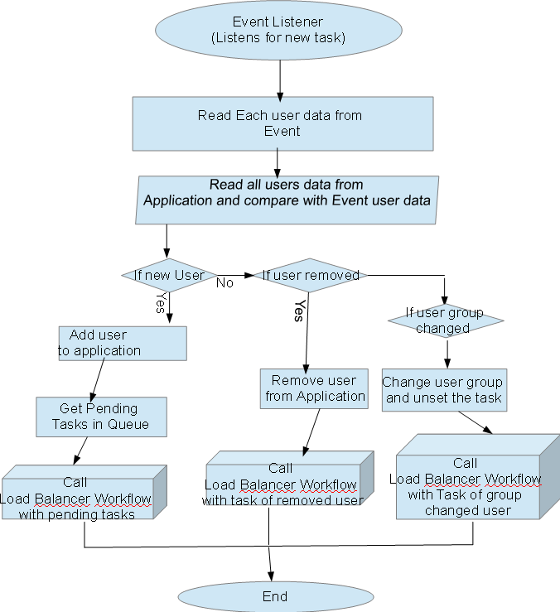
User Modification Workflow

Slide 5
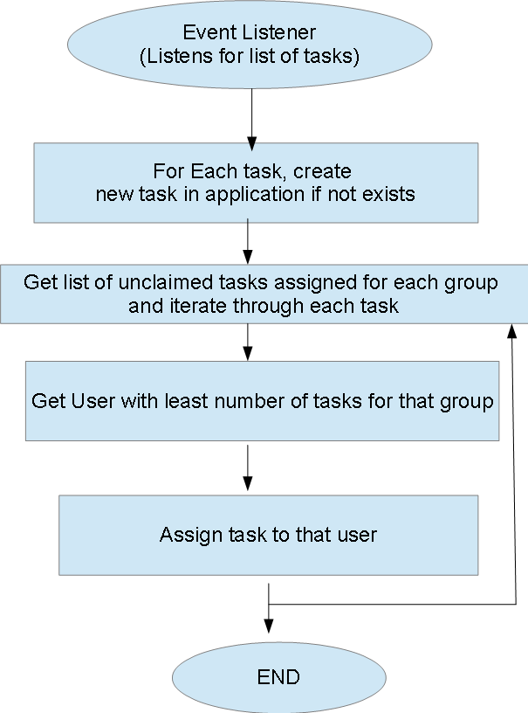
Load balancer workflow

Slide 6
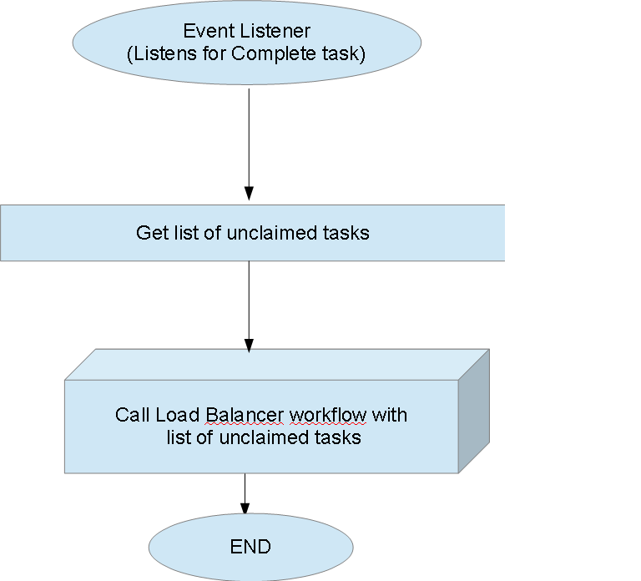
Task completion workflow

Slide 7
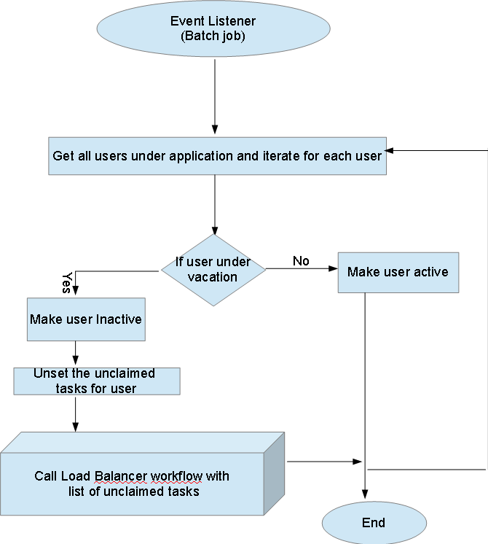
Vacation plan workflow

Slide 8
Appendix -1
GitHub Project link: https://github.com/amarkmr548/ITM/tree/master/ITM

Slide 9
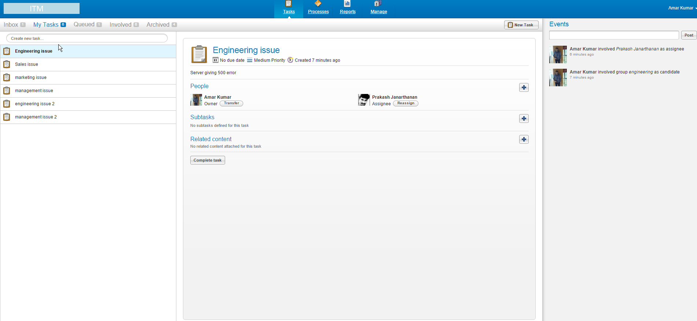
Appendix -2-(Task List)
Assigning Tasks with Load balancing

Slide 10
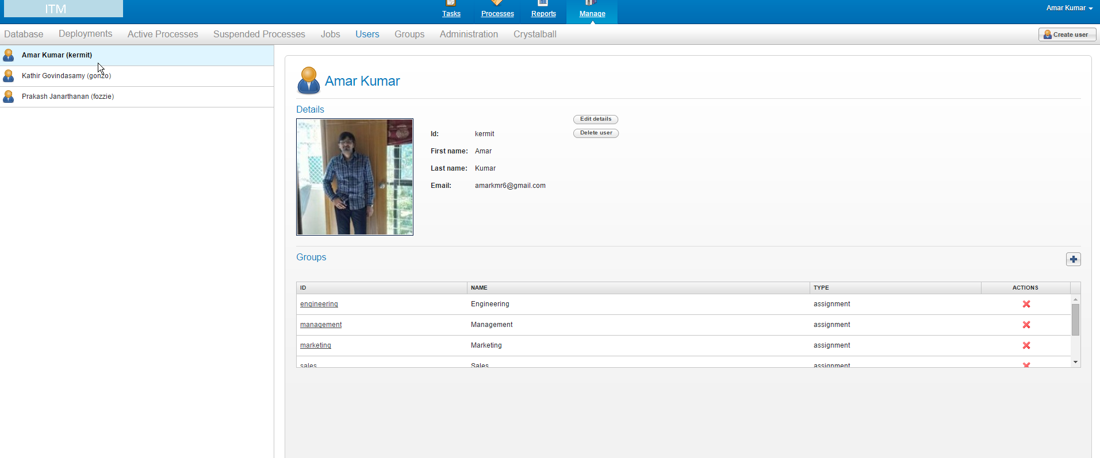
Appendix -(User List)
List of Users

Slide 11
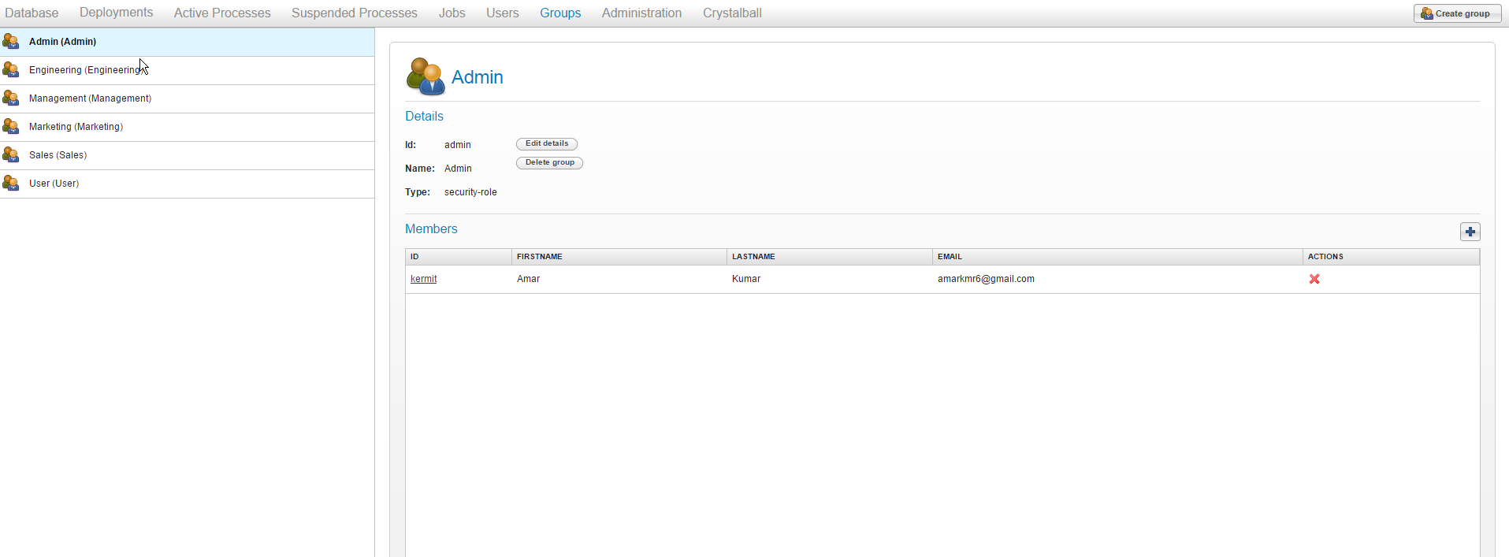
Appendix -(Group List)
List of Groups

