Slide 1

DIAGNOSEs ALZHEIMER'S DISEASE

Slide 2
TEAM MEMBERS:-
Arav Kumar
Agna P
Muskan Betageri
Amar Krishna Kamble
Chetan Appanna Rathod
Shivakumar Ganiger
Balu

Slide 3
INTRODUCTION
Alzheimer's disease is a progressive neurodegenerative disorder that affects memory, thinking, and behavior. It is one of the most common forms of dementia, impacting millions of people worldwide, especially the elderly. As the global population ages, the number of Alzheimer's cases continues to rise, making early diagnosis and intervention crucial for improving the quality of life of patients and their families.

Slide 4
EXPLORATORY DATA ANALYSIS (EDA)
Exploratory Data Analysis (EDA) is a critical step in the data analysis process . It involves analyzing the main characteristics of the data set, often visualizing the data, to understand its structure, discover patterns, spot anomalies, and check assumptions before applying more advanced statistical methods or machine learning algorithms.
EDA helps in:
Summarizing the dataset: By using descriptive statistics to get insights into the data, such as mean, median, mode, variance, and standard deviation
Visualizing the data: Employing plots like histograms, bar charts, box plots, scatter plots, and heatmaps to get a better understanding of the distribution and relationships in the data.
Identifying outliers and anomalies: Detecting unusual data points that might indicate data entry errors or significant insights.
Handling missing values: Understanding the nature and extent of missing data to decide on appropriate methods for dealing with them, such as imputation or removal

Slide 5
TECHNIQUES
Handling Missing Values: Identifying and addressing missing data through techniques such as imputation, deletion, or using algorithms that can handle missing values.
Outlier Detection: Identifying unusual data points that can skew the analysis. Techniques include using, IQR methods, and visual inspections via box plots
Feature Selection: selecting the most important features using hypothesistesting and using ols method and using random forest regressor it gives the importance score of features.
Data Scaling : using the standard scaler we scaled the data that isbeneficial for our model to learn patterns amongs the data.

Slide 6
TOOLS & LIBRARIES
DATA MANIPULATION : Pandas, NumPy
Data visualization : Matplotlib, Seaborn
Data Preprocessing : Train Test Split
Model Building : Scikit-learn
Model Evaluation : Scikit-learn
Model Deployment: Pickle, Streamlit
IDE : Jupyter Notebook, Google Colab

Slide 7
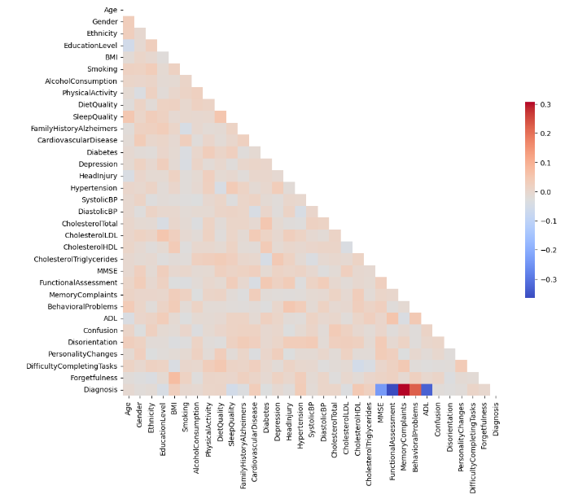
EXPLORING CORRELATIONS

Slide 8
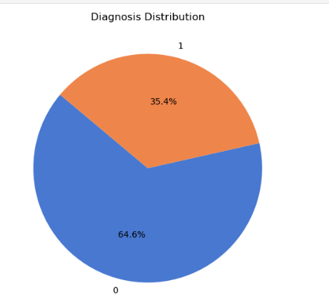
Distribution of a Target Variable

Slide 9
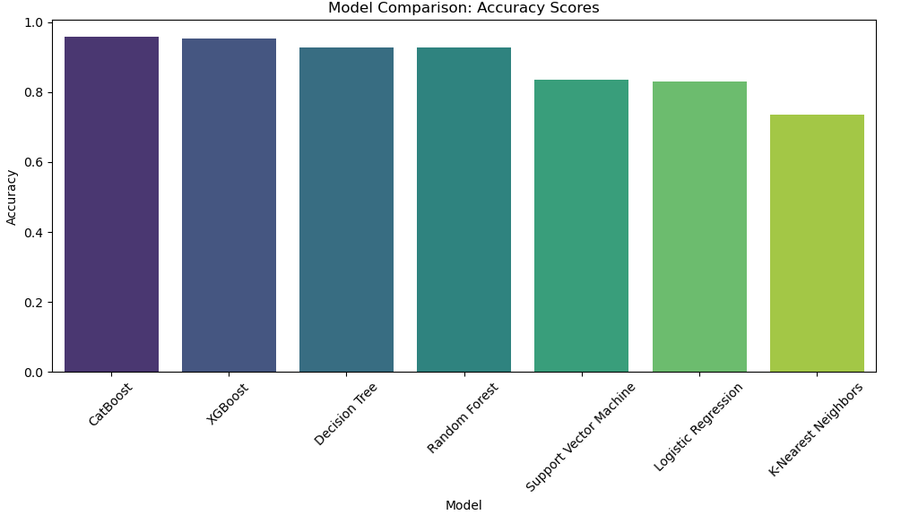
MODEL BUILDING

Slide 10
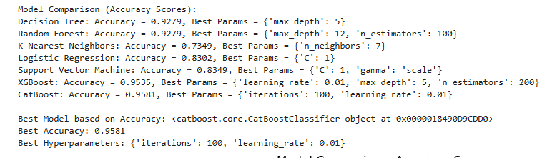
CHOOSING BEST MODEL

Slide 11
MODEL DEPLOYMENT USING STREAM-LIT
Stream-lit is a powerful Python library that allows you build and share data apps with minimal coding effort. It's perfect for quickly prototyping and deploying machine learning models.
Why we use Stream-lit:
Simplicity : Create interactive web apps with just Python code.
Speed: Rapid development and deployment.
Flexibility: Customize your app's appearance and functionality.
Sharing: Easily share your app with others.

Slide 12
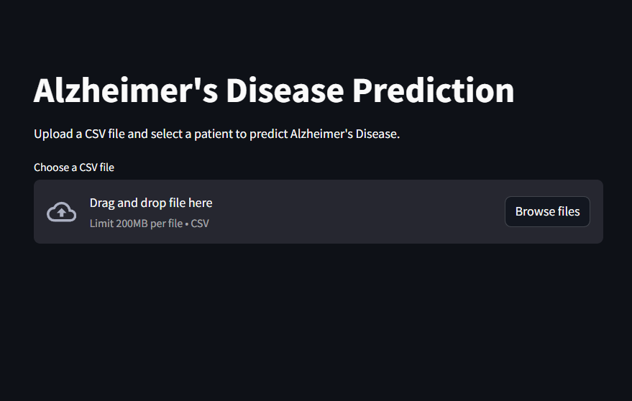
STREAMLIT WEB PAGE

Slide 13
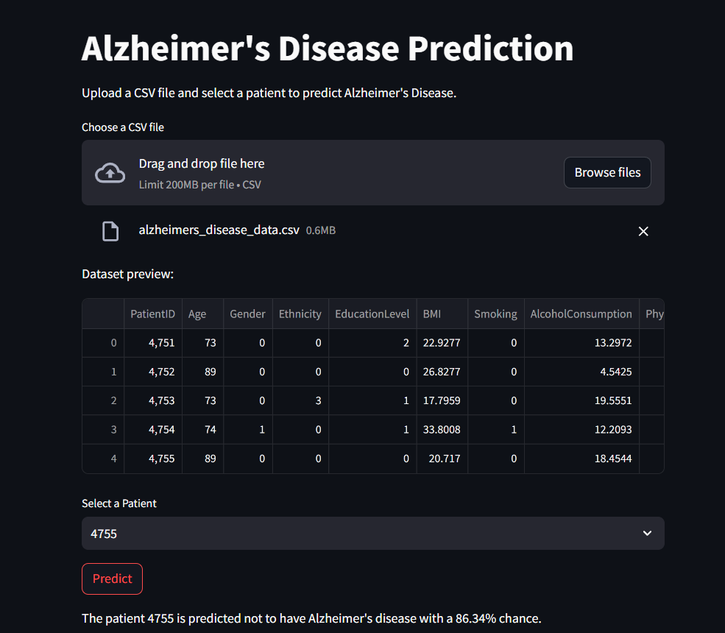
STREAMLIT WEB PAGE AFTER PREDICTION

Slide 14
THANK YOU

