Slide 1
LENDING CLUB CASE STUDY
Mayur Surkutla
Amar Nath KUMAR

Slide 2
PROBLEM STATEMENT
Background
Lending Club is a consumer finance company specializing in providing various types of loans to urban customers.
When a loan application is received, the company must decide whether to approve the loan based on the applicant's profile.
This decision involves two key risks:
If the applicant is likely to repay the loan, rejecting the application results in a loss of business for the company.
If the applicant is likely to default on the loan, approving the application could lead to financial loss for the company.

Slide 3
Objective
Identify risky loan applicants to minimize the issuance of such loans, thereby reducing the company's credit losses.
Utilize Exploratory Data Analysis (EDA) to identify key variables that serve as strong indicators of loan default.
Conduct an analysis to uncover the driving factors behind loan defaults.
Leverage these insights to improve the company's portfolio management and risk assessment strategies.

Slide 4
ANALYSIS APPROACH
Data Exploration
Analyse the metadata to gain a comprehensive understanding of the dataset.
Identify and address the presence of null values or duplicate rows.
Data Cleaning
Apply imputation techniques to handle missing values.
Remove irrelevant columns that do not contribute to the analysis.
Standardize values to ensure consistency across the dataset.
Eliminate columns with a single unique value, as they do not provide meaningful insights.

Slide 5
ANALYSIS APPROACH
Univariate Analysis
Visualize data distribution using box plots and distribution charts.
Detect and remove outliers to ensure data quality.
Create count plots for each column, noting key observations for both categorical and continuous variables.

Slide 6
Bivariant Analysis
Generate a correlation matrix to examine relationships among variables.
Explore the relationship between annual income and other variables using bar plots for deeper insights.
Analyse loan amounts in relation to other columns through bar plots to uncover additional patterns.

Slide 7
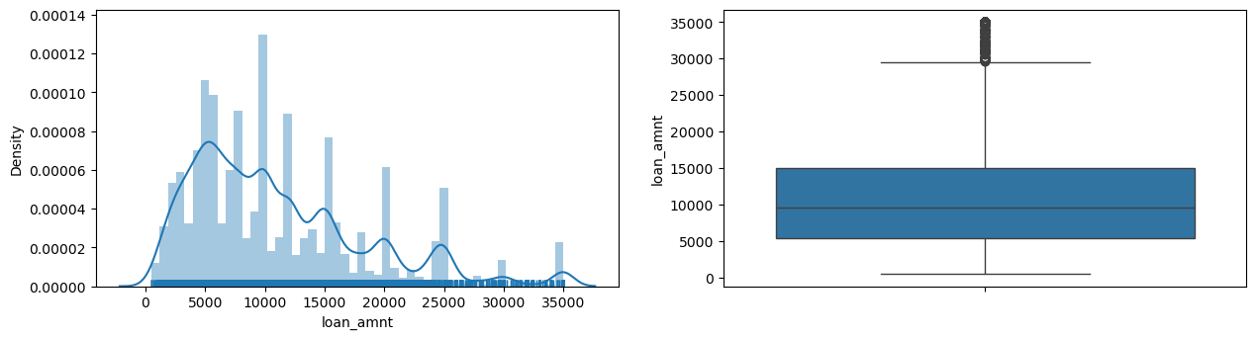
OBSERVATION – UNIVARIANT ANALYSIS
Plotting shows us that most of the loan amounts are in the range of 5000-15000

Slide 8
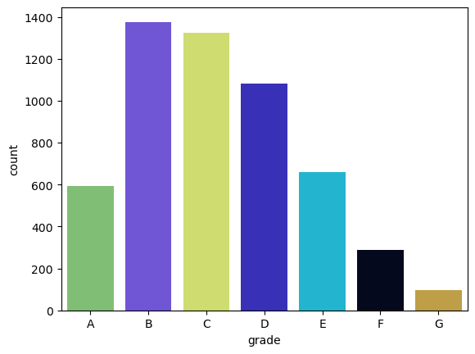
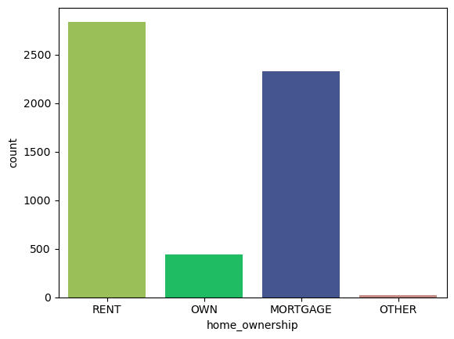
OBSERVATION – UNIVARIANT ANALYSIS
Looks like grades B & C have the highest number of defaulters amongst the dataset.
Grade B being the highest of all
People renting homes have the highest number of defaulters

Slide 9
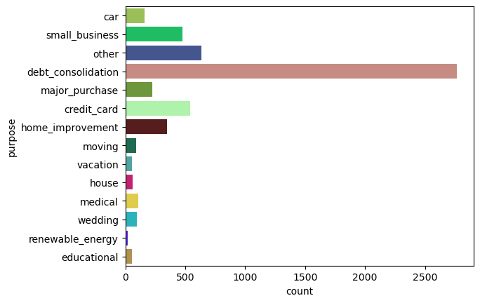
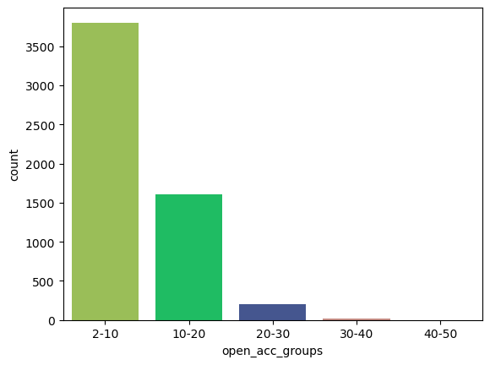
OBSERVATION – UNIVARIANT ANALYSIS
The dataset reveals that a significantly higher number of people are borrowing money
for debt consolidation compared to other purposes
People with 2-10 open accounts are more likely to default on their loan

Slide 10
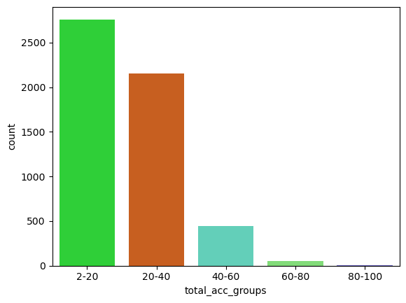
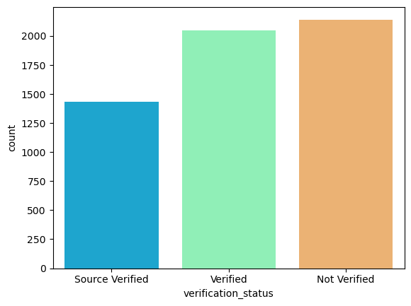
OBSERVATION – UNIVARIANT ANALYSIS
People with 2-20 total accounts are more likely to default on their loan
People whose income is not verified are defaulting more than the verified ones.
Lenders need to have strict income verification policies to reduce such applications.

Slide 11
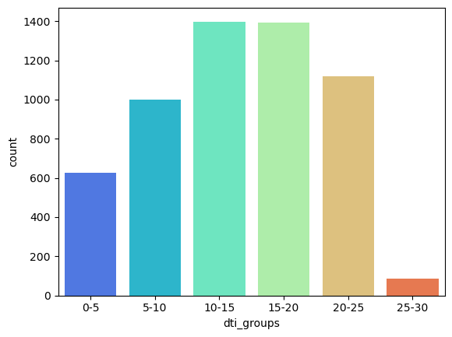
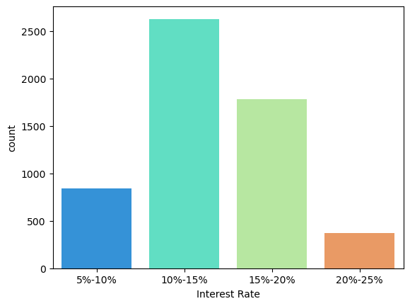
OBSERVATION – UNIVARIANT ANALYSIS
DTI ranging from 10-20 is the highest amongst the dataset.
Such people are more likely to default than rest
Interest rates between 10-15% seems to have highest number of defaulters.
Need to compare this with other features to get further insights

Slide 12
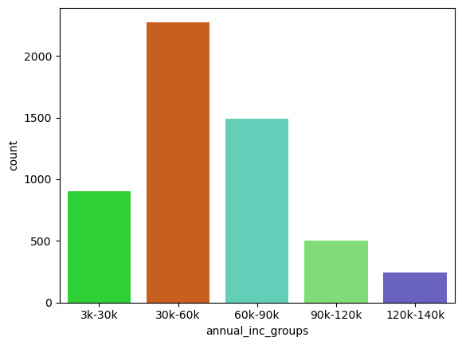
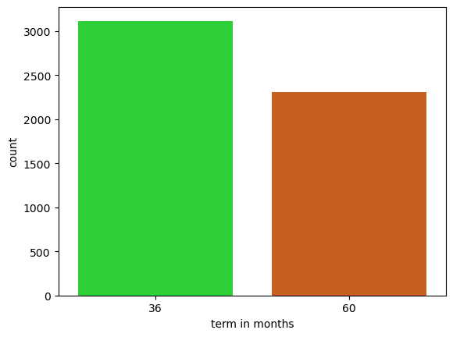
OBSERVATION – UNIVARIANT ANALYSIS
People with annual income between 30-60k seems to be having most
number of defaulters
Surprisingly people with short term loans are defaulting more than
people with long term loans

Slide 13
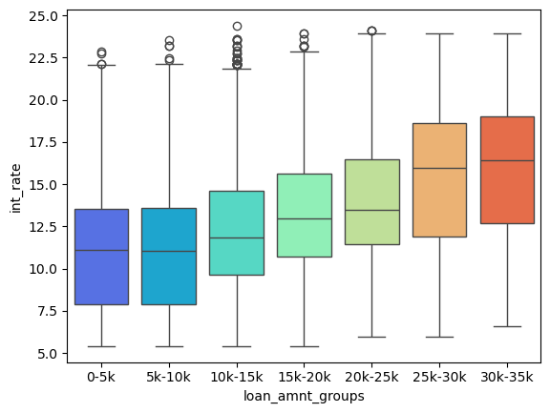
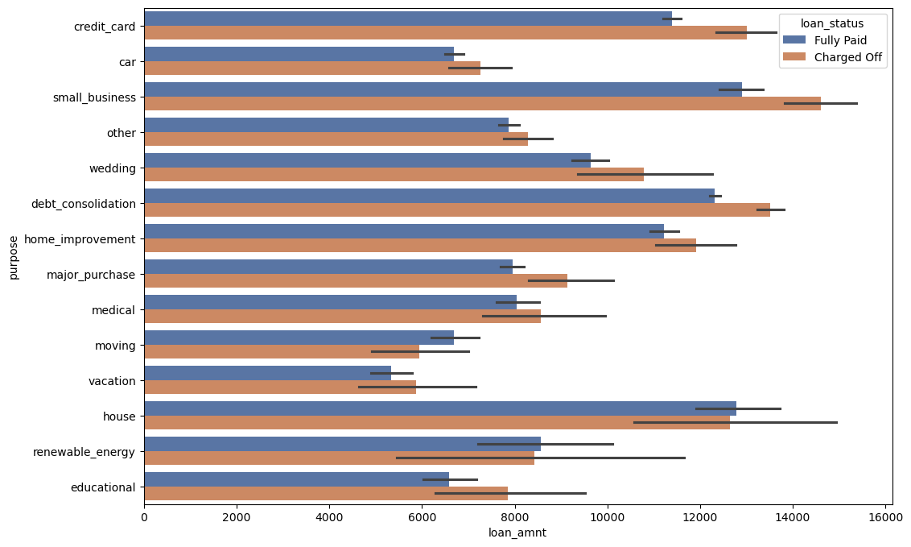
OBSERVATION – BIVARIATE ANALYSIS
Loan amount Group Vs Interest Rate
Interest rate on charged off loans is consistently higher than on fully paid loans
Loan Amount Vs Purpose - Comparing purpose with loan amounts tell us that small businesses tend to
have high risk as they have higher default rates along with higher loan amounts.
This overturns our initial assumption of debt consolidation being the highest
defaulter purpose.

Slide 14
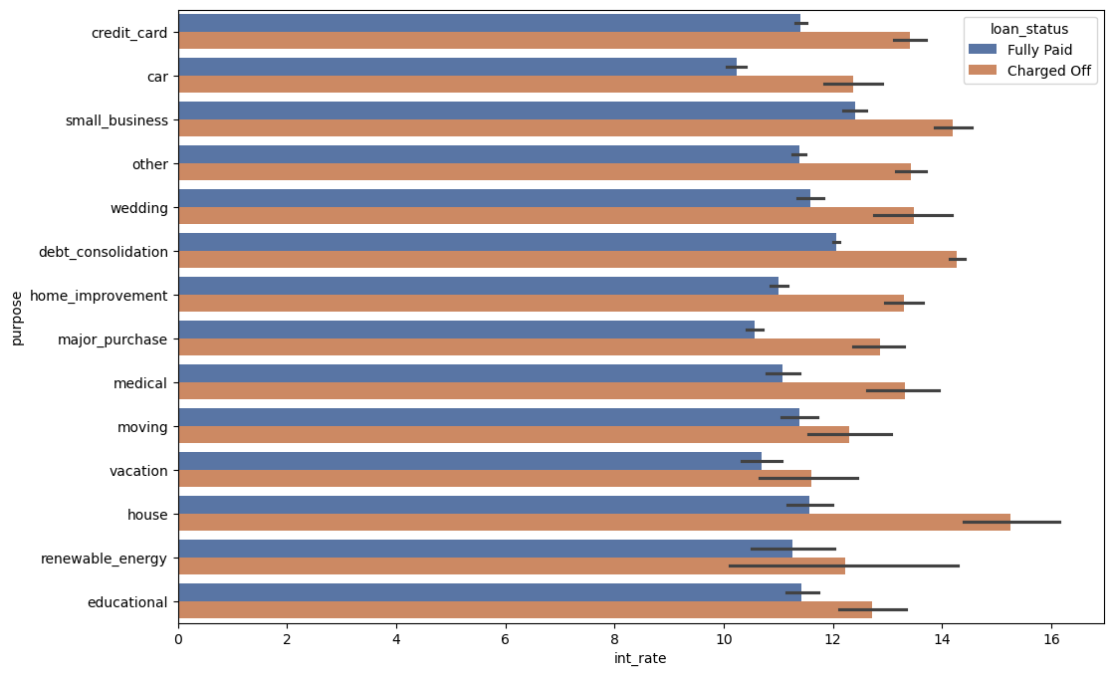
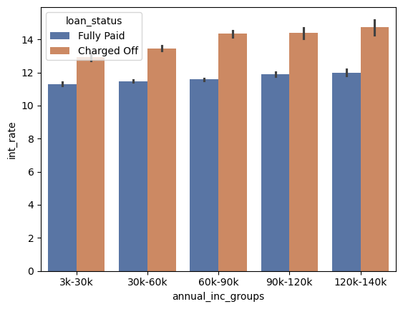
OBSERVATION – BIVARIATE ANALYSIS
Interest Rate Vs Purpose Interest rate compared with purpose shows pretty even distribution
Annual Income Group Vs Interest Rate
Distribution seems pretty even across all bins

Slide 15
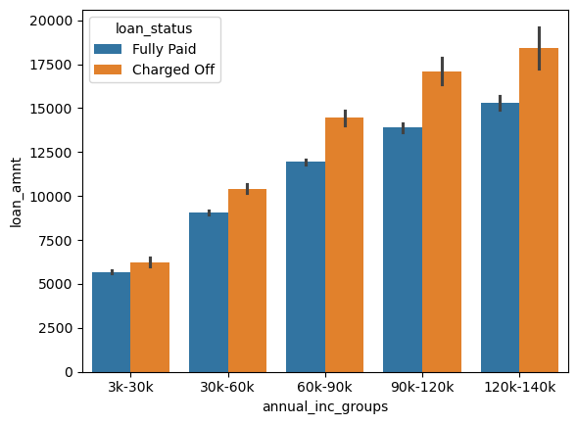
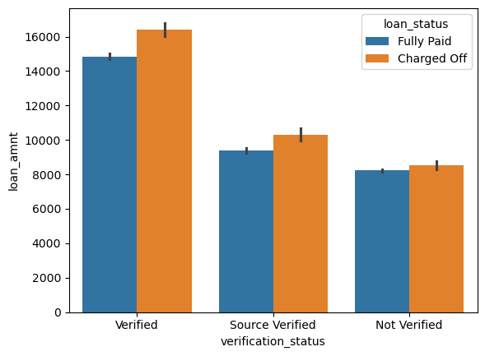
OBSERVATION – BIVARIATE ANALYSIS
Annual Income Groups Vs Loan Amount
As annual income is increasing, loan amount is also increasing.
Making it riskier as defaulter loan amount is also high
Even though not verified had higher number of defaulters, it is clear here that average
loan amount is higher from verified people. This shows strong indication of loans being
approved with loose verification methods.

Slide 16
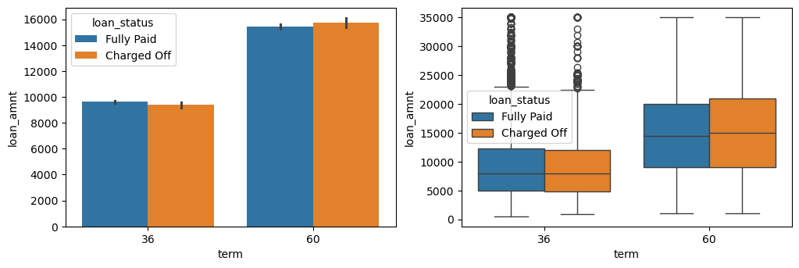
OBSERVATION – BIVARIATE ANALYSIS
Term Vs Loan Amount
Loans with 60 month term have higher average loan amount than 36 month. Which makes it more risky

Slide 17
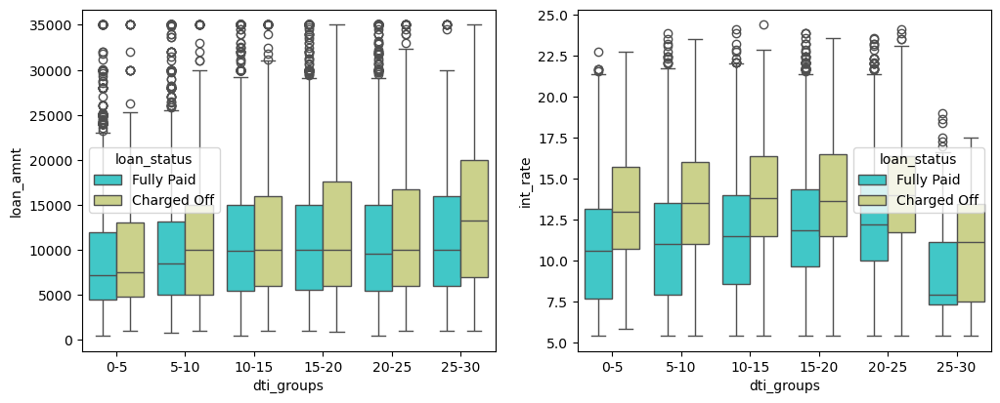
OBSERVATION – BIVARIATE ANALYSIS
Charged off loans are with higher amount compared with paid off loans

Slide 18
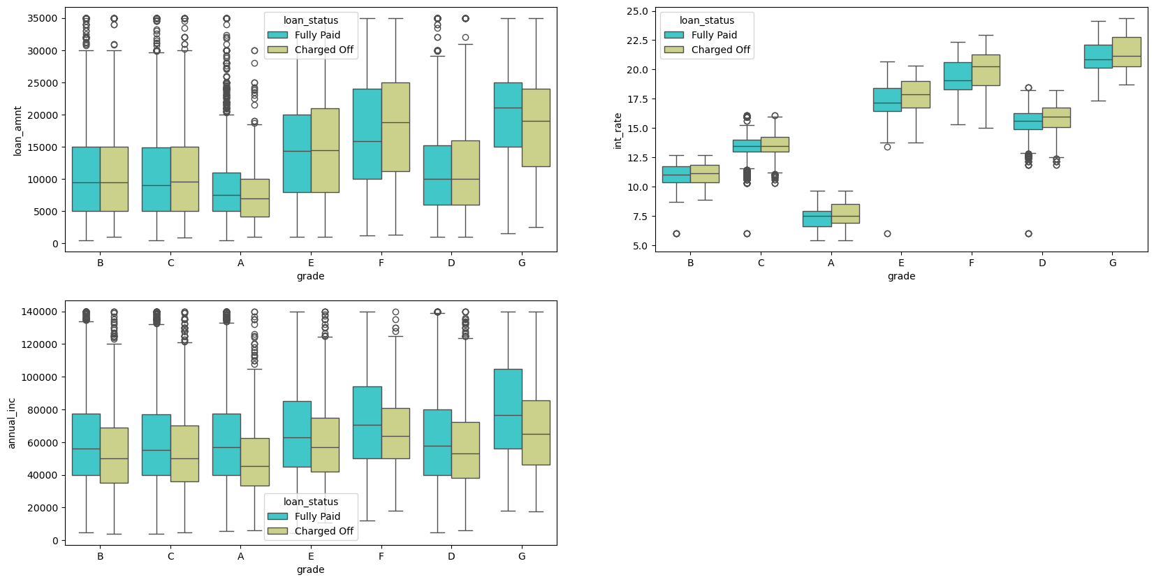
OBSERVATION – BIVARIATE ANALYSIS

Slide 19
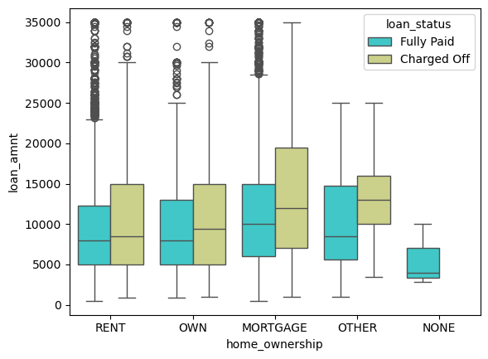
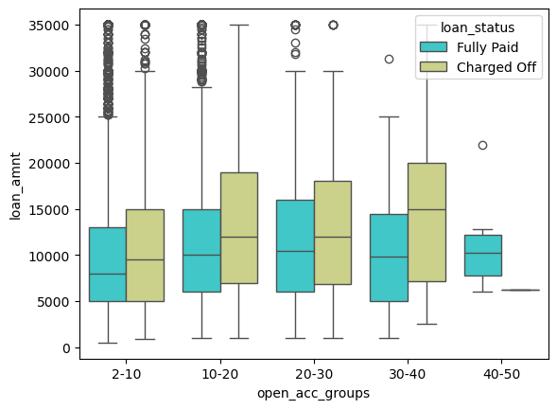
OBSERVATION – BIVARIATE ANALYSIS
Borrowers with "MORTGAGE" tend to take larger loans,
and the risk of charge-offs increases with the loan amount.
Borrowers with 10-40 account are taking larger loans which in turn have
higher risk of charge-offs

Slide 20
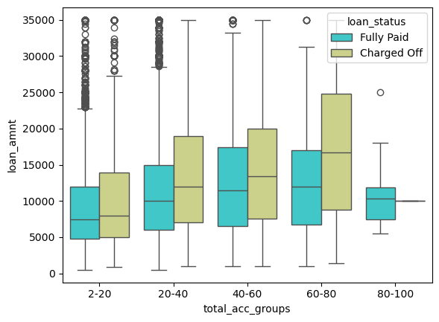
OBSERVATION – BIVARIATE ANALYSIS
Borrowers with 60-80 total accounts are taking larger loans & has higher risk of charge-offs as well.

Slide 21
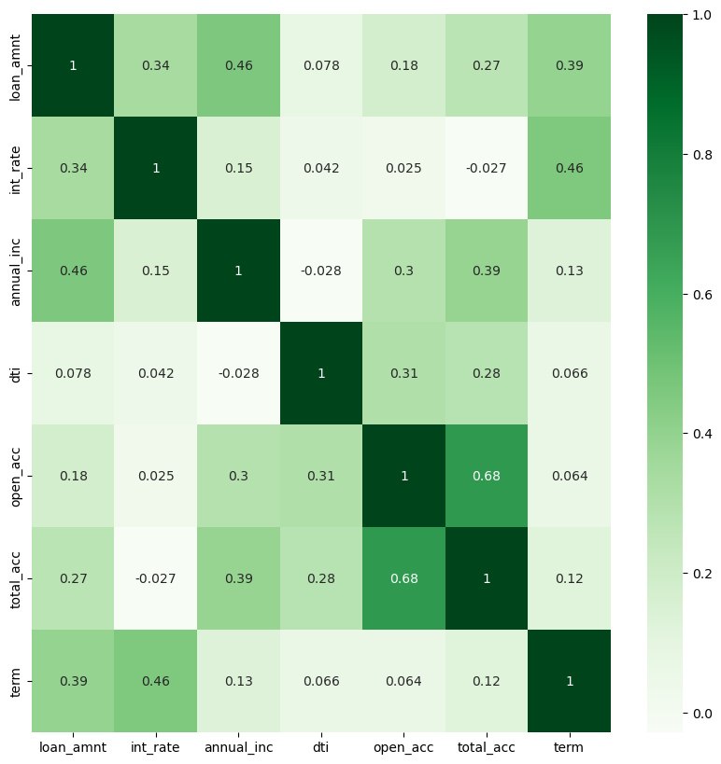
OBSERVATION – MULTIVARIATE ANALYSIS
- High DTI and a large number of open accounts might be associated with a higher risk of default.
- Borrowers with higher incomes tend to get larger loans and have more accounts.
- Larger loans often have higher interest rates and longer terms.

Slide 22
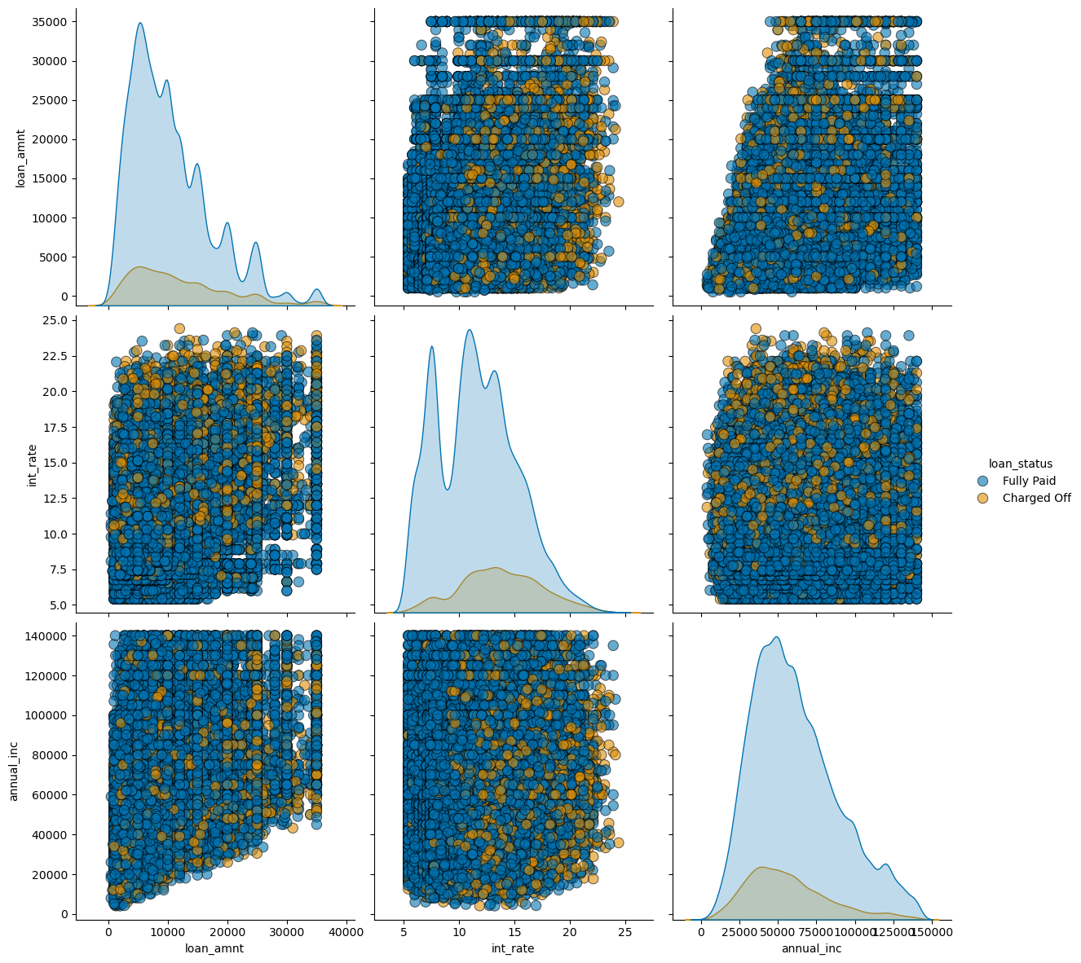
OBSERVATION – MULTIVARIATE ANALYSIS
- Higher interest rates are showing higher charged off.
- Interest rate increasing with loan amount is resulting in high charged off.

Slide 23
Final Insights
High Interest Rates Correlate with Higher Charge-Off Risk:** Loans with higher interest rates, especially in the 10-15% range, show significantly higher charge off rates, indicating a greater lending risk.
Large Loan Amounts and Longer Terms Increase Risk:** Larger loans, often with longer terms (e.g., 60 months), have higher default rates due to increased exposure and potentially higher interest rates.
High DTI and More Open Accounts are Associated with Higher Default Risk:** Borrowers with high DTI (10-20) and a large number of open accounts (2-20) tend to default more frequently, highlighting the need for careful assessment of financial behavior.
Income Verification Plays a Key Role:** Unverified income loans have higher charge off rates, but verified income loans have larger loan amounts, suggesting potential issues with verification methods.
Loan Purpose and Borrower Profile Impact Default Rates:** Small businesses and borrowers with higher-grade loans (e.g., Grade B & C) and larger loan amounts are at higher risk of default, while debt consolidation, although common, does not have the highest charge off rate.

Slide 24
Solutions to reduce Lending Risk
Adjust Interest Rates: Offer tiered rates based on risk profiles; avoid excessively high rates.
Limit Loan Amounts and Terms: Cap loans for high-risk borrowers and prefer shorter terms.
Strict DTI and Account Limits: Set stricter DTI and account limits for eligibility.
Better Income Verification: Use robust income checks (pay stubs, tax returns) and automate processes.
Reevaluate Loan Purposes: Scrutinize small business loans and adjust for higher-risk categories.
Assess Purpose Carefully: Set stricter criteria small business, debt consolidation loans.

Slide 25
Thank You!

