Slide 1

Automating the TAM Day
Custom Workflows for Portfolio Scale
Amar Kutwal | TAM, BeNeLux
TAM Summit 2026
© 2026, Amazon Web Services, Inc. or its affiliates.
Notes:
Hi everyone. I am Amar from the BeNeLux team. Today I want to share something I built to solve a problem we all face — how to manage a growing portfolio without drowning.

Slide 2
The Problem We All Know
8-12 customers, each with 8% time
(~3-4 hours per customer per week)
Cases, health events, SSPs, cadence calls,
emails, Slack — all scattered across tools
Morning question:
"Where do I start today?"
Growing portfolio = more context switching,
more things falling through cracks
8%
= 3-4 hrs per customer
per week
That is ALL you get.
© 2026, Amazon Web Services, Inc. or its affiliates.
Notes:
Raise your hand if this feels familiar. You open your laptop Monday morning and you have cases from 4 customers, 3 health events, 2 emails asking for updates, a cadence call in 2 hours that you have not prepped for. Where do you start? This is the problem. We all face it. Especially now with EOP customers joining Enterprise.

Slide 3
What I Built
Not a product — a practical workflow any TAM can replicate
Portfolio Dashboard
AI Workflows
One page, all customers,
everything you need
Auto-prep your day,
rank your priorities
Time Framework
Scalable to 8-12 CX
Know exactly how much
each customer needs
Grow portfolio without
drowning
© 2026, Amazon Web Services, Inc. or its affiliates.
Notes:
I built three things that work together. First, a portfolio dashboard — one page, all your customers, everything you need to know. Second, AI workflows that do the boring stuff — prep your cadence calls, check your health events, rank your priorities. Third, a framework that tells you how much time each customer tier actually needs. Let me show you how it works in practice.

Slide 4
Live Demo: A Morning in 5 Minutes
1
Open dashboard
Instant portfolio health
2
See what needs attention
Auto-ranked priorities
3
Check engagement gaps
Who have I not talked to?
4
Prep for next call
Topics, history, actions
5
Mark things done
Comms handled, tracked
6
Expand if needed
Dense sections collapsed
Switching to live demo now...
© 2026, Amazon Web Services, Inc. or its affiliates.
Notes:
Now let me show you this live. I will walk you through what my actual morning looks like. This takes me about 5 minutes before I start my day. [SWITCH TO BROWSER - open tam-portfolio-dashboard.html]

Slide 5
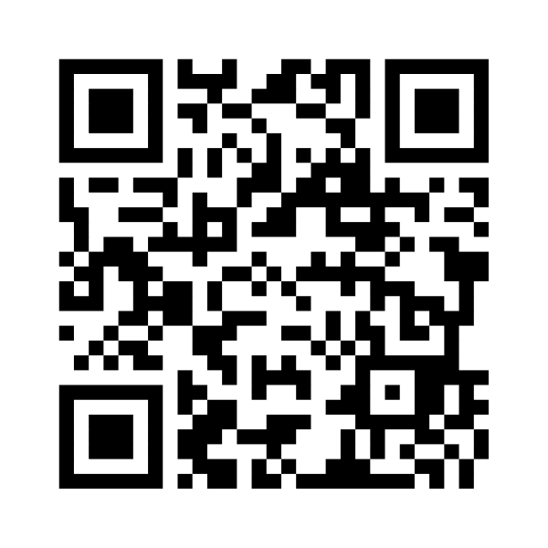
Try It Yourself
This is an MVP
Your feedback shapes what comes next
Runs locally on your machine
No approvals, no new tools to install
Built with Amazon Quick + custom workflows
Tool-agnostic approach — use what works for you
Want to try?
Come talk to me after this session!
Share Your Feedback
pulse.aws/survey/G0SHQ5YP
Takes 30 seconds
© 2026, Amazon Web Services, Inc. or its affiliates.
Notes:
This is version one. It is an MVP. I want your feedback on what is useful, what is confusing, what you would add. Everything runs on your local machine — no approvals needed. If you want to try it or build your own version, come talk to me after. I am happy to walk you through the setup. Please also fill in the survey — it takes 30 seconds and helps me prioritize what to build next. Thank you!

