Slide 1
Python for Data Science

Slide 2
Installation and Overview of Python Libraries for Data Scientists
Reading Data; Selecting and Filtering the Data; Data manipulation, sorting, grouping, rearranging
Plotting the data
Descriptive statistics

Slide 3
Installation of Anacoda

Slide 4
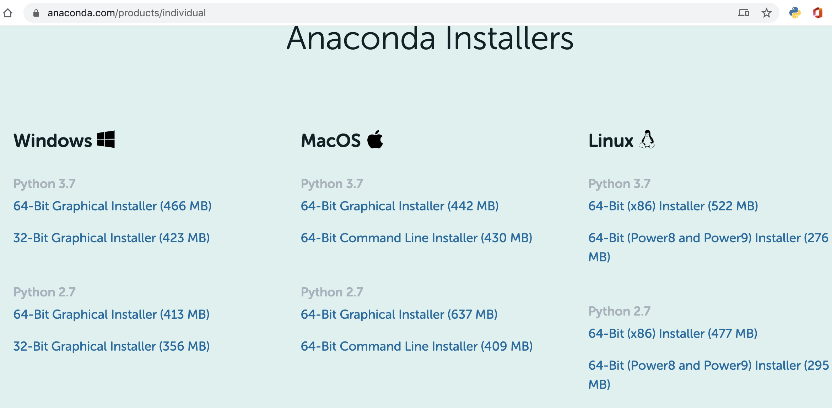
https://www.anaconda.com/products/individual

Slide 5
Python Libraries for Data Science
Popular Python toolboxes/libraries:
NumPy
Pandas
SciKit-Learn
Keras
Visualization libraries
matplotlib
Seaborn
plotly
and many more …

Slide 6

Python Libraries for Data Science
Pandas:
Adds data structures and tools designed to work with table-like data (similar to Series and Data Frames in R)
Provides tools for data manipulation: reshaping, merging, sorting, slicing, aggregation etc.
Allows handling missing data
Link: http://pandas.pydata.org/

Slide 7

Python Libraries for Data Science
SciKit-Learn:
Provides machine learning algorithms: classification, regression, clustering, model validation etc.
Built on NumPy, SciPy and matplotlib
Link: http://scikit-learn.org/

Slide 8

Python Libraries for Data Science
matplotlib:
Python 2D plotting library which produces publication quality figures in a variety of hardcopy formats
A set of functionalities similar to those of MATLAB
Line plots, scatter plots, barcharts, histograms, pie charts etc.
Relatively low-level; some effort needed to create advanced visualization
Link: https://matplotlib.org/

Slide 9
Python Libraries for Data Science
Seaborn:
Based on matplotlib
Provides high level interface for drawing attractive statistical graphics
Similar (in style) to the popular ggplot2 library in R
Link: https://seaborn.pydata.org/

Slide 10
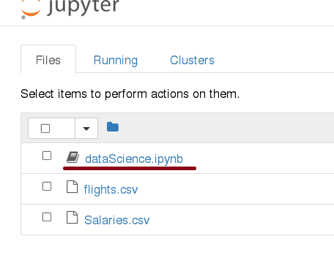
Start Jupyter notebook

Slide 11
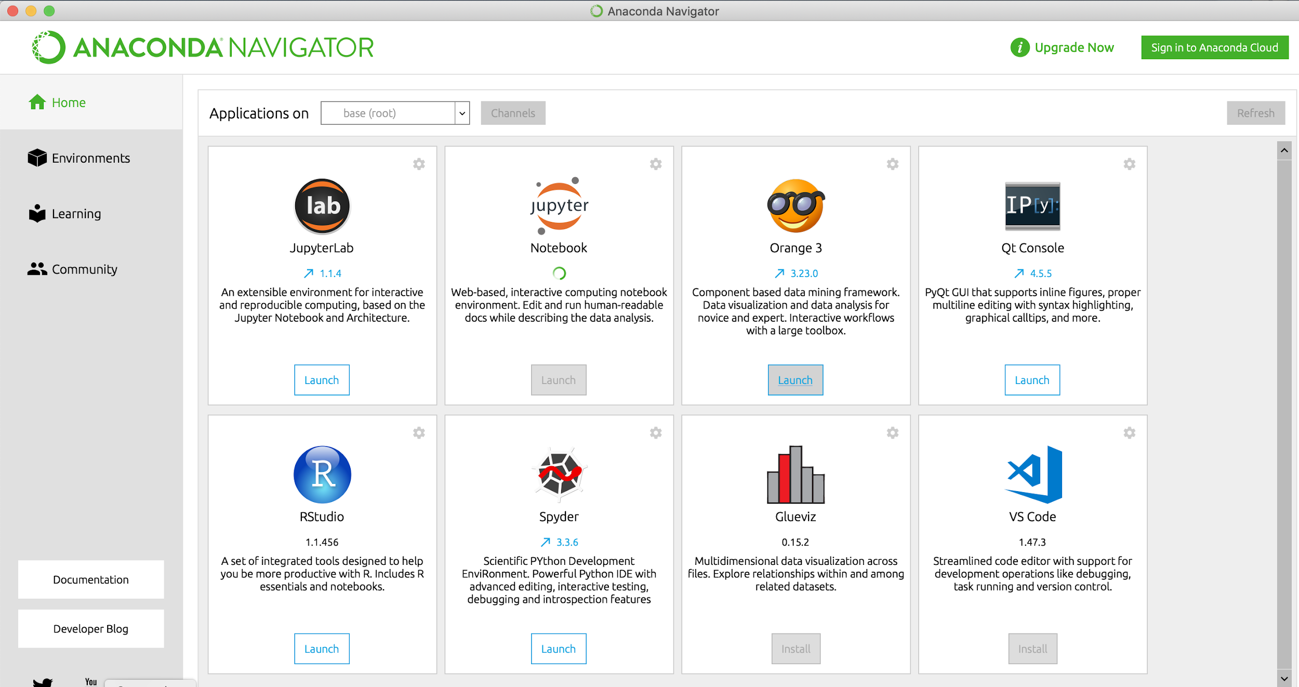

Slide 12
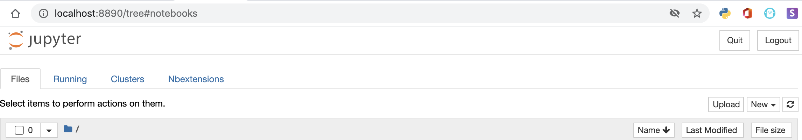
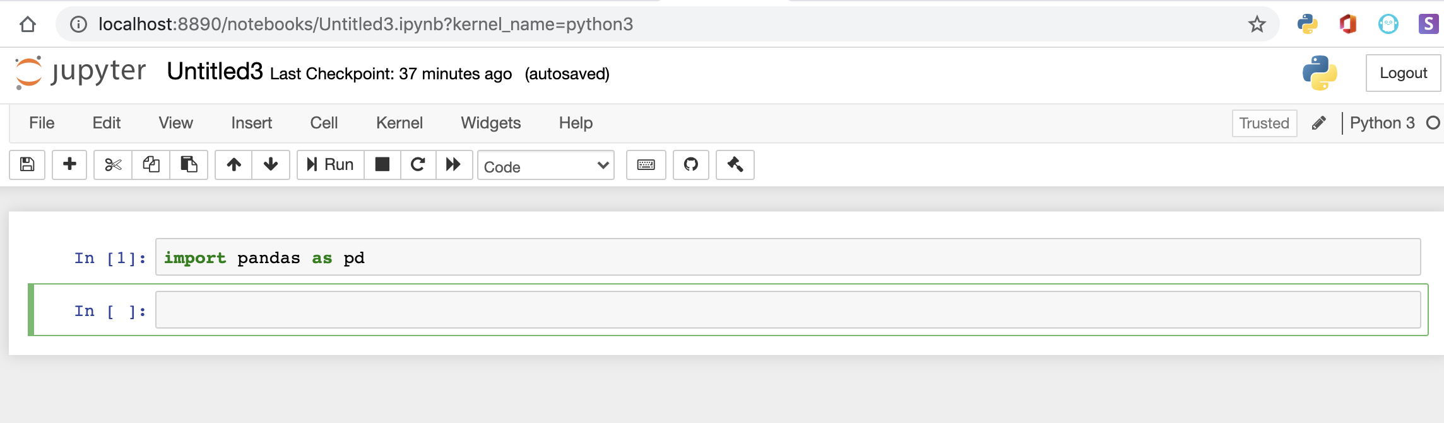

Slide 13
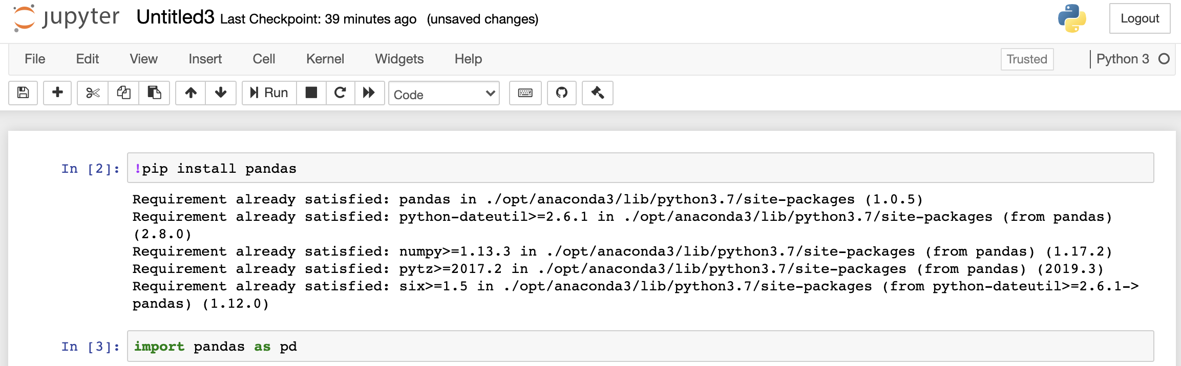
Install libraries

Slide 14
Loading Python Libraries
In [ ]:
#Import Python Libraries
import numpy as np
import pandas as pd
import matplotlib as mpl
import seaborn as sns
Press Shift+Enter to execute the jupyter cell

Slide 15
Reading data using pandas
In [ ]:
#Read csv file
df = pd.read_csv("http://rcs.bu.edu/examples/python/data_analysis/Salaries.csv")
Note: The above command has many optional arguments to fine-tune the data import process.
There is a number of pandas commands to read other data formats:
pd.read_excel('myfile.xlsx',sheet_name='Sheet1', index_col=None, na_values=['NA'])
pd.read_stata('myfile.dta')
pd.read_sas('myfile.sas7bdat')
pd.read_hdf('myfile.h5','df')

Slide 16
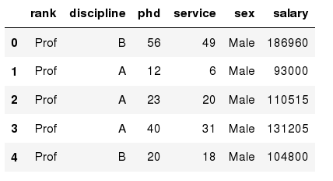
Exploring data frames
In [3]:
#List first 5 records
df.head()
Out[3]:

Slide 17
Hands-on exercises
Read the first 10, 20, 50 records;

Slide 18
Data Frame data types
Pandas Type | Native Python Type | Description
object | string | The most general dtype. Will be assigned to your column if column has mixed types (numbers and strings).
int64 | int | Numeric characters. 64 refers to the memory allocated to hold this character.
float64 | float | Numeric characters with decimals. If a column contains numbers and NaNs(see below), pandas will default to float64, in case your missing value has a decimal.
datetime64, timedelta[ns] | N/A (but see the datetime module in Python’s standard library) | Values meant to hold time data. Look into these for time series experiments.

Slide 19
Data Frame data types
In [4]:
#Check a particular column type
df['salary'].dtype
Out[4]: dtype('int64')
In [5]:
#Check types for all the columns
df.dtypes
Out[4]:
object
object
int64
int64
object
int64
rank
discipline
phd
service
sex
salary
dtype: object

Slide 20
Data Frames attributes
Python objects have attributes and methods.
df.attribute | description
dtypes | list the types of the columns
columns | list the column names
axes | list the row labels and column names
ndim | number of dimensions
size | number of elements
shape | return a tuple representing the dimensionality
values | numpy representation of the data

Slide 21
Hands-on exercises
Find how many records this data frame has;
How many columns are there?
What are the column names?
What types of columns we have in this data frame?

Slide 22
Data Frames methods
Unlike attributes, python methods have parenthesis.
All attributes and methods can be listed with a dir() function: dir(df)
df.method() | description
head( n), tail( n ) | first/last n rows
describe() | generate descriptive statistics (for numeric columns only)
max(), min() | return max/min values for all numeric columns
mean(), median() | return mean/median values for all numeric columns
std() | standard deviation
sample(n) | returns a random sample of the data frame
dropna() | drop all the records with missing values

Slide 23
Hands-on exercises
Give the summary for the numeric columns in the dataset
Calculate standard deviation for all numeric columns;
What are the mean values of the first 50 records in the dataset?

Slide 24
Selecting a column in a Data Frame
Method 1: Subset the data frame using column name:
df[‘rank']
Method 2: Use the column name as an attribute:
df.rank
Note: there is an attribute rank for pandas data frames, so to select a column with a name "rank" we should use method 1.

Slide 25
Hands-on exercises
Calculate the basic statistics for the Phd column;
Find how many values in the Phd column (use count method);
Calculate the average Phd;

Slide 26
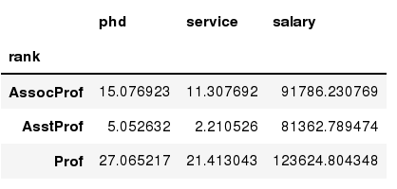
Data Frames groupby method
Using "group by" method we can:
Split the data into groups based on some criteria
Calculate statistics (or apply a function) to each group
Similar to dplyr() function in R
In [ ]:
#Group data using rank
df_rank = df.groupby(['rank'])
In [ ]:
#Calculate mean value for each numeric column per each group
df_rank.mean()

Slide 27
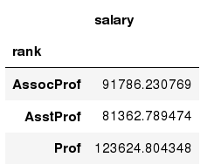
Data Frames groupby method
Once groupby object is created we can calculate various statistics for each group:
In [ ]:
#Calculate mean salary for each professor rank:
df.groupby('rank')[['salary']].mean()
Note: If single brackets are used to specify the column (e.g. salary), then the output is Pandas Series object. When double brackets are used the output is a Data Frame

Slide 28
Data Frames groupby method
groupby performance notes:
- no grouping/splitting occurs until it's needed. Creating the groupby object only verifies that you have passed a valid mapping
- by default the group keys are sorted during the groupby operation. You may want to pass sort=False for potential speedup:
In [ ]:
#Calculate mean salary for each professor rank:
df.groupby(['rank'], sort=False)[['salary']].mean()

Slide 29
Data Frame: filtering
To subset the data we can apply Boolean indexing. This indexing is commonly known as a filter. For example if we want to subset the rows in which the salary value is greater than $120K:
In [ ]:
#Calculate mean salary for each professor rank:
df_sub = df[ df['salary'] > 120000 ]
Any Boolean operator can be used to subset the data:
> greater; >= greater or equal;
< less; <= less or equal;
== equal; != not equal;
In [ ]:
#Select only those rows that contain female professors:
df_f = df[ df['sex'] == 'Female' ]

Slide 30
Data Frames: Slicing
There are a number of ways to subset the Data Frame:
one or more columns
one or more rows
a subset of rows and columns
Rows and columns can be selected by their position or label

Slide 31
Data Frames: Slicing
When selecting one column, it is possible to use single set of brackets, but the resulting object will be a Series (not a DataFrame):
In [ ]:
#Select column salary:
df['salary']
When we need to select more than one column and/or make the output to be a DataFrame, we should use double brackets:
In [ ]:
#Select column salary:
df[['rank','salary']]

Slide 32
Data Frames: method iloc (summary)
df.iloc[0] # First row of a data frame
df.iloc[i] #(i)th row
df.iloc[-1] # Last row
df.iloc[:, 0] # First column
df.iloc[:, -1] # Last column
df.iloc[0:7] #First 7 rows
df.iloc[:, 0:2] #First 2 columns
df.iloc[1:3, 0:2] #First and Second rows and first 2 columns
df.iloc[[0,5], [1,3]] #1st and 5th rows and

Slide 33
Aggregation Functions in Pandas
Aggregation - computing a summary statistic about each group, i.e.
compute group sums or means
compute group sizes/counts
Common aggregation functions:
min, max
count, sum, prod
mean, median, mode, mad
std, var

Slide 34
Aggregation Functions in Pandas
agg() method are useful when multiple statistics are computed per column:
In [ ]:
df[[Phd’,’Salary']].agg(['min','mean','max'])

Slide 35
Basic Descriptive Statistics
df.method() | description
describe | Basic statistics (count, mean, std, min, quantiles, max)
min, max | Minimum and maximum values
mean, median, mode | Arithmetic average, median and mode
var, std | Variance and standard deviation
sem | Standard error of mean
skew | Sample skewness
kurt | kurtosis

Slide 36
Graphics to explore the data
import matplotlib.pyplot as plt
%matplotlib inline

Slide 37
The primary data visualization library in Python is matplotlib, a project begun in the early
2000s, that was built to mimic the plotting capabilities from MATLAB.
Matplotlib is enormously capable of plotting most things you can imagine, and it gives its users tremendous power to control every aspect of the plotting surface
Also Pandas has the plotting capability and usually plots what we want with a single call to the plot method. pandas does no plotting on its own. It internally calls matplotlib functions to create the plots
Seaborn is also a visualization library that wraps matplotlib and does not do any actual plotting itself. Seaborn makes beautiful plots and has many types of plots that are not available from matplotlib or pandas.
Seaborn works with tidy (long) data, while pandas works best with aggregated (wide) data.

Slide 38
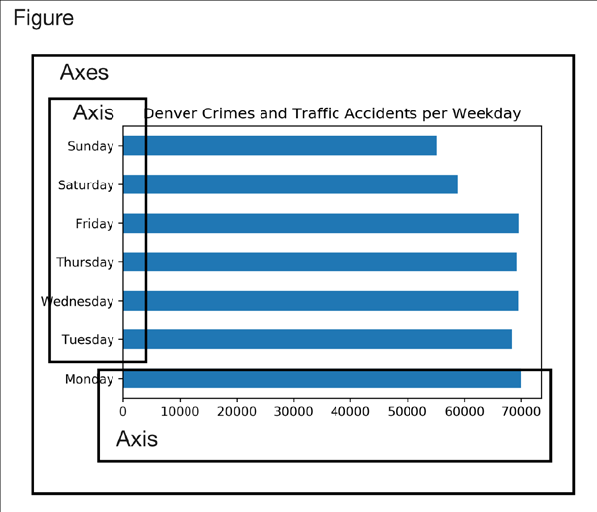
Matplotlib
Matplotlib uses a hierarchy of objects to display all of its plotting items in the output.
The Figure and Axes objects are the two main components of the hierarchy.
The Figure object is at the top of the hierarchy.
It is the container for everything that will be plotted.
Contained within the Figure is one or more Axes object(s).
The Axes is the primary object that you will
interact with when using matplotlib and can be thought of as the plotting surface.
The Axes contains an x-axis, a y-axis, points, lines, markers, labels, legends, and any other useful item
that is plotted

Slide 39
Go to Visualization_mat_seaborn.ipynb

Slide 40
Thank you

