Slide 1

DIGITAL PORTFOLIO
STUDENT NAME: AMARNATH R
REGISTER NO: 24131030500121001
NMID: 1219EBD371A06D68C684A151D42BB351
DEPARTMENT: BCA-II Year
COLLEGE: GOVERNMENT ARTS COLLEGE,CHIDAMBARAM

Slide 2
PROJECT TITLE
Digital portfolio
A digital portfolio is an online collection of a person’s work, skills, experiences, and achievements presented in a structured way. It’s like an upgraded version of a resume but more interactive and visual.

Slide 3
AGENDA
1.Problem Statement
2.Project Overview
3.End Users
4.Tools and Technologies
5.Portfolio design and Layout
6.Features and Functionality
7.Results
8.Screenshots
9.Conclusion

Slide 4
PROBLEM STATEMENT
Traditional resumes are static and fail to showcase technical skills effectively. A digital portfolio provides an interactive way to highlight education, skills, and personal identity.

Slide 5
PROJECT OVERVIEW
This project is a personal portfolio website for Amarnath, a BCA student. It introduces him, displays his education and skills, and serves as an online professional identity.

Slide 6
END USERS
The portfolio is designed for recruiters, faculty, peers, and collaborators who want to know more about Amarnath’s academic and technical background.

Slide 7
TOOLS AND TECHNIQUES
The portfolio is developed using;
* HTML for structure
* CSS for styling. It was created in Visual Studio Code and can run on any web browser.

Slide 8
POTFOLIO DESIGN AND LAYOUT
The design is clean and minimal with sections for profile, about me, education, skills, and contact. A sky blue theme makes it simple and professional.

Slide 9
FEATURES AND FUNCTIONALITY
It includes a profile introduction, educational background, technical skills in C, Java, and Python, and contact details for collaboration.

Slide 10
RESULTS
The final outcome is a functional and elegant digital portfolio for Amarnath. It successfully displays his academic background, skills, and contact information in an organized format.

Slide 11
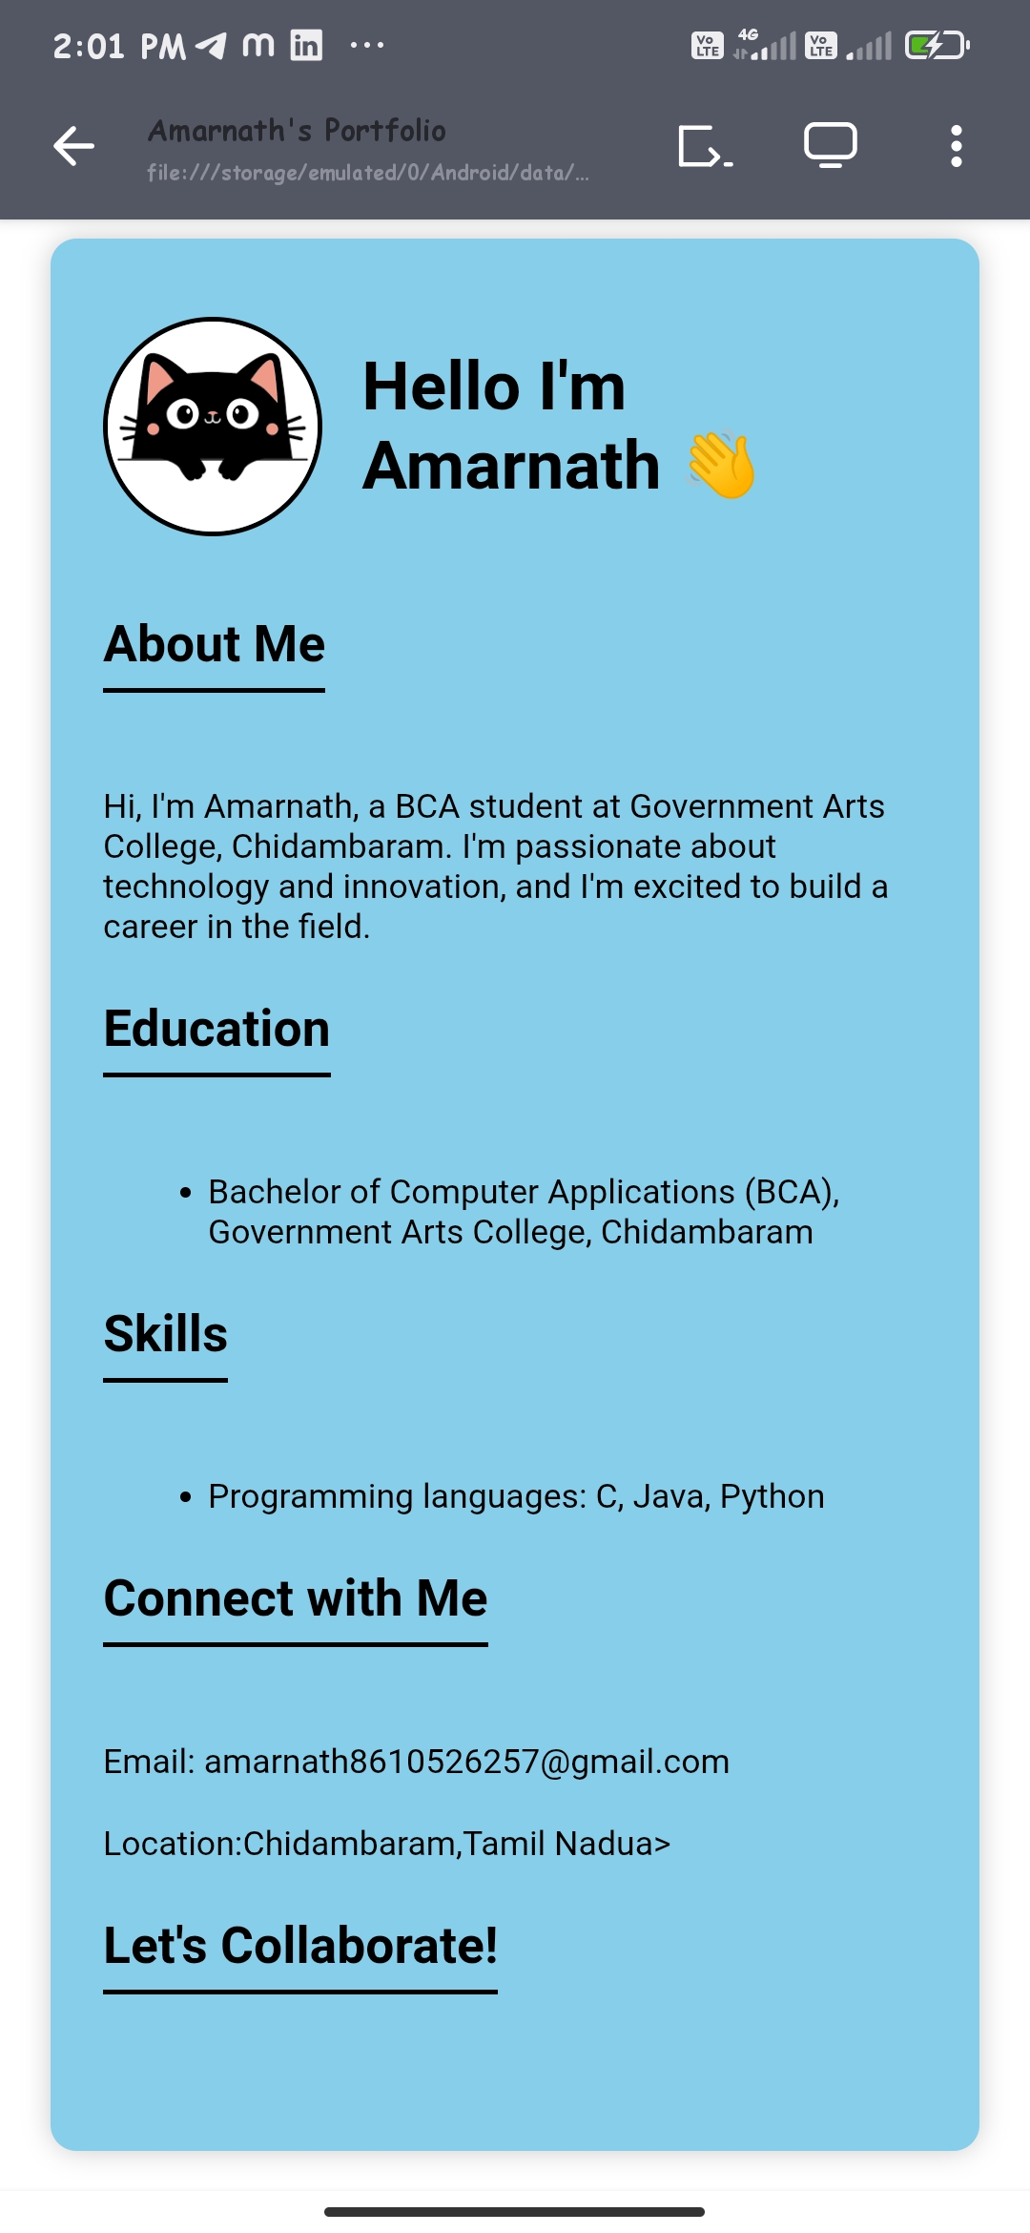
SCREENSHOTS

Slide 12
CONCLUSION
The portfolio acts as a digital resume, giving Amarnath a professional online presence. It can be expanded with projects and certifications in the future.
“THANK YOU”

