Slide 1
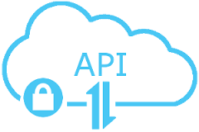
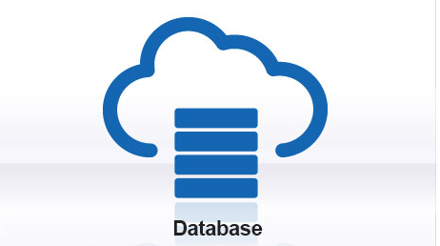
DASC : Database & API as a Service in Cloud
Project Presentation
Date : 12/08/2015
Team Members:
- Amarnath
- Deepthi
- Saud
- Tarun Shedhani

Slide 2

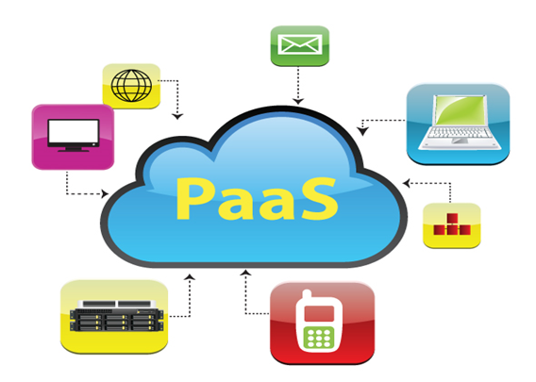


PROBLEM DEFINITION :
To provide customized database’s as a service
We are implementing a regular database with general parameters (for eg : like year, total no of enrollments , total no of enrollments for graduation program-full time , total no of enrollments – part time, total no of enrollments with disabilities, total applications received , total applications considered etc….)
Also we are implementing a customized database with certain criteria's applied on the dataset more specifically to the students .
To provide different set of API’s in cloud for the user’s to explore our database - Platform as a Service
To provide different set of APIs to explore the dataset on which other systems (desktop, web or mobile) can be developed.
Also we are providing Data as a Service in our project.
Develop different databases based on certain conditions to help Students to refine their search for universities

Slide 3


AT THE PRESENT:
Extracted dataset from National Center for Education Statistics (NCES) for the following time period 2000-2014 .
The dataset is focused only to Universities in Missouri state.
We have created two set of databases in :
MongoLab : MongoLab is a fully managed cloud database service featuring automated provisioning and scaling of MongoDB databases, backups, 24/7 monitoring and alerting, MongoDB GUI tools.
CloudAnt : is best suited for applications that need a database to handle a massively concurrent mix of reads and writes. Its data replication & synchronization technology also enables continuous data availability, as well as off-line app usage for mobile or remote users.
REST API is implemented – is responsible for accessing the data from the database created in the cloud.

Slide 4
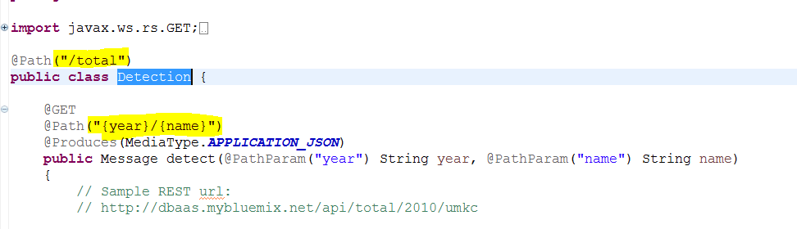
REST API CODE : The code is written in Java
https://hub.jazz.net/pipeline/tshedhani/DBaaS

Slide 5
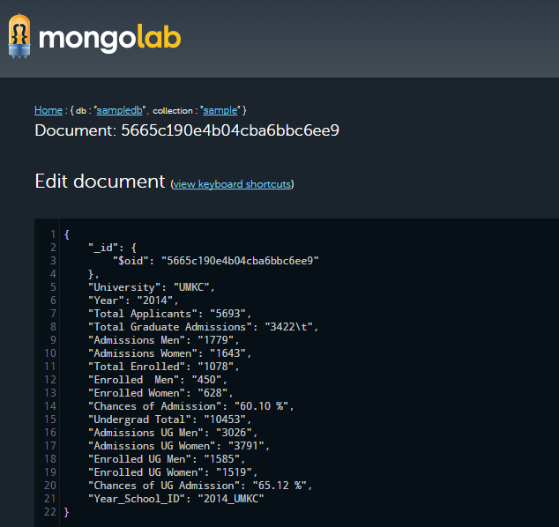
DATABASE in MONGOLAB

Slide 6
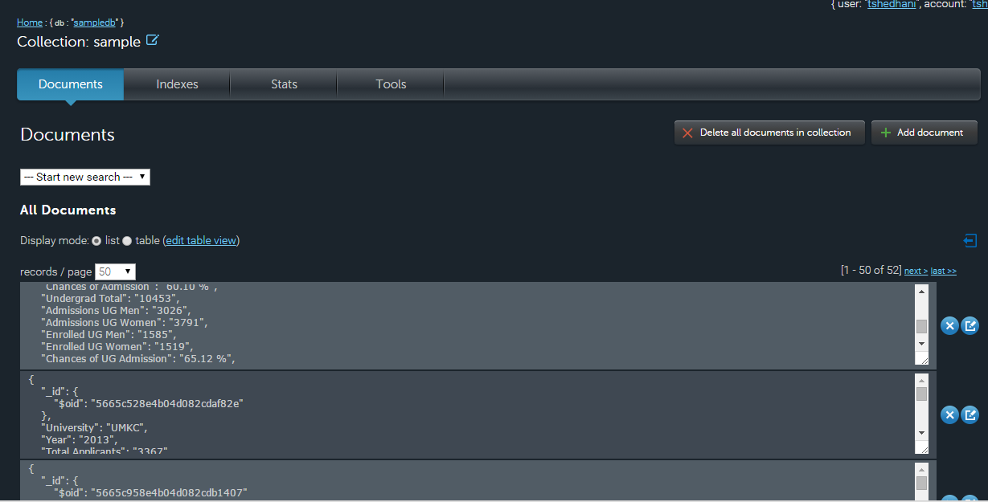

Slide 7
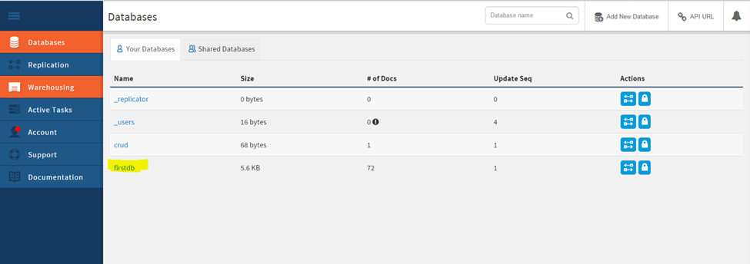
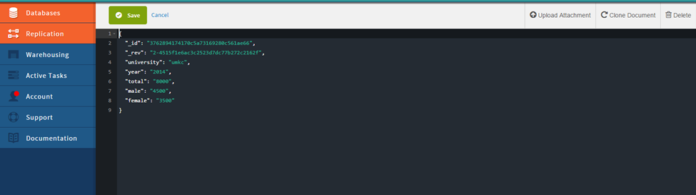
DATABASE in CLOUDANT

Slide 8
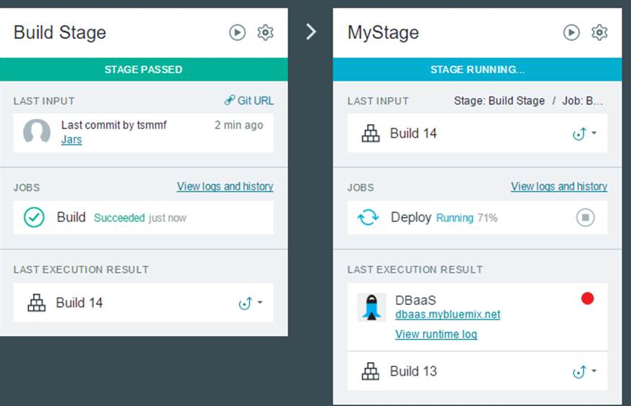
DEPLOYING IN THE CLOUD

Slide 9

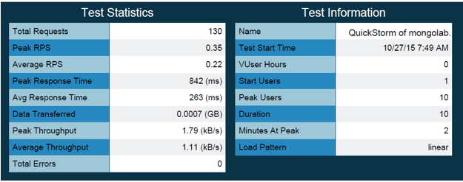
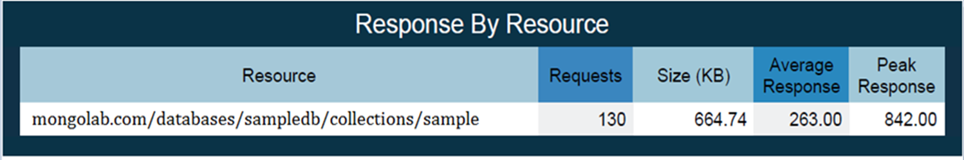
Storage Analysis of cloud database
Performance Analysis on requests sent to MongoLab Database was done using LoadStorm Tool

Slide 10
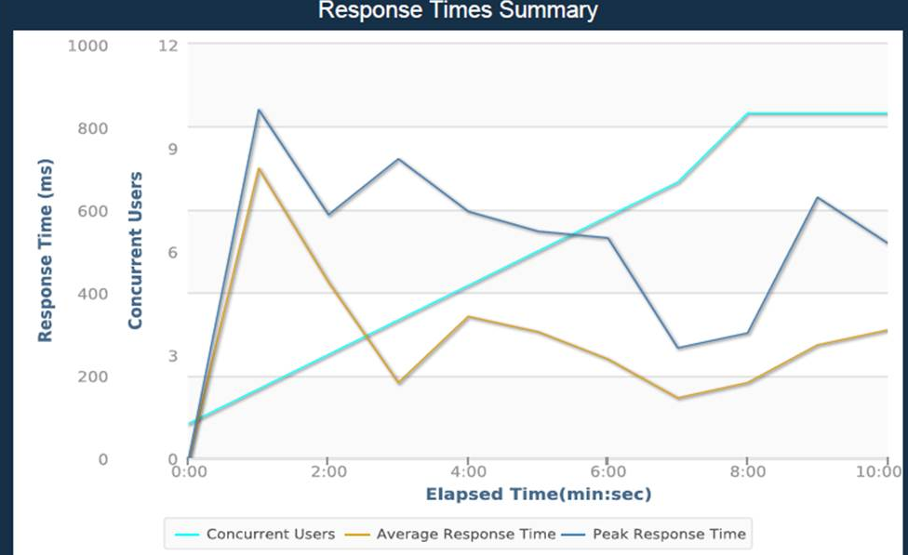

Slide 11
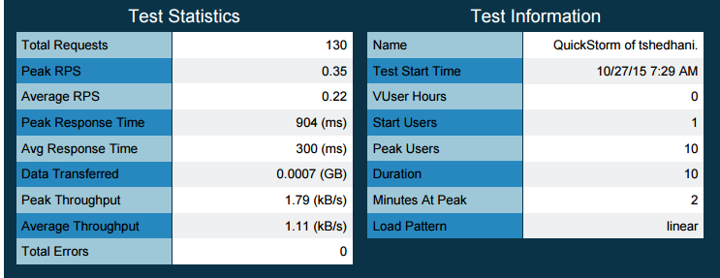

Performance Analysis on requests sent to Cloudant Database was done using LoadStorm Tool

Slide 12
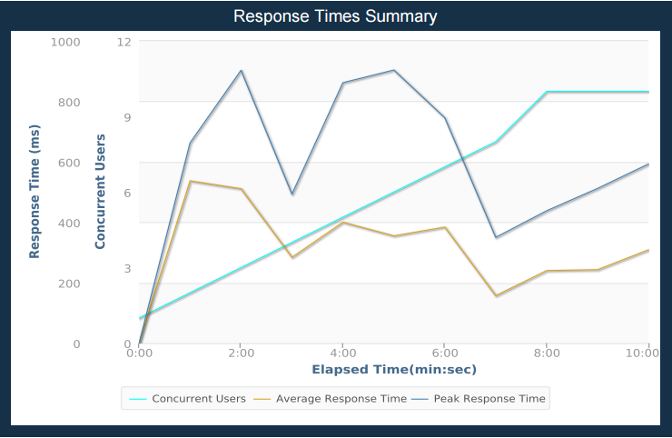

Slide 13
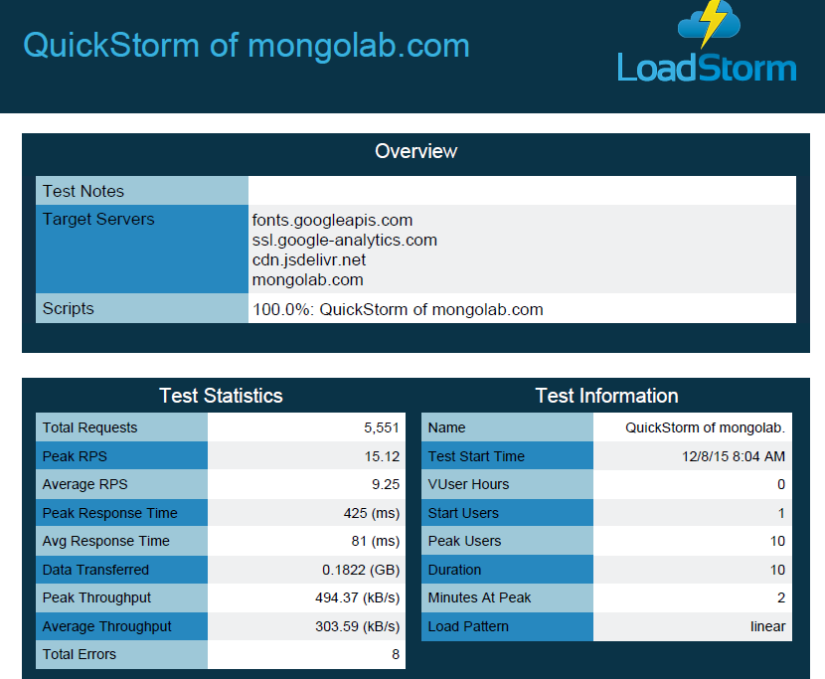
Retrieval Analysis of cloud database
Performance Analysis on requests sent to MongoLab Database was done using LoadStorm Tool and we used curl command to place the API calls.

Slide 14
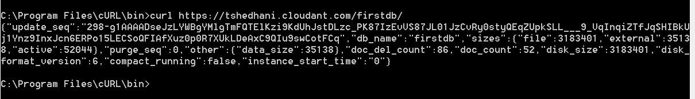
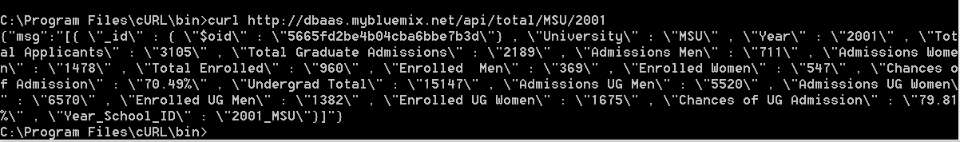

Slide 15
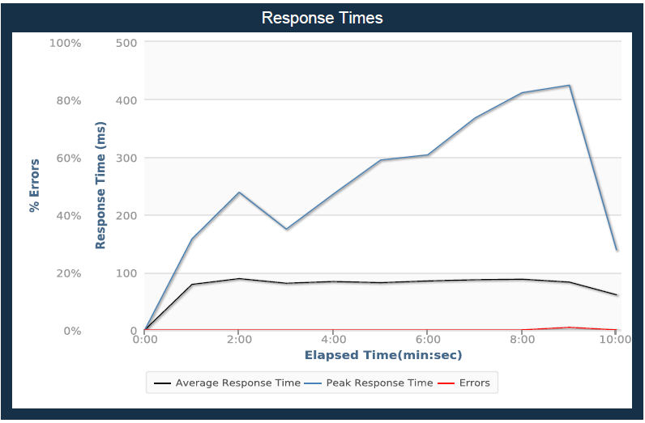

Slide 16
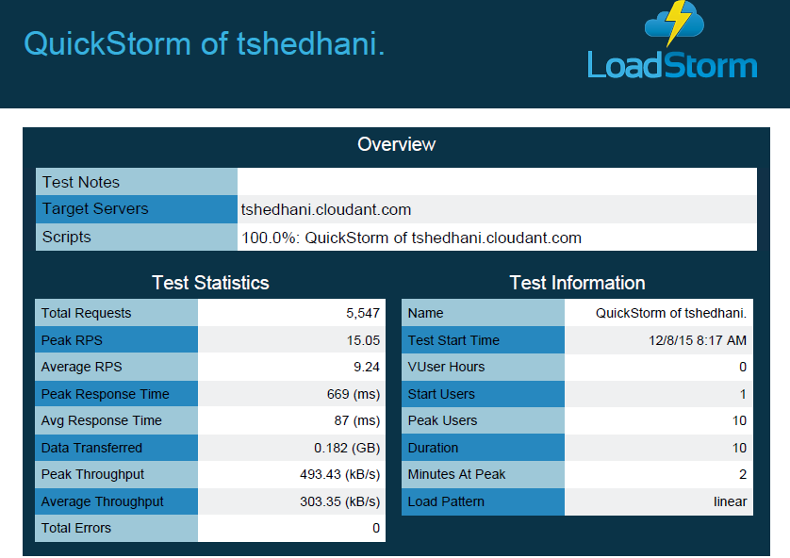
Performance Analysis on requests sent to Cloudant Database was done using LoadStorm Tool and we used curl command to place the API calls.

Slide 17
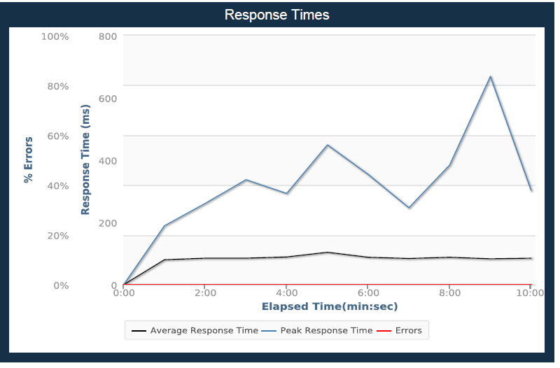

Slide 18


API as a Service

Slide 19
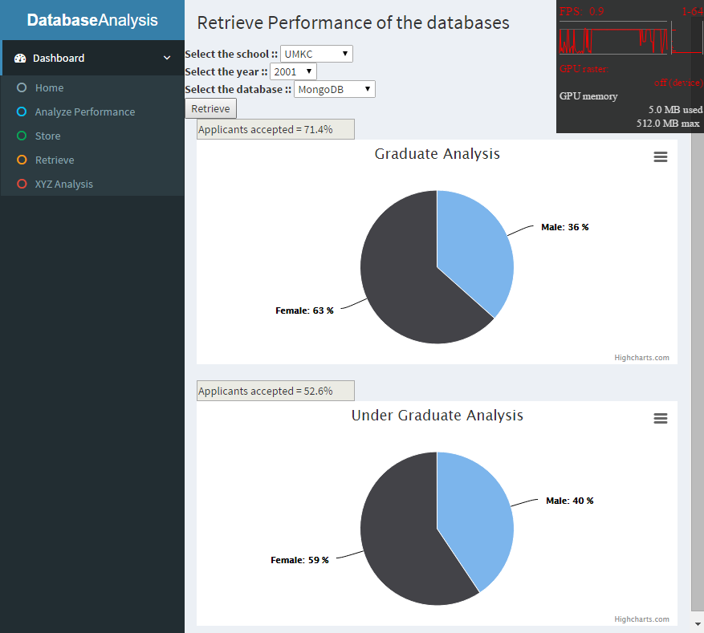
RETRIVE the data

Slide 20
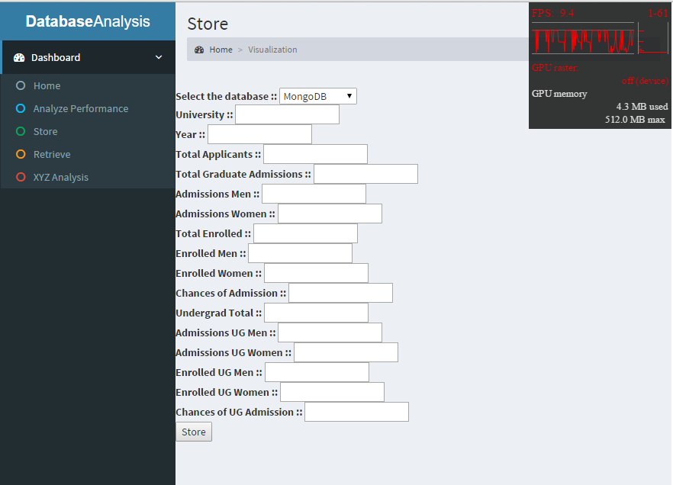
STORE the data

Slide 21
OBSERVATIONS :
It is observed that when the number of concurrent users is increased the peak response time also increases linearly and drastically indicating the LONGEST cycle during that time interval of the test.
Also we conclude that average response is a reflection of the speed of the web application being tested.
We also observe the graphs for Mongolab DB response time are more smoother comparatively while the graphs of Cloudant DB edges seems to be cut –off . This can be due to the differences in the underlying infrastructures.
Cloudant DB is slightly more available than MongoLab DB.
Throughput of both the DBs for over 5000 requests/10 minutes are approximately equal.
MongoDB is more cheaper than Cloudant DB.

Slide 22
Outcome of the project:
To compare the two databases on the basis of how fast the data can be stored and retrieved.
To create sample API’s to test the API service
To create end user side web application to access the database for friendly navigation within the cloud
To expand our database to include dataset from all the universities belonging to Missouri and Kansas state
Also to measure the over all performance (with respect to response time, throughput, no of concurrent users supported etc..) when we have a huge database
To ensure that end users are satisfied with the service provided

Slide 23
Differences between MongoLab and CloudAnt :
MongoLab
CloudAnt
Abrupt failures in the database service was observed
Cost is less expensive
Lesser reliability
Availability of the service is less
Replication/ Cloning of very huge amount of data needs higher versions
Low Latency for objects to retrieved
Failures were not observed
Cost is more expensive
High reliability
High Availability of database
Replication/Cloning can be done easily
Latency is higher compared to MongoLab

Slide 24
THANK YOU

