Slide 1
Lead Scoring Assignment
Amarnath Tangudu
Neetha K N

Slide 2

Agenda
Building a logistic regression model to assign a lead score between 0 and 100 to each of the leads which can be used by the company to target potential leads. A higher score would mean that the lead is hot, i.e. is most likely to convert whereas a lower score would mean that the lead is cold and will mostly not get converted.

Slide 3
Premise: Lead Scoring Assignment
An education company named X Education sells online courses to industry professionals. On any given day, many professionals who are interested in the courses land on their website and browse for courses.
X Education has appointed us to help them select the most promising leads, i.e. the leads that are most likely to convert into paying customers.
The model is built with a lead score to each of the leads such that the customers with higher lead score have a higher conversion chance and the customers with lower lead score have a lower conversion chance.
The CEO, in particular, has given a ballpark of the target lead conversion rate to be around 80%.

Slide 4
Dataset
Input files for the analysis includes:
Leads.csv file and Leads Data Dictionary.xlsx
Output expected:
A well commented Python file, which should be able to predict 80% of probability of conversion of the leads into students.
A word file answering all the questions asked by the company in the word document provided.
Summary report of the entire analysis.

Slide 5
Steps involved in building the model in Python
Import the required Libraries
Import the data set (Leads.csv)
Follow Exploratory Data Analysis by
Exploring the data set to see how many categorical and numerical variables present
Do the data cleaning by imputing ‘Null’ and ‘Select’ values with appropriate values
Treat the outliers
Dropped single value columns
Created dummy variables for categorical variables to help with Machine Learning
Model Building for Machine Learning
Split the model into Test and Train Datasets with 70:30 ratio
Standard Scaler is used to scale the numerical data
Build a logistic regression model
RFE is used to reduce number of variables (reduced to 15 variables)
Check the VIF and p values and reduce the variable if VIF>5 or p>0.05
Rerun the model after above step (Left with 13 variables)
Once model is ready, check the AUC (Area Under The Curve)-ROC (Receiver Operating Characteristics) curve. Higher the AUC, better the model is at predicting 0s as 0s and 1s as 1s.
Next step is to Make Predictions on the test set
The accuracy, sensitivity and specificity of the model is checked using Confusion matrix.

Slide 6
Data Exploration steps followed in the model
Using functions like .head(), .describe() and .info() to know about the dataset.
Null values imputed with mean, median or mode. ‘Select’ and ‘Null’ values tagged as ‘Other’ as the higher number rows were falling in this category.
Outliers were treated with IQR method
Using pd.get_dummies, dummy variables for categorical varibles is done in one go.

Slide 7
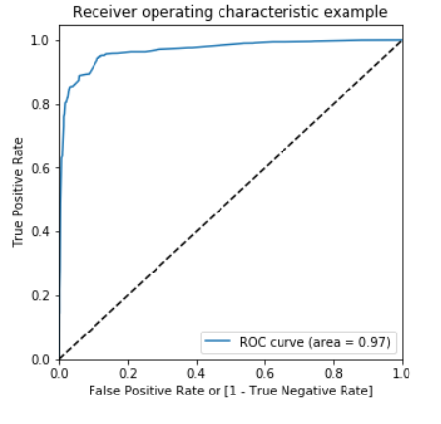
AUC-ROC Curve
As Area Under The Curve is high, probability of predicting 0s as 0s and 1s as 1s is also high

Slide 8
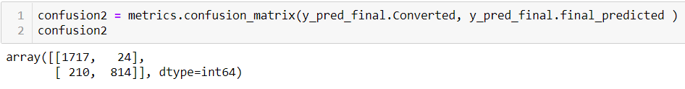
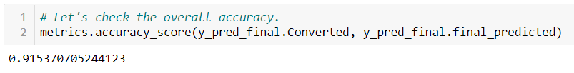


Confusion Matrix
Confusion matrix is:
Accuracy of the model is 91.53%
Sensitivity is 79.49%
Specificity is 98.6%

Slide 9
Conclusion
As the model is meeting the criteria of predicting 80% of the conversion leads into students, model can be effectively used for the prediction.

Slide 10
Recommendations
As the model predicts high probability of conversion with the lead score ranging between 0 to 100 and 100 is the high probability, these candidates should be given top most priority and contact them based on the lead score. Try to contact people with score of 50 to 100 in the initial levels and rest later.

