Slide 1


AUDITING IN ECATALOG
Amarnath

Slide 2
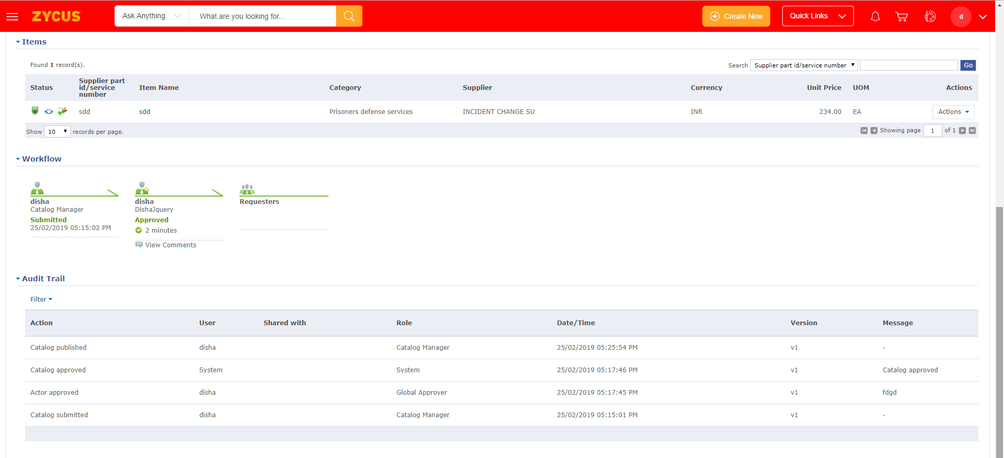
AUDIT TRAIL IN A CATALOG

Slide 3


WHAT IS THERE IN THE AUDIT TRAIL???
When any events are occurred for an entity, they are captured.
What event was occurred.
Who did it.
What is the role of the user who did it.
When did the event occur.
For which version did the event occur.
Comments/messages during the event occurance.

Slide 4

WHERE IS THE DATA STORED???
Data is stored in ENTITY_AUDIT_TRAIL Table.

Slide 5

Thank You!!!

