Slide 1


Avishek Pal, Ph.D.
Senior Data Scientist
Microsoft
Introduction to Python

Slide 2
Outline
Introduction to Programming
Python as a Programming Language
Getting Started – Anaconda Installation
Basics of Python (covered in Jupyter notebook)

Slide 3
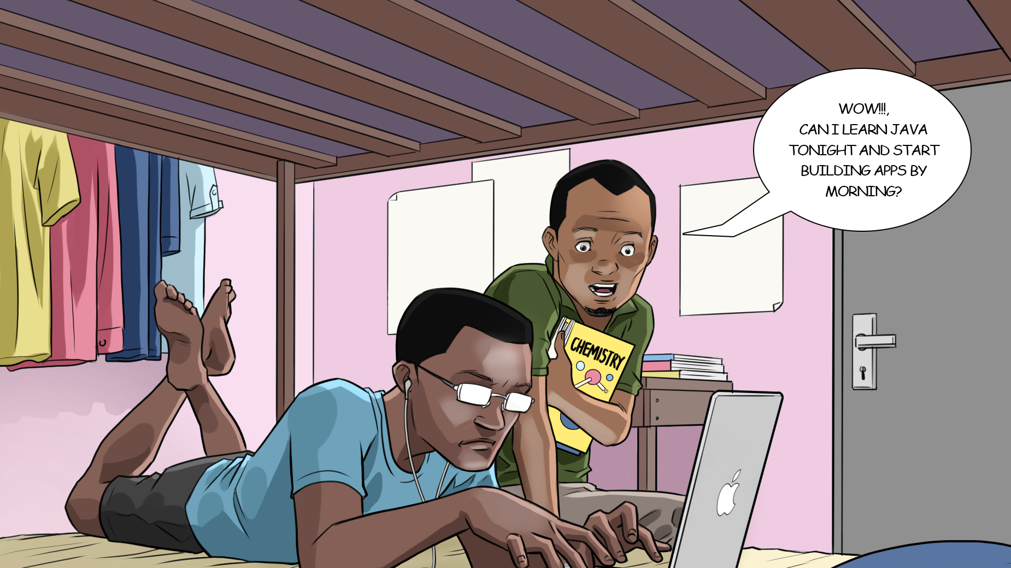
Programming = Making money!!

Slide 4
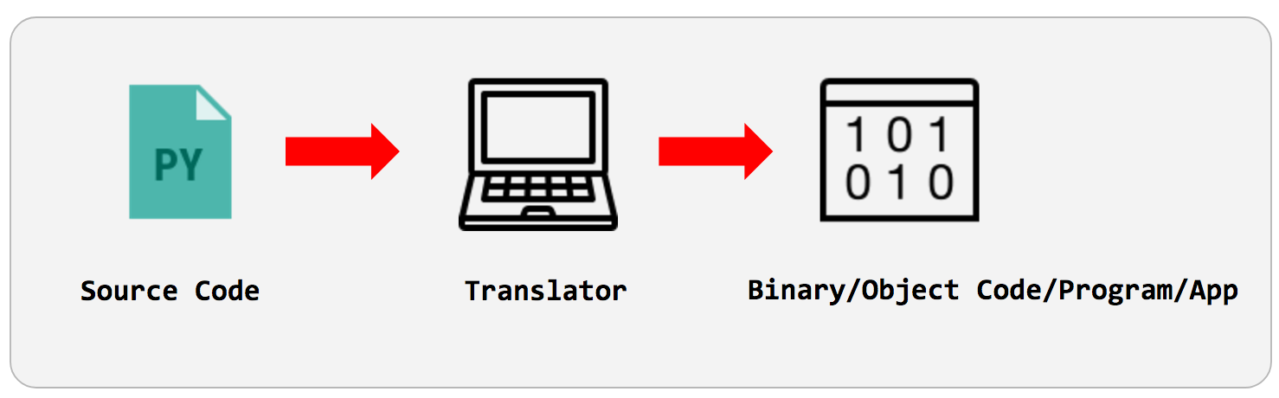
Programs (Code) = Building Blocks of Software

Slide 5
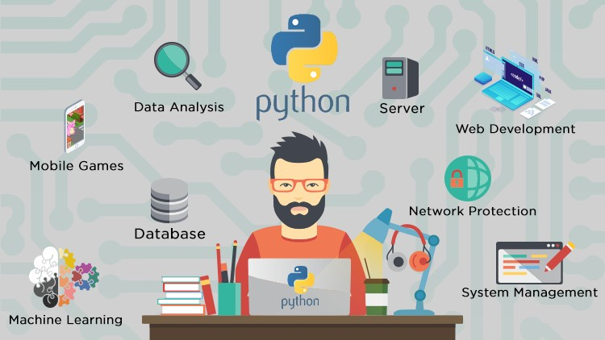
Programming in Python

Slide 6
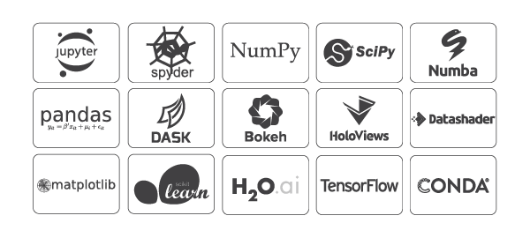

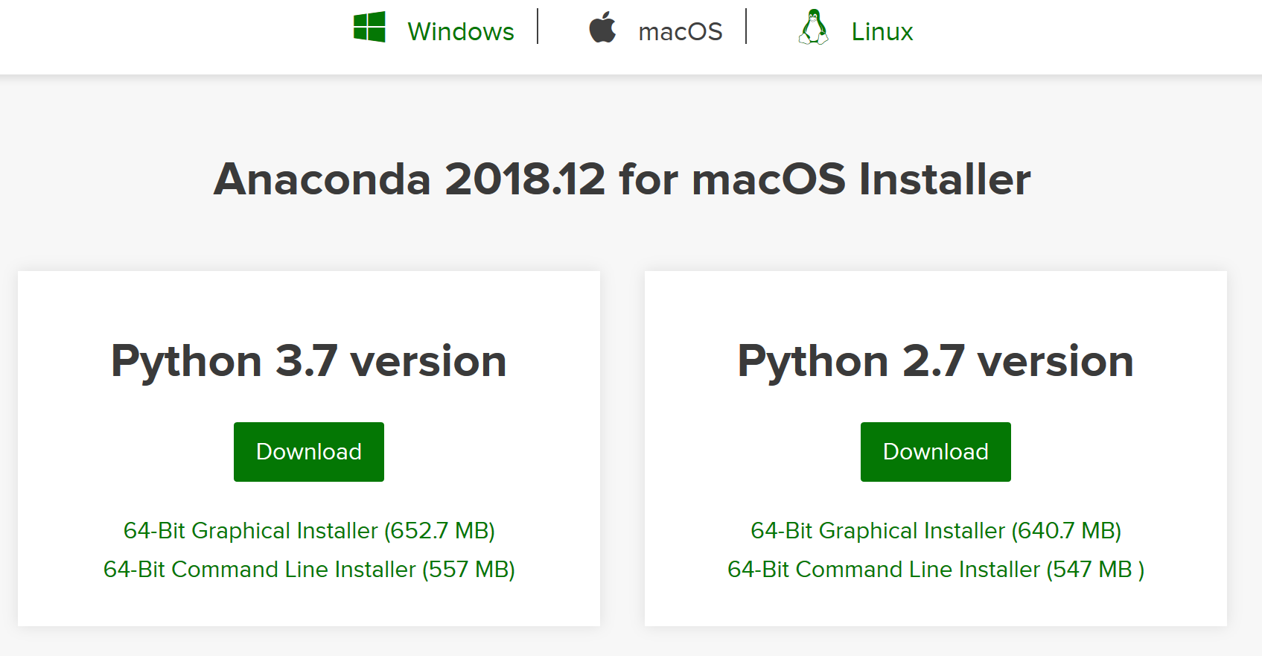
Getting Started in Python – Anaconda Installation

