Slide 1

HEALTH MANAGEMENT SYSTEM

Slide 2

CIMAGE GROUP OF INSTITUTIONS
Guided By: Presented By:
Prof. NEERAJ SIR AMARPAL,JITESH,ROHIT,
ABHISHEK

Slide 3

DEVELOPERS
AMARPAL,JITESH,ROHIT,
ABHISHEK

Slide 4
OVER VIEW
Health management system is a project which aims in developing a computerized system to maintain all the daily work of hospital.
It has a facility of admin login through which the admin can monitor the whole system .
Admin modules are manage patients , manage doctor s, and manage appointments.
Overall this project of ours is being developed to help , maintain the hospital management in the best way possible and also reduce the human efforts.

Slide 5
MODULES
MANAGE PATIENTS(ADD , VIEW , REMOVE, EDIT)
MANAGE DOCTORS
MANAGE APPOINTMENTS

Slide 6
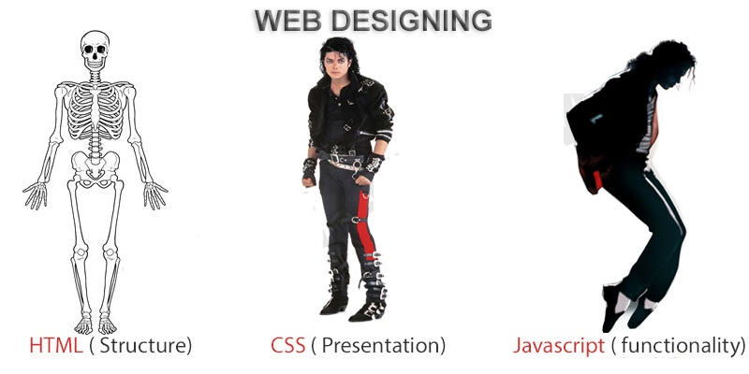
FRONTEND (LANGUAGE USED)
HTML (HYPERTEXT MARKUP LANGUAGE)
CSS (CASCADING STYLE SHEET)
BOOTSTRAP (FRAMEWORK OF CSS AND JS)

Slide 7

BackEnd Technologies Used
PHP(Hypertext Preprocessor)(Server Side Language)
MYSQL(Database)

Slide 8
SOFTWARE USED
XAMPP(Apache Mysql Php)
VSCODE OR ANY OTHER TEXT EDITOR
CHROME OR ANY OTHER BROWSER

Slide 9
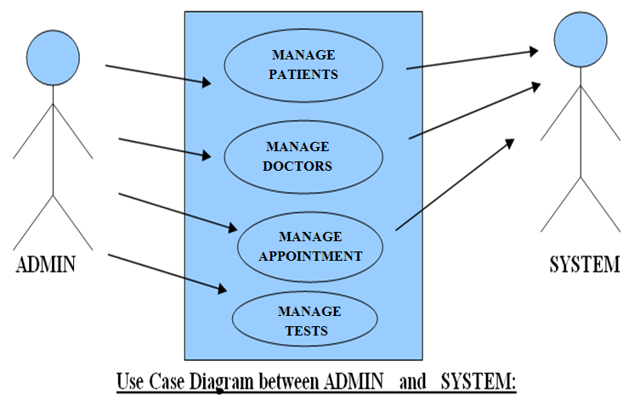

Slide 10
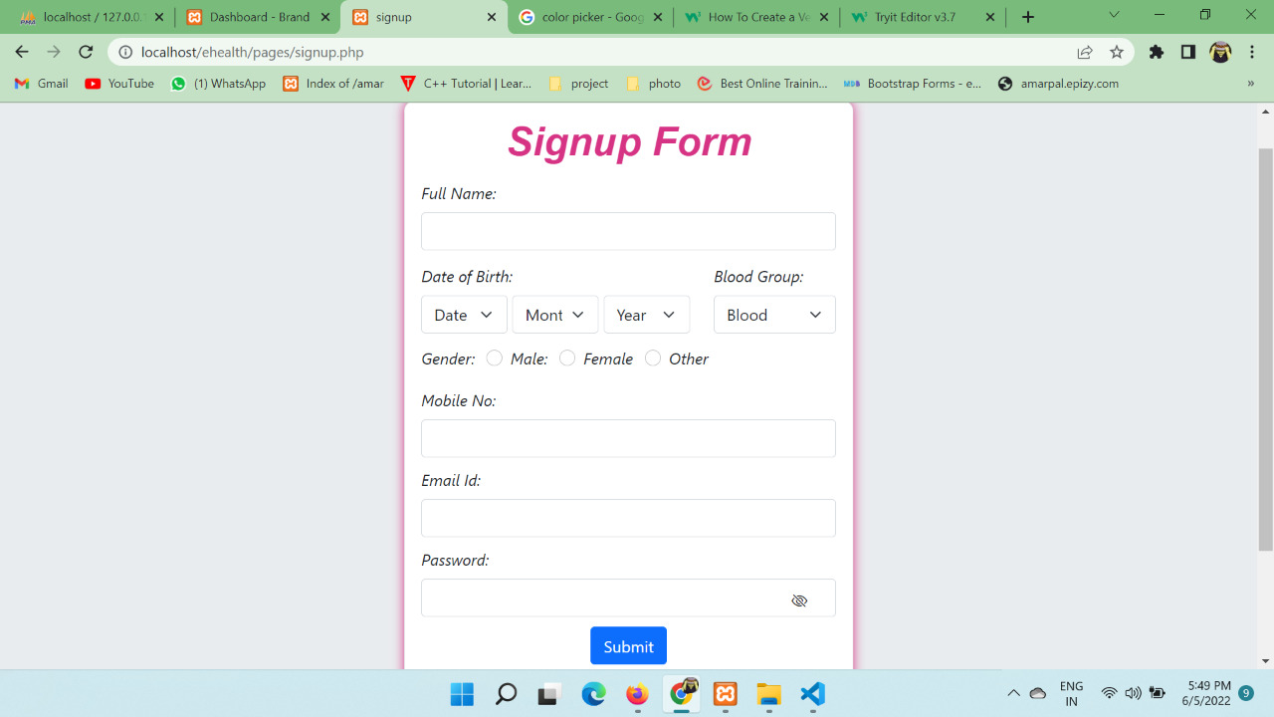
SIGNUP FORM

Slide 11
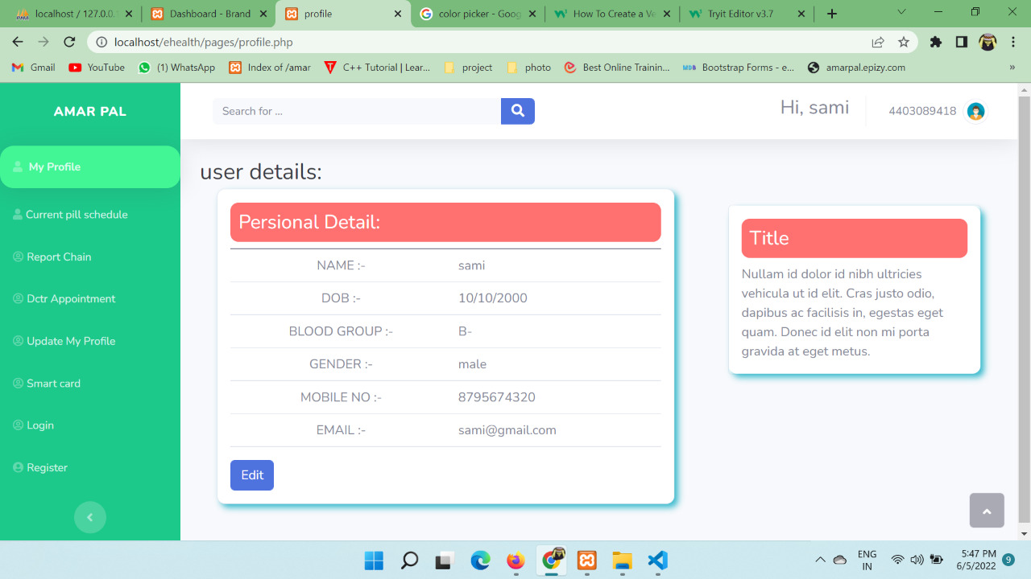
USER DASHBORD

Slide 12
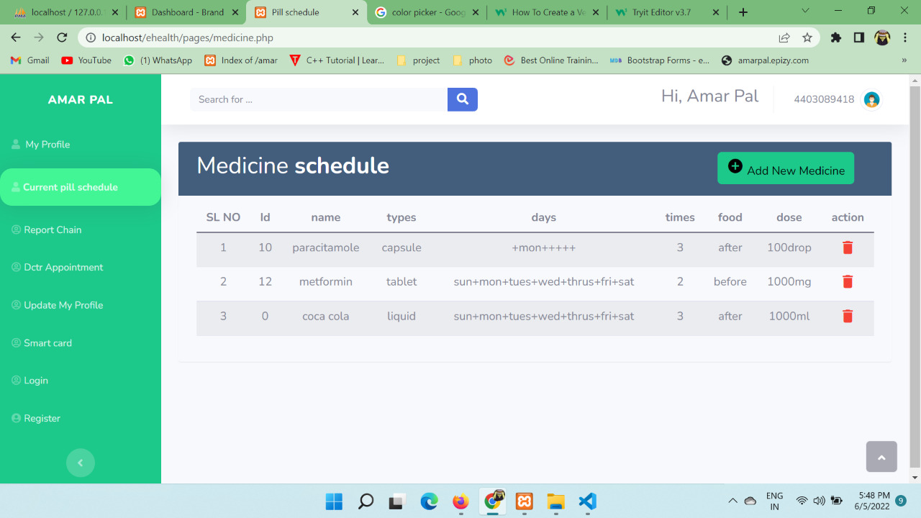
MEDICINE SCHEDULE

Slide 13
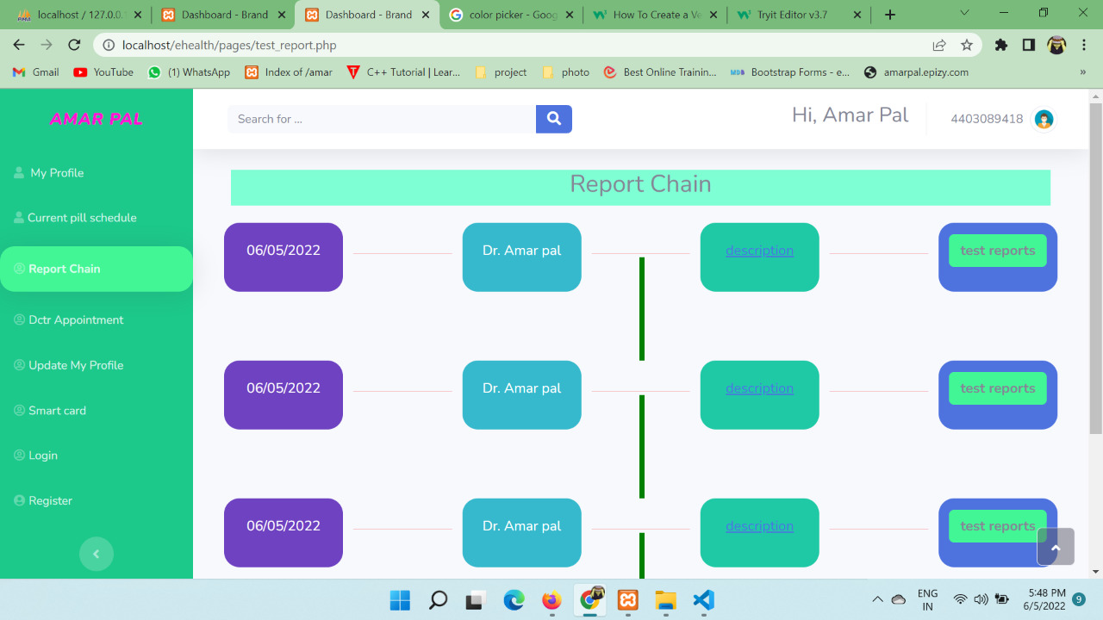
REPORT CHAIN

Slide 14
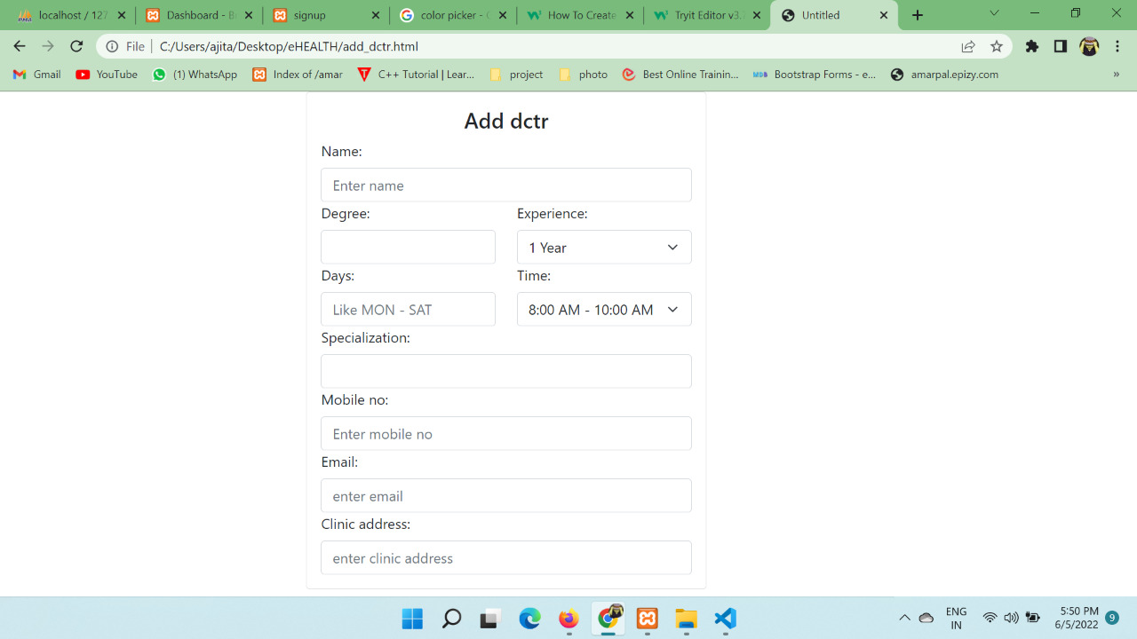
ADD DOCTOR

Slide 15
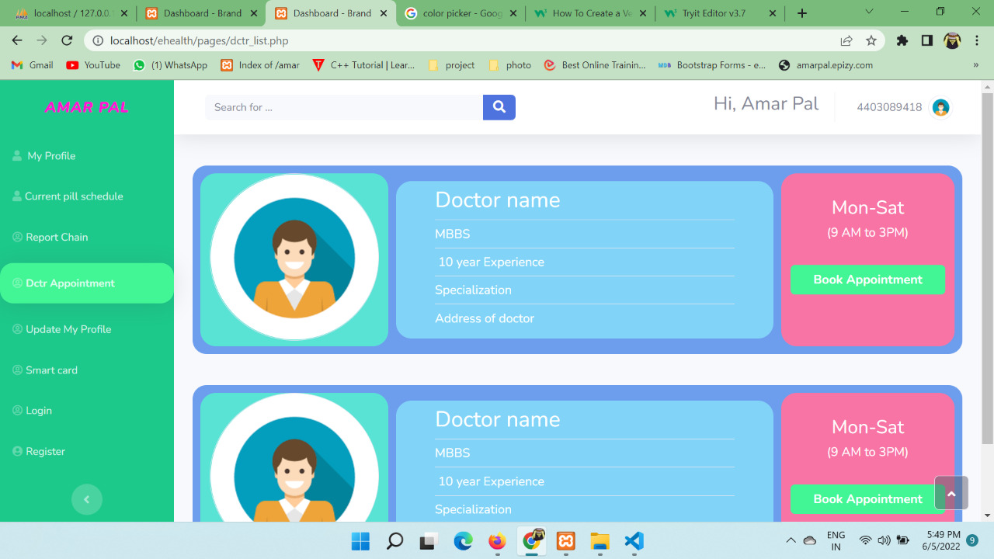
VIEW DOCTOR

Slide 16
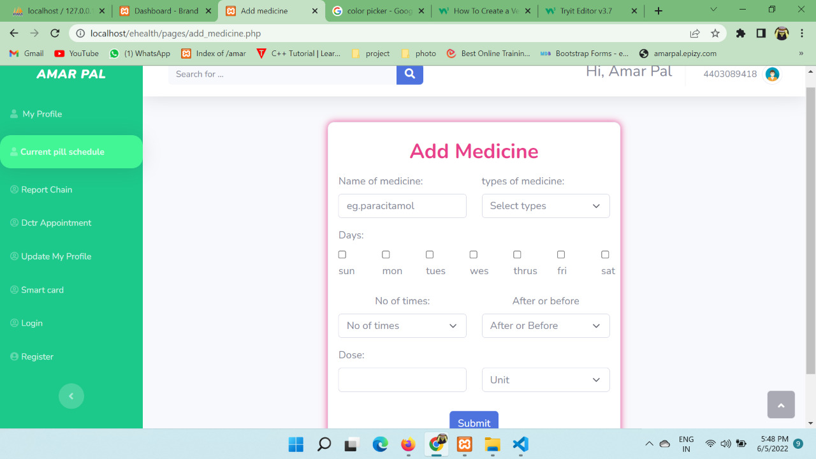
ADD MEDICINE

Slide 17
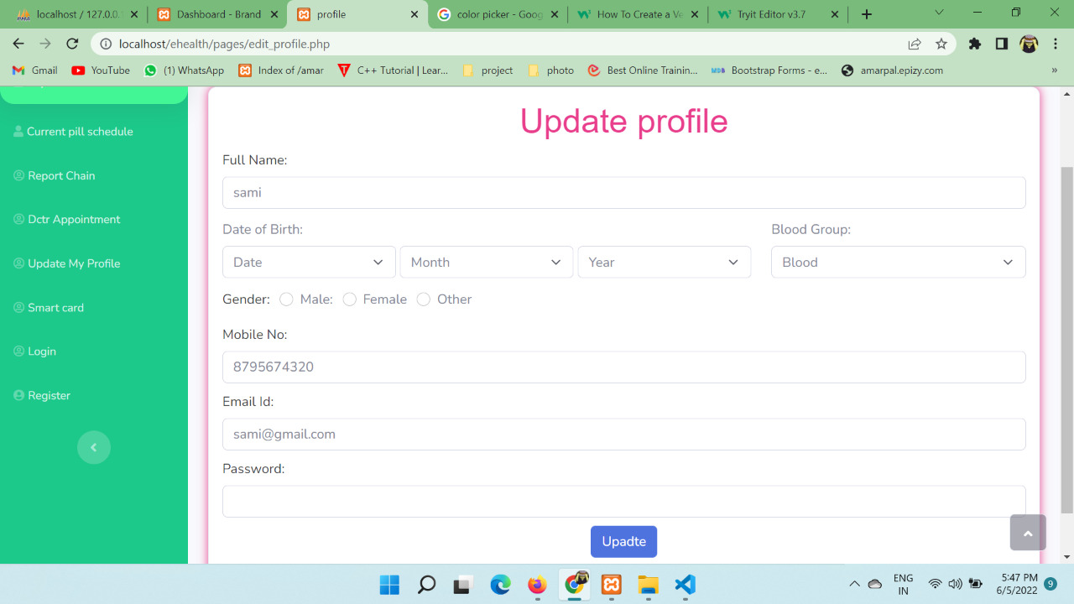
UPDATE PROFILE

Slide 18
CONCLUSION & FUTURE SCOPE
FUTURE SCOPE
This web application involves almost all the features of the hospital management. The future implementation will be online help for the patients and chatting with website administrator.
CONCLUSION
The project entitled “Health Management System” is developed using HTML , CSS and BOOTSTRAP as front end and PHP language and Mysql database in back end to computerize the process of health management. This project covers only the basic features required.

Slide 19
THANKYOU

