Slide 1
READMISSION ANALYSIS OF DIABETES PATIENT
IE 7300: STATISTICAL LEARNING FOR ENGINEERING
FINAL PROJECT
GROUP 8:
Anshita Aishwarya
Amar Sai Kiran Poosarla
Bijin Rao
Manoj Kondlay

Slide 2
Introduction
Diabetes is one of major chronic disease which results readmission due to poor control measures. Also, it is a severe chronic disease where a person suffers from an extended level of blood glucose in the body. Around 7% of the population worldwide are suffering with Diabetes. Therefore, it is very important to control readmission of diabetes patient.
This dataset has been obtained from the following UCI Machine Learning Repository: https://archive.ics.uci.edu/ml/datasets/Diabetes+130-US+hospitals+for+years+1999-2008
It contains data of over 130 US hospitals and delivery networks of 10 consecutive years from 1999 to 2008.
We will use all of these diverse features with valuable and heterogeneous data about the patients and Machine Learning models to predict whether the diabetic patient is readmitted or not.

Slide 3
Problem Definition
The term ‘Hospital Readmission’ refers to when a patient discharged from a hospital has to be re-admitted within a certain time interval. The patients hospitalized with diabetes have a higher risk of being readmitted than the ones who weren’t hospitalized.
This is classification problem as patients are classified into two groups i.e., readmitted in less than 30 days (“<30”), readmitted in more than 30 days (“>30”) and not readmitted (“No”).
Here the class of interest is patients who are readmitted (“<30” or “>30”) in order to identify and reduce the risk of readmission.

Slide 4
Data Description
Dataset consists of more than 50 features and 100K records of patients. The dataset has 13 numerical columns 37 categorical columns.
It contains several features like race, age, patient id, lab test performed, gender, emergency visits, medication details etc. which affect the patient and hospital outcomes.
There are 24 features for indicating medications such as metformin, insulin, Nateglinide, chlorpropamide, etc. which indicate whether the drug was prescribed or there was a change in the dosage.
The target column 'readmitted' tells us whether the patient was readmitted or not. This column has 3 different values
- <30 (Readmitted in less than three days)
- >30 (Readmitted in more than three days)
- No (Not readmitted)

Slide 5
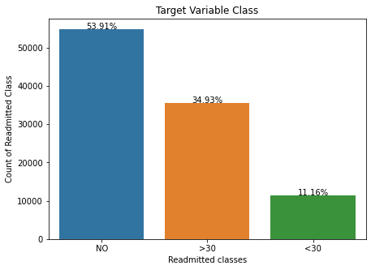
Exploratory Analysis
It is an essential step before we start building models. This analysis further aids us in the process of data cleaning and processing.
We observe that there is a lot of imbalances in the target variable classes. We know that the class >30 signifies that the patient was readmitted in more than 30 days and <30 signifies that the patient was readmitted in less than 30 days.
Therefore, we combine these 2 classes and call it class 1 (patient was readmitted). On the other hand, class ‘No’ means that the patient was not readmitted at all, and we call it class 0 (patient was not readmitted).

Slide 6
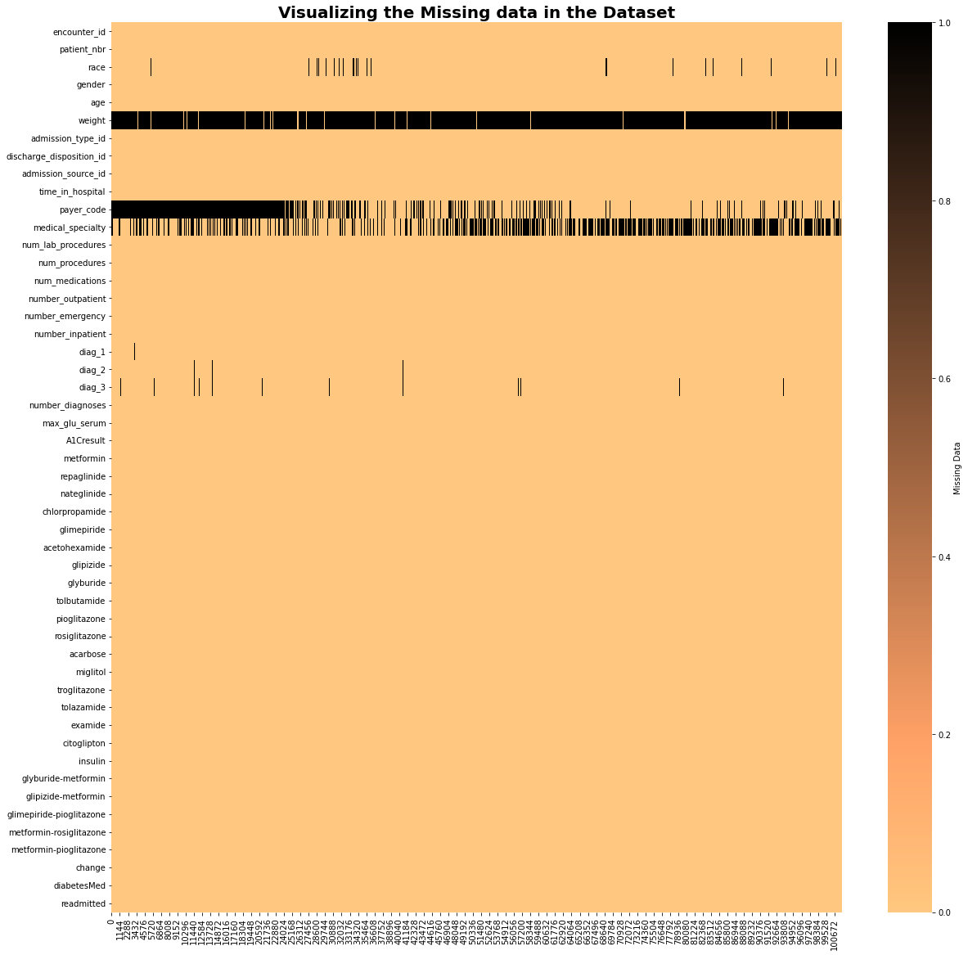
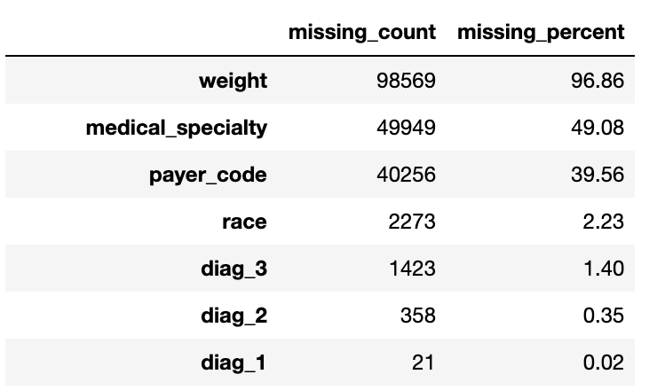
Data Cleaning and Processing: Missing Values
Having missing data can lead to discrepancies during analysis, thus we either try to impute them or drop the columns that have more than 90% missing data.
We observe that the weight column has more than 95% missing data and medical specialty has almost 50% missing data. Hence, we drop these 2 columns.

Slide 7
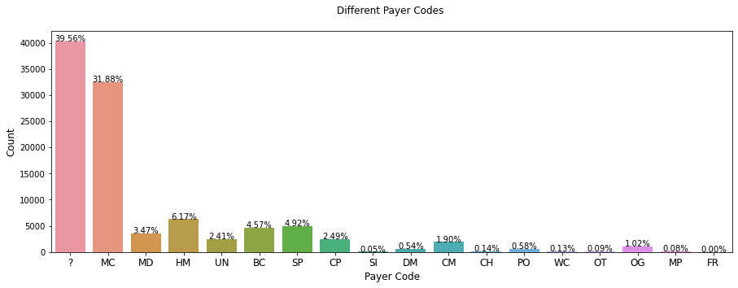
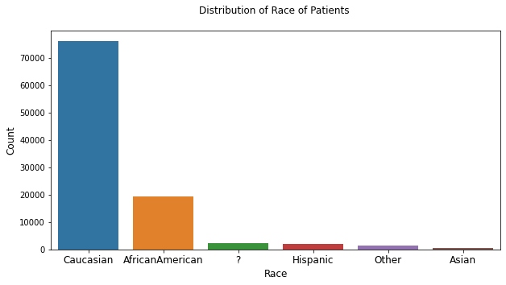
Data Cleaning and Processing: Missing Values
Payer code is an identifier corresponding to 23 distinct values, for example, Blue Cross/Blue Shield, Medicare, Self-pay.
We observe that each of the categories account for less than 35% of total and almost 40% of the data is missing. Hence, we drop this column as well.
A small portion of ‘race’ column has missing data. Therefore, we impute the column and set the unknown values ‘?’ as ‘Other’ category

Slide 8
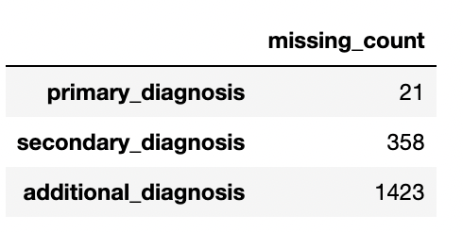
Data Cleaning and Processing: Missing Values
The diagnosis columns ‘primary_diagnosis’, ‘secondary_diagnosis’ and ‘additional_diagnosis’. These columns correspond to the primary diagnosis, secondary diagnosis and additional secondary diagnosis. These columns have been coded as first three digits of ICD9.
The primary diagnosis contains 848 distinct values, the secondary diagnosis has 923 distinct values whereas additional secondary diagnosis has 954 distinct values.
The number of missing values in these 3 columns is considerably very small as compared to the number of rows in our dataset. Hence, we drop the rows containing missing values in these columns.

Slide 9
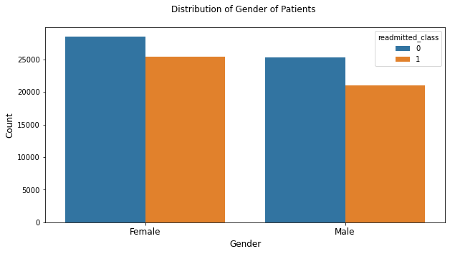
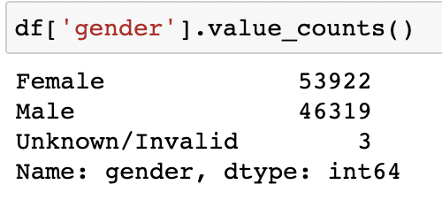
Data Cleaning and Processing: Missing Values
The ‘gender’ column is identified by 3 different categories i.e., Male, Female, Unknown/Invalid.
The number of records with the ‘Unknown/Invalid’ category are extremely small as compared to the 2 other categories, Hence, we drop the 3 rows containing this value.

Slide 10
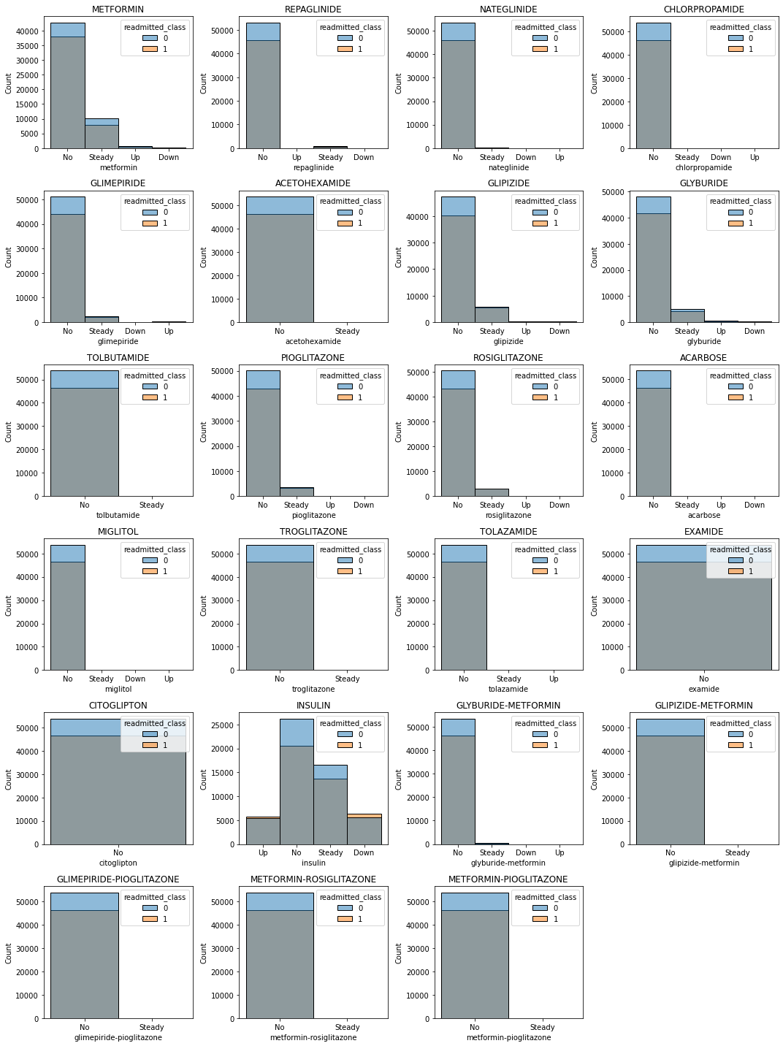
Data Cleaning and Processing:
Dimension Reduction

Slide 11
Data Cleaning and Processing:
Dimension Reduction
OBSERVATION
From the previous histogram plot of these features, we can observe that
‘acetohexamide’ - ‘examide’
‘tolbutamide’ - ‘citoglipton’
‘troglitazone’ - ‘glipizide-metformin’
‘tolazamide’. - ‘glimepiride-pioglitazone’
‘metformin-rosiglitazone’ - ‘metformin-pioglitazone’
These columns mostly have patients who were never readmitted and very less values for the success class. Hence, we drop these columns.

Slide 12
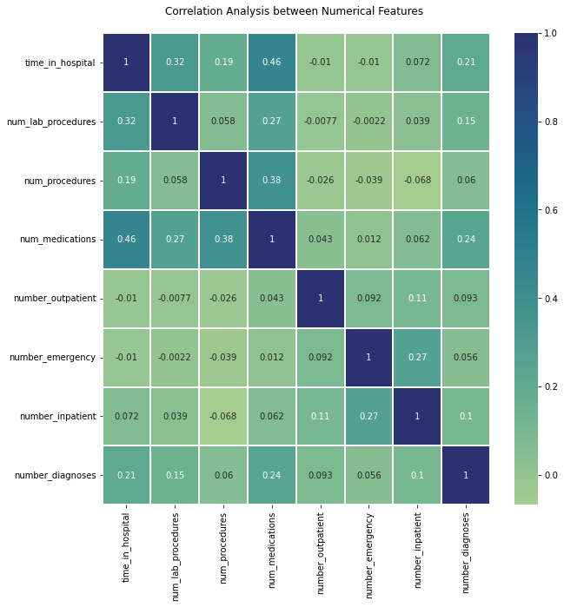
Correlation Analysis
OBSERVATIONS
The highest correlation is between time in hospital and num medication with 0.46.
We do not see any high correlation between any 2 features. Hence, we retain all the columns.

Slide 13
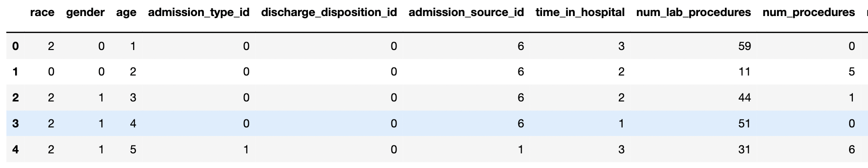
Data Encoding
Since, we are dealing with categorical columns in our dataset, we map these unique values into numerical values as few Machine Learning models can only deal with numeric data.
All of the categorical columns present in our dataset have ordinal categories i.e., they do not have any particular order.
In this case, we have used Label encoding for the categorical columns.

Slide 14
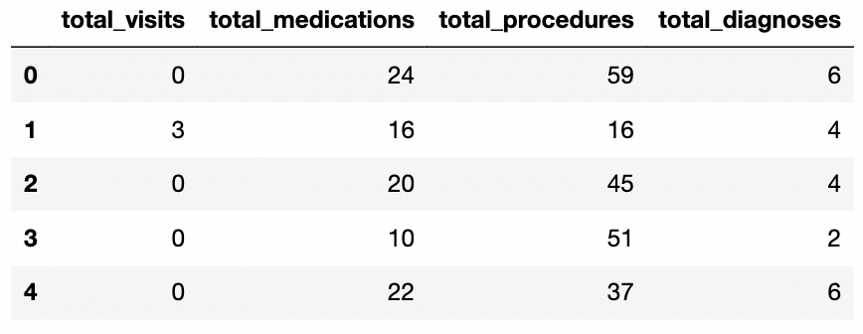
Feature Engineering
In our project we have used Feature engineering technique to come up with new columns that includes:
1. Total hospital visits = number of outpatient visits + number of emergency visits + number of inpatient visits
2. Total medications = number of medications given + number of diagnoses
3. Total procedures completed = number of lab procedures + number of other procedures
4. Total diagnoses = number of diagnoses + number of inpatient visits

Slide 15
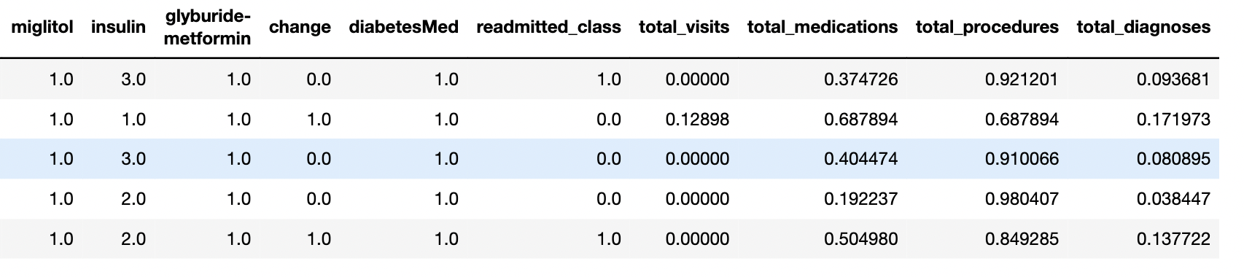
Data Scaling/Normalization
The goal of this step is to bring all the features to a similar scale as it is an important step since in ensuring equal consideration of all the feature.
Thus, improving the numerical stability of our model. It may also speed up the training process. We have used sklearn's normalize function to scale our dataset.

Slide 16
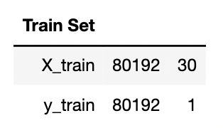
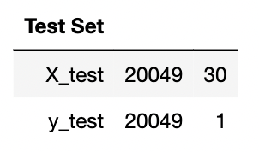
Data Partitioning/Splitting
Data partitioning or data splitting is the process of dividing the dataset into 2 or more parts, typically to train the model on one part and validate on the other.
This step is performed to avoid overfitting. Data should be split in a way that we have more data for the training purpose.
In our case, we have performed an 80-20 split for creating train and test sets.

Slide 17
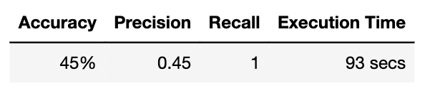
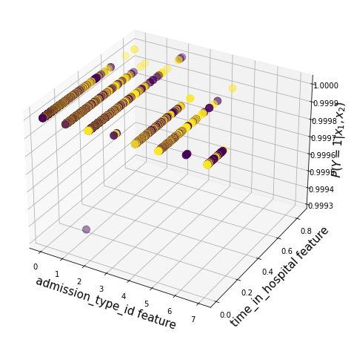
Model Implementation: Logistic Regression
This our base model because it can interpret the model coefficients as indicators of feature importance, it performs well when the dataset is linearly separable.
In this case, we have used logistic regression using gradient descent with a maximum number of iterations as 10000. For the model training, we have used the values of Learning Rate as 0.0000001 and Tolerance as 0.0000001.
This resulted in achieving an accuracy of 45%, precision of 0.45.

Slide 18
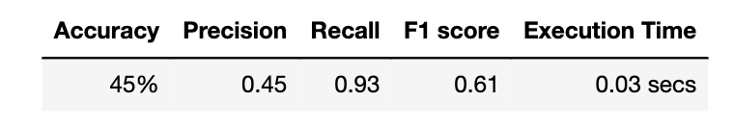
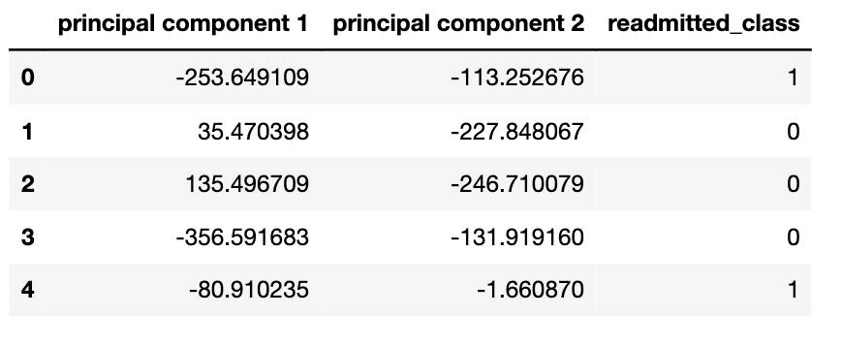
Model Implementation: Naïve Bayes with PCA
We have used this classification method, since it is fast and efficient while giving accurate results even for large datasets. We have also applied Laplace smoothing that handles the problem of zero probability in the Naive Bayes model.
We used PCA as there were 30 features and see if the model performs any better than our base model. After performing PCA, we consider the first 2 components which covers 99% (53% and 46% of components 1 and 2 respectively) of the variance of the dataset.

Slide 19
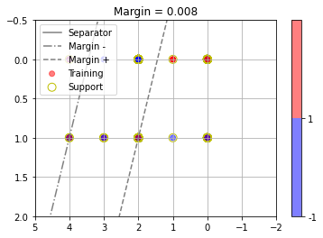
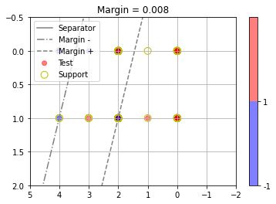
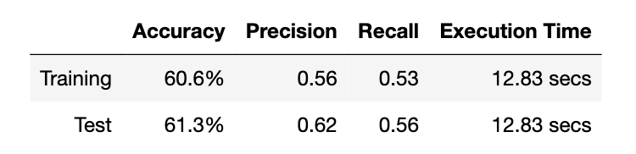
Model Implementation: SVM
For SVM the computation time and complexity increases with the number of rows in the dataset, therefore in our case, we have used a sampled dataset of 500 records.
The decision boundary line is plotted by predicting the target variable class on both the training set and test.
Even though, SVM is performing the best out of all the 3 models that we have explored, however the computation time is higher. Even when we sampled the dataset to 500 records, the time taken by SVM is around 13 seconds. If we take the complete dataset (~100k records), then the computation time would be much higher. This is not ideal.

Slide 20
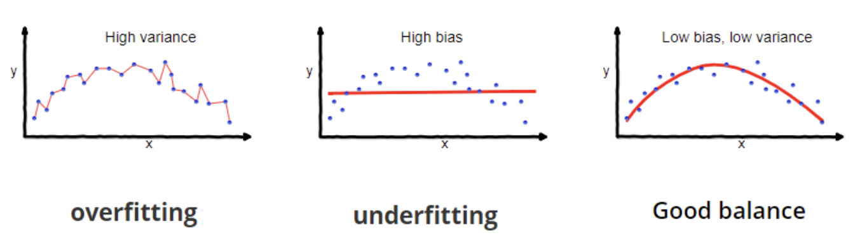
Bias-Variance Trade-Off
In our chosen model that is, Logistic Regression, we have calculated the bias and variance of the model as follows:
- Bias: 0.54
- Variance: 0.54
We observe that there is a proper balance between the 2 values, hence the model we have chosen is neither overfitting nor underfitting.

Slide 21
Conclusion
For the classification problem, we have used the Logistic Regression Model as the base model and considering the following factors, we have chosen this as the best performing model on our dataset:
The algorithm is efficient and takes only about 93 seconds to provide the results for over 100k records.
It has been able to accurately predict the new data (test data) with a recall score of 0.92.

Slide 22
Thank You

