Slide 1
Perspektiv
An Image Camouflaging Tool using Thayer Counter Shading

Slide 2
The Basis Behind the Project
The idea for this project is based on the paintings of Abbott Handerson Thayer. Abbott Handerson Thayer (August 12, 1849 – May 29, 1921) was an American artist, naturalist and teacher. As a painter of portraits, figures, animals and landscapes, he enjoyed a certain prominence during his lifetime, and his paintings are represented in the major American art collections. He is perhaps best known for his 'angel' paintings, some of which use his children as models.

Slide 3
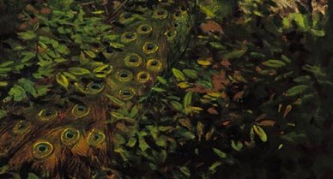

Slide 4
What is Counter Shading?
Countershading, or Thayer's Law, is a method of camouflage in which an animal's coloration is darker on the upper side and lighter on the underside of the body.
When light falls from above on a uniformly coloured three-dimensional object such as a sphere, it makes the upper side appear lighter and the underside darker, grading from one to the other. This pattern of light and shade makes the object appear solid, and therefore easier to detect.

Slide 5
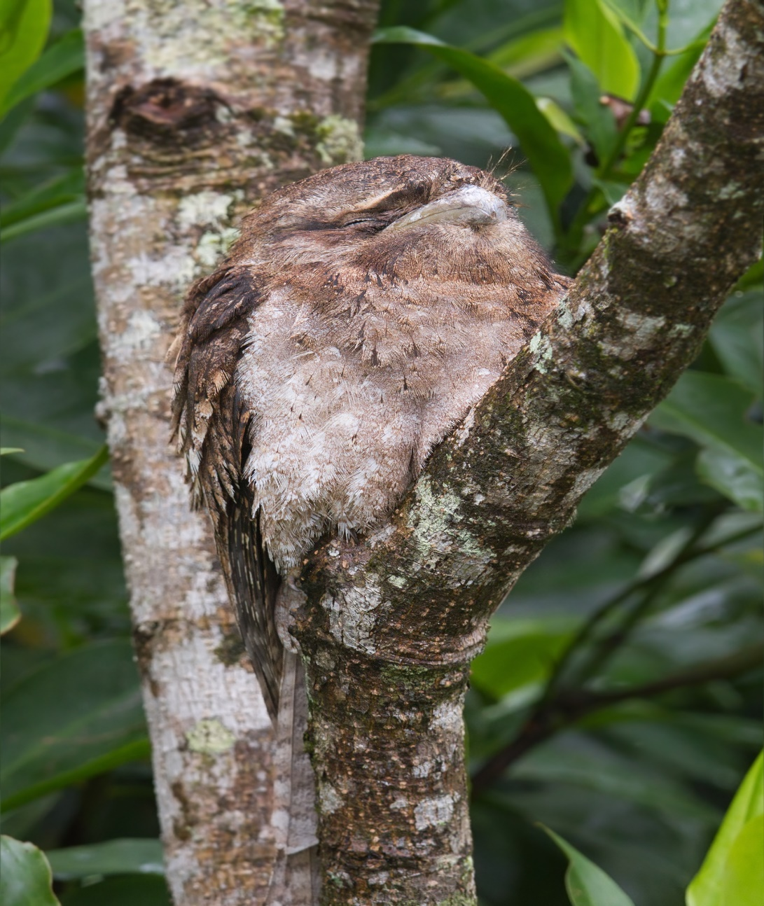

Slide 6
Description
We are attempting to make a software that will take a image and hide the main object of the image in the background of the image. The real image can be obtained using an encryption key which will be known, only by the sender and receiver.
We are using counter shading technique to match the intensities of the pixels in the image. An image will be disintegrated into a large number of pixels. Each pixel has 4 bytes containing the RGBA values (Red, Green, Blue and Alpha). We are interested in the value of A, for all the pixels. We will run an iteration operation to find the Alpha values of all the pixels, find the average value and then change the Alpha values of all the pixels to this average value. By doing so, the intensities of all the pixels will be the same and hence the object of the image will be hidden in the image itself.

Slide 7
What will this be for a User?
From the user’s perspective, this software will be an image encryption software or a camouflage software. It will have a minimalistic user interface. This project has mainly been designed for communication of images between defence personnel. But it can also be used as an image encryption software. The user will just have to load an image to the software and he will get a camouflaged or encrypted image.

Slide 8
How it works?
Choose an image.
Upload the image to the software.
The algorithm will extract the value of each and every pixel.
Each pixel will have 4 values-RGBA(Red, Blue, Green and Alpha)
All these values are separately stored in an array and their average is computed.
The average values are reloaded back to each pixel.
This will result in the object being camouflaged in the background.
This change can be observed by looking at the histogram of the original and the final image.

Slide 9
What has been done so far…
We have managed to build a proper algorithm for extracting the pixel values from an image.
We have removed the format constraints for the image.
We can successfully extract and separate each value(i.e. Alpha, Red, Green and Blue) for each pixel.
We can also compute the average value that has to be reloaded into each pixel.

Slide 10
What needs to be done…
The average value computation algorithm is not very efficient. It takes a very long time to compute the values. This needs to be optimized.
The average values have to be reloaded to each pixel in the image.
This will need a separate algorithm to be developed.
The resultant image must be displayed along with the histogram of the original and camouflaged image.

Slide 11
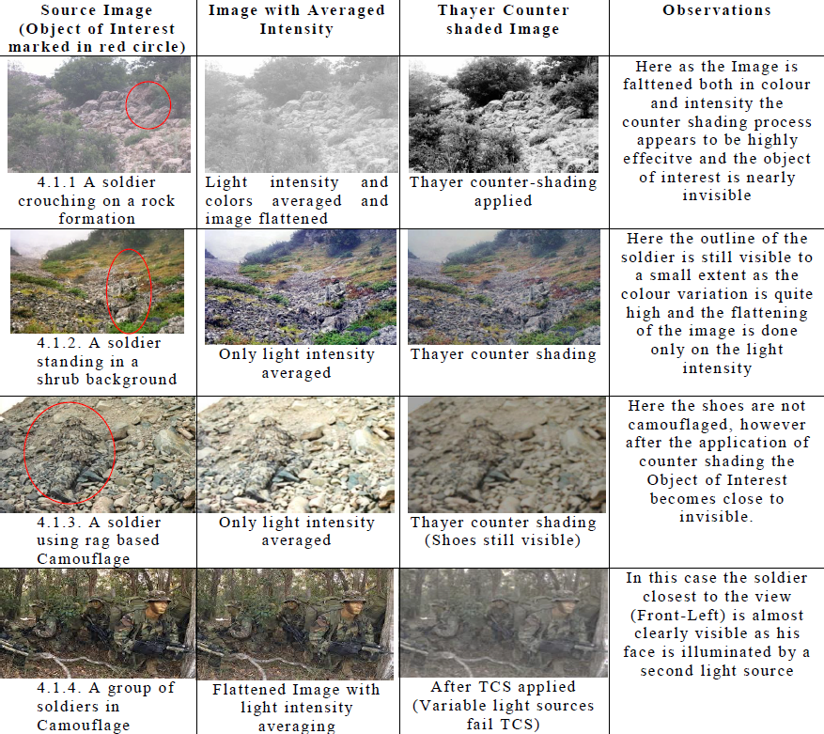

Slide 12
Future Scope
This software is mainly being developed for communication of images between defence personnel.
However, it can also be used by common users as an encrypted image communication software.
We can add an encryption element to this software and it can be used for secure communication.

Slide 13
Thank You!

