Slide 1
VAPT PRACTICAL
Week 5 – Cyber Security Internship
Nmap • Nikto • Burp Suite
Submitted by: Amar Pratap
DG Interns Hub
Authorized lab target: testphp.vulnweb.com

Slide 2
INDEX / CONTENTS
Week 5 – Vulnerability Assessment & Penetration Testing (VAPT)
01
Overview & Objectives
Introduction, scope and practical workflow
02
Nmap – Version & SYN Scan
Nmap verification and host/port discovery
03
Nmap – Service & Aggressive Scan
Service/version detection and OS detection attempt
04
Nikto – Web Assessment
Nikto setup, connectivity checks and limitations
05
Burp Suite – HTTP Interception
Capturing HTTP requests through Proxy
06
Burp Suite – Request Inspection
Inspecting artists.php request and headers
07
Burp Suite – Additional Request
Inspecting categories.php request
08
Burp Suite – HTTP History
Reviewing captured requests
09
Findings & Interpretation
Evidence-based observations
10
Challenges, Learning & Conclusion
What was learned and completed tasks
Submitted by: Amar Pratap • DG Interns Hub • Cyber Security Internship

Slide 3
1. Week 5 – VAPT Practical Overview
Hands-on evidence from the authorized internship lab
• Reconnaissance and service discovery with Nmap.
• Web-server assessment attempt with Nikto.
• HTTP request interception and inspection with Burp Suite.
• Evidence-based interpretation of tool results.
• Real screenshots from the Kali Linux / Burp practical are included.
Nmap
Host, port & service discovery
Nikto
Web-server assessment
Burp Suite
HTTP interception & history
DG Interns Hub | Cyber Security Internship | Week 5 – VAPT | 2

Slide 4
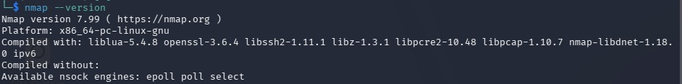
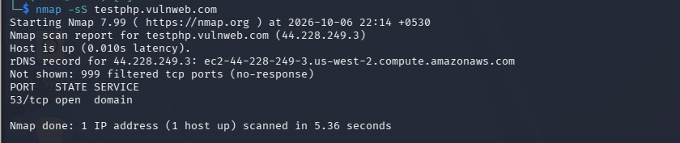
2. Nmap – Version & SYN Scan
Real terminal evidence
Nmap 7.99 version verification
nmap -sS testphp.vulnweb.com
• Nmap 7.99 was installed and working in Kali Linux.
• The host was detected as up.
• 53/tcp was reported open; many other TCP ports showed no response.
DG Interns Hub | Cyber Security Internship | Week 5 – VAPT | 3

Slide 5
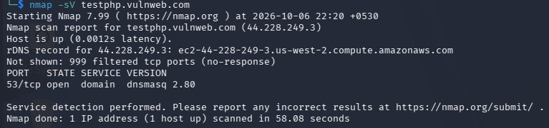
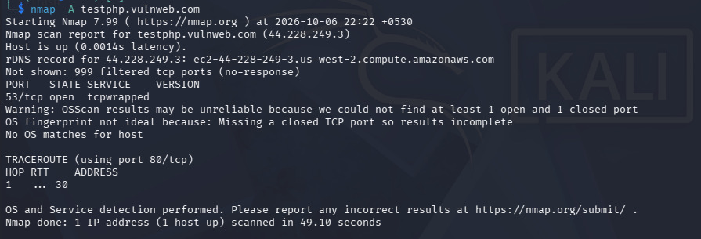
3. Nmap – Service & Aggressive Scan
Service identification and deeper enumeration
nmap -sV – service/version detection
nmap -A – aggressive scan
• 53/tcp was identified as domain service; version shown as dnsmasq 2.80.
• OS detection was inconclusive because the scan lacked the required open/closed TCP-port combination.
• No OS match was claimed from the incomplete fingerprint.
DG Interns Hub | Cyber Security Internship | Week 5 – VAPT | 4

Slide 6

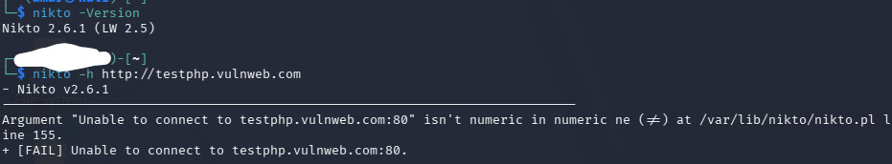
4. Nikto – Web Assessment Attempt
Real terminal evidence and verified connectivity limitation
Nikto 2.6.1 version verification
Nikto connection failure + Nmap/curl verification
• Nikto 2.6.1 was installed successfully.
• Nikto could not connect to testphp.vulnweb.com:80.
• Nmap reported 80/tcp and 443/tcp as filtered.
• curl also failed to connect to port 80.
• Therefore, no web vulnerability is claimed from the incomplete Nikto run.
DG Interns Hub | Cyber Security Internship | Week 5 – VAPT | 5

Slide 7
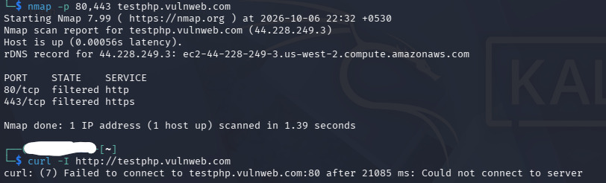
5. Burp Suite – HTTP Interception
Captured traffic from the authorized lab target
Burp Proxy – Intercept ON and captured GET request
DG Interns Hub | Cyber Security Internship | Week 5 – VAPT | 6

Slide 8
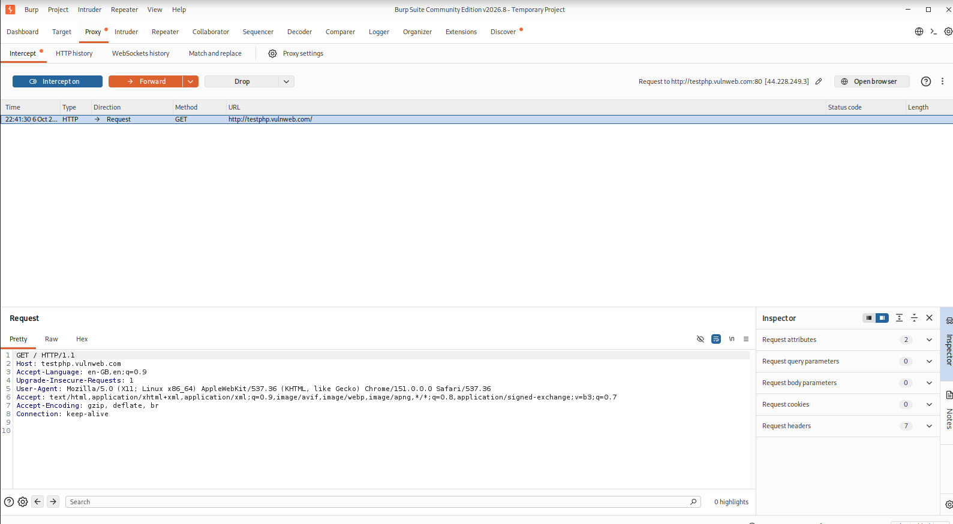
6. Burp Suite – Request Inspection
Inspecting request path, headers and query parameters
Captured artists.php request with query parameters
DG Interns Hub | Cyber Security Internship | Week 5 – VAPT | 7

Slide 9
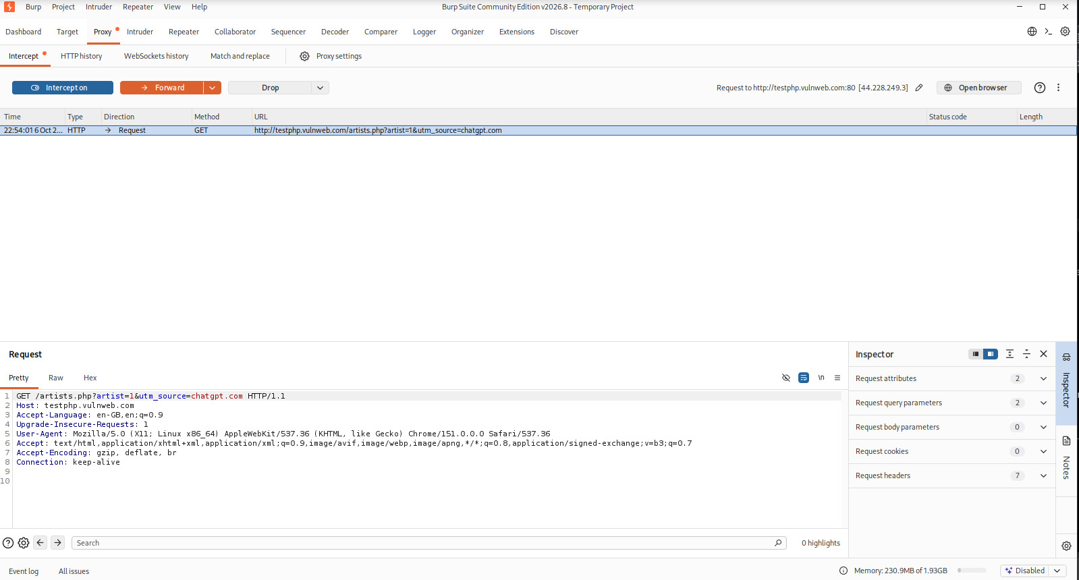
7. Burp Suite – Additional Request
categories.php request captured successfully
Captured categories.php request
DG Interns Hub | Cyber Security Internship | Week 5 – VAPT | 8

Slide 10
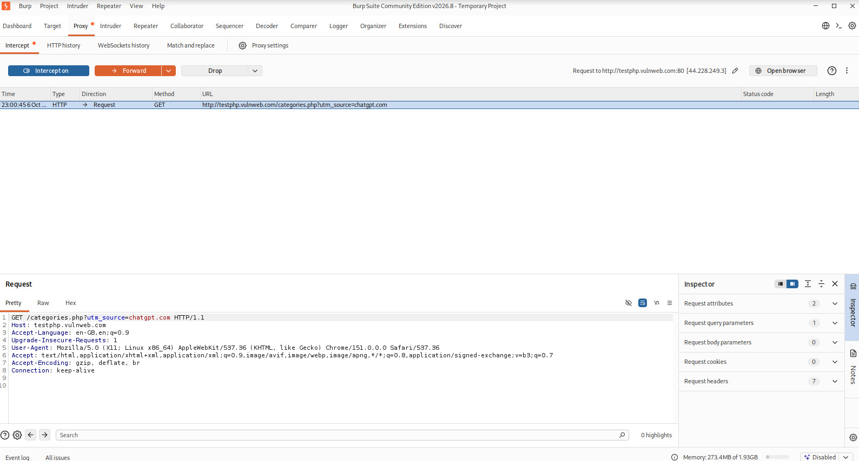
8. Burp Suite – HTTP History
Reviewing multiple captured requests
HTTP History showing repeated requests and captured PHP endpoints
• HTTP History consolidated the captured GET requests.
• The listener was visible on port 8080 in the Burp session.
• Captured traffic included the root path and PHP endpoints such as artists.php and categories.php.
DG Interns Hub | Cyber Security Internship | Week 5 – VAPT | 9

Slide 11
9. Findings & Interpretation
What the evidence actually demonstrates
01
Nmap
53/tcp open; dnsmasq 2.80 detected
Observed exposed service; not automatically a vulnerability.
02
Nikto / HTTP
80 & 443 filtered; curl unable to connect
Web assessment was limited by connectivity.
03
Burp Suite
GET requests, headers and parameters visible
Successful HTTP interception and inspection.
• No unsupported high-impact vulnerability is claimed.
• All observations are based on the screenshots captured during the authorized practical.
DG Interns Hub | Cyber Security Internship | Week 5 – VAPT | 10

Slide 12
10. Challenges, Learning & Conclusion
Week 5 practical summary
• Challenge: the target web ports were filtered, so Nikto could not complete a web scan.
• Solution: verified the condition independently with Nmap and curl.
• Learning: VAPT results must be validated and interpreted before reporting a vulnerability.
• Completed: Nmap version/SYN/service/aggressive scans, Nikto setup and troubleshooting, Burp interception and HTTP History.
• Conclusion: the practical provided hands-on exposure to reconnaissance, web assessment and HTTP traffic analysis.
Submitted by: Amar Pratap | DG Interns Hub | Cyber Security Internship – Week 5
DG Interns Hub | Cyber Security Internship | Week 5 – VAPT | 11

