Slide 1
WEEK 3 – ADVANCED CYBERSECURITY PRACTICAL
Network Security Assessment & Traffic Investigation
Amar Pratap • Cybersecurity Intern

Slide 2
2. Objective & Lab Architecture
Authorized VMware lab assessment only.
Kali Linux is the scanning/analysis workstation.
Assessment range shown in evidence: 192.168.56.0/24.
Terminal evidence reports 3 hosts up.
Kali Linux (eth0)
↓
VMware Lab Network
↓
Authorized Lab Hosts

Slide 3
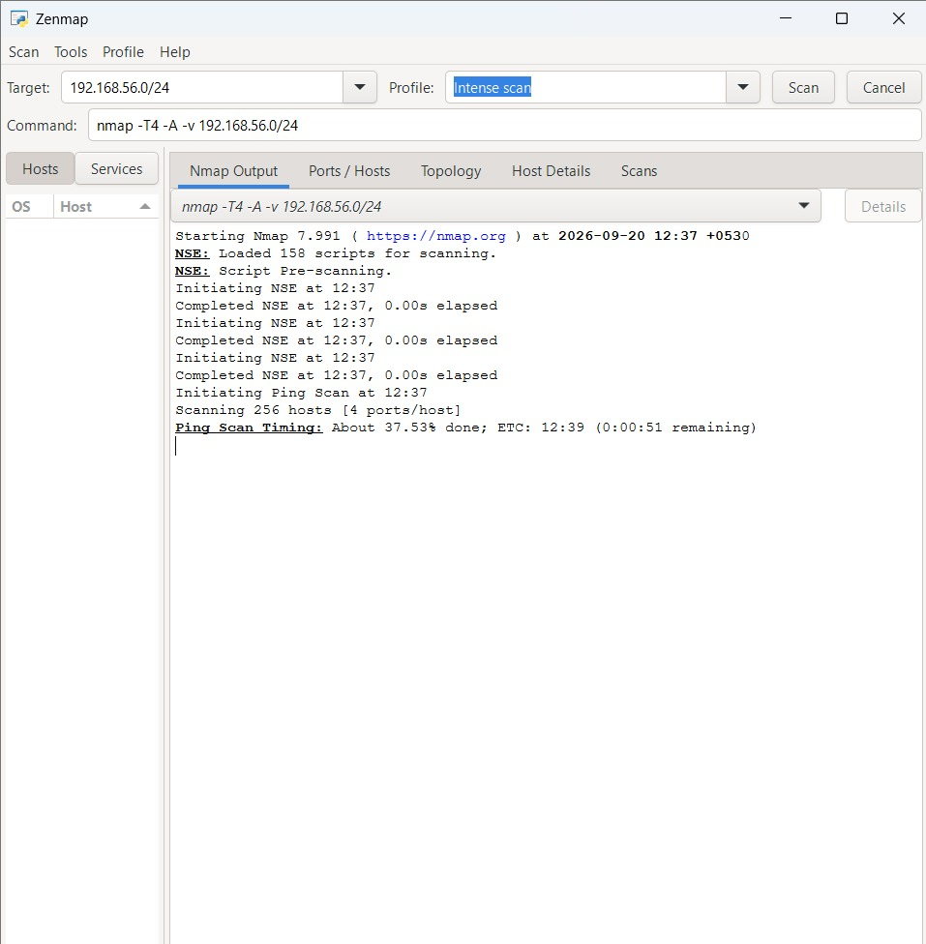
3. Network Discovery
Zenmap/Nmap targeted 192.168.56.0/24.
256 addresses were scanned.
Completed terminal evidence reports 3 hosts up.
Original evidence is preserved.

Slide 4
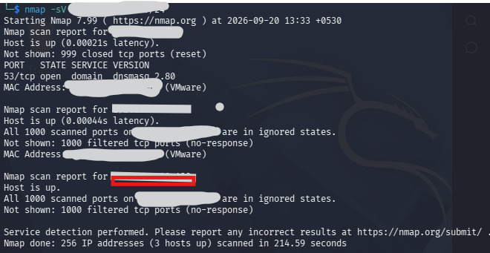
4. Advanced Nmap Results
53/tcp is visible as open.
Service/version output shows domain / dnsmasq 2.80.
OS fingerprinting includes VMware/Windows-related guesses.
UDP evidence shows 53/udp on a host.

Slide 5
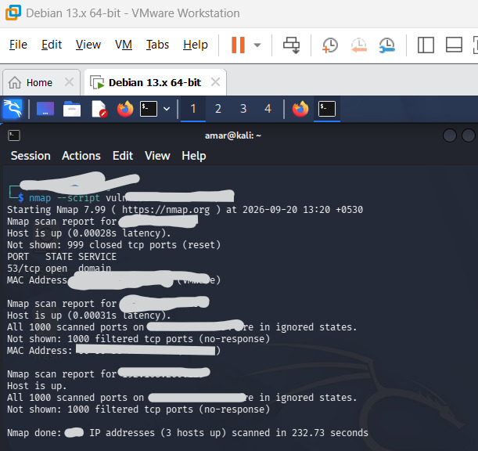
5. NSE Vulnerability Assessment
NSE vulnerability scripts were executed.
No confirmed CVE is visible in the supplied summary.
Do not invent a vulnerability or severity.
Verify versions manually against current advisories.

Slide 6
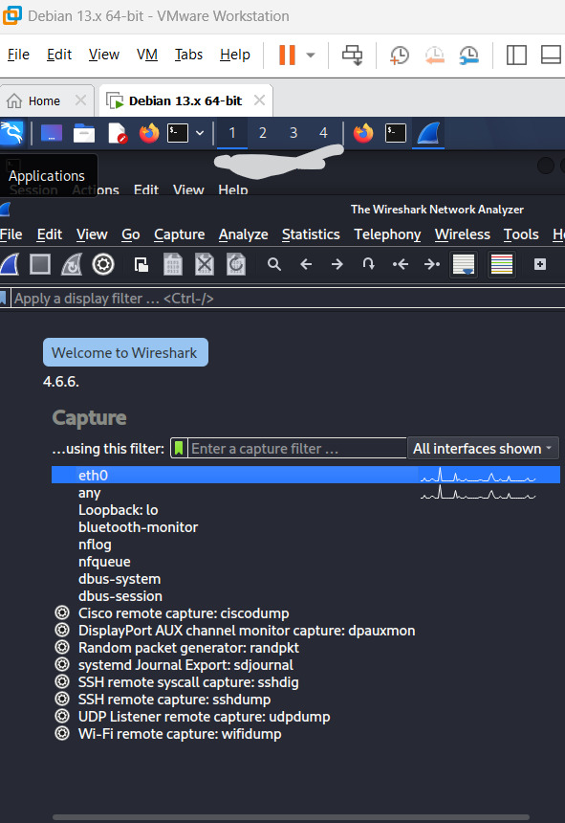
6. Wireshark Methodology
Wireshark 4.6.6 is installed.
eth0 is available for capture.
Filters: dns, tcp, udp, icmp, arp.
Also use SYN/RST and DNS-query filters.

Slide 7
7. Nmap + Wireshark Investigation
Run: sudo nmap -sS <TARGET-IP> during capture.
Open TCP: SYN → SYN/ACK is commonly observed.
Closed TCP: SYN → RST is commonly observed.
No response may indicate filtering or another network condition.
Packet-level screenshots are still pending.
Nmap SYN
↓
Target response
↓
Wireshark correlation

Slide 8
8. Traffic Investigation
Identify top communicating hosts.
Analyze DNS queries/responses.
Inspect TCP SYN, SYN/ACK and RST packets.
Investigate repeated attempts and unusual ports.
Record at least 5 evidence-backed events.
Current supplied images do not contain packet lists.
dns
tcp
udp
icmp
arp
tcp.flags.syn == 1
tcp.flags.reset == 1

Slide 9
9. Security Findings & Risk
DNS exposure on TCP/53 and UDP/53 should be validated.
Filtered ports should be checked against firewall policy.
VMware/infrastructure fingerprints should be documented.
NSE output alone does not establish a vulnerability.
Risk ratings remain provisional until host role/exposure is confirmed.
Finding → Evidence → Risk → Recommendation
DNS TCP/53 → Nmap → Medium*
DNS UDP/53 → UDP scan → Medium*
Filtered ports → Nmap → Informational*

Slide 10
10. Security Hardening & Before/After
Restrict unnecessary DNS/service exposure.
Disable unnecessary services only after validation.
Use least-privilege firewall rules.
Repeat the same Nmap scan after changes.
Before/after screenshots are still required.
BEFORE
↓
Security issue
↓
Action taken
↓
AFTER

Slide 11
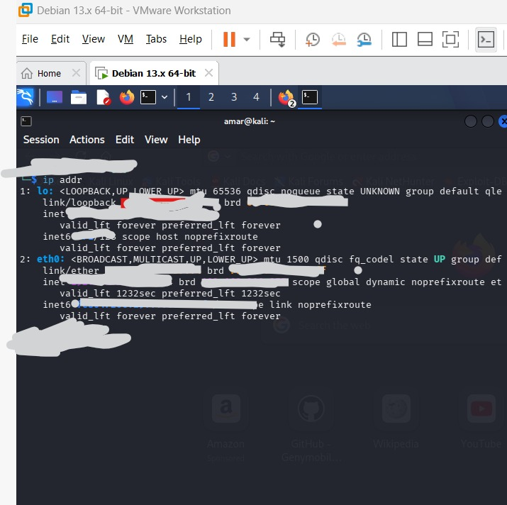
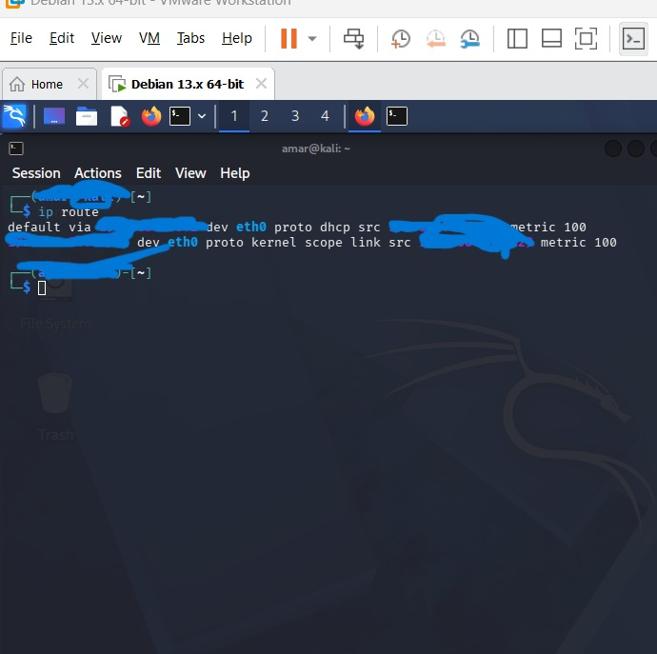
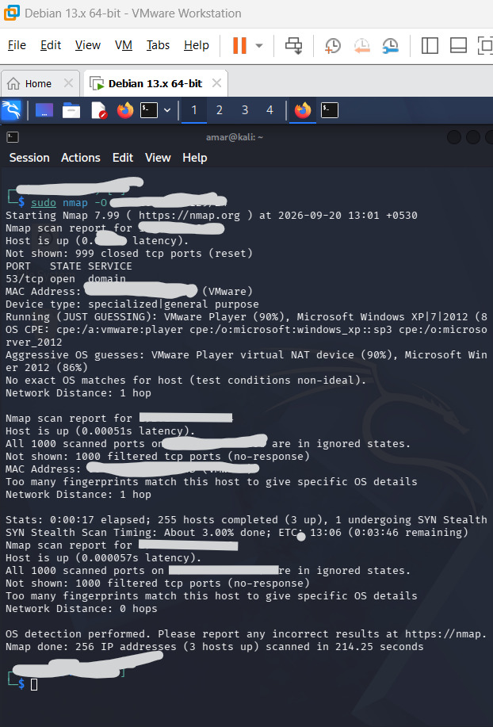
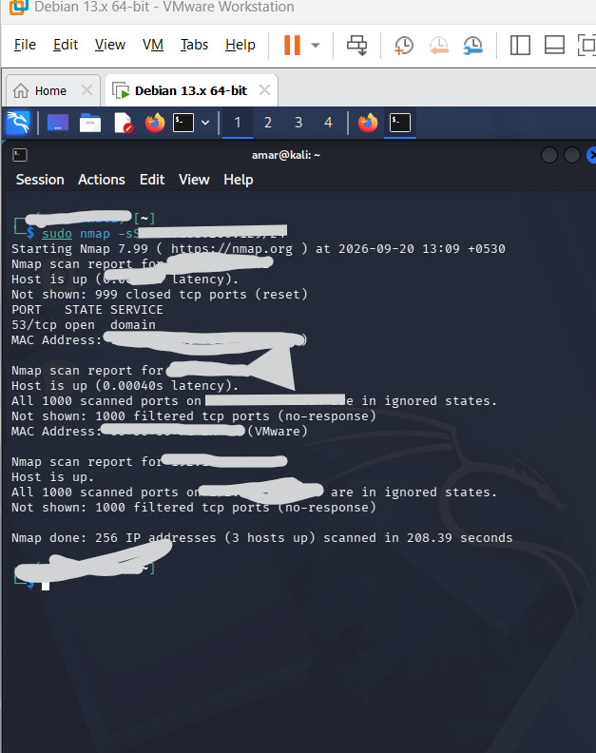
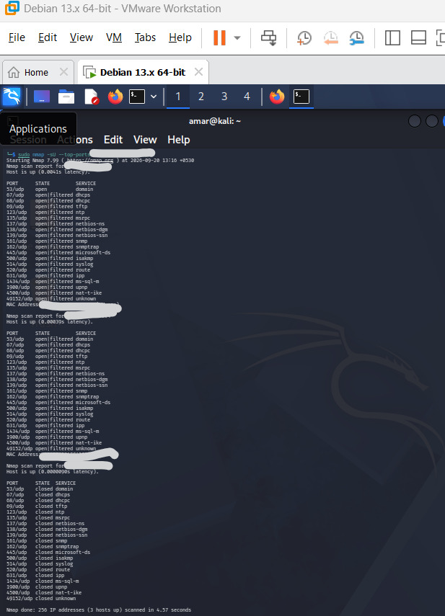
11. Evidence Screenshots
Original evidence 1
Original evidence 2
Original evidence 3
Original evidence 4
Original evidence 5
Original evidence 6
Original evidence 7
Original evidence 8
Original evidence 9

Slide 12
12. Conclusion & Submission Status
Nmap discovery/enumeration evidence is documented.
Wireshark interface evidence is documented.
Original screenshots are included in the evidence gallery.
Still required: packet-level Wireshark evidence, five traffic events, and before/after hardening evidence.
Once those are collected, the report can be finalized without fabricated evidence.

