Slide 1
WEEK 4 – CYBER SECURITY INTERNSHIP
Network Configuration, Connectivity & Security Analysis
Amar Pratap • DG Interns Hub • Kali Linux / VMware

Slide 2
INDEX / SUBMISSION STATUS
1
Project Overview
Slide 3
2
Lab Setup & Network Configuration
Slide 4
3
IP, Connectivity & Routing
Slide 5
4
DNS & Network Interface Checks
Slide 6
5
Nmap Scanning
Slide 7
6
Traceroute & HTTPS/TLS Analysis
Slide 8
7
System & Packet Analysis
Slide 9
8
Key Findings & Conclusion
Slide 10
Evidence check: Task 1 ✓ | Task 2 △ Web-server screenshot missing | Task 3 ✓ | Task 4 △ ICMP only

Slide 3
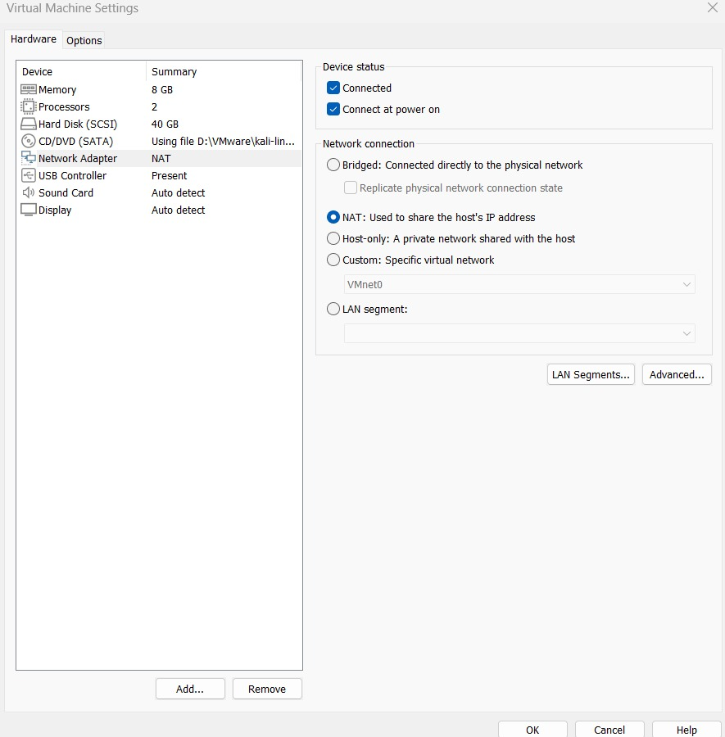
Lab Setup & Network Configuration
VMware NAT + Kali Linux
• VMware Network Adapter: NAT
• Adapter connected and enabled at power-on
• Kali Ethernet interface is UP
• Private IPv4 address is assigned dynamically
• Routing and connectivity were verified
VMware NAT configuration

Slide 4
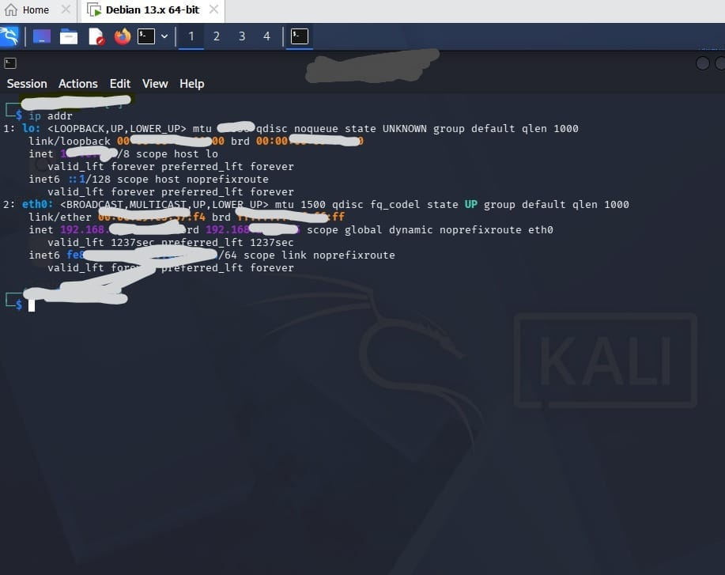
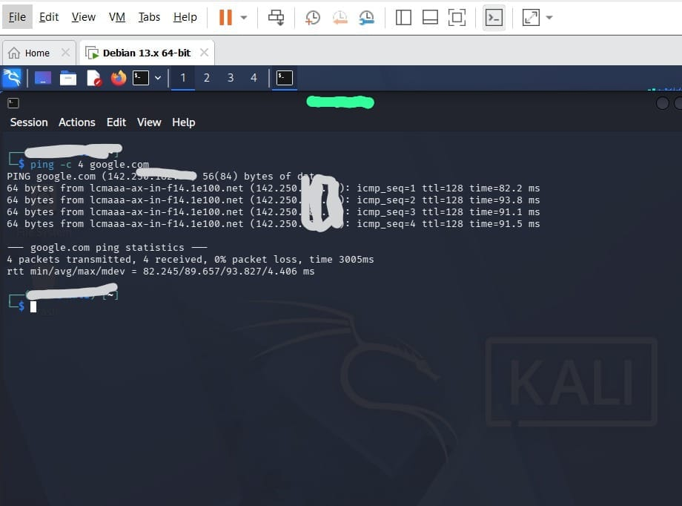
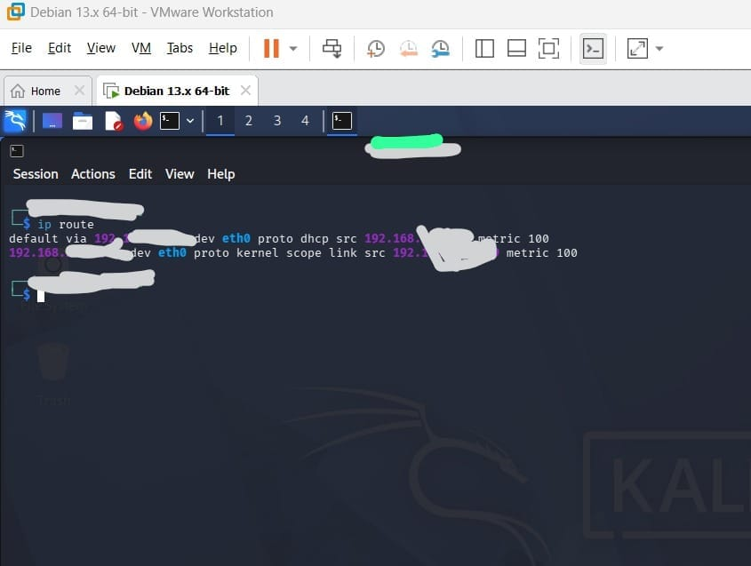
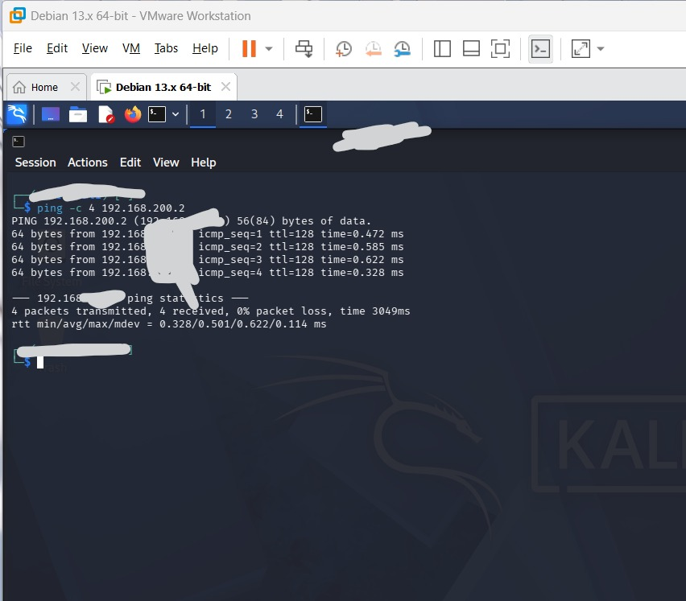
IP, Connectivity & Routing
Actual lab evidence
ip addr
ping google.com — 0% packet loss
ip route
Private-network ping — 0% packet loss

Slide 5
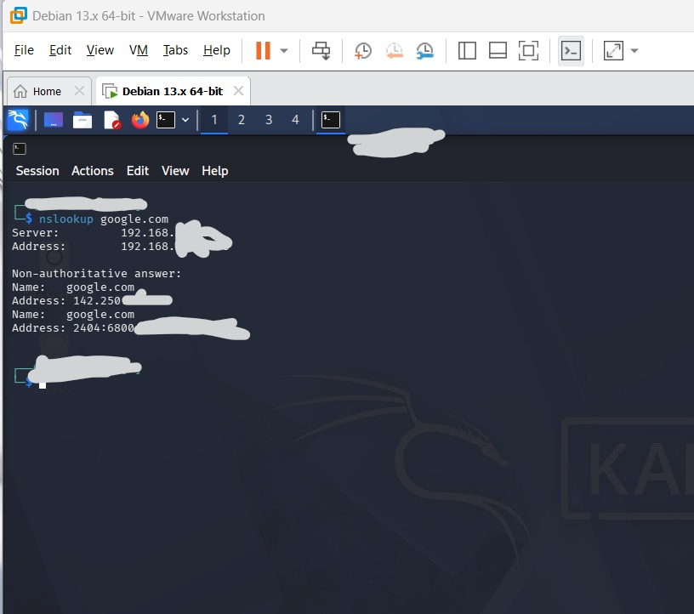
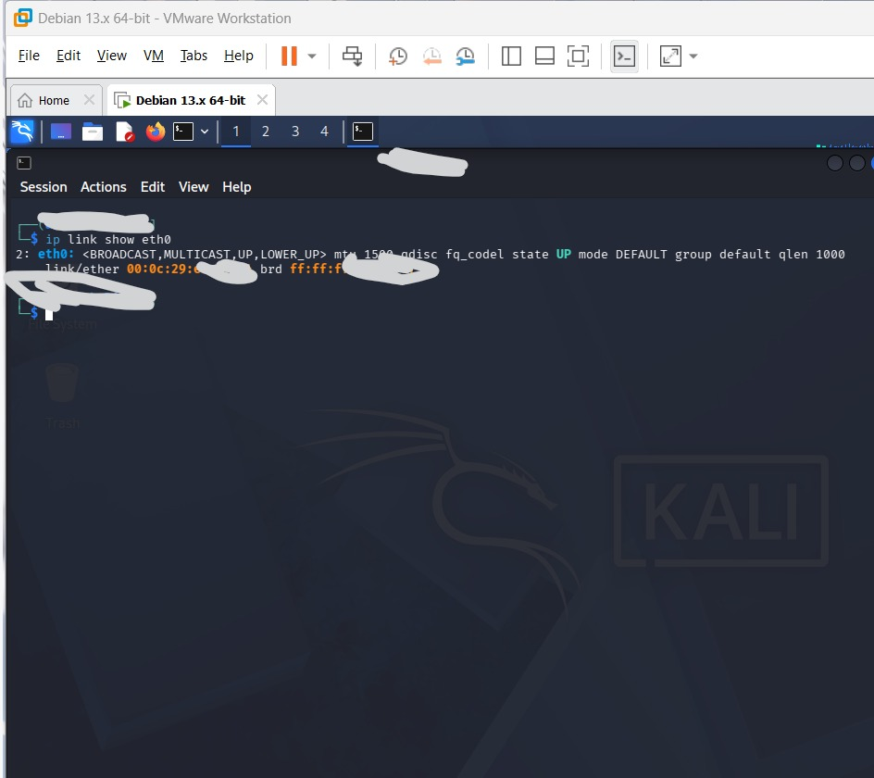
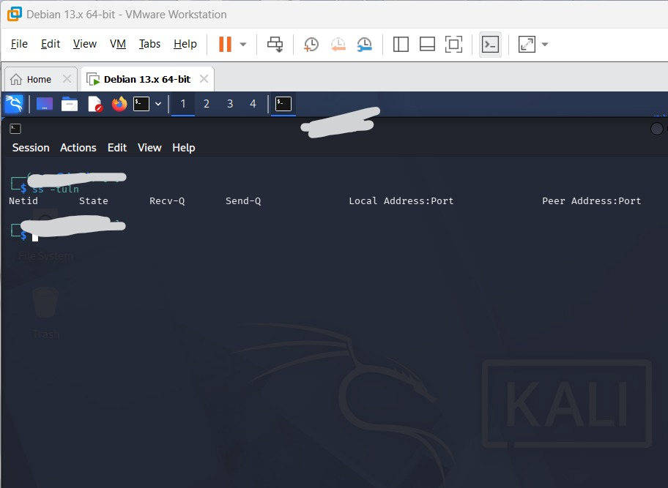
DNS & Network Interface Checks
Resolution, link state and sockets
nslookup google.com
ip link show eth0
• DNS resolution succeeded.
• eth0 is UP.
• Socket inspection was performed with ss -tuln.
ss -tuln

Slide 6
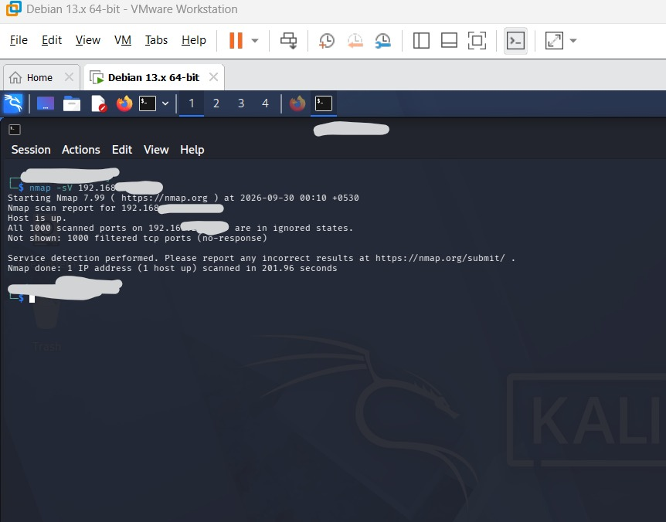
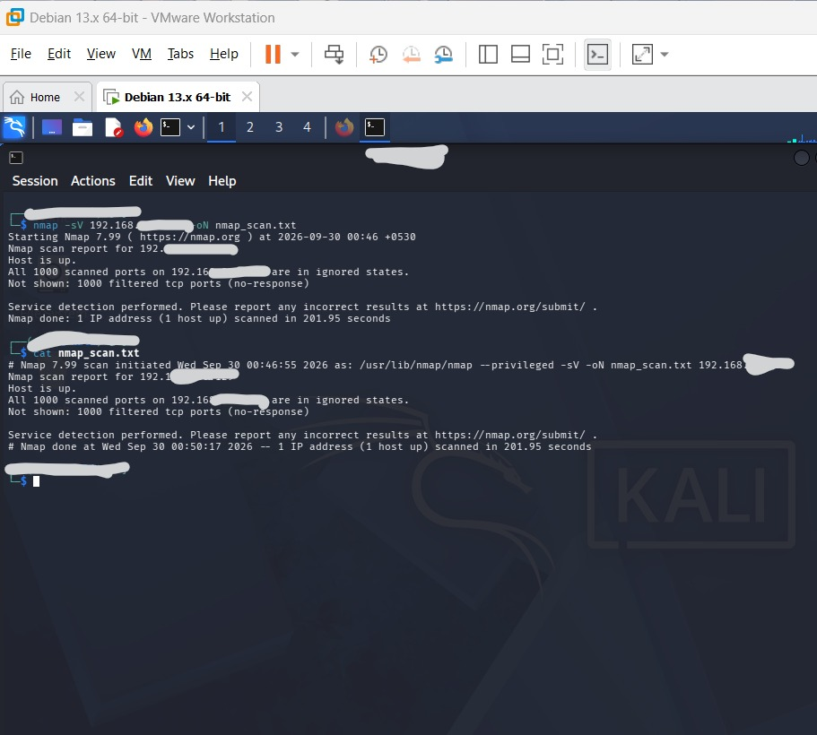
Nmap Scanning
Service/version discovery on authorized targets
Nmap target scan — 1000 TCP ports filtered/no-response
Saved nmap_scan.txt output
• The target host was up.
• The visible default 1000 TCP ports were filtered/no-response.
• No open service is claimed from this evidence.
• The scan output was preserved in nmap_scan.txt.

Slide 7
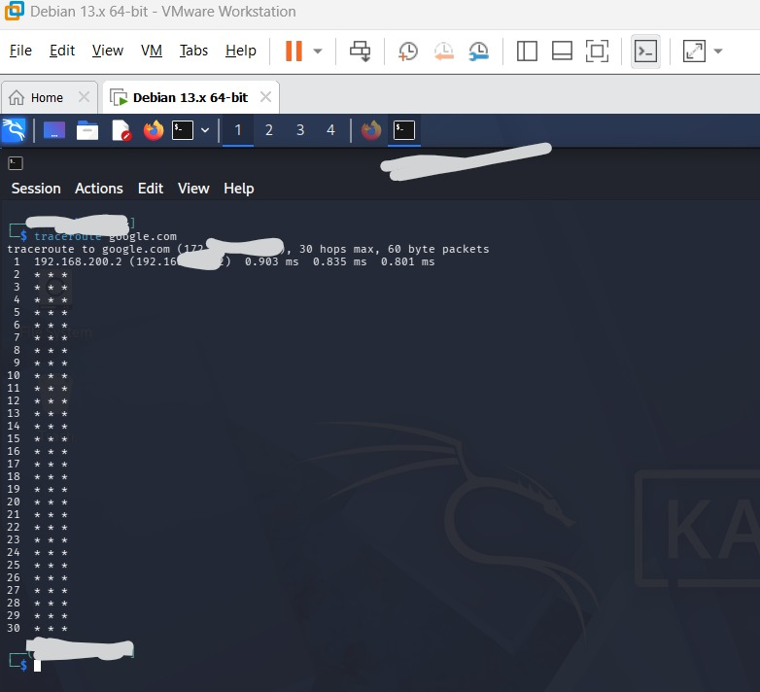
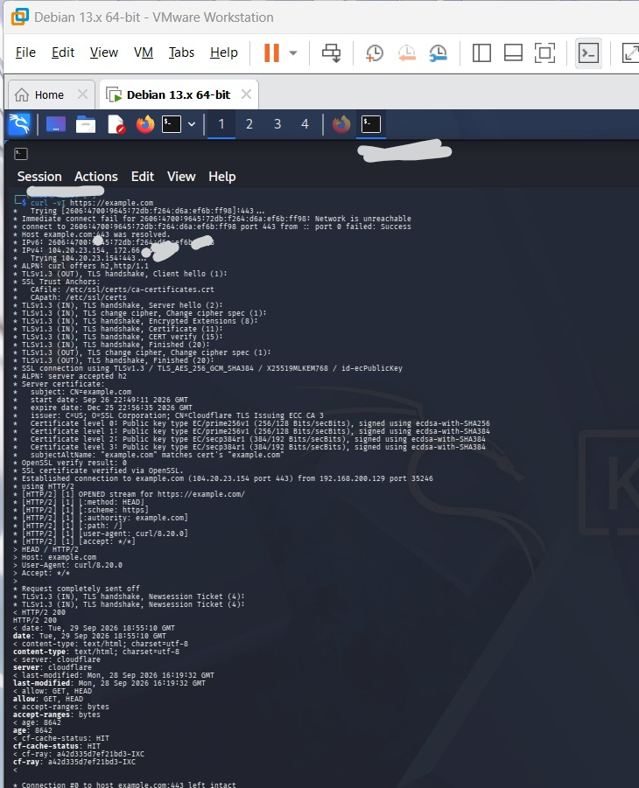
Traceroute & HTTPS/TLS Analysis
Path observation and encrypted web communication
traceroute google.com
curl -v — TLS 1.3 / HTTP/2
• The first visible traceroute hop is the private gateway.
• Later hops did not respond in the captured output.
• curl showed successful HTTPS communication with example.com.
• The verbose output shows TLS 1.3 negotiation and HTTP/2.

Slide 8
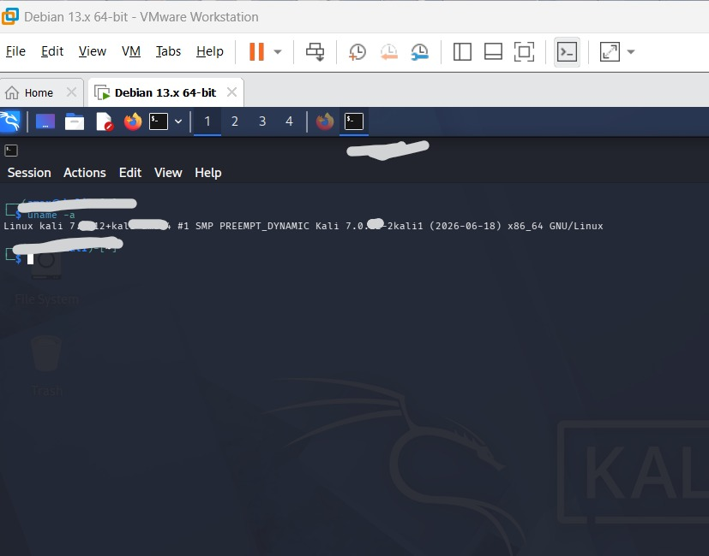
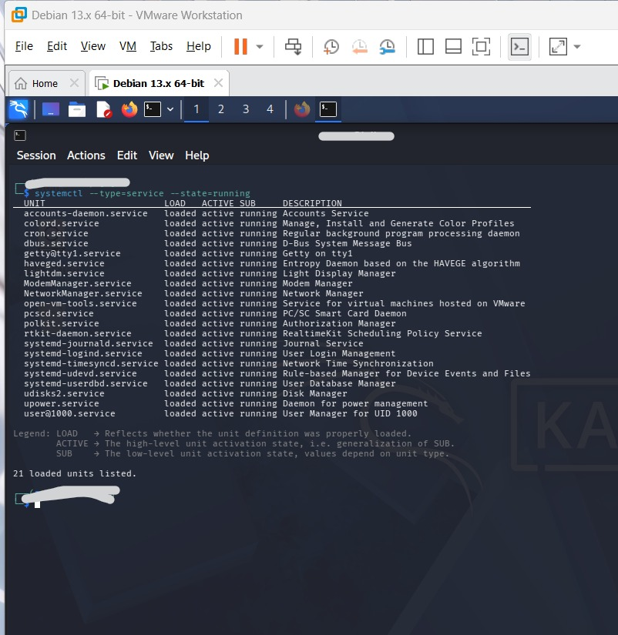
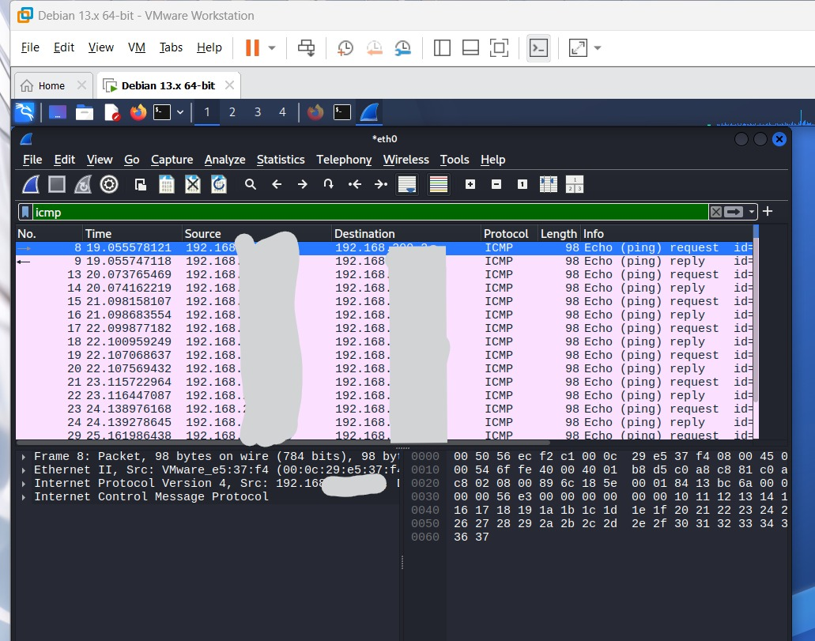
System & Packet Analysis
Kali Linux environment + Wireshark
uname -a
Running services
Wireshark — ICMP Echo request/reply

Slide 9
Key Findings & Conclusion
Evidence-based Week 4 summary
• VMware NAT networking and Kali interface configuration were verified.
• Internet and private-network connectivity were successfully tested.
• DNS resolution and routing were verified.
• Nmap target evidence shows filtered/no-response default TCP ports.
• The Nmap output was saved for reproducibility.
• Traceroute, curl/TLS, system and Wireshark evidence were documented.
• The practical demonstrates a complete basic network-observation workflow.
Final evidence gap: target Apache/Nginx screenshot + Wireshark DNS/HTTP captures are still required if your task sheet requires them.
Thank You • Week 4 Cyber Security Internship

