Slide 1
WEEK 6 PRACTICAL REPORT
WEB APPLICATION SECURITY
ASSESSMENT (VAPT)
SQL Injection • Reflected & Stored XSS
Burp Suite Community Edition • OWASP ZAP
Prepared by: Amar Pratap
Lab: Local DVWA on Kali/Linux guest in VMware
AUTHORIZED TRAINING LAB ONLY | Target shown: http://127.0.0.1:4280

Slide 2
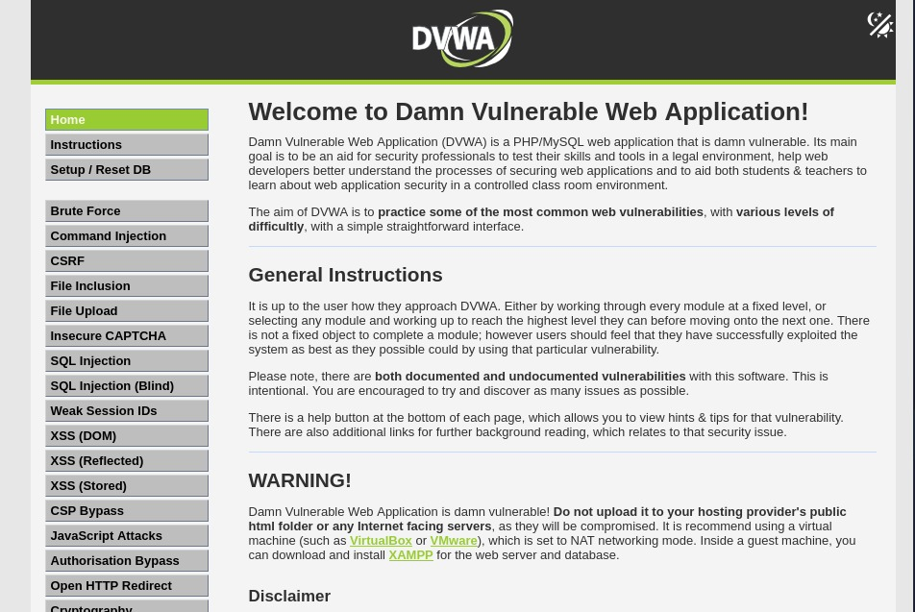
Contents, Scope & Lab Environment
• 1. Lab setup and assessment workflow
• 2. SQL Injection: source, baseline and modified result
• 3. Reflected and Stored XSS proof-of-concepts
• 4. Burp Suite request/response analysis
• 5. OWASP ZAP report and findings
• 6. Remediation, verification and conclusion
Original evidence: DVWA home page and lab warning
Scope: local target only — 127.0.0.1:4280
No public website or production system is included.
Safety: DVWA is intentionally vulnerable. Keep it on localhost/isolated networking; never expose it publicly.
WEEK 6 VAPT PRACTICAL • OVERVIEW
2

Slide 3
Tools & Assessment Workflow
DVWA
Intentionally vulnerable training app for controlled practice.
Burp Suite
Intercepts and records HTTP requests/responses for manual review.
OWASP ZAP
Scanner identifies potential issues; each alert needs validation.
Browser
Shows application behavior and XSS proof-of-concept alerts.
Workflow
• Confirm local scope → run normal baseline → test DVWA training modules → inspect traffic in Burp → run ZAP checks → document evidence and fixes.
WEEK 6 VAPT PRACTICAL • METHOD
3

Slide 4
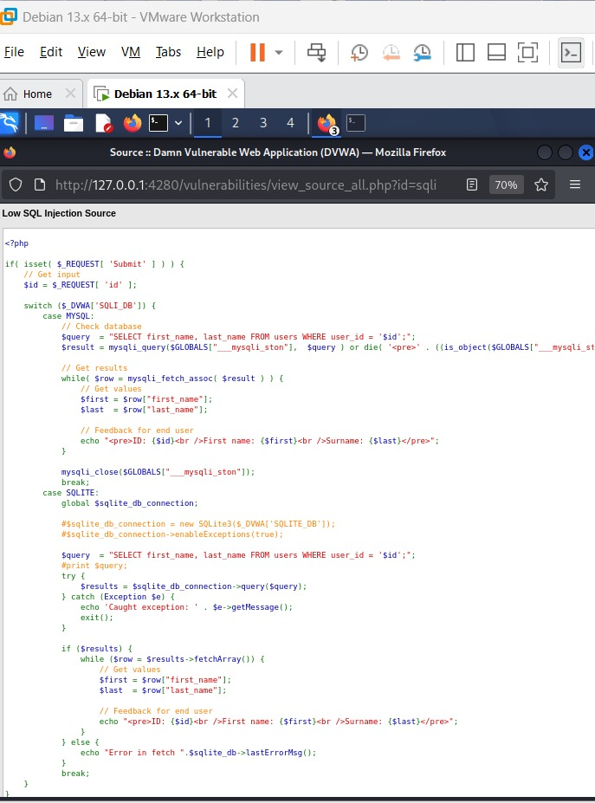
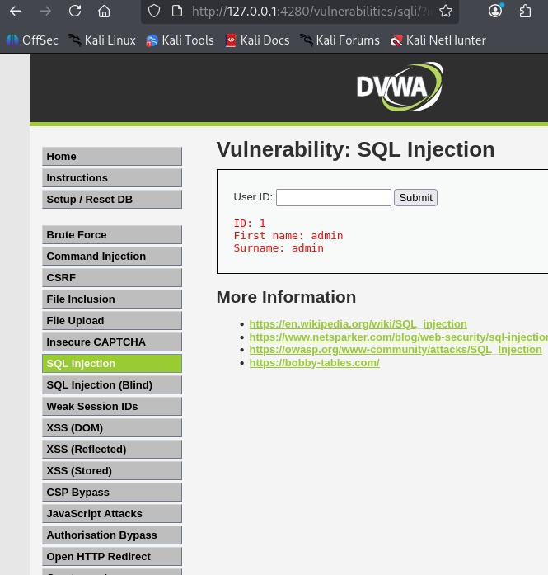
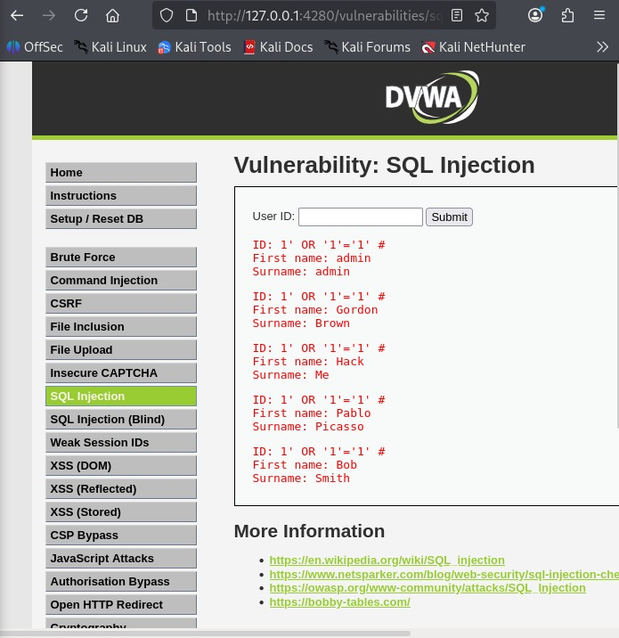
SQL Injection — Source, Baseline & Result
SQL Injection occurs when untrusted input is joined into SQL query text, allowing input to alter query logic.
Evidence interpretation
• Source screenshot shows the ID input used in a query.
• Normal lookup returns the admin record.
• Modified input returns multiple records in this deliberately vulnerable lab.
Baseline: ID 1 returns one record
Fix: prepared statements / parameterized queries, input type checks, least-privilege DB account, and safe error handling.
SQLi source code
Modified input returns multiple records
WEEK 6 VAPT PRACTICAL • SQLI
4

Slide 5
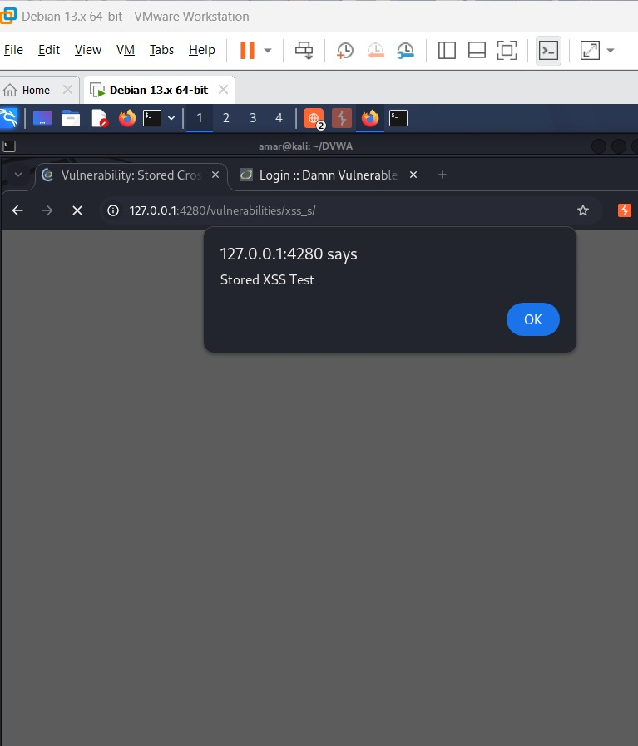
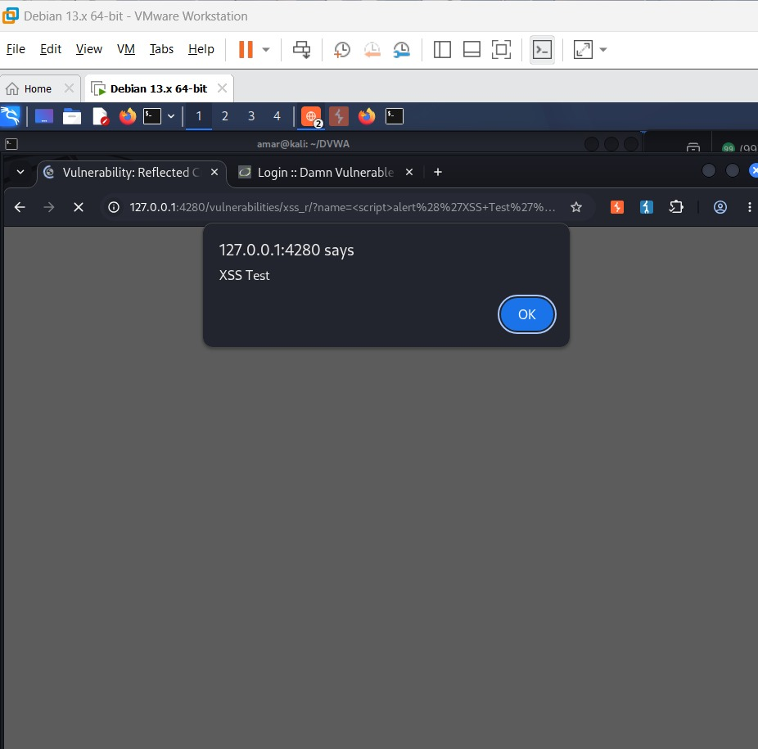
Cross-Site Scripting — Reflected & Stored
Reflected XSS
Untrusted input is returned in the immediate response and interpreted by the browser.
Stored XSS
Untrusted input is saved and displayed later, potentially affecting subsequent visitors.
Evidence
The screenshots show “XSS Test” and “Stored XSS Test” alert dialogs in local DVWA.
Fix
Context-aware output encoding, safe DOM APIs, careful rich-text sanitization, and CSP as defense in depth.
Original: reflected XSS alert
Original: stored XSS alert
Lab proof-of-concept only; screenshots do not demonstrate compromise of a real user.
WEEK 6 VAPT PRACTICAL • XSS
5

Slide 6
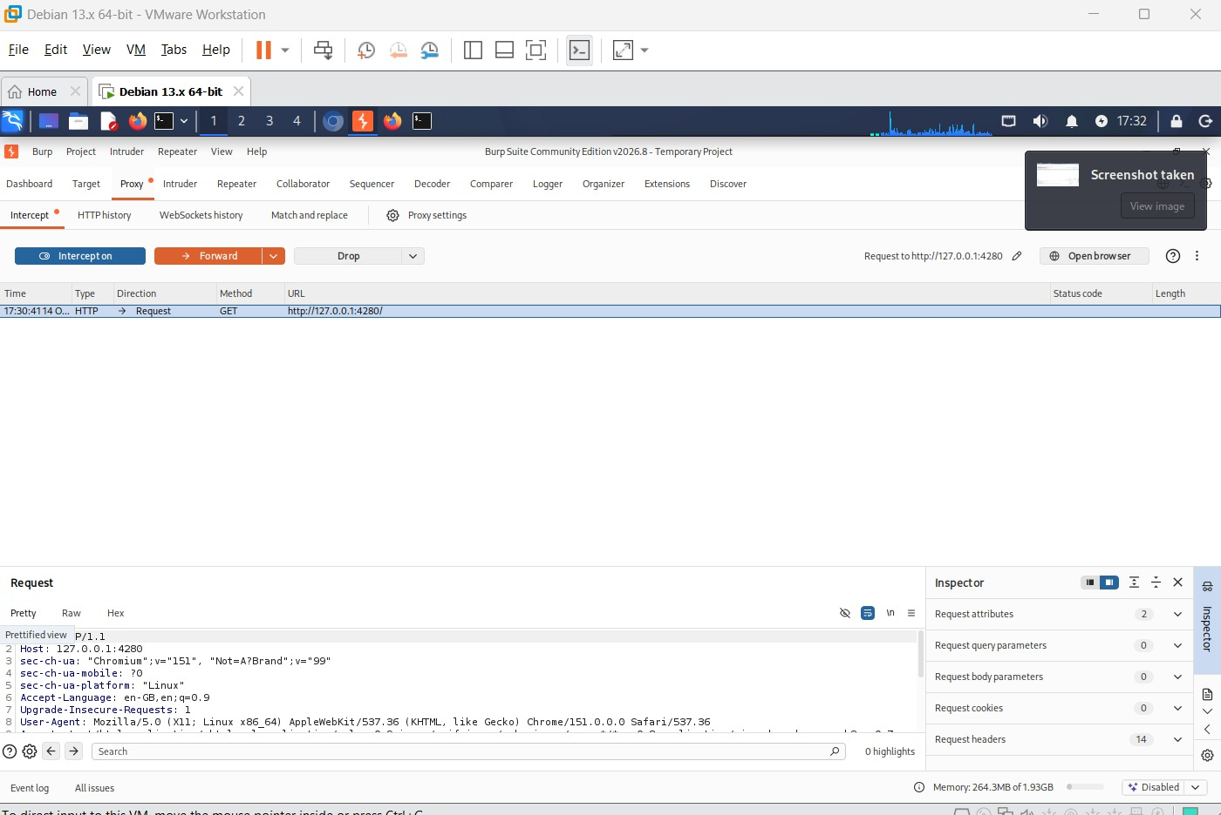
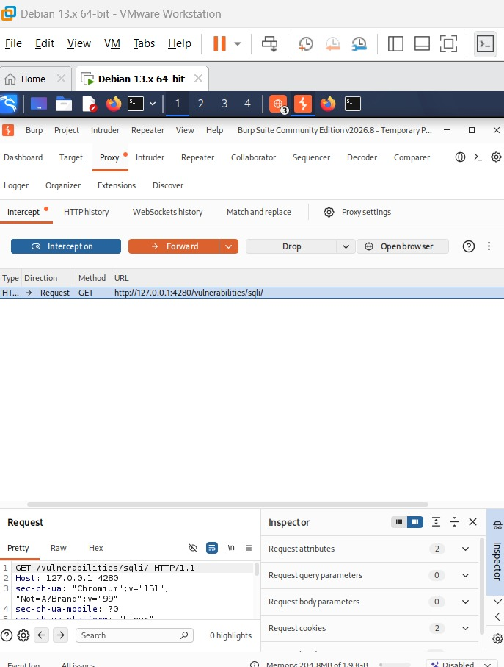
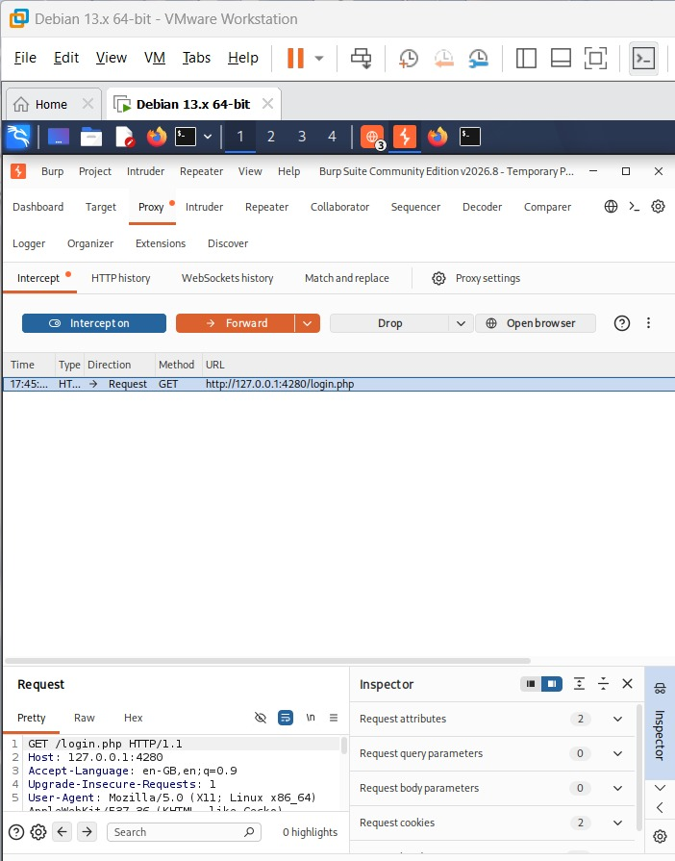
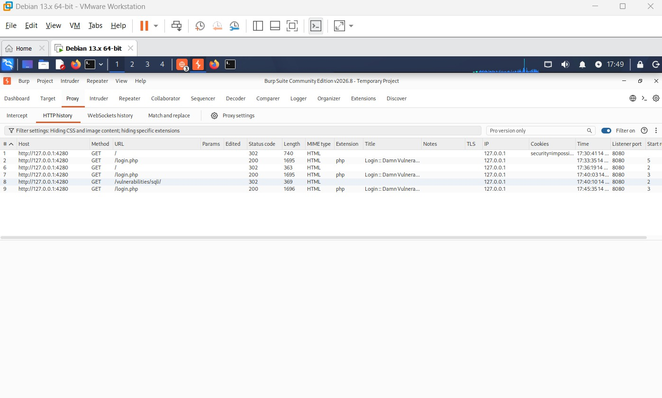
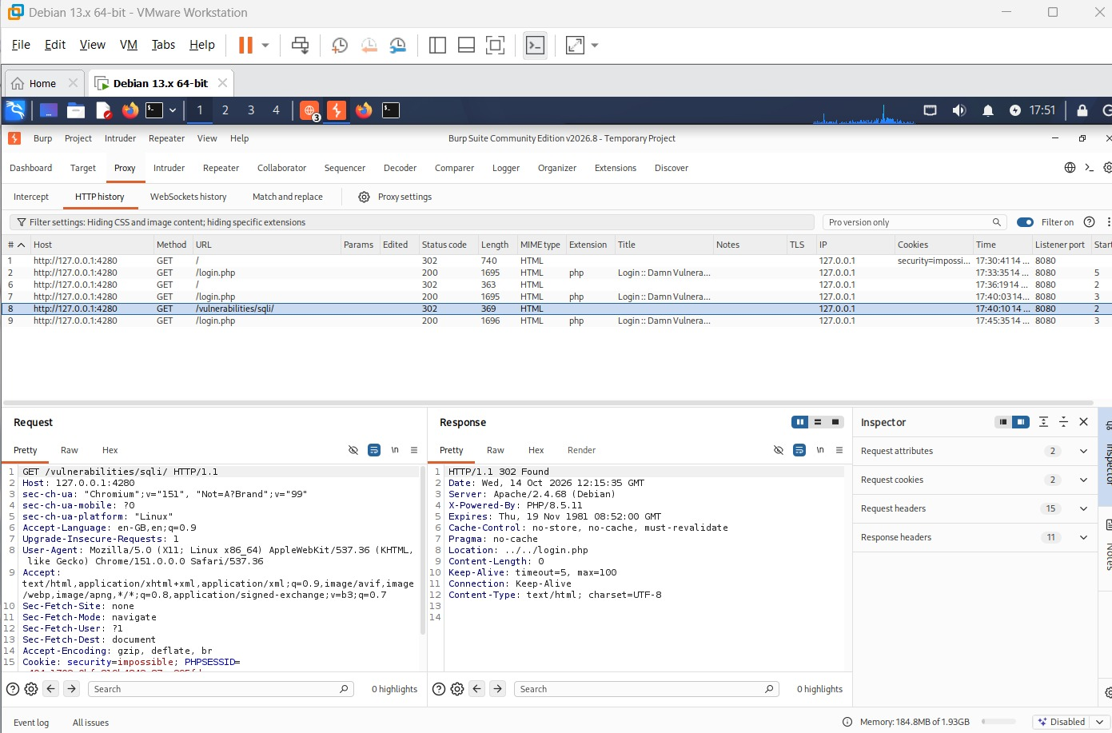
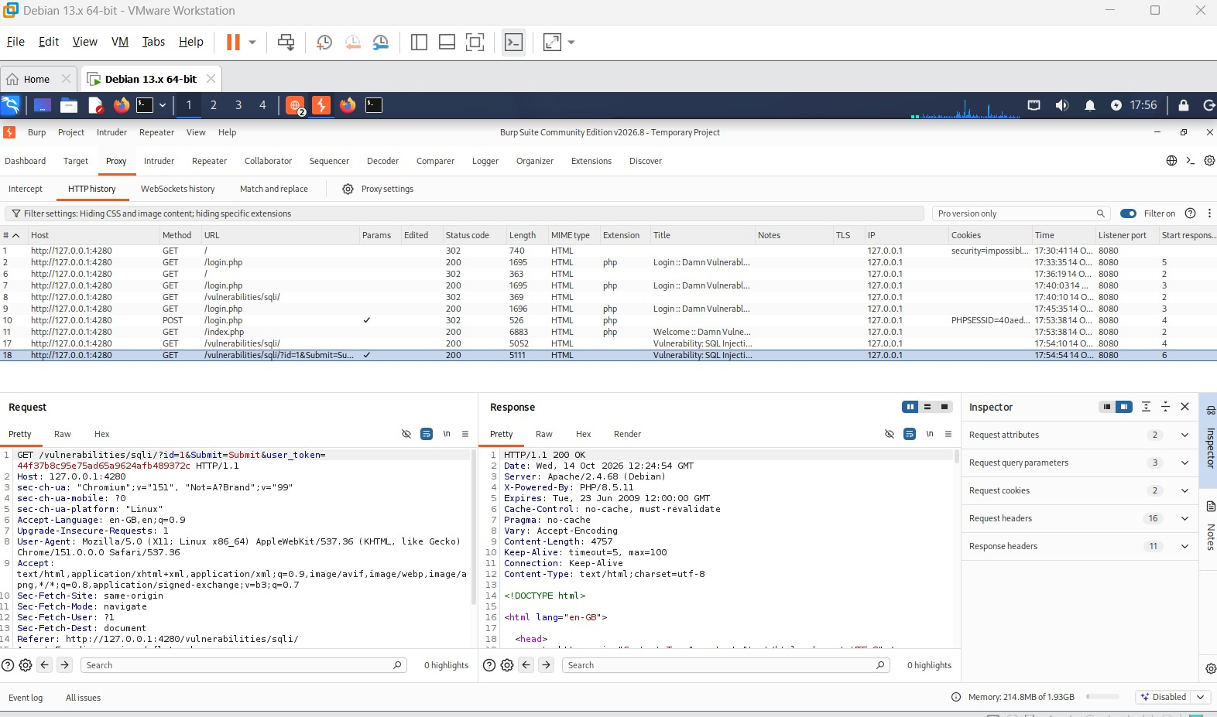
Burp Suite — HTTP Traffic Inspection
Burp captures browser traffic so the tester can compare request paths, methods, parameters, cookies, response status and headers.
Proxy intercept
Request to SQLi module
Login request
HTTP history
302 redirect and headers
SQLi request / 200 response
Important: HTTP 200/302 and a visible request are not vulnerabilities by themselves. Redact cookies and tokens before sharing.
WEEK 6 VAPT PRACTICAL • BURP
6

Slide 7
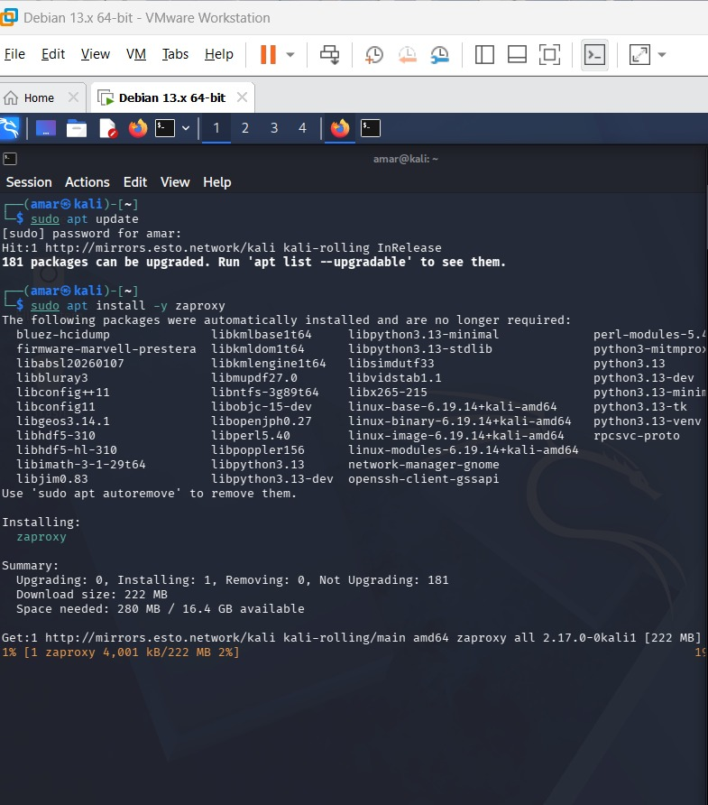
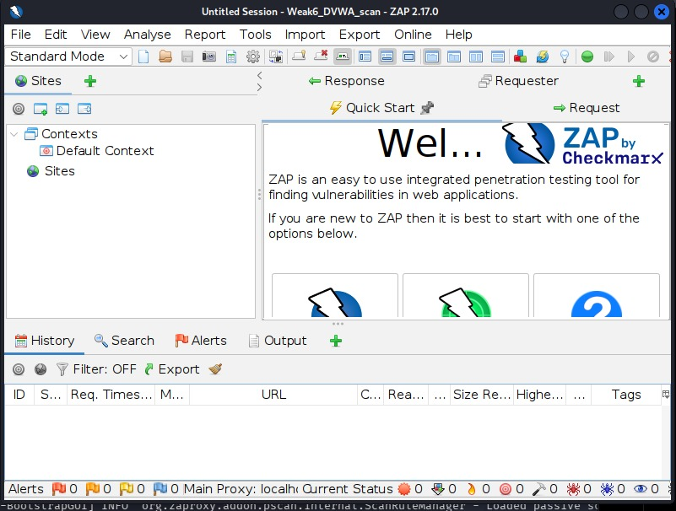
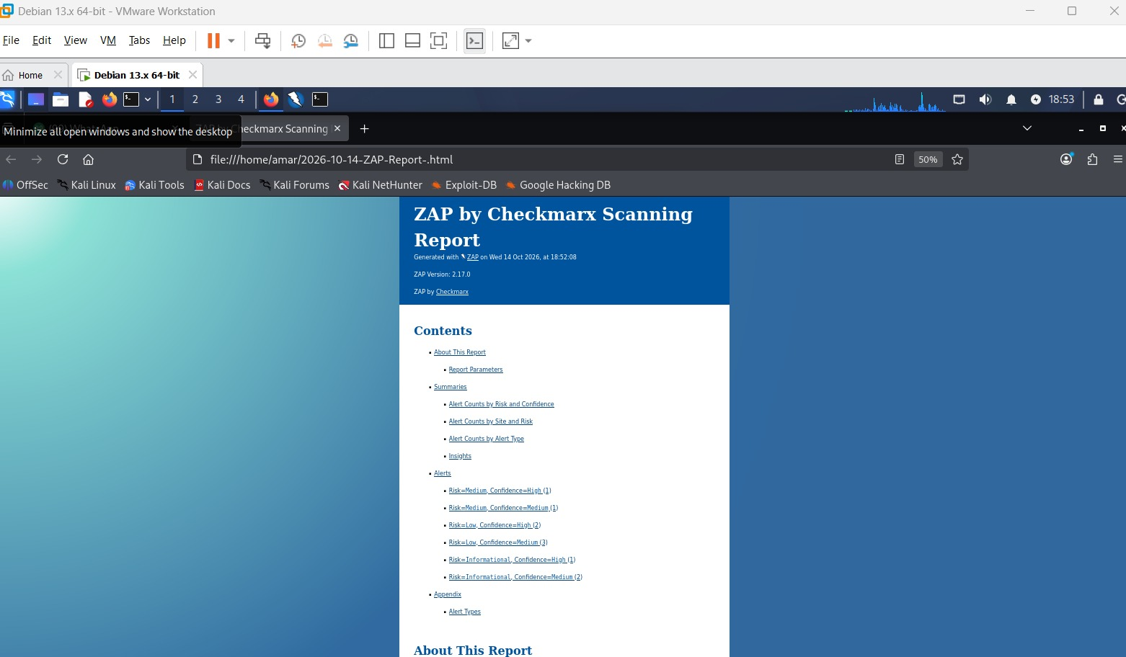
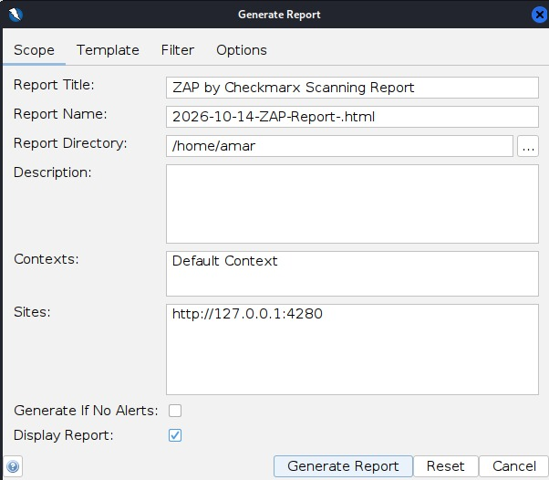
OWASP ZAP — Setup & Report Generation
ZAP 2.17.0 was used to scan the local DVWA target and generate an HTML report.
Report configuration shown:
• Site: http://127.0.0.1:4280
• Directory: /home/amar
• HTML report opened locally
A scanner report is a starting point. Validate each alert and review whether it applies to the application.
Terminal: ZAP package installation
ZAP main interface
Generated report cover
Generate Report settings
WEEK 6 VAPT PRACTICAL • ZAP
7

Slide 8
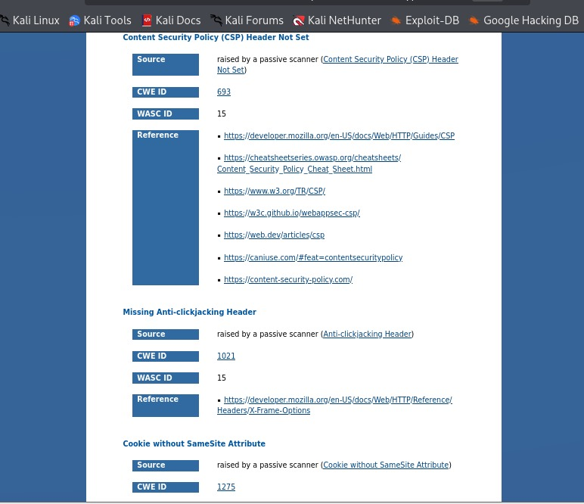
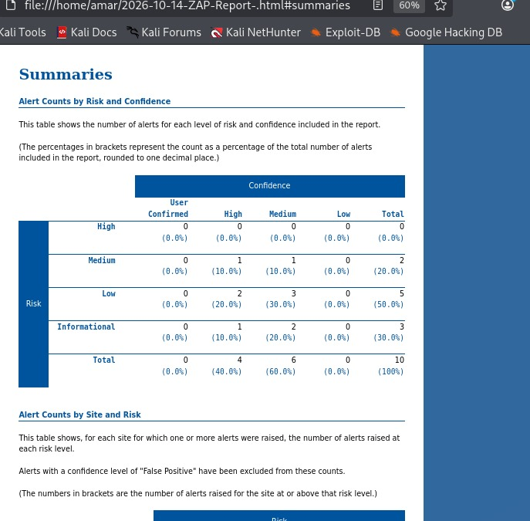
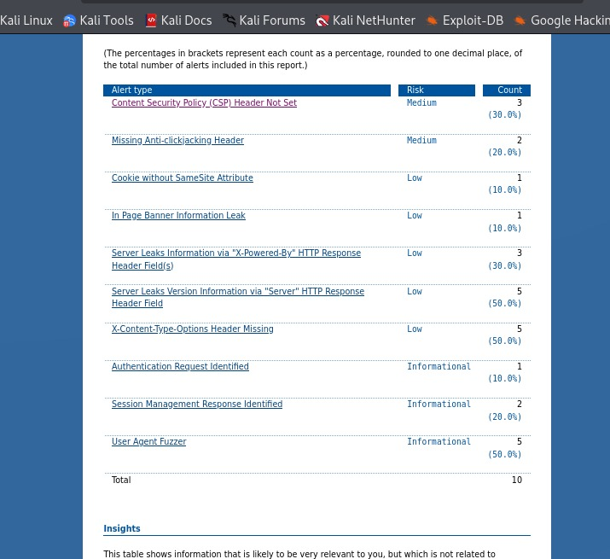
ZAP Results — Risk, Confidence & Alert Types
Summary visible in the report
High: 0
Medium: 2
Low: 5
Informational: 3
Total alert records: 10
Confidence: 4 High, 6 Medium.
Risk and confidence are different. Occurrence counts may repeat across multiple responses and do not equal unique vulnerabilities.
Alert details / references
Risk/confidence summary
Alert-type occurrence counts
WEEK 6 VAPT PRACTICAL • FINDINGS
8

Slide 9
Remediation Plan & Retesting Checklist
• SQL Injection → use parameterized queries and least-privilege DB access.
• XSS → context-aware output encoding, safe DOM APIs, tested sanitizer for rich text.
• CSP missing → design and test a policy; enforce after observing report-only results.
• Anti-clickjacking header missing → CSP frame-ancestors and/or X-Frame-Options.
• Cookie SameSite missing → choose suitable SameSite; review Secure and HttpOnly.
• Server/version disclosure → minimize banners and keep software patched.
• X-Content-Type-Options missing → set nosniff and correct MIME types.
Retest after fixes
• Repeat normal and invalid-input tests in the local lab.
• Confirm SQL input is treated as data, not query syntax.
• Confirm XSS test strings render as text and do not execute.
• Review response headers and cookie attributes in Burp.
• Rerun ZAP and manually validate changed/new alerts.
Do not report scanner observations as confirmed vulnerabilities until manually validated.
WEEK 6 VAPT PRACTICAL • REMEDIATION
9

Slide 10
Conclusion & Key Learning
• Practiced web security testing in intentionally vulnerable DVWA.
• Observed SQLi behavior and learned why parameterized queries matter.
• Compared reflected and stored XSS behavior in a safe lab.
• Used Burp to inspect HTTP traffic and ZAP to summarize potential issues.
• Learned to separate risk, confidence, alert occurrences and confirmed impact.
• Documented remediation and retesting steps.
Evidence included
19 original screenshots
Target shown: 127.0.0.1:4280
ZAP version shown: 2.17.0
Report date shown: 14 Oct 2026
Final note
This is a screenshot-based training report. It does not prove a production system was tested or that findings were retested after remediation.
THANK YOU • AUTHORIZED LAB TESTING ONLY

