Slide 1
WEEK 7 — WEB APPLICATION VAPT
• Prepared by: Amar Pratap
• Tools: Burp Suite Community, Gobuster, OWASP ZAP
• Target: local DVWA at 127.0.0.1:42001
• Kali Linux in VMware
• Authorized training lab only
• Evidence-based result: Reflected XSS confirmed

Slide 2
Scope & Methodology
• Intercept and inspect local HTTP traffic
• Map routes and input parameters
• Test reflected input handling
• Enumerate common paths with Gobuster
• Explore requests and alerts in ZAP
• Validate evidence before calling something a vulnerability

Slide 3
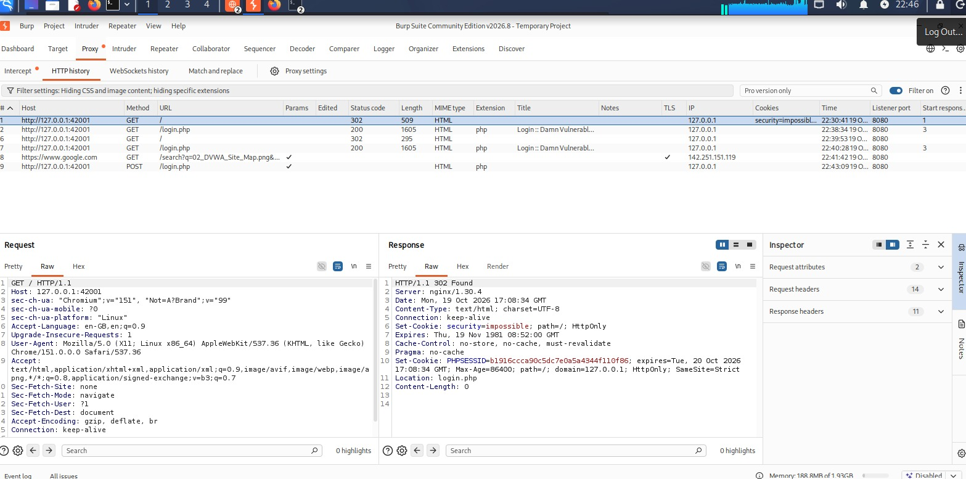
Burp Suite — Proxy & Login Traffic
• Burp captured requests to 127.0.0.1:42001
• GET /login.php and POST /login.php observed
• Proxy listener shown on port 8080
• 302 redirect to login.php is not proof of bypass
• Login outcome requires separate verification
Evidence: Burp HTTP history and response details

Slide 4
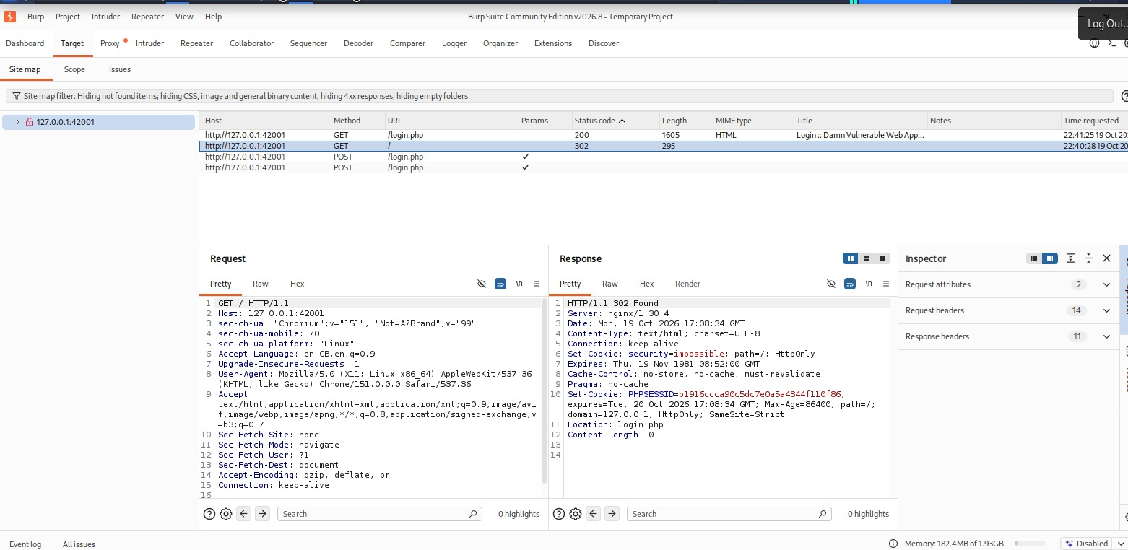
Application Mapping
• Site map shows local host and login endpoint
• Reflected XSS uses the name parameter
• Brute Force page exposes username/password parameters in URL
• Current screenshots do not prove a complete crawl
• Keep unrelated Google traffic out of target findings
Evidence: Burp Target → Site map

Slide 5
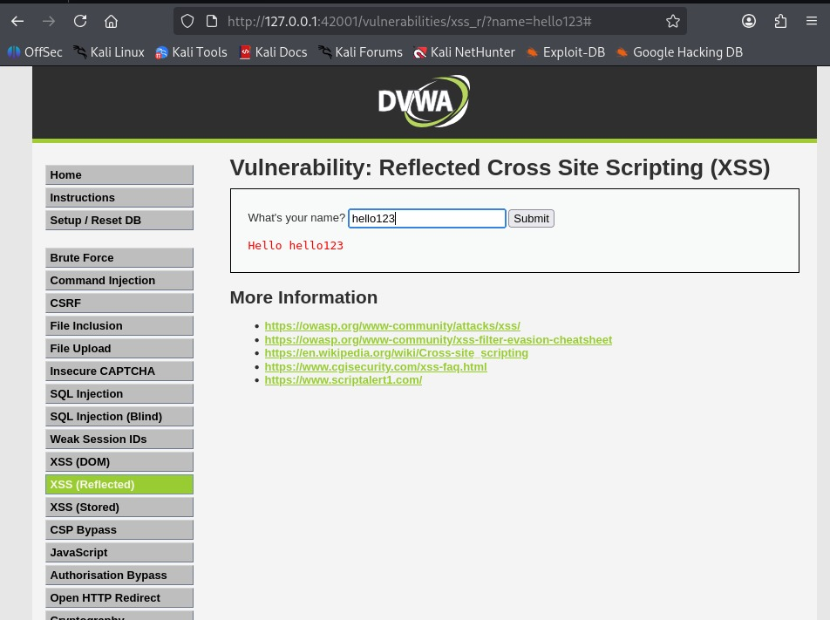
Confirmed Finding — Reflected XSS
• Baseline value hello123 is reflected by the page
• Script test triggered browser alert “1”
• This confirms script execution in the local DVWA lab
• Potential real-world impact: script execution in victim browser
• Fix with context-aware output encoding and safe templating
Evidence: browser alert showing 1

Slide 6
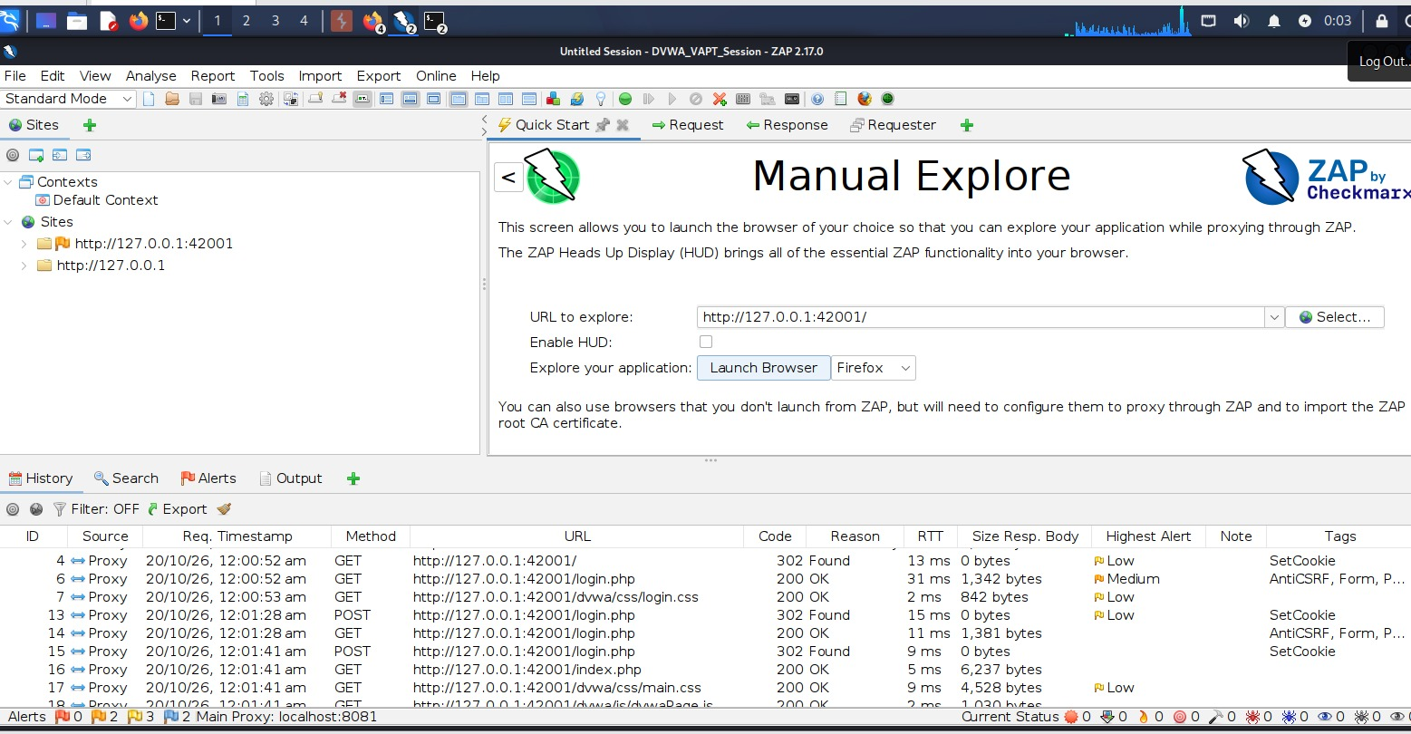
Gobuster Enumeration
• Gobuster v3.8.2 completed 4,613/4,613 requests
• Wordlist: /usr/share/wordlists/dirb/common.txt
• Paths include /config/, /database/, /docs/, /php.ini, /phpinfo.php
• A discovered path or 200/301/302 alone is not a vulnerability
• Inspect content and access controls before claiming disclosure
Evidence: completed local directory enumeration

Slide 7
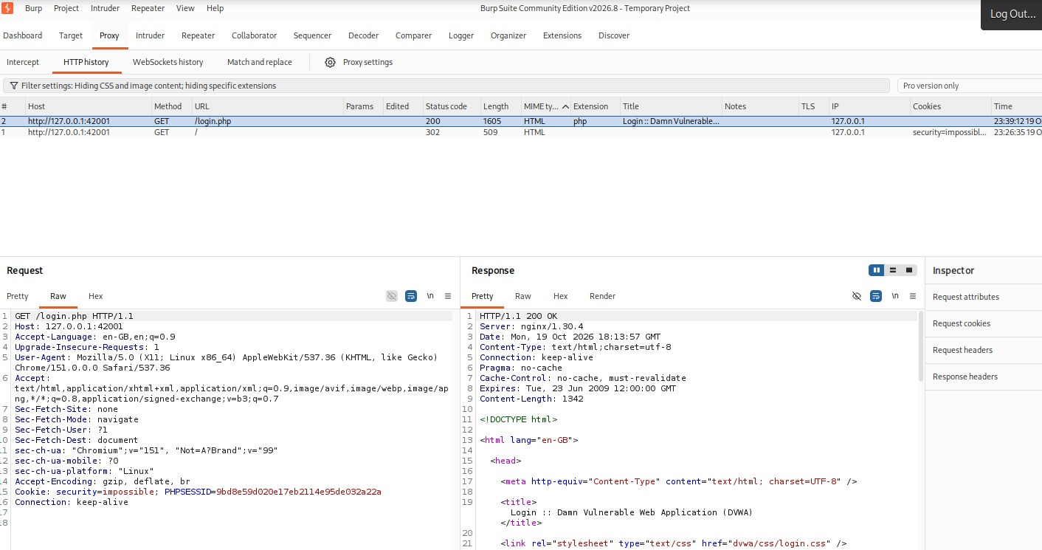
Brute Force & SQLi Status
• Brute Force screenshot shows incorrect credentials
• No successful brute-force or bypass evidence provided
• No SQLi payload/result pair proves database behavior change
• These tests should remain unconfirmed until repeatable evidence is captured
• Test only against the local DVWA instance
Evidence: rejected login attempt

Slide 8
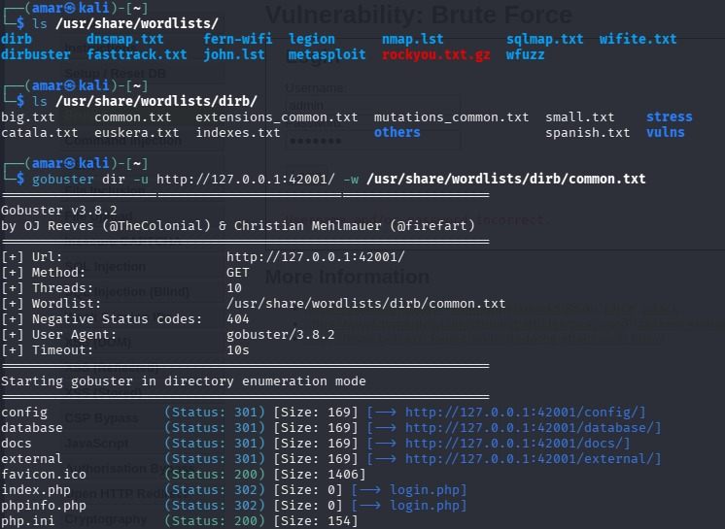
OWASP ZAP Exploration
• ZAP 2.17.0 explored the local DVWA site
• History contains local requests and alert indicators
• Review each alert for exact name, risk, confidence, and evidence
• Generic tags do not automatically prove vulnerabilities
• Manually validate before final reporting
Evidence: ZAP site tree and request history

Slide 9
Results & Remediation
• Confirmed: Reflected XSS in local DVWA
• Observed: path enumeration, login redirects/cookies
• Unverified: SQLi, brute-force weakness, sensitive-file exposure, individual ZAP alerts
• Fix XSS with contextual output encoding and regression tests
• Need at least two more verified findings to meet the “3 working vulnerabilities” requirement
• Report limitation: screenshots reviewed; no live re-test performed

