Slide 1
DG Interns Hub
Cybersecurity Internship – Week 2
Advanced Networking, Analysis & Security Concepts
Prepared by: Amar Pratap
DG Interns Hub • Cybersecurity Internship • Week 2 1/10

Slide 2
Topics Covered
Theory + practical work completed during Week 2
Ports & Services
Common TCP/UDP ports and their real-world uses.
Network Devices
Router, Switch and Firewall — working and differences.
Security Concepts
Network Security, MITM, DoS and Packet Sniffing.
Wireshark
DNS and TLS/HTTPS traffic analysis.
Nmap
Authorized scanning and service/version detection.
Packet Tracer
LAN topology and connectivity testing.
DG Interns Hub • Cybersecurity Internship • Week 2 2/10

Slide 3
Networking Devices & Security Basics
Router
Connects different networks and forwards packets using IP-based routing information.
Switch
Connects devices in a LAN and forwards Ethernet frames using MAC-address information.
Firewall
Applies traffic-control rules to allow legitimate communication and block unauthorized traffic.
MITM
Attacker conceptually positions between communicating parties. Prevention: HTTPS/TLS, VPN and secure networks.
DoS
Attempts to make a service unavailable. Defenses include filtering, rate limiting and monitoring.
Packet Sniffing
Capturing/analyzing packets for troubleshooting or security analysis; encryption reduces exposure.
DG Interns Hub • Cybersecurity Internship • Week 2 3/10

Slide 4
Ports & Services
Examples of commonly used network ports
20/21 • TCP • FTP
File transfer
22 • TCP • SSH
Secure remote login
23 • TCP • Telnet
Remote login
25 • TCP • SMTP
Email sending
53 • TCP/UDP • DNS
Domain resolution
67/68 • UDP • DHCP
IP configuration
80 • TCP • HTTP
Web traffic
110 • TCP • POP3
Email retrieval
123 • UDP • NTP
Time synchronization
143 • TCP • IMAP
Email retrieval
161 • UDP • SNMP
Network management
389 • TCP/UDP • LDAP
Directory services
443 • TCP • HTTPS
Secure web traffic
445 • TCP • SMB
File/printer sharing
3389 • TCP • RDP
Remote Desktop
DG Interns Hub • Cybersecurity Internship • Week 2 4/10
DG Interns Hub • Cybersecurity Internship • Week 2 4/10

Slide 5
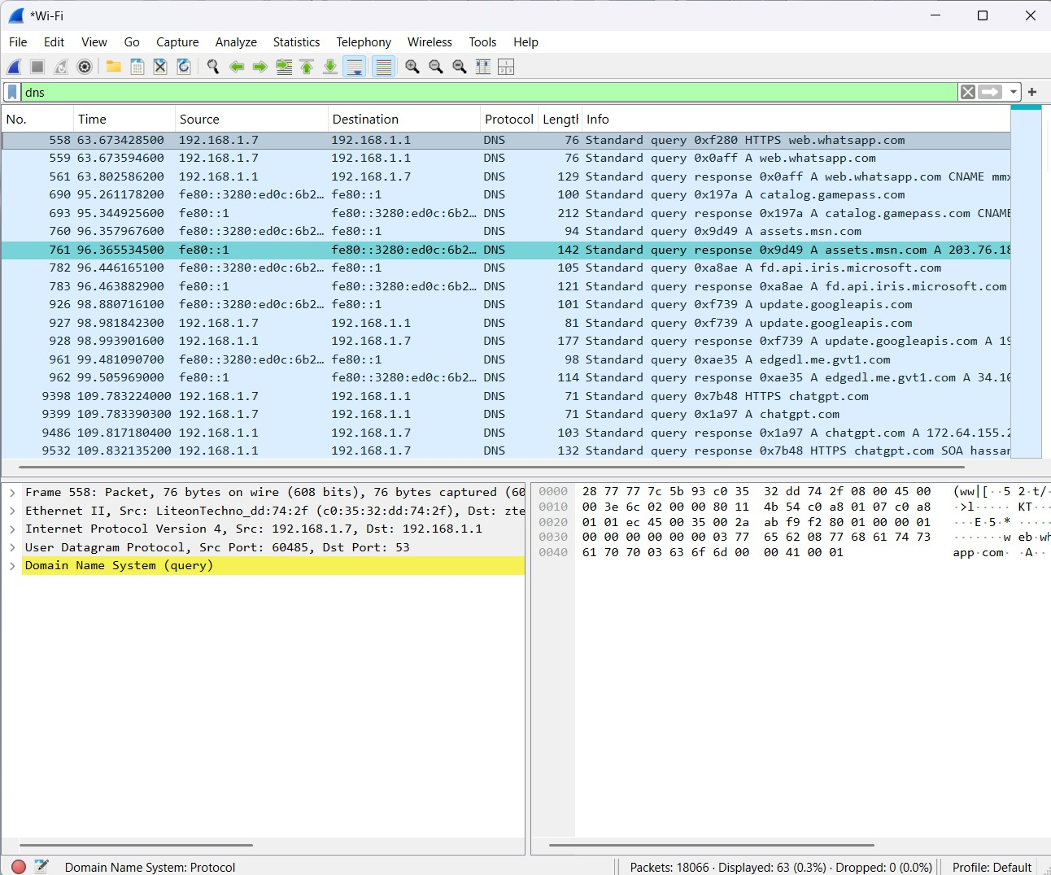
Wireshark – DNS Analysis
Screenshot from the user's own packet capture
Filter Used
dns
The capture displays DNS queries and responses.
Observed
Source: 192.168.1.7
DNS server: 192.168.1.1
Examples
web.whatsapp.com
chatgpt.com
DG Interns Hub • Cybersecurity Internship • Week 2 5/10

Slide 6
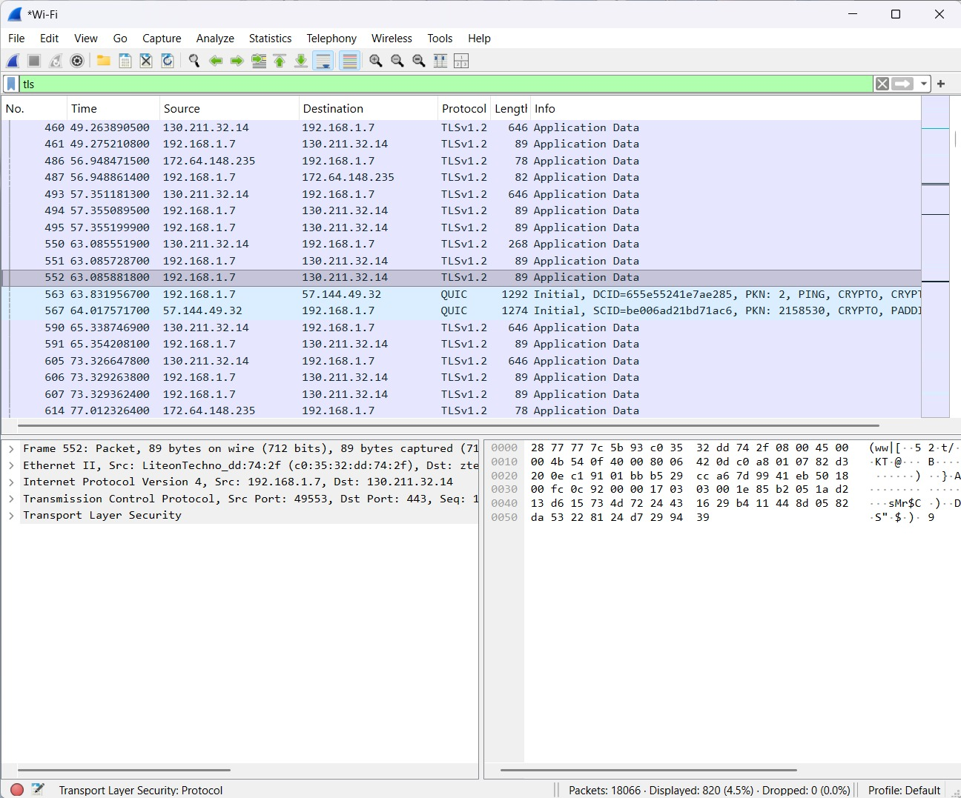
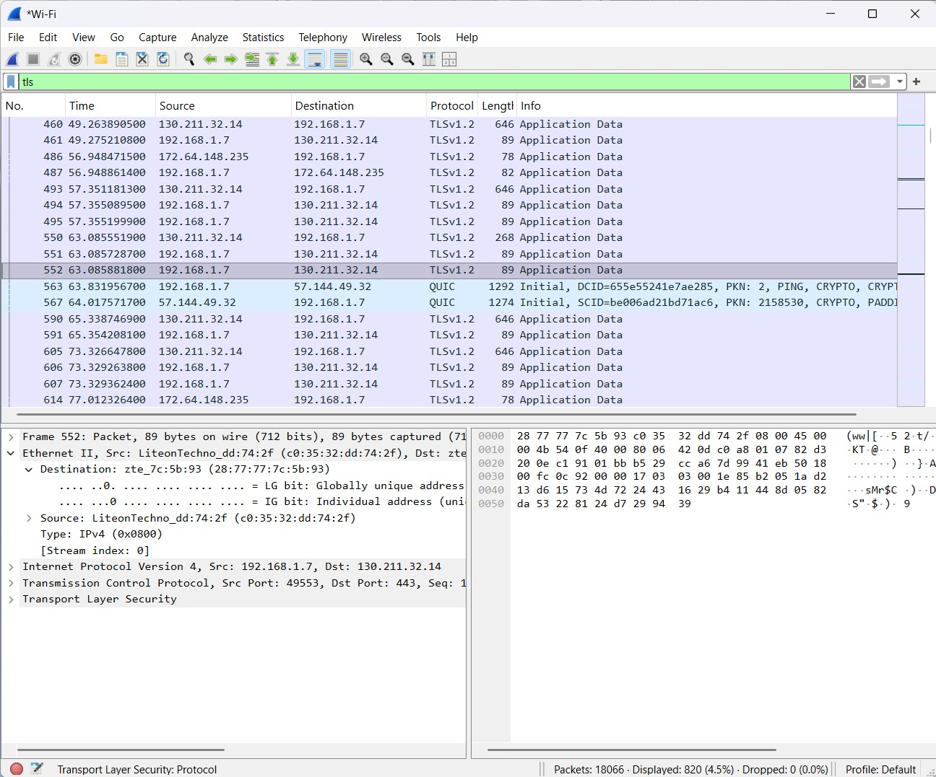
Wireshark – TLS/HTTPS Traffic
Encrypted web traffic observed in the capture
Filter Used
tls
Packet Details
Source: 192.168.1.7
Destination: 130.211.32.14
Destination port: 443
DG Interns Hub • Cybersecurity Internship • Week 2 6/10

Slide 7
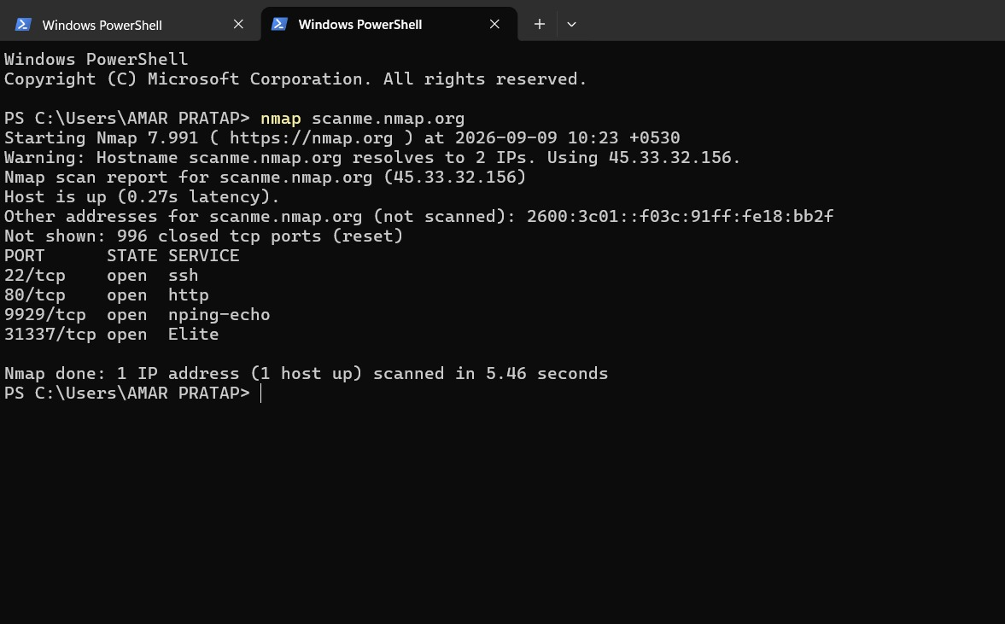
Nmap – Basic Scan
Authorized practice target: scanme.nmap.org
Command
nmap scanme.nmap.org
Observed Open Ports
22/tcp – ssh
80/tcp – http
9929/tcp – nping-echo
31337/tcp – Elite
Safety
Scan only systems where testing is authorized.
DG Interns Hub • Cybersecurity Internship • Week 2 7/10

Slide 8
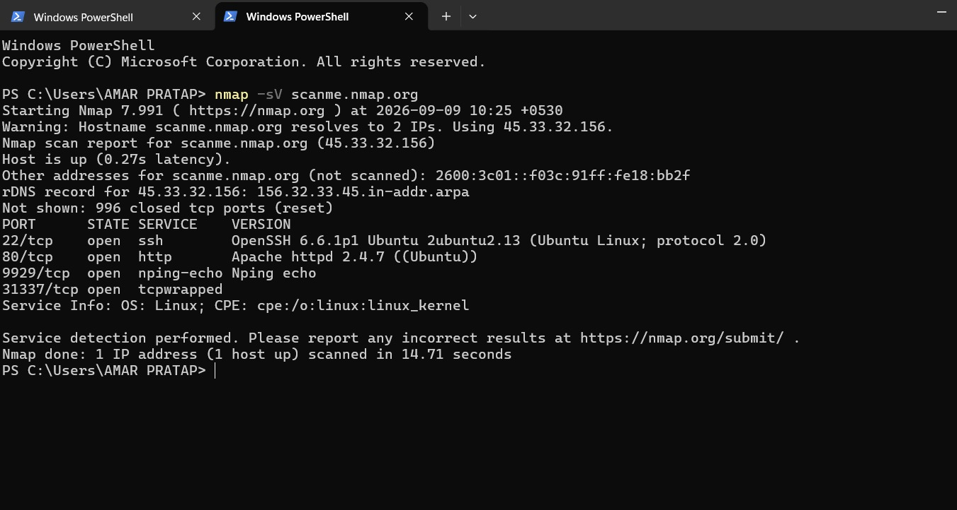
Nmap – Service / Version Detection
Using -sV to identify reported service information
Command
nmap -sV scanme.nmap.org
Observed
22/tcp – OpenSSH 6.6.1p1
80/tcp – Apache httpd 2.4.7
9929/tcp – Nping echo
31337/tcp – tcpwrapped
Host Info
Nmap reports Linux service information.
DG Interns Hub • Cybersecurity Internship • Week 2 8/10

Slide 9
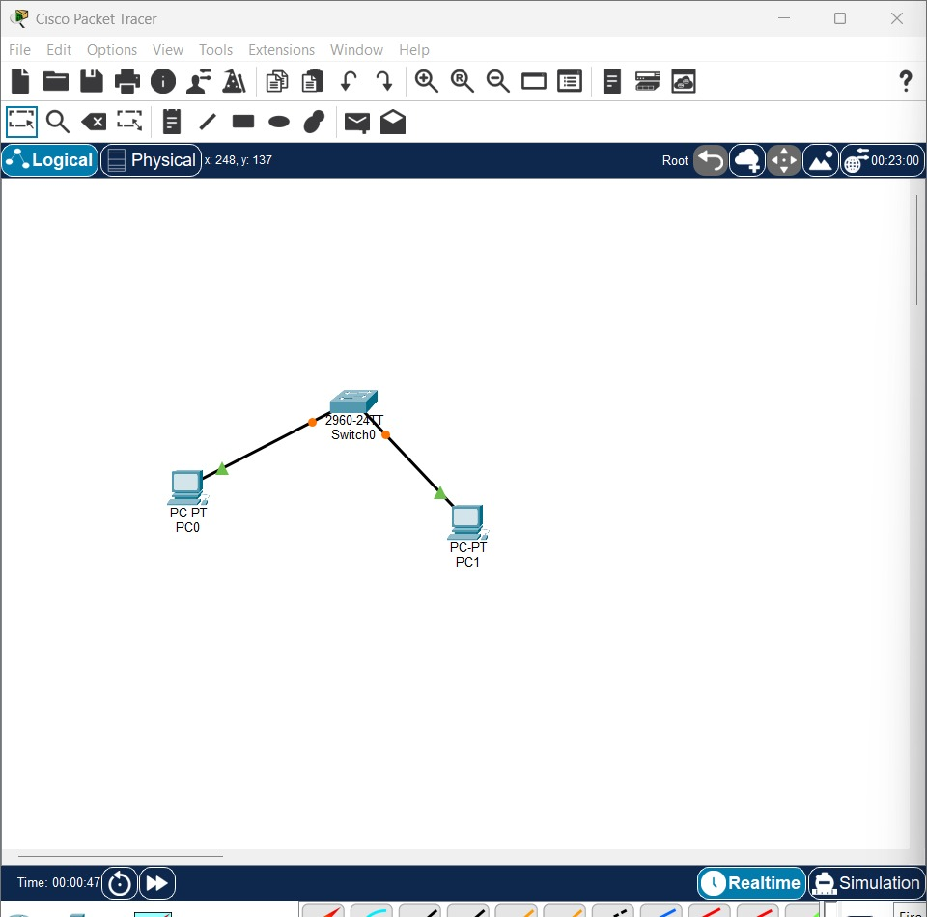
Cisco Packet Tracer – LAN Setup
Two PCs connected through a Cisco 2960 switch
PC1
IP: 192.168.1.10
Subnet: 255.255.255.0
PC2
IP: 192.168.1.11
Subnet: 255.255.255.0
Important Evidence Note
The supplied ping screenshots show each PC pinging its own IP. They do not prove PC-to-PC ping.
DG Interns Hub • Cybersecurity Internship • Week 2 9/10

Slide 10
Key Learnings & Final Checklist
Week 2 completion summary
What I Learned
Network ports, device roles, packet analysis, DNS/TLS traffic, authorized scanning and basic LAN design.
Before Submission
Keep only your own screenshots and verify that every practical result is supported by the screenshot.
Security Understanding
MITM, DoS and packet sniffing concepts, risks and practical prevention measures.
One Screenshot Still Needed
For the LAN requirement, take a screenshot of PC0/PC1 pinging the OTHER PC's IP (e.g., PC0 → 192.168.1.11).
Tools Practiced
Wireshark • Nmap • Cisco Packet Tracer
Conclusion
Week 2 strengthened practical networking and cybersecurity fundamentals.
DG Interns Hub • Cybersecurity Internship • Week 2 10/10

