Slide 1

LAKSHMI NARAIN COLLEGE OF TECHNOLOGY, EXCELLENCE
Approved by AICTE & Govt. of M.P.
ELECTRICITY BILLING
SUBMITTED BY:
NAME:- AMAR PRATAP SINGH
Enrollment No.:-0176CS201026
College :-LNCTE

Slide 2
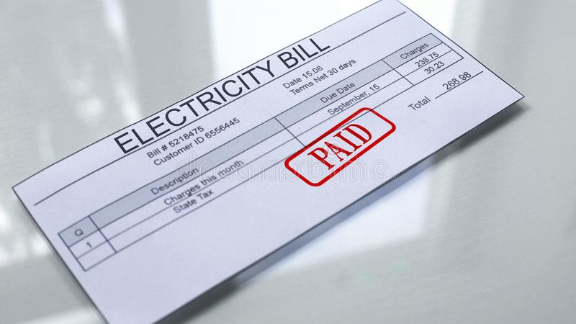
INTRODUCTION
This system work mainly generate bill of customer . In this electricity billing system mainly use the concept of object oriented programming . Using this system, we easily generate electricity bill, save data and generate pdf of the bill.

Slide 3
HOW IT WORK ?
Firstly this system take customer name, Phone number, Consumer No.
Then it take last month and current month meter reading.
Then calculate amount of bill.
After that it calculate last date of pay electricity date.
Then add ₹10 on amount as late fine after paying last date

Slide 4

HOW CALCULATE AMOUNT OF BILL ?
BILL CALCULATE IN FOLLOWING WAY-
It take last month meter reading and current month
meter reading.
Calculate unit = current month meter reading-last month reading.
Then that unit will charge with 5.5. and add sub charge with discount.
At last it calculate total amount

Slide 5
Function of electricity billing
Function are:-
1)Calculated amount
II) Generate bill
III) Save bill data in excel sheet
IV) Generate pdf of bill
Electricity Billing

Slide 6




Technology and model
Technology and Tool Use:-
->Python
->Vscode
Model & Library Use:-
->Tkinter
->Date & Time
->Report lab
->CSV

Slide 7
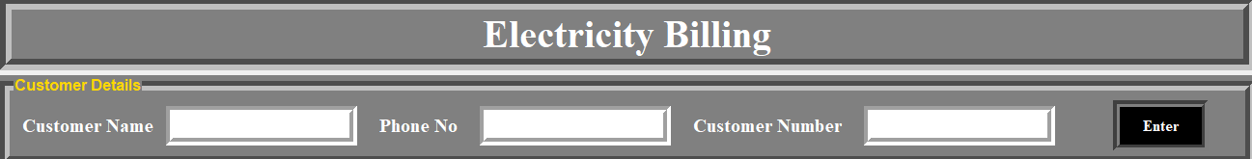
Slide of application
Customer Name
Consumer Number
Customer Mobile Number

Slide 8
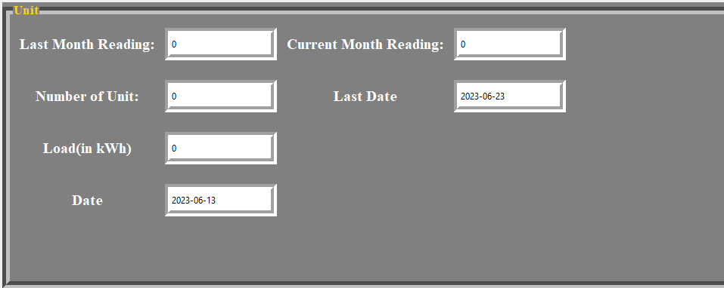
Unit Frame
Current Month Reading
Last Month Reading
No. Of Unit(Auto Generate)
Last Date Of Submission
Meter Load
Current Date

Slide 9
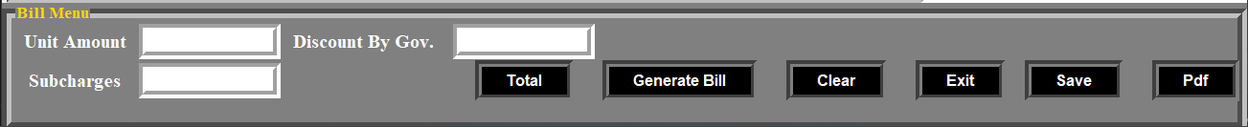
Bill Menu
Unit Amount
Discount By state Gov.
Bill Generate Button
Exit Button
Pdf Button
Sun Charge or tax
Total Button
Clear Button
Save Button

Slide 10
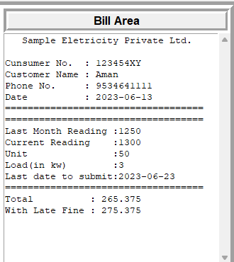

Bill Area
Sample Bill

Slide 11
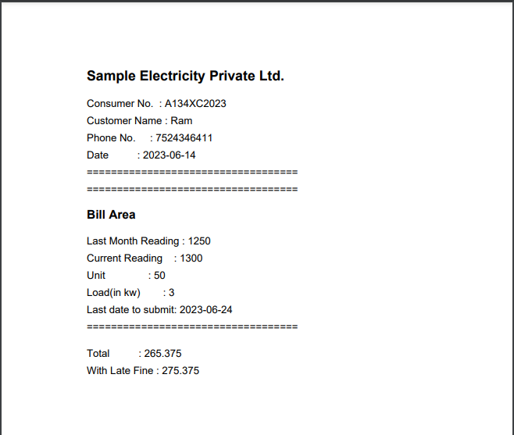
Sample of pdf

Slide 12
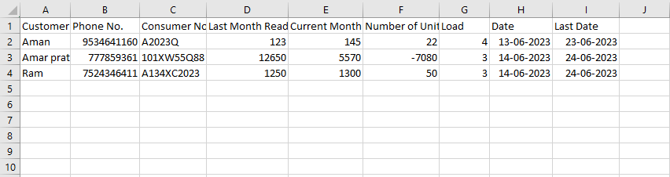
Save Data

Slide 13
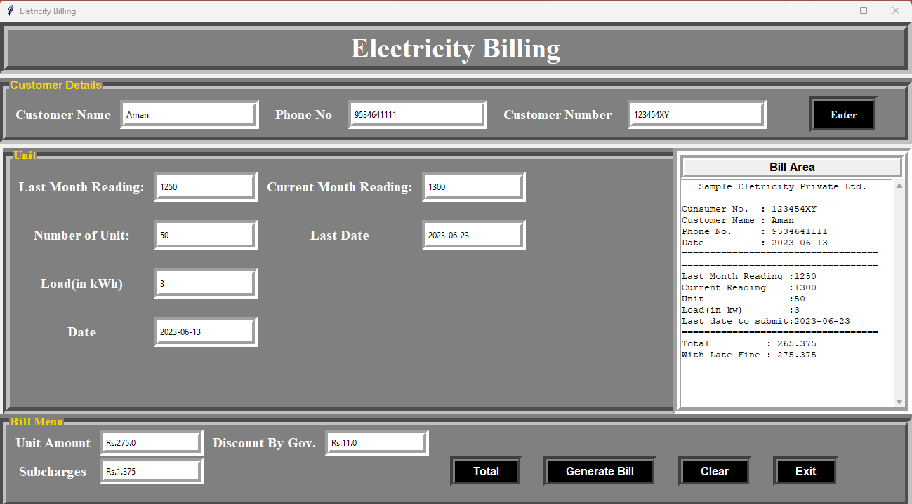

Slide 14
Thank
You
All

