Slide 1



Credit Default Prediction
Project Members:
Pravin Anand Pawar
Fnu Priyesh
NUID:001094740

Slide 2
Credit Default Prediction
Prediction of customer defaults using their personal finance data
Interpretation of results and identifying key factors affecting the result
Analyse clients dataset with Delinquency, Spend, Payment, Balance and Risk features
Develop efficient model for accurate predictions

Slide 3
Why is it interesting?
Real world dataset of American Express(450k+ rows and more than 50 predictors) with practical application
Banks has 100k + lending accounts
Reduce Risk and maintain flow of money
Current accuracy is still 80%

Slide 4
What are the approaches you plan to explore?
Exploratory Analysis:
Covariance and heatmap
Preprocessing:
Data cleaning and normalization
PCA
Classification Algorithm:
Logistic
SVM
Tree Based Method(Decision Tree, Random forest)
Neural Network
Gradient Boosting Algorithms(XGBOOST)
Multi model ensemble
Interpretation of results:

Slide 5
Rationale behind the proposed approach
Logistic Regression:
Logistic regression can serve as a good baseline to track linear relationships for binary classification. Due to its transparency, it is widely used in industries like banking & finance.
Support Vector Machine:
SVMs can handle non-linear data which is useful when fraud patterns are complex. It also maximizes the margin between classes, making it robust against the outliers seen in such data.
Tree Based Method(Decision Tree, Random forest):
Decision trees are easy to understand, and random forests provide an ensemble approach that reduces overfitting. They can also help in highlighting important features valuable for understanding fraud patterns.

Slide 6
Rationale behind the proposed approach
Neural networks:
Neural networks, can capture complex, non-linear patterns in data. It can also provide some insights on the effectiveness of simpler models such as logistic regression.
Gradient Boosting Algorithms (XGBoost, LightGBM):
Gradient boosting algorithms often perform very well in terms of classification accuracy. These algorithms can handle imbalanced datasets and outliers effectively, which is common in fraud detection.
Multi-Model Ensemble:
Combining predictions from multiple models can lead to more accurate fraud detection. It can also mitigate the risk of false positives, false negatives, and overfitting.

Slide 7
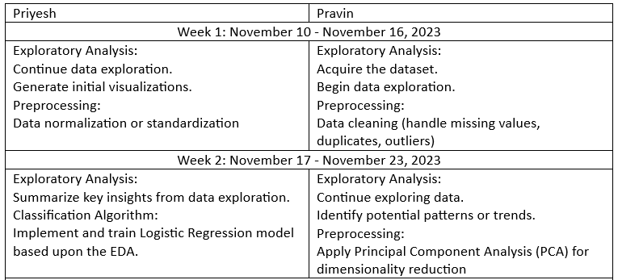
TIMELINE

Slide 8
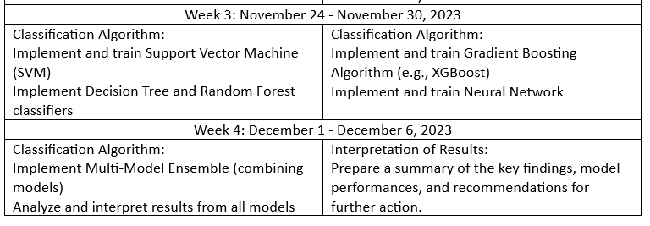
TIMELINE

Slide 9
THANK YOU

