Slide 1

Reproducibility Study: Bi-Dimensional Representation of Patients for Diagnosis Prediction
Tariq Aziz, Allen Marquez
CSE6250 - Georgia Institute of Technology

Slide 2
General Problem
Disease prediction from unstructured EHR notes
Original paper used discharge summaries to predict ICD-9 codes
Goal: build patient representations and train classifiers

Slide 3
Specific Approach from the Paper
Extracted symptoms using MetaMap
BiLSTM models with TF-IDF, Word2Vec, and hybrid representations
Evaluated on MIMIC-III with standard metrics (F1, AUC)

Slide 4
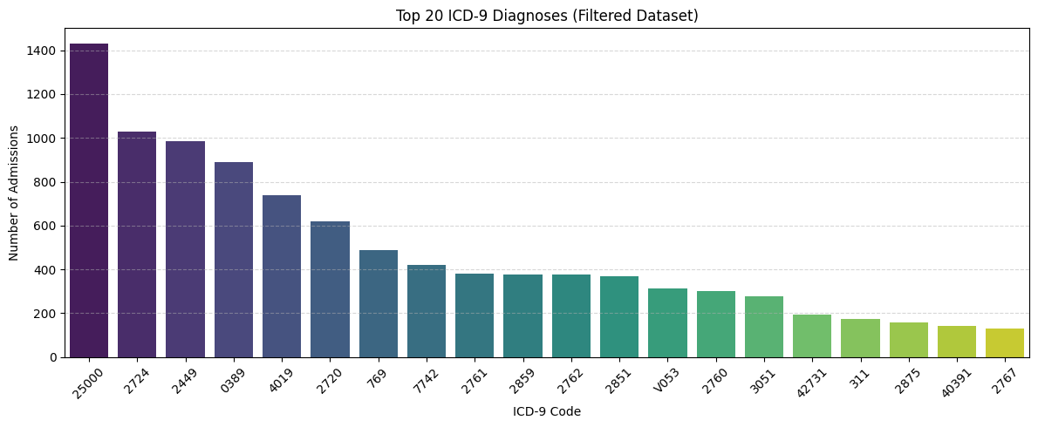
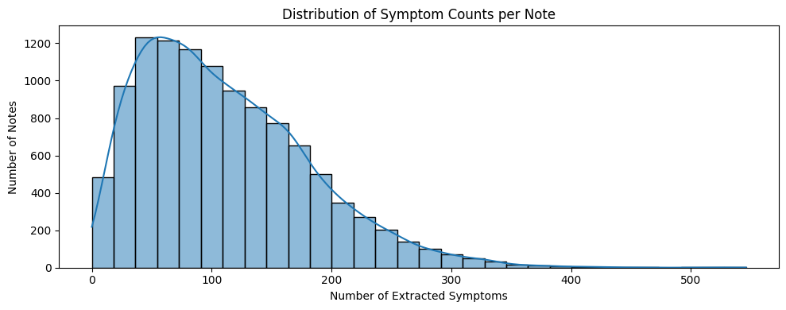
Our Pipeline
Used SciSpaCy + UMLS linker for symptom extraction
Filtered to top 50 ICD-9 codes
Cleaned and sectioned notes from MIMIC-III

Slide 5
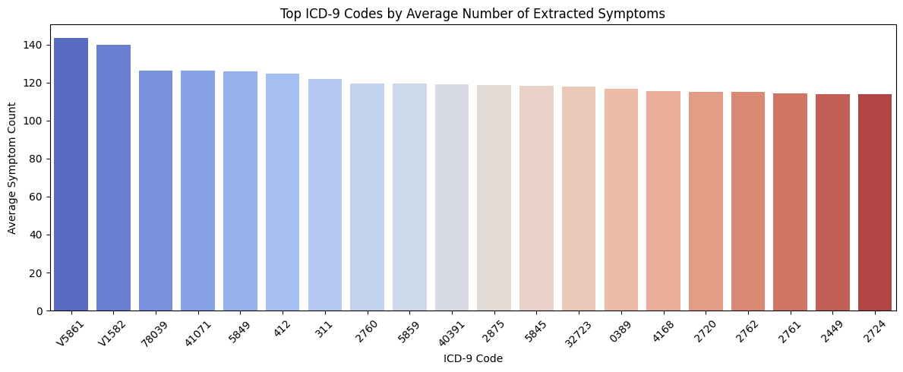
Models Implemented
TF-IDF + BiLSTM
Word2Vec + BiLSTM
Hybrid (TF-IDF + Word2Vec) + BiLSTM
Custom PyTorch implementation

Slide 6
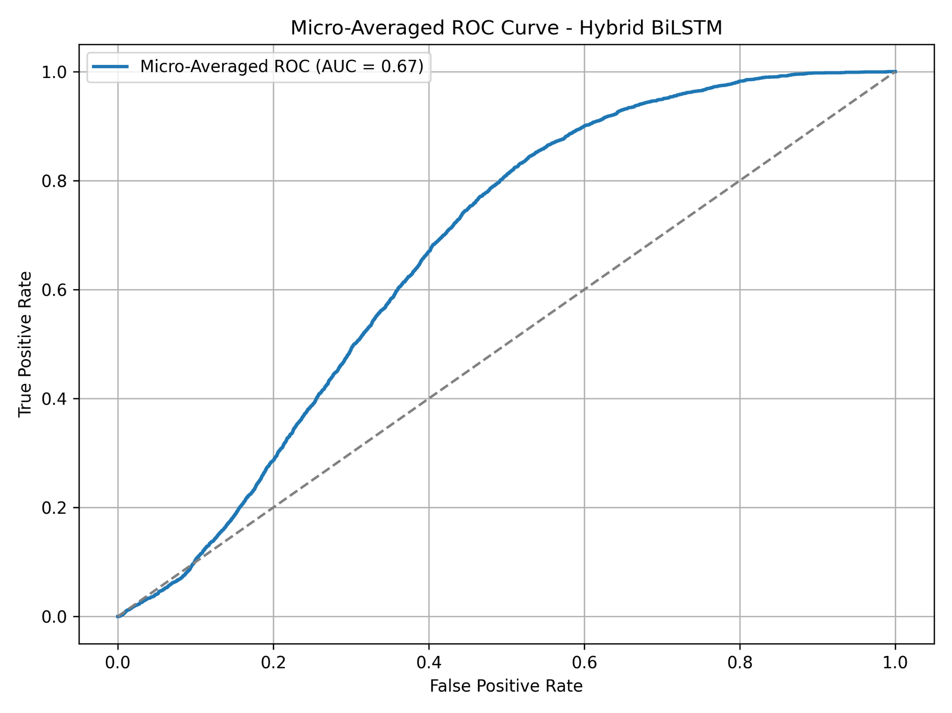
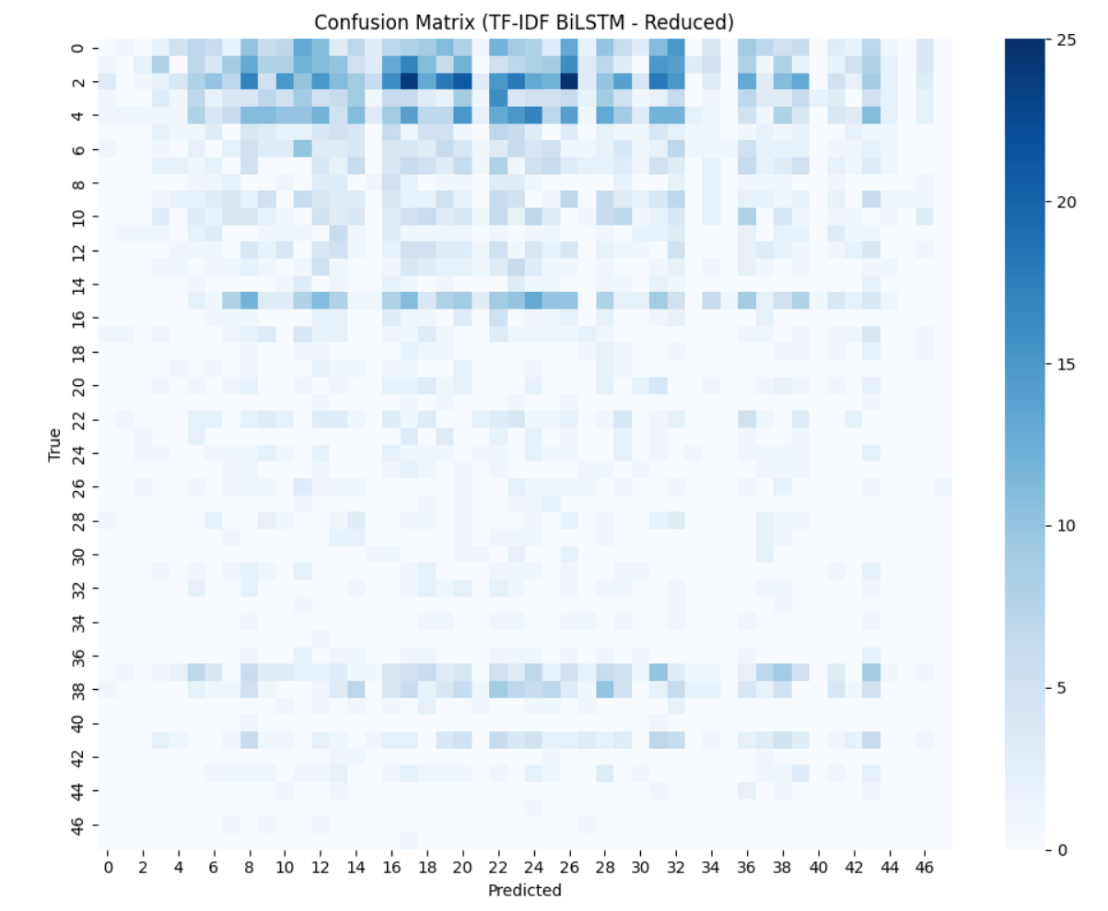
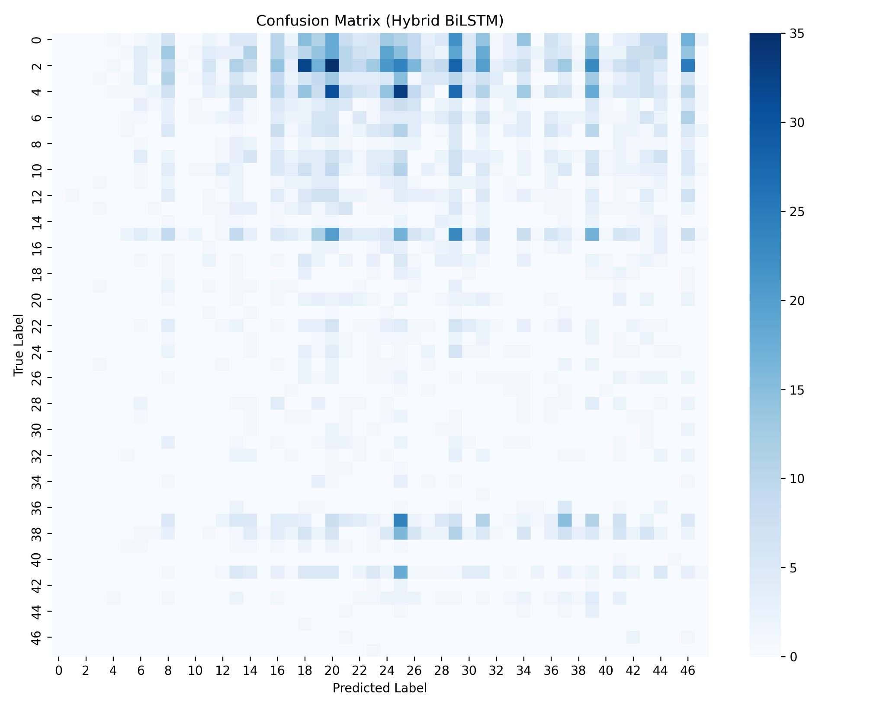
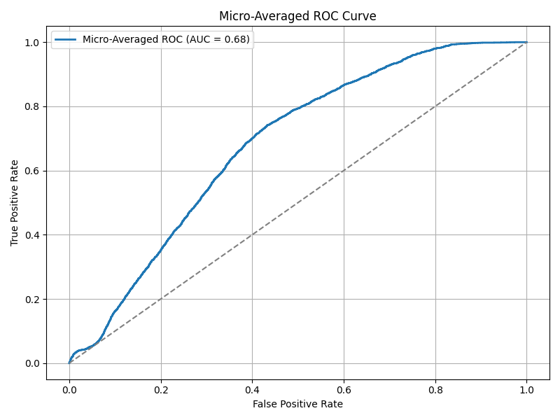
Results Summary
Hybrid model achieved highest F1 and AUC
Performance similar to original paper despite tool differences
Confusion matrices and ROC curves support findings

Slide 7
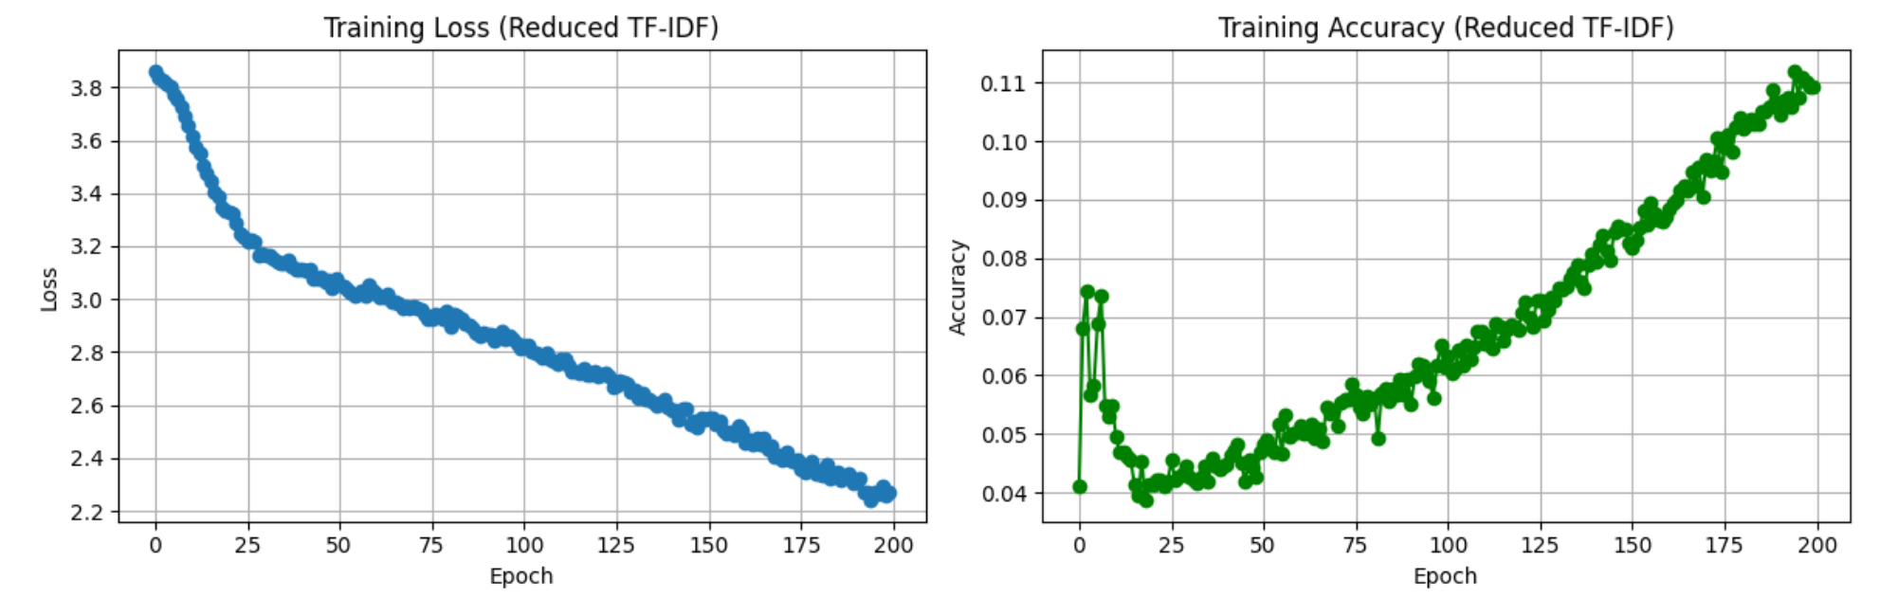
Why It Matches / Differs
Matching trends with original paper
Differences due to symptom extractor (MetaMap vs SciSpaCy)
Manual tuning and class imbalance may affect minor variations

Slide 8
Extensions & Observations
Analyzed symptom count variability
Observed richer symptom profiles for some ICD-9 codes
Explored ablation but focused on reproducibility

Slide 9
Challenges Faced
No public code from original authors
Ambiguity in symptom extraction logic
Heavy label imbalance, sparse symptoms in some notes

Slide 10
Reproducibility Verdict
Largely reproducible with effort and modern tools
SciSpaCy and LLMs helped bridge gaps
Reinforces robustness of core methodology

Slide 11
Artifacts & Acknowledgments
Codebase: https://github.com/amarqez/BD4H
Presentation Video: [Insert Link]
Thank you!

Slide 12
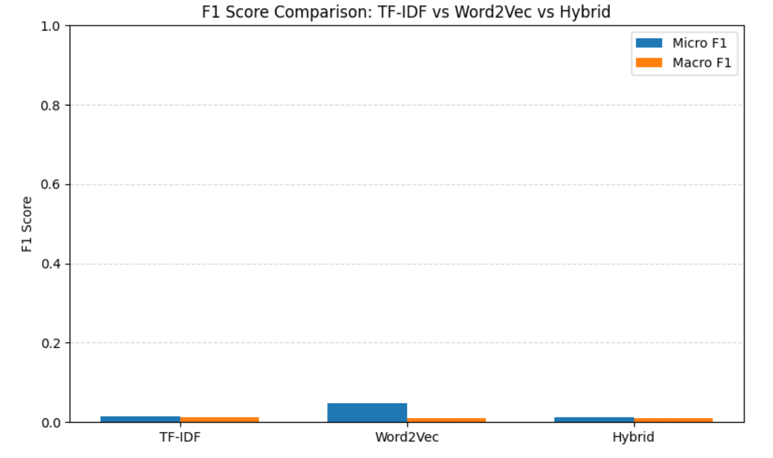
F1-Score Comparison: TF-IDF vs Word2Vec vs Hybrid

