Slide 1
Internship report 2021-2022

Slide 2

Prsesented by
Amar Pratap Singh
CSE 3A
1900300100024
Anuj Pratap Singh
CSE 3A
1900300100040
INDERPRASTHA ENGINEERING COLLEGE

Slide 3
Introduction of courses
Courses Done By Amar:
Crash course on Python
Java Foundations
Courses Done By Anuj:
Crash course on Python
Java Foundations
Project Link: github.com/amarrathore045/ProjectIGE

Slide 4
Course outline : Crash Course ON python
Python is one of the most popular programming languages in the world – Huge companies like Google use it in mission critical applications like Google Search.
Python is the number one language choice for machine learning, data science and artificial intelligence.
In this course we have learnt :
Understand what Python is and why Python is relevant to automation
Object-Oriented Programming (OOP)

Slide 5
Course outline : java foundations
Engages participants with little programming experience in Java programming using a standard Java editor.
Participants are introduced to programming concepts, object-oriented concepts, terminology, and syntax, and the steps required to create basic Java programs.
In this course we have learnt :
Develop problem-solving, collaboration,
and critical-thinking skills
Object-Oriented Skills in Java

Slide 6
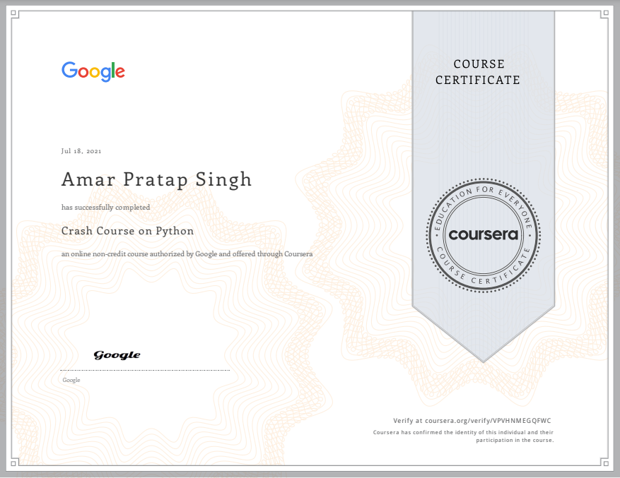
Certifacte of Amar
Course 1: Crash Course on python

Slide 7
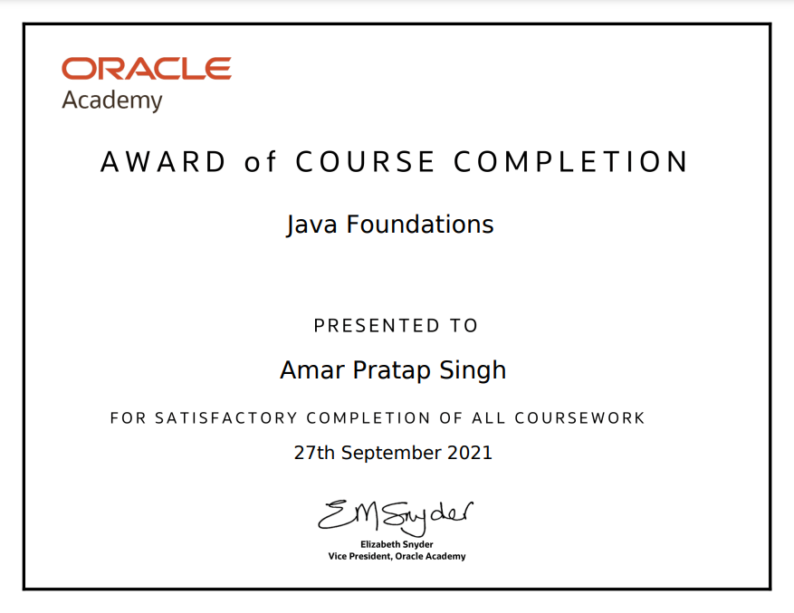
Certifacte of Amar
Course 2: java foundations

Slide 8
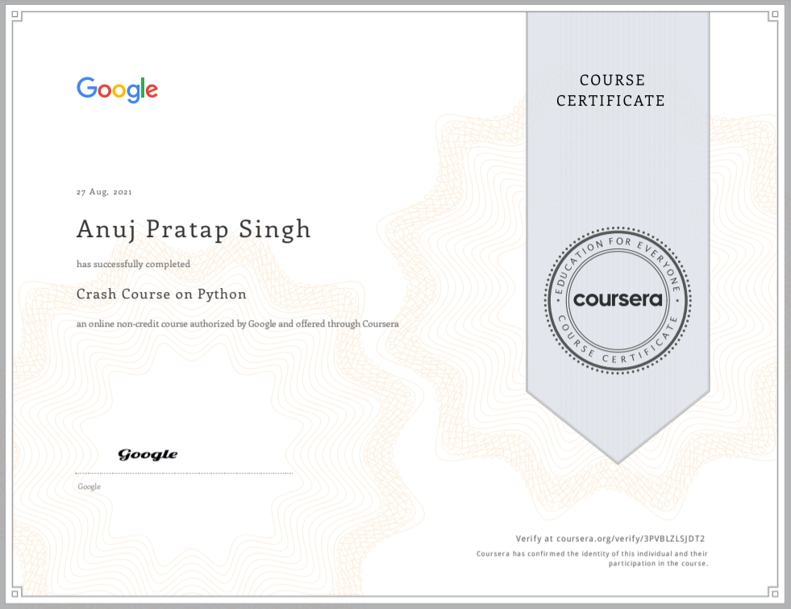
Certifacte of Anuj
Course 1: Crash Course on python

Slide 9
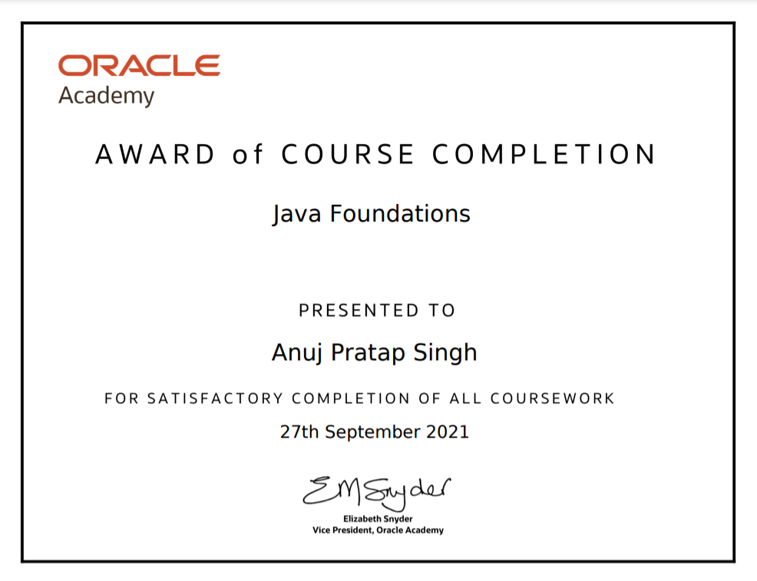
Certifacte of Anuj
Course 2: java foundations

Slide 10
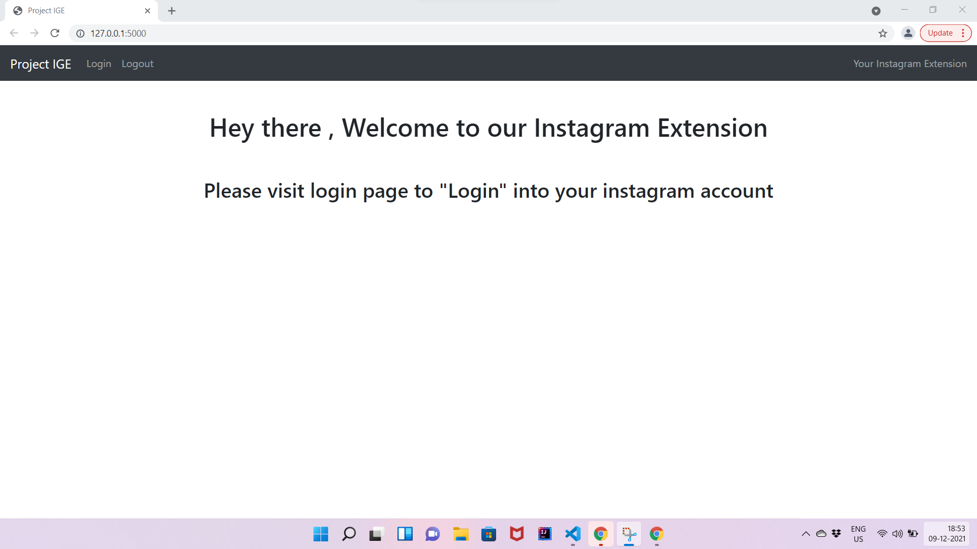
Our project:
Project ige
(Instagram
extension)
Project Link: github.com/amarrathore045/ProjectIGE

Slide 11
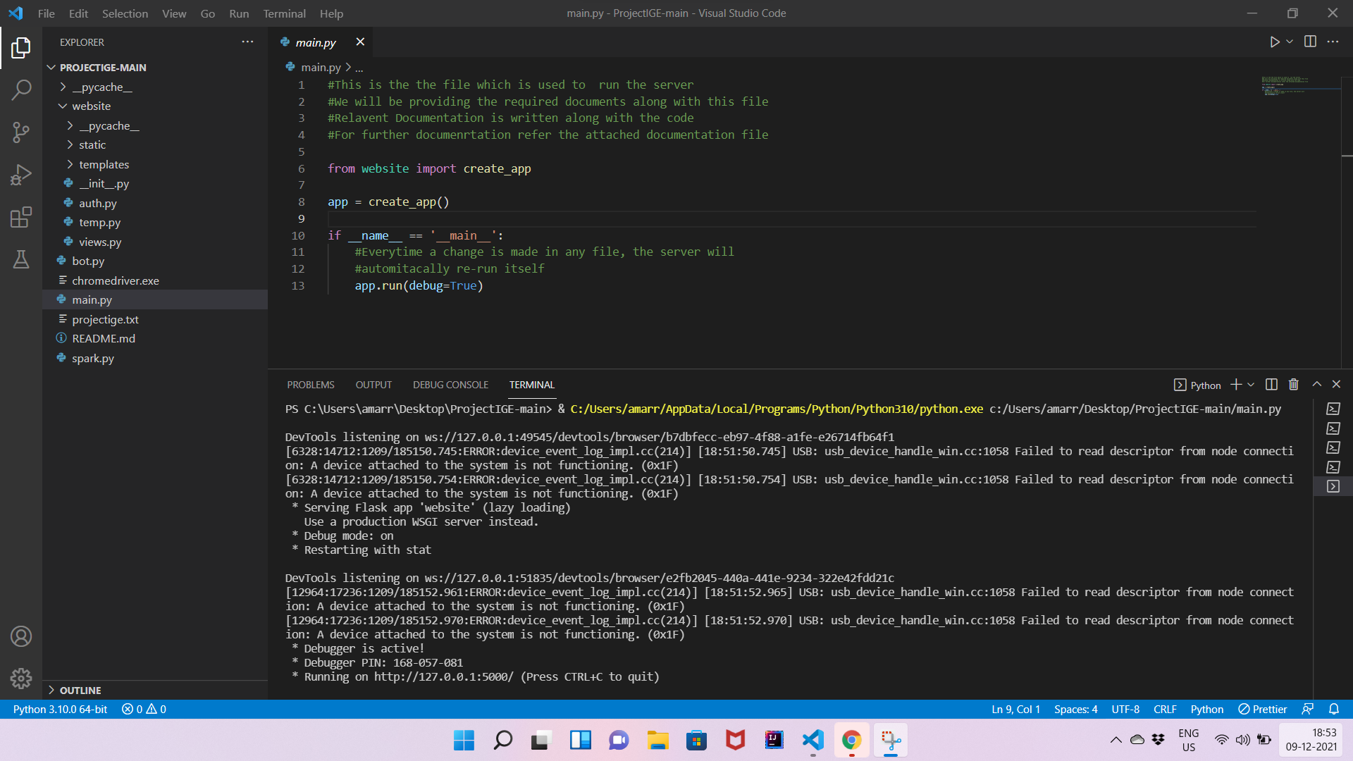
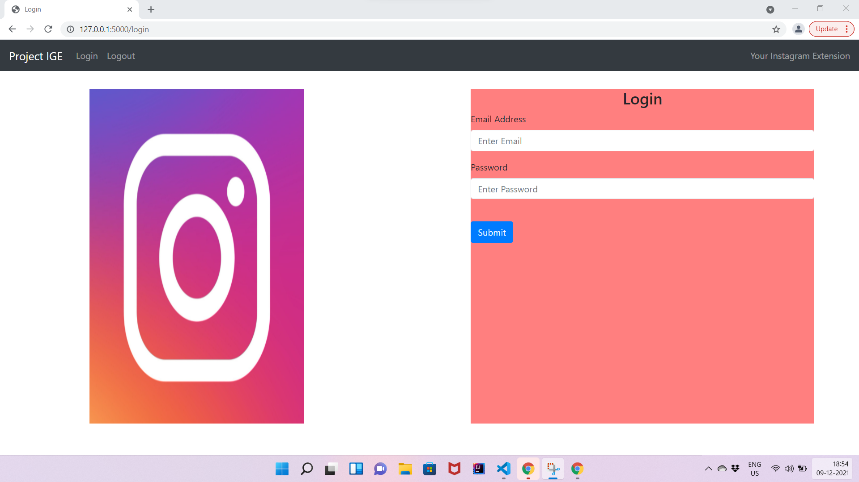
Our project: project ige
Project Link: github.com/amarrathore045/ProjectIGE

Slide 12
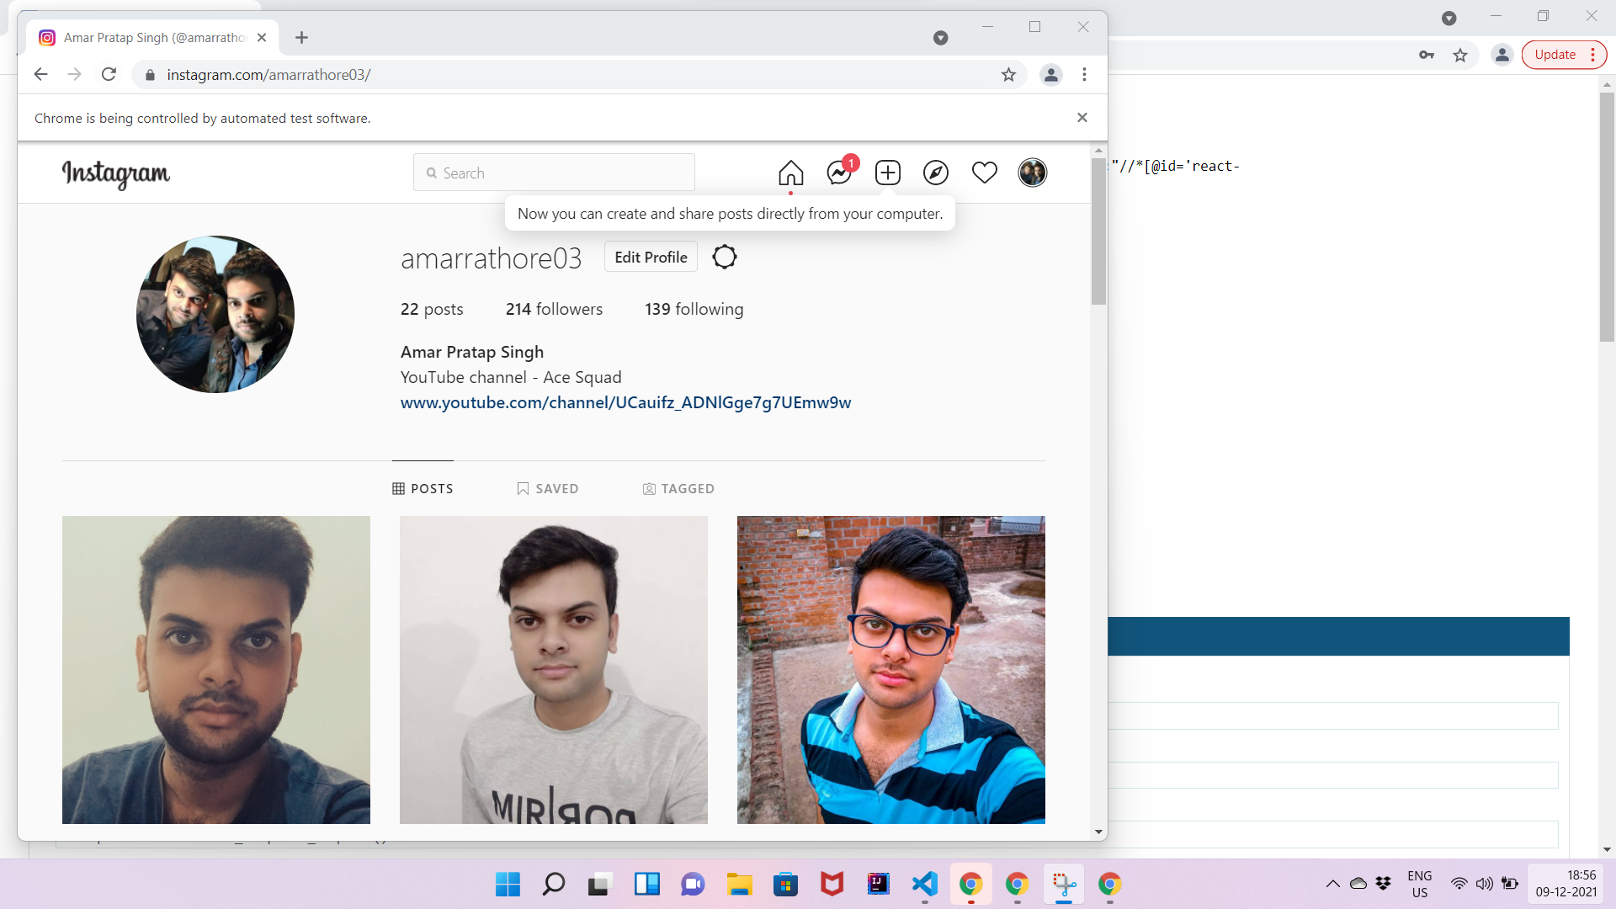
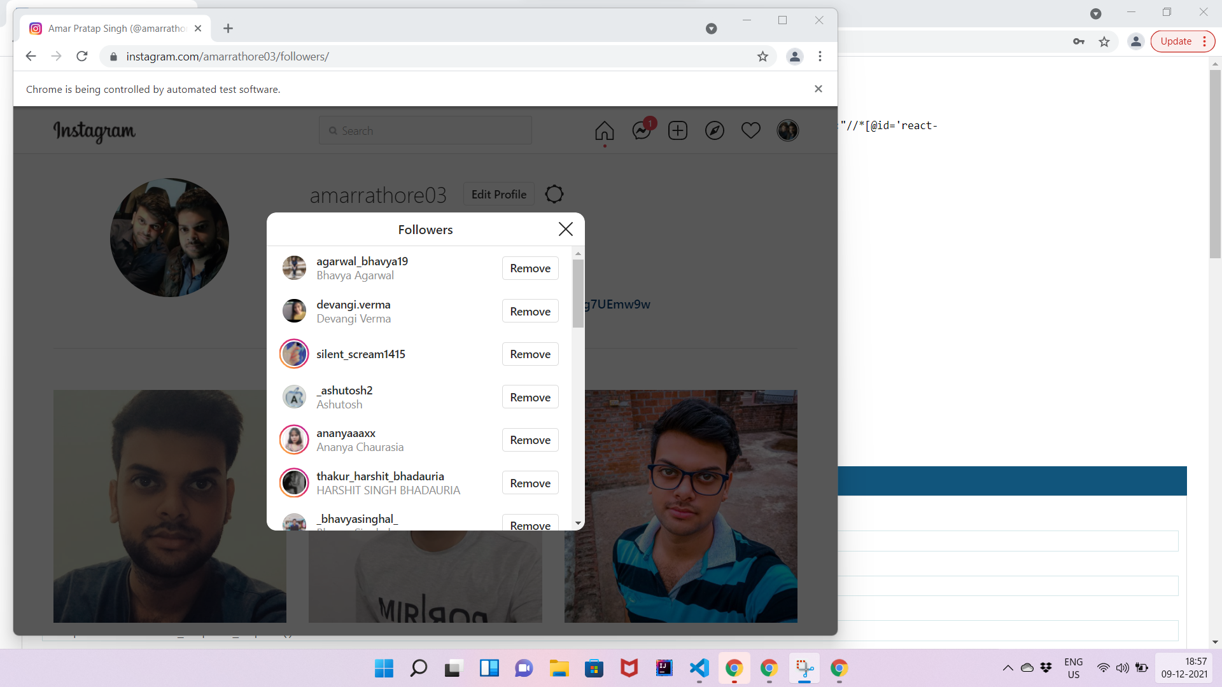
Our project: project ige
Project Link: github.com/amarrathore045/ProjectIGE

Slide 13
Thank You !
Project Link: github.com/amarrathore045/ProjectIGE

