Slide 1
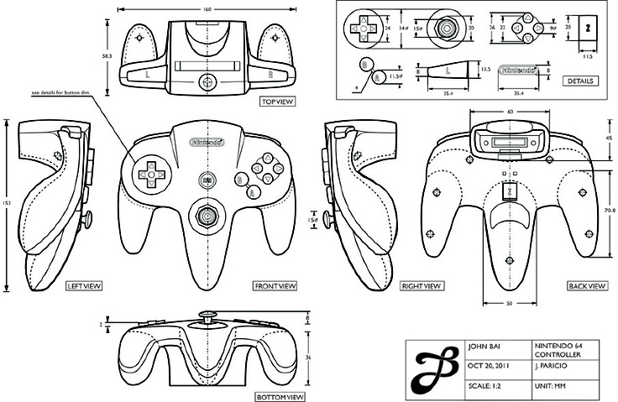
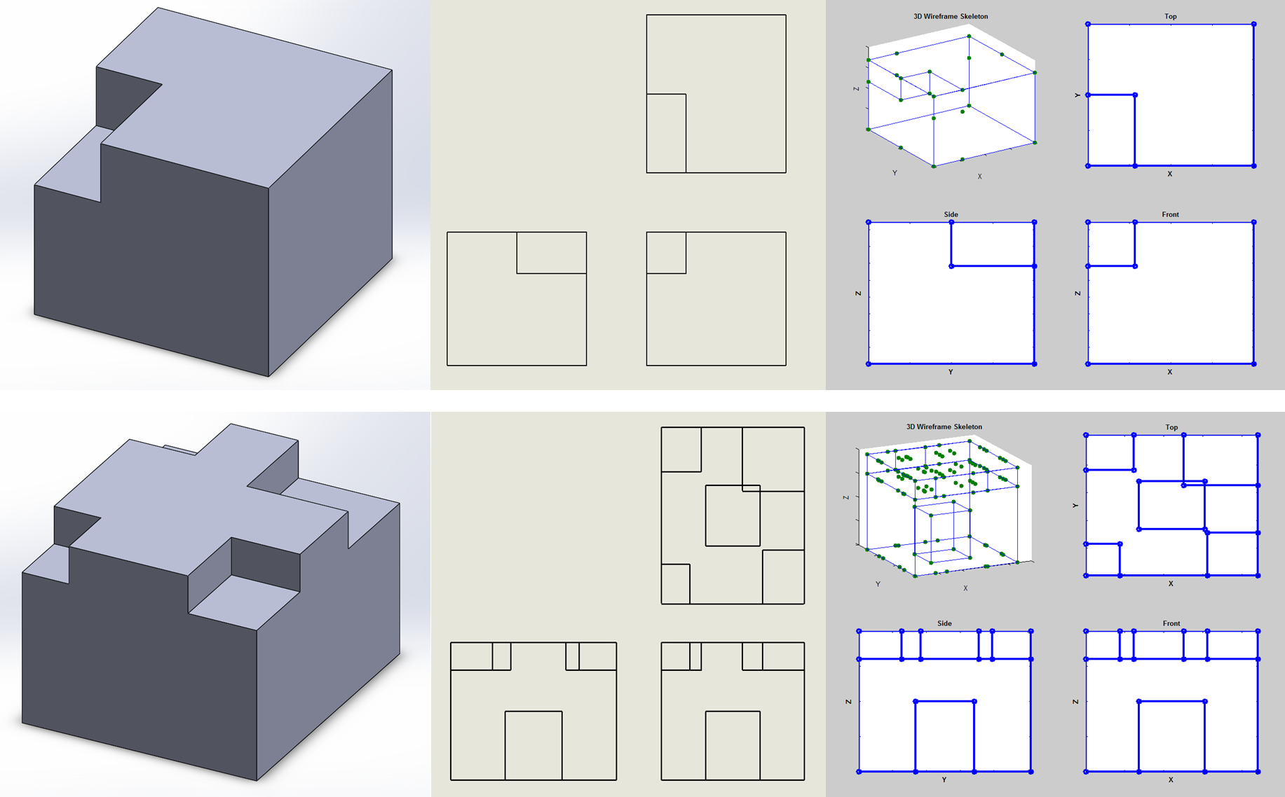
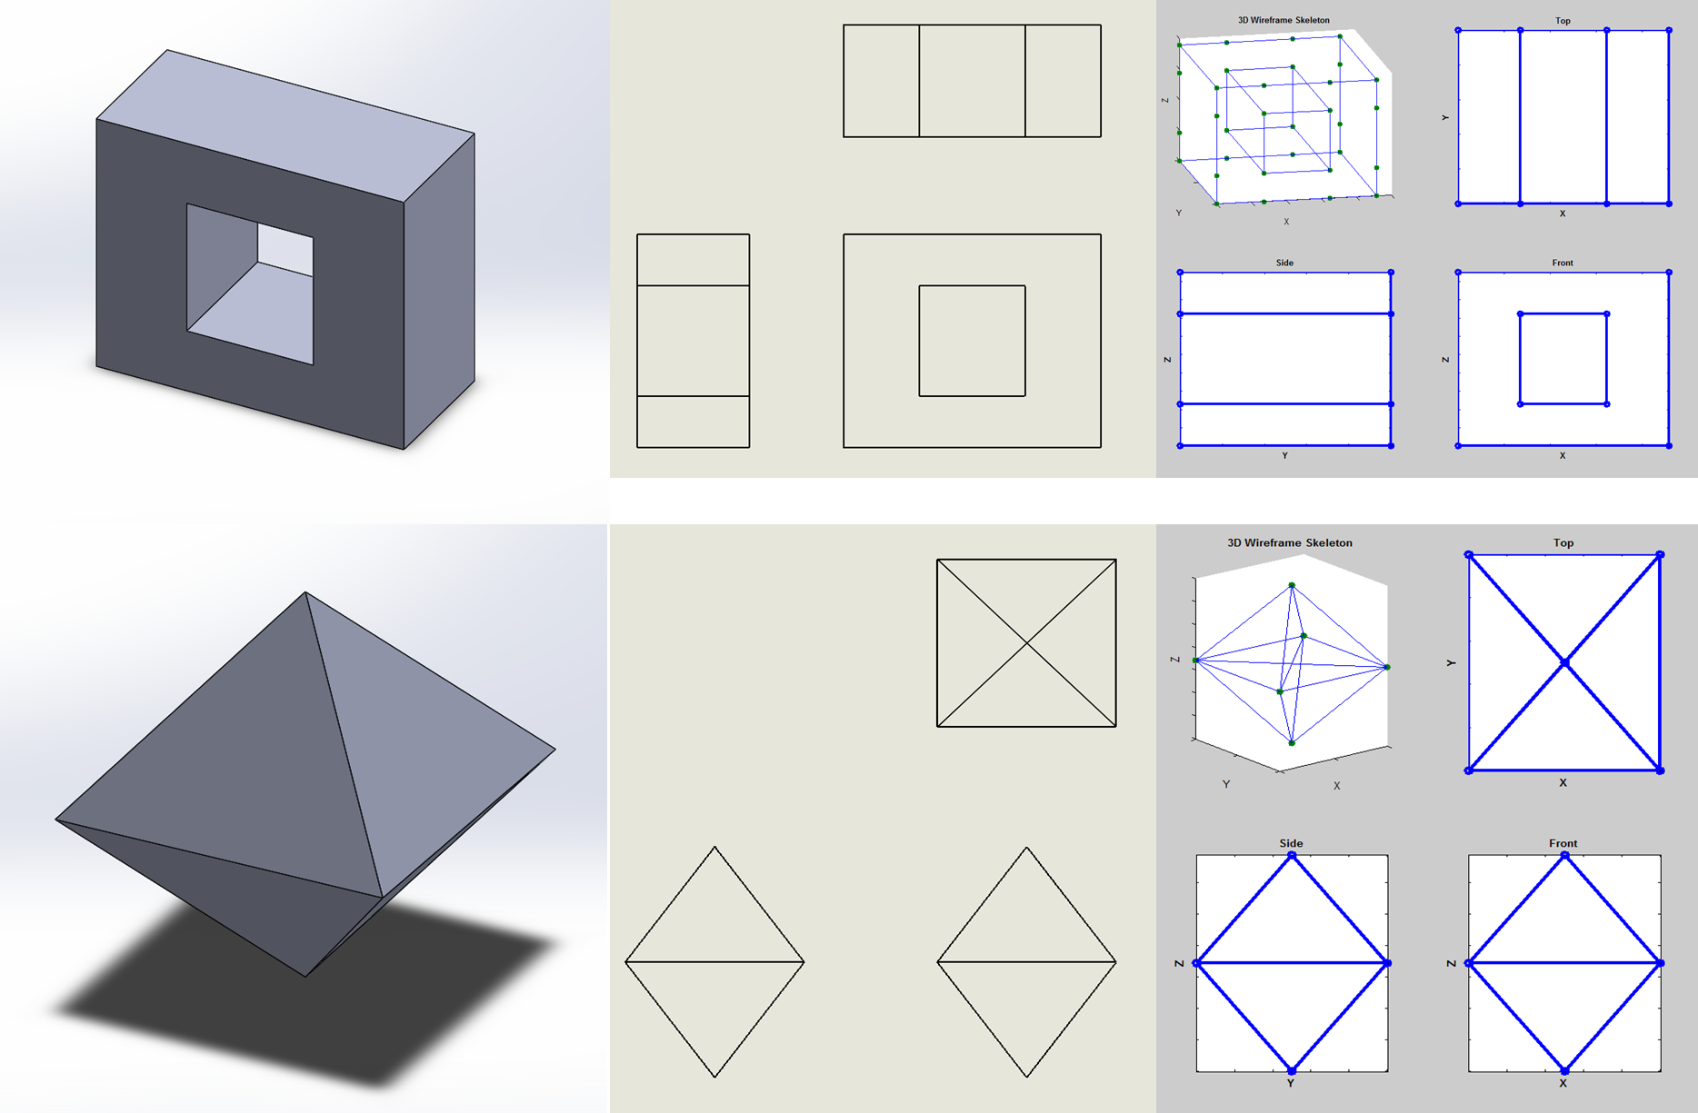

2D Orthographic Drawings to 3D Objects
What is an orthographic drawing?
Who cares?
How did I do it?
Where to go from here?

