Slide 1


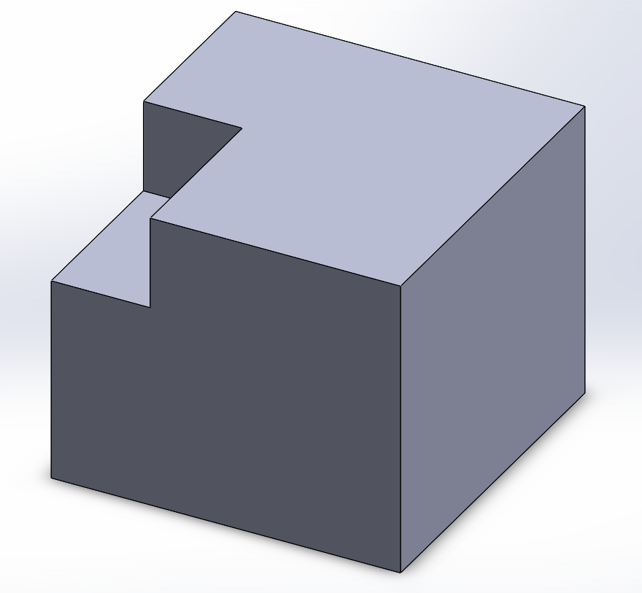
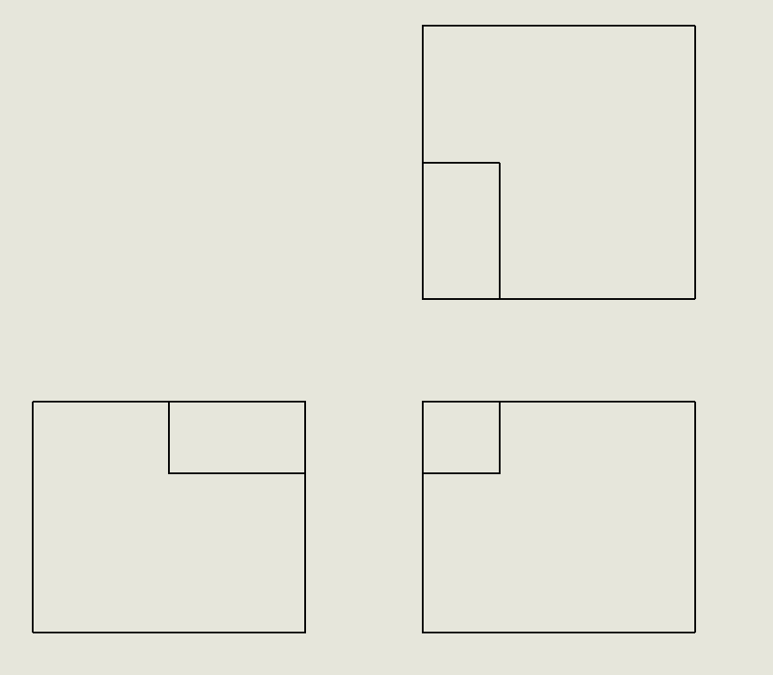
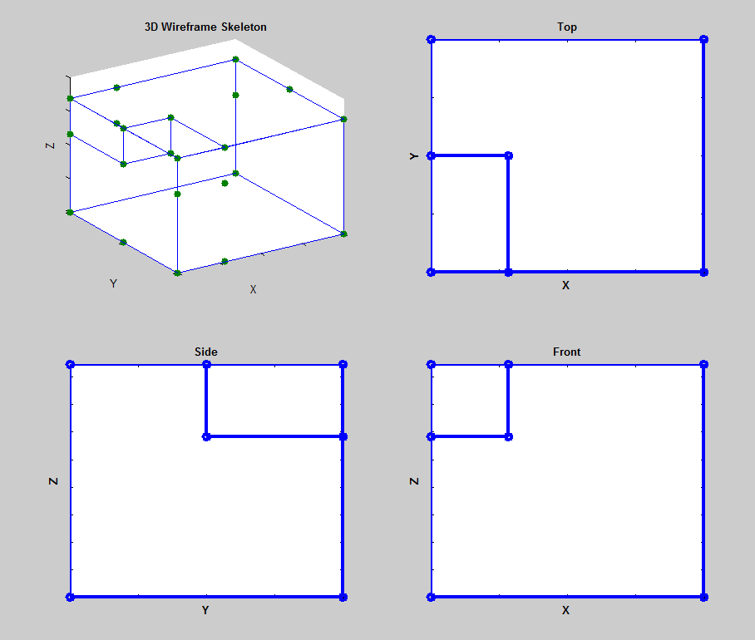
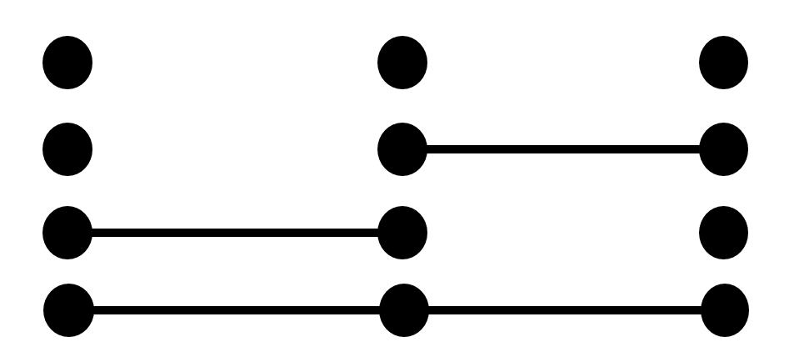
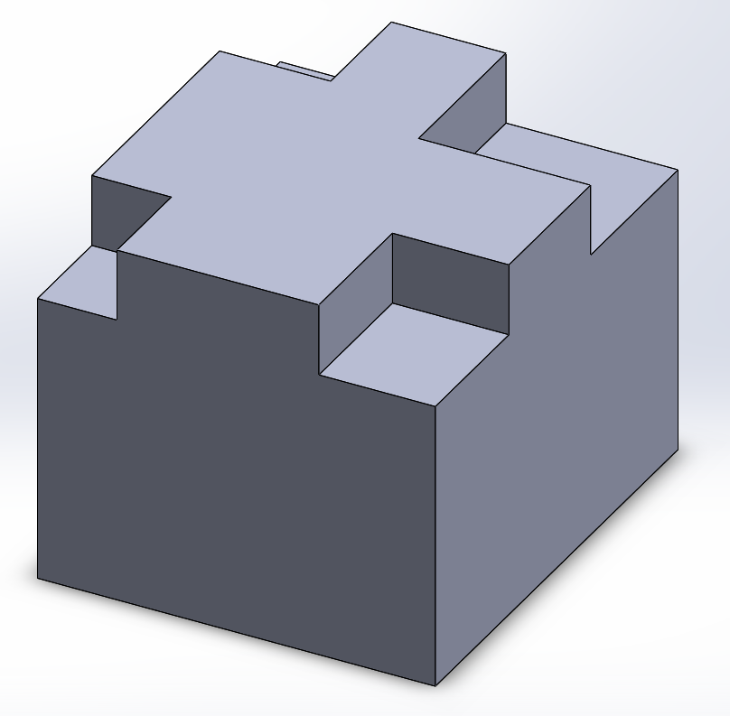
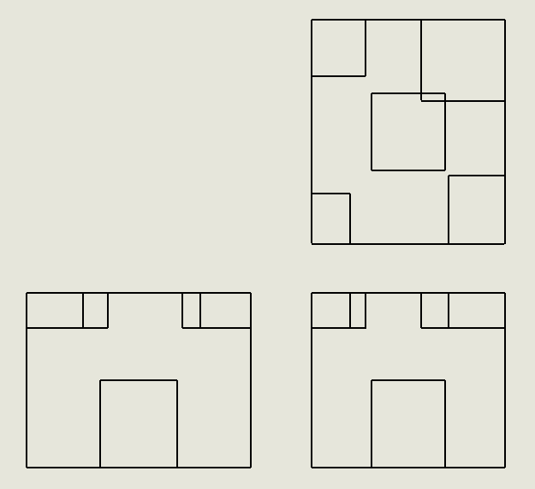
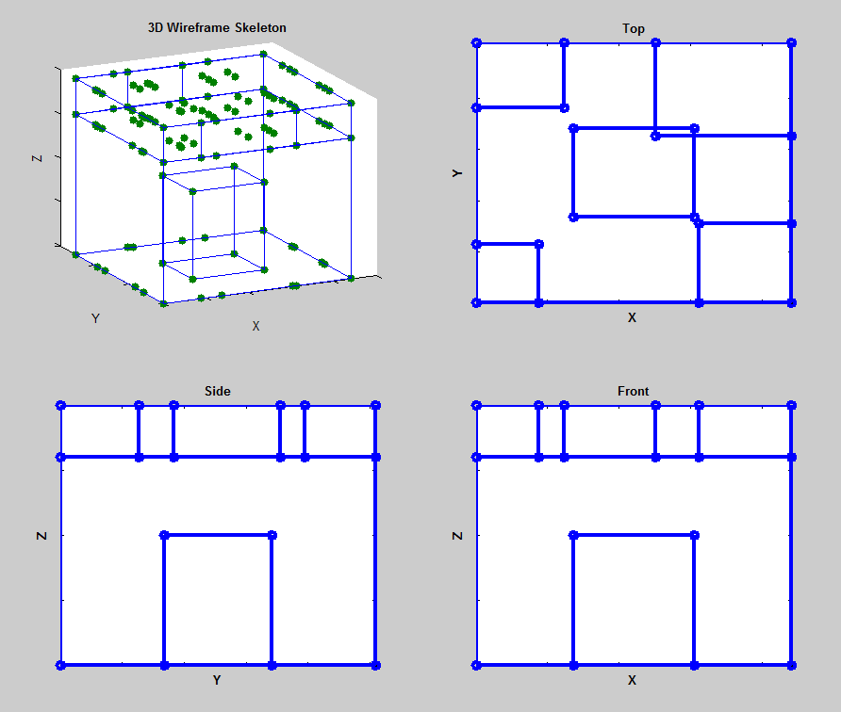
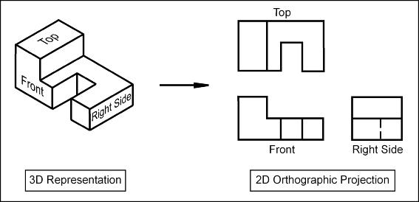
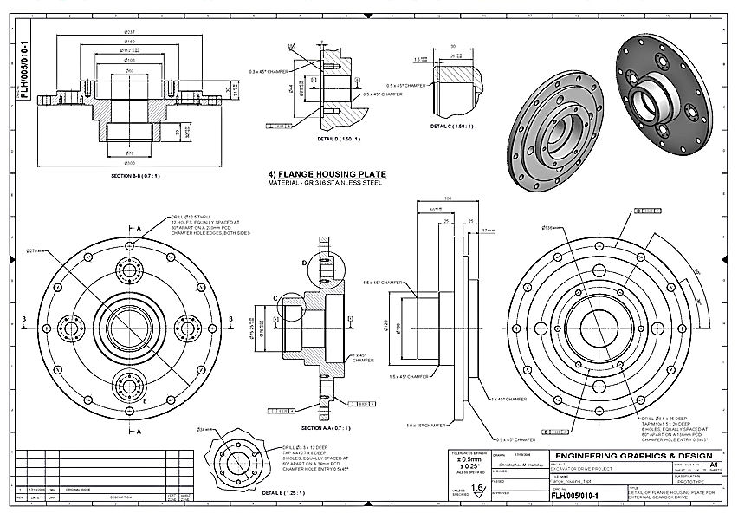
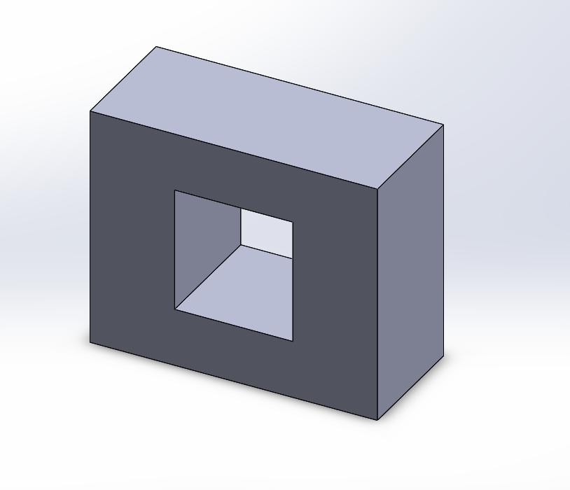
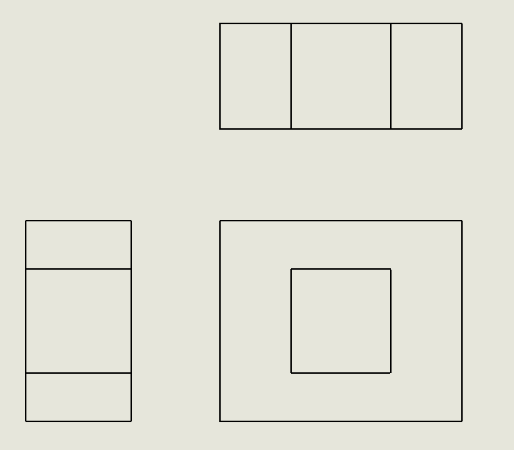
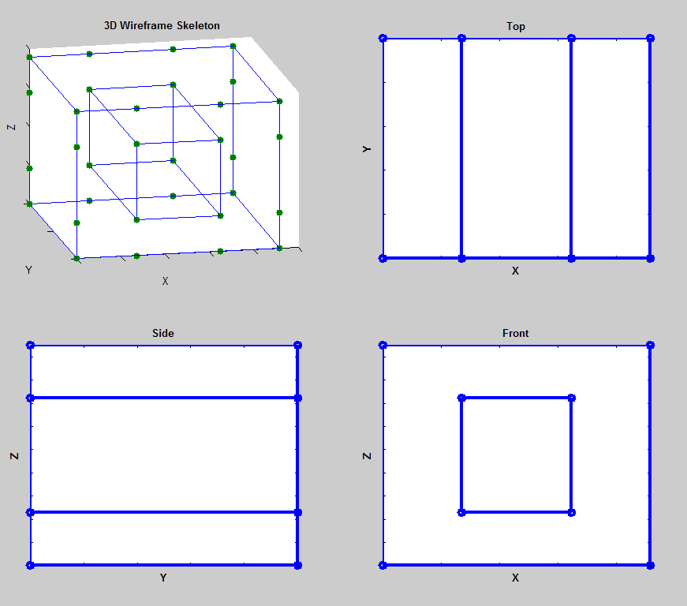
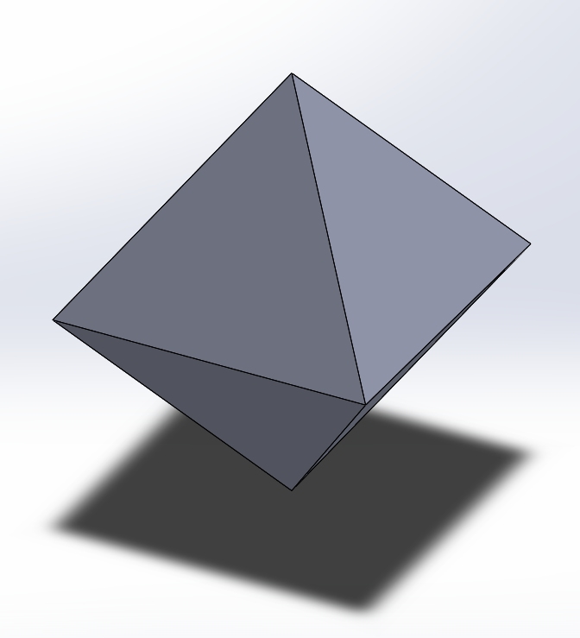
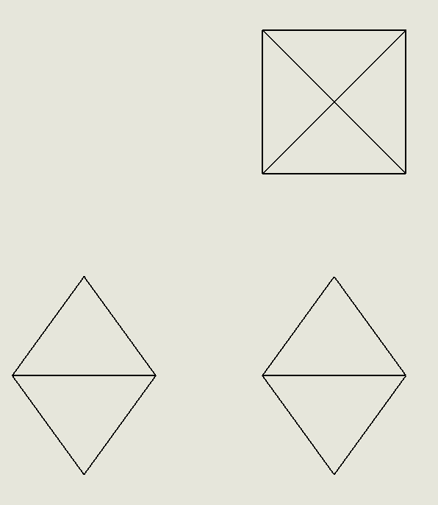
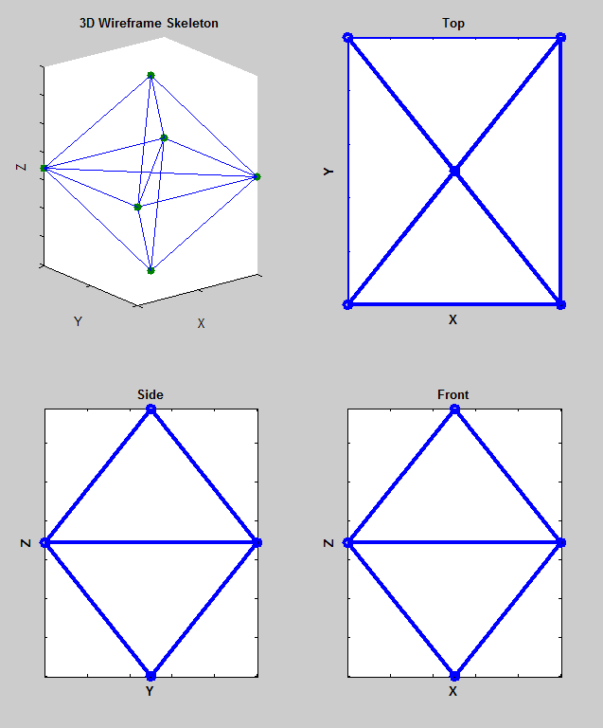
2D Image to 3D Object Reconstruction
Drew Marschner
ID #11
Abstract
Many 3D CAD models are represented by 2D drawings from several different orthographic views. Utilizing algorithms that exploit the orthographic nature of the 2D drawings, a 3D wireframe can be created using DXF files that correspond to the “Front”, “Top”, and “Side” orthographic representations of a 3D object.
Method
3D models were created using a CAD program to test the algorithm.
Individual DXF files of each orthographic view (“Front”, “Top”, “Side”) of a model are created and then processed into (X,Y), (X,Z), and (Y,Z) coordinates representing start and end nodes that are connected by edges. All possible edges between nodes given the actual drawing are created. Not all generated edges are necessarily representative of an actual edge in the 3D model, but this process ensures that no edges that might be viable are missed due to the edge representation in the DXF file input. Through this process a list of nodes and an adjacency matrix representing edges between nodes is created for each orthographic view.
Simplified representation showing all possible and acceptable edges between 3 nodes
Next the algorithm uses the nodes and adjacency matrix for each orthographic view to compare and match potential 3D edges. By comparing all adjacency matrices it is possible to surmise a 3D edge if in every orthographic view there is either an edge connection or a point correspondence. At the end of this process a 3D “skeleton” of edges has been created that represents the object’s shape.
Results
Larger, more complex models and models with curves or edge cuts could not be accurately recreated by the algorithms.
Motivation
Hardware vendors often only distribute 2D engineering drawings to customers, resulting in a designer recreating the part in order to incorporate it into their CAD design. This project is an attempt to begin to automate this inefficiency through computational geometry. The end goal would be a system that can take many different formats of 2D drawings and recreate an accurate 3D object using only those drawings and minimal input from a human user.
http://www.engineeringessentials.com/ege/ortho/ortho_page2.htm
http://www.engd.com.au/Engd_Image_webpages/Eng_dwg_3.html
Future Work
Several different avenues for improvement are possible:
Accurate 3D reconstruction of more complex geometry such as that used in real engineering drawings.
Complete 3D reconstruction rather than only wireframe construction.
Improved performance for parts with many edges.
Reconstruction for specific views such as cross-section or detailed views.
Conversion of different file types besides DXF, such as PDF, JPEG, or PNG into useable coordinates for vertex and edge reconstruction.
Results
Several different shape recreations were attempted. Simple objects such as those shown below were accurately recreated.
References
Wesley, Michael. Markowsky, George. 1981. “Fleshing Out Projections: Reconstruction of Objects”
Furferi, Rocco, et. al. 2010. “From 2D Orthographic Views to 3D Pseudo-Wireframe: An Automatic Procedure”
Carfagni, Monica, et. al. 2011. “3D Reconstruction Problem: An Automated Procedure”
Theory
Each orthographic drawing can be treated as a connected graph, where graph nodes are vertices in the drawing, or intersection points between 2 or more non-parallel lines. A connected graph is made for each orthographic view, and these connected graphs can then be processed into a 3D wireframe of the object.

