Slide 1
CAR-T therapy
Teaching T-cells to fight cancer

Slide 2
Cancer and the immune system

Slide 3
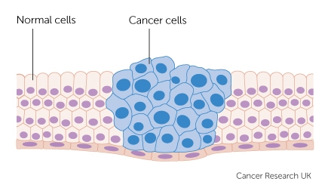
What is cancer?
Cancer is a condition where cells in a specific part of the body grow and reproduce uncontrollably. The cancerous cells can invade and destroy surrounding healthy tissue, including organs.
[CRUK]

Slide 4
What is cancer?
Cancer is a condition where cells in a specific part of the body grow and reproduce uncontrollably. The cancerous cells can invade and destroy surrounding healthy tissue, including organs.
Cancer is caused by accumulating genetic alterations in a cell
[CRUK]

Slide 5
Evolution at work
Mother cell

Slide 6
Evolution at work
Mother cell
Fast division

Slide 7
Evolution at work
Mother cell
Fast division
T-cell

Slide 8
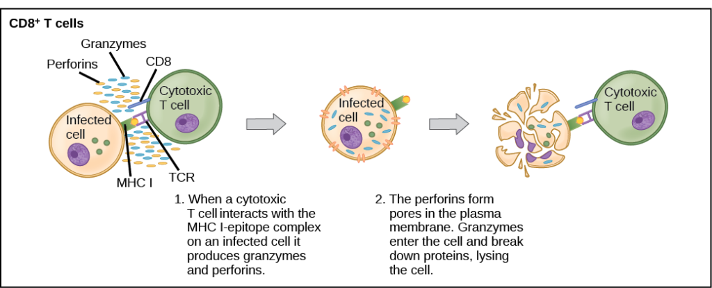
How T-cells recognise cancerous cells?
[lumenlearning.com]

Slide 9
Evolution at work
Mother cell
Escapes immune system
T-cell
Daughter cells able to escape the immune system and gather more mutations

Slide 10
Can we teach T-cells to recognise cancer cells?

Slide 11
CAR - Chimeric Antigen Receptors
Receptor gene
T-cell
Cancer cell

Slide 12
CAR - Chimeric Antigen Receptors
Receptor gene
T-cell
Cancer cell

Slide 13
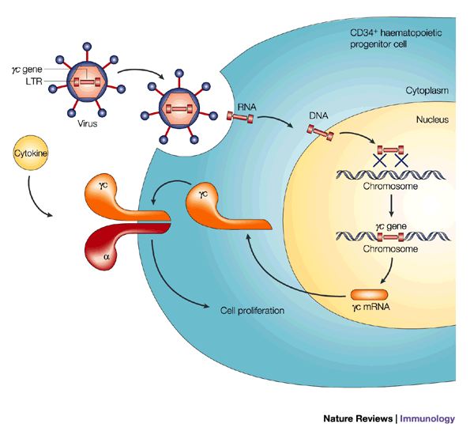
Viruses as a genetic modification tool

Slide 14
Clinical application
Extract T-cells from the patient
Expansion in the lab
Genetic modification of the cells to integrate the new receptor
Modified cells are injected back into the patient

Slide 15
The FDA approved the first CAR-T cell therapy in february 2018
The NHS has made the therapy available for certain patients

Slide 16
Thanks for listening!
Any questions?
Contact me:
amalia.martinez.segura@gmail.com
Slides available at:
github.com/amarseg/decoded_presentation

Slide 17
Thanks for listening!

