Slide 1
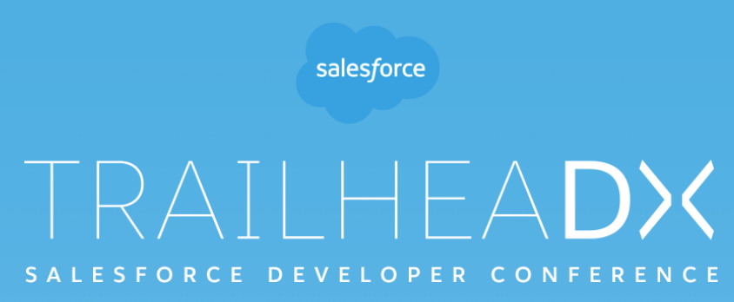
TrailheaDX 2019 summary
June 2019

Slide 2
Summary / Themes / Key takeaways
Salesforce DX – a developer ecosystem
Not just scratch orgs
Visual Studio Code
Salesforce CLI – scripting / cmd line is back!
Packaging
Lightning++
Mulesoft++
Gitlab++
Open sourcing – lwc components, etc.
https://opensource.salesforce.com/

Slide 3
Visual Studio Code
Lots here…more to come as we adopt this IDE
Code completion / debugger / run tests / etc. – directly from IDE
Source format
https://developer.salesforce.com/docs/atlas.en-us.sfdx_dev.meta/sfdx_dev/sfdx_dev_source_file_format.htm
Upcoming
Compare diffs from local source and org
Detect merge conflicts when deploy/retrieve
Local development (BETA)
https://www.youtube.com/watch?v=t36IFzjXcvs
Cloud based tools

Slide 4
The Salesforce CLI
Can use today with existing format and non scratch orgs
Keys to the kingdom for DX
More advanced then ANT which just wraps the metadata API
More interactive, specific use cases
Can convert existing meta format to source format
https://developer.salesforce.com/docs/atlas.en-us.sfdx_dev.meta/sfdx_dev/sfdx_dev_ws_convert_mdapi.htm
Examples:
Apex-run tests, can script to act upon logic based on coverage results (e.g. ‘blame’ the failed tests)
https://lekkimworld.com/2018/04/13/salesforcedx-and-test-coverage-reporting/
Create a data dictionary using sfdx force:schema:sobject:describe
Script Puppeteer for manual tasks
https://itnext.io/getting-started-using-puppeteer-headless-chrome-for-end-to-end-testing-8487718e4d97
Various other open sourced scripts on github/lab

Slide 5
Salesforce CLI - Recent Updates
Sandbox commands
Create / Clone / etc
https://releasenotes.docs.salesforce.com/en-us/summer19/release-notes/rn_sandboxes_cli_commands.htm?edition=&impact=
Scaffolding:
https://releasenotes.docs.salesforce.com/en-us/summer19/release-notes/rn_sf_cli_project_create.htm
Push / pull – coming soon to non scratch orgs
https://developer.salesforce.com/docs/atlas.en-us.sfdx_dev.meta/sfdx_dev/sfdx_dev_pull_md_from_scratch_org.htm
https://cdn-images-1.medium.com/max/2000/1*zvN5fiO7Jds9nJiQRQTrRw.png

Slide 6
Gitlab partners with Salesforce
Gitlab partners with Salesforce (keynote)
https://developer.salesforce.com/blogs/2019/05/gitlab-salesforce-devops-made-easy.html
While Jenkins is something we have had success with both currently and in the past, might make sense to investigate GITLAB CI. It’s actually something the DevSecOps team brought up as well.
Full e2e process in gitlab
Issue tracking->feature branch creation>merge request->commit triggers ci build->etc.

Slide 7
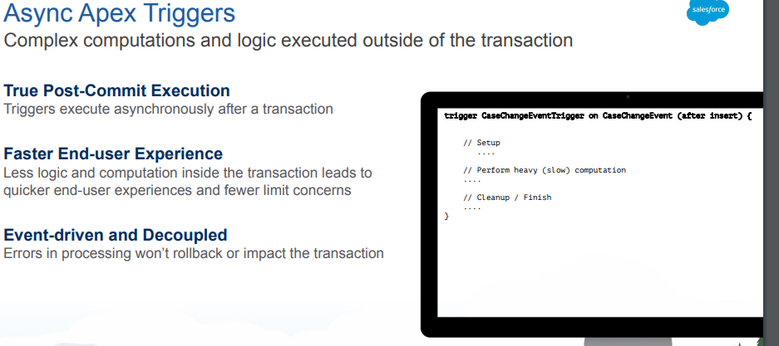
Async triggers
https://releasenotes.docs.salesforce.com/en-us/summer19/release-notes/rn_change_event_triggers.htm

Slide 8
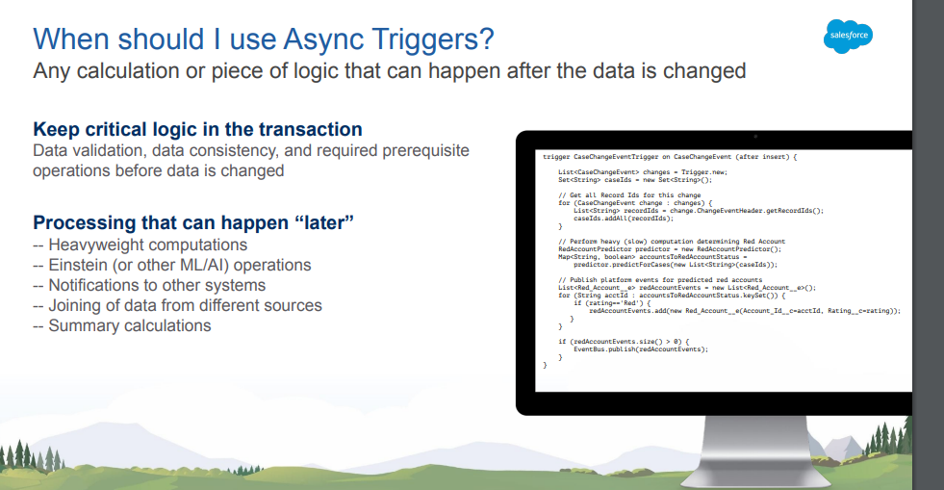
Async triggers II

Slide 9
Lightning Web Components
Open sourced @
https://lwc.dev/
Key takeaway – we need to start learning lightning

Slide 10
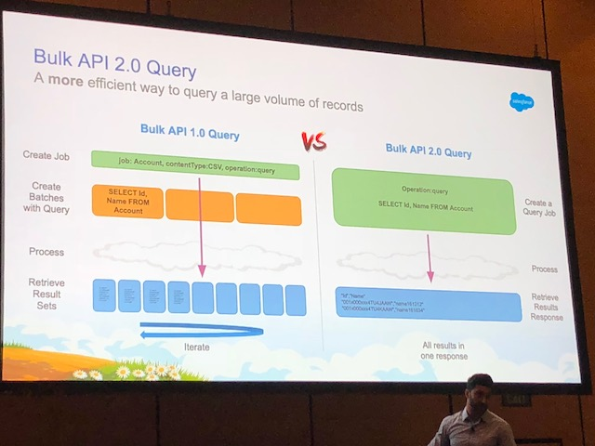
Bulk API 2.0
Bulk API 2
https://www.youtube.com/watch?v=lFNt6QOdc10
Mass operations API
https://www.youtube.com/watch?v=mWm4bHenuWQ

Slide 11
Advanced testing
https://trailhead.salesforce.com/content/learn/modules/unit-testing-on-the-lightning-platform/mock-stub-objects

Slide 12
Salesforce DX in Enterprise Organizations
Salesforce DX in Enterprise Organizations (John Hegstrom, Accenture)
An interesting talk on how to adopt this experience in larger organizations. Originally built for ISV’s, how to adopt DX in an enterprise organization?
The biggest investment, something we have been talking about, is with the staff and up scaling them.
DX = Slower adoption in Enterprise. Plan ahead, not something you can just easily switch over to.
Challenges:
Change management controls
Dependencies on managed packages
DEV Hub requires admin licenses in prod
Limitations
4 users in scratch orgs

Slide 13
Blockchain and Salesforce
Blockchain and salesforce (keynote)
https://www.wsj.com/articles/salesforce-rolls-out-blockchain-builder-for-noncoders-11559167641
FYI/More interesting than anything, of how it could be applied

Slide 14
Vendors
https://provartesting.com/
https://www.metazoa.com/

Slide 15
Resources
https://trailhead.salesforce.com/users/strailhead/trailmixes/tdx-19-code
Keynote 2 - https://www.youtube.com/watch?v=nS-I27cROk4
Keynote1 - https://www.youtube.com/watch?v=9I0A_Mj0gHA

