Slide 1
Parallelizing Congruence Closure
Zachary Kent* · Amar Shah*
Carnegie Mellon University
FMCAD 2026
* equal contribution
github.com/amarshah10/ParallelEgraph
Notes:
Title. Joint work with Amar Shah, equal contribution. I will cover the problem, the two algorithms, and implementation; Amar covers the evaluation.

Slide 2
Outline
1
Intro
2
Background
3
Motivating example
4
Algorithm
5
Evaluation

Slide 3
Congruence closure
Given a set of terms and equalities over them, compute the least equivalence relation respecting function symbols
2
Notes:
State the problem in one sentence and leave it up for the rest of the build. Terms, equalities between them, and we want the smallest equivalence relation that contains those equalities and still respects function symbols.

Slide 4
Congruence closure
Given a set of terms and equalities over them, compute the least equivalence relation respecting function symbols
f(a)
f(c)
a
b
c
3
Notes:
A tiny instance. Three constants and two applications of f. Nothing is equal to anything yet: five terms, five classes.

Slide 5
Congruence closure
Given a set of terms and equalities over them, compute the least equivalence relation respecting function symbols
f(a)
f(c)
a
=
b
=
c
input equalities
4
Notes:
Now the input equalities: a equals b, and b equals c. This is the set E we are handed.

Slide 6
Congruence closure
Given a set of terms and equalities over them, compute the least equivalence relation respecting function symbols
f(a)
f(c)
a
=
b
=
c
equivalence: a ≡ b ≡ c
5
Notes:
Close under equivalence: reflexive, symmetric, transitive. a, b and c land in one class, so a and c are equal even though nobody said so.

Slide 7
Congruence closure
Given a set of terms and equalities over them, compute the least equivalence relation respecting function symbols
f(a)
f(c)
a
=
b
=
c
congruence: equal arguments, so f(a) ≡ f(c)
6
Notes:
The part that makes this more than union-find. f(a) and f(c) were never mentioned in the input, but their arguments are now equal, so the two applications are equal too. That is congruence, and it is what forces the closure to be recomputed as classes change.

Slide 8
Congruence closure
Given a set of terms and equalities over them, compute the least equivalence relation respecting function symbols
f(a)
f(c)
a
=
b
=
c
Congruence rule
Nelson & Oppen 1980 · Downey, Sethi & Tarjan 1980
s₁ ≡ t₁ … sₖ ≡ tₖ
f(s₁, …, sₖ) ≡ f(t₁, …, tₖ)
7
Notes:
The rule, once, in general form. Equal arguments give equal applications. Everything in the talk is about applying this rule to many terms at the same time.

Slide 9
Outline
1
Intro
2
Background
3
Motivating example
4
Algorithm
5
Evaluation

Slide 10
Use in practice
Engines
Applications
SMT solvers: Z3, cvc5 (theory of uninterpreted functions)
SAT solvers: Kissat (clausal congruence closure)
Equality saturation: egg, egglog
Type unification
Circuit equivalence checking
Software verification: Dafny, Verus
Hardware design
Theorem proving: Lean grind
8
Notes:
Congruence closure sits inside a lot of engines, and hence inside the applications built on them. Decades of engineering have gone into sequential implementations.

Slide 11
Use in practice
Engines
Applications
SMT solvers: Z3, cvc5 (theory of uninterpreted functions)
SAT solvers: Kissat (clausal congruence closure)
Equality saturation: egg, egglog
Type unification
Circuit equivalence checking
Software verification: Dafny, Verus
Hardware design
Theorem proving: Lean grind
Called repeatedly per solver run: the cost adds up
9
Notes:
And in these engines it runs a lot: it is called repeatedly over the course of a solver run, so its cost shows up in the total. How much depends on the instance, which is why the evaluation looks at several benchmark families.

Slide 12
State of the art
Practice: every implementation fully sequential, on machines with 96 cores
Theory: congruence closure is P-complete
Worst case: likely inherently sequential
Kanellakis & Revesz 1989
Question: worst case is sequential.
Are the instances people actually solve?
10
Notes:
Where things stand. Despite how widely it is used, every implementation we know of is fully sequential, while the machines are wide: our test box has 96 cores. The theory is discouraging too. Congruence closure is P-complete, so we should not expect an algorithm that is fast on every input; in the worst case it really does look inherently sequential. But worst case is not the same as the instances people actually solve, and that is the question we ask.

Slide 13
Contributions
1
Two bulk-synchronous parallel algorithms: ParentCC and FilterCC
2
Workload characterization for parallelization effectiveness
3
Evaluation demonstrating effective speedup in practice
11
Notes:
Read the detail out loud, one line per bullet. One: two parallel algorithms, ParentCC and FilterCC, which replace the sequential worklist with bulk-synchronous rounds of data-parallel primitives over a lock-free concurrent union-find. Two: a workload characterization in terms of congruence depth and width, where width, the number of independent merges available in a round, turns out to be the dominant factor empirically. Three: an evaluation on random, synthetic and circuit-equivalence benchmarks, with near-linear speedup up to 32 cores over a tuned sequential baseline. Everything is open source.

Slide 14
Outline
1
Intro
2
Background
3
Motivating example
4
Algorithm
5
Evaluation

Slide 15
Equivalence checking
C₁
C₂
12
Notes:
The setting our running example comes from, and where the circuit benchmarks come from. Two combinational circuits.

Slide 16
Equivalence checking
Are C₁ and C₂ equivalent?
C₁
C₂
13
Notes:
The question: do they compute the same function? Equivalent means they agree on every input, all two to the n of them, so we cannot simply simulate.

Slide 17
Equivalence checking
Are C₁ and C₂ equivalent?
C₁
C₂
same inputs r, s, u, v, c
14
Notes:
Standard construction, a miter. Feed both circuits the same inputs.

Slide 18
Equivalence checking
Are C₁ and C₂ equivalent?
XOR
m₁
m₂
C₁
C₂
same inputs r, s, u, v, c
15
Notes:
XOR the corresponding outputs. The XOR is 1 exactly when the two outputs differ.

Slide 19
Equivalence checking
Are C₁ and C₂ equivalent?
p
XOR
m₁
m₂
C₁
C₂
same inputs r, s, u, v, c
16
Notes:
The XOR output is the single bit p, the miter output.

Slide 20
Equivalence checking
Are C₁ and C₂ equivalent?
p = 1 ⟺ C₁ and C₂ disagree on this input
p
XOR
m₁
m₂
C₁
C₂
same inputs r, s, u, v, c
17
Notes:
So p is 1 exactly when the circuits disagree on the input we fed them.

Slide 21
Equivalence checking
Are C₁ and C₂ equivalent?
p = 1 ⟺ C₁ and C₂ disagree on this input
p
XOR
m₁
m₂
C₁
C₂
same inputs r, s, u, v, c
equivalent ⟺ p = 1 is unsatisfiable
18
Notes:
Flip it around and it is a satisfiability question: assert p = 1 and ask whether any input satisfies it. Unsatisfiable means no disagreeing input exists, so the circuits are equivalent. Encoding a miter to CNF destroys the gate structure, so Biere et al. recover the gates and close them under congruence, which often decides the instance outright.

Slide 22
Running example
ITE
ITE
m₁
m₂
a₁
a₂
x₁
x₂
AND
AND
XOR
XOR
r
r′
s
s′
c
c′
u
u′
v
v′
19
Notes:
Miter adapted from Biere et al., Clausal Congruence Closure, SAT 2024. Two copies of the same three-gate circuit, side by side. Each copy has its own input wires. Nodes are terms, one per gate; edges point to children. Say out loud that the left half is copy one and the right half is copy two, and that the two ITE gates at the top are the two outputs.

Slide 23
Running example
Query
ITE
=?
ITE
m₁
m₂
a₁
a₂
x₁
x₂
AND
AND
XOR
XOR
r
r′
s
s′
c
c′
u
u′
v
v′
20
Notes:
Assert that the two outputs differ. If that is unsatisfiable the circuits are equivalent. The query is the only thing on the slide, sitting between the two output gates. The point of the miter for us: once the gate structure is recovered from the CNF, congruence closure alone often decides the instance, which is why Biere et al. run it inside a SAT solver.

Slide 24
Reading the diagram
m₂ = ITE(c′, a₂, x₂)
ITE
ITE
m₁
m₂
a₁
a₂
x₁
x₂
AND
AND
XOR
XOR
r
r′
s
s′
c
c′
u
u′
v
v′
21
Notes:
Focus on a single node before the trace starts. The box carries the operator, the name sits alongside, and the three outgoing edges are its children in argument order. Everything else is greyed out so only this term and its children are in view.

Slide 25
Reading the diagram
ITE
ITE
parent
m₁
m₂
a₁
a₂
x₁
x₂
AND
AND
child
XOR
XOR
child
r
r′
s
s′
c
c′
u
u′
v
v′
child
22
Notes:
Name the relationship the algorithms are built around. An edge goes from a term to the arguments it is applied to. m2 is the parent, its three arguments are the children. Every term is the parent of its arguments and a child of every term that mentions it.

Slide 26
Closure by hand
ITE
ITE
m₁
m₂
a₁
a₂
x₁
x₂
AND
AND
XOR
XOR
r
r′
s
s′
c
c′
u
u′
v
v′
=
=
=
=
=
23
Notes:
Start from the given equalities: each input wire of copy one equals the corresponding wire of copy two. These are the only given equalities, and they are what we union first.

Slide 27
Closure by hand
ITE
ITE
m₁
m₂
a₁
a₂
x₁
x₂
AND
AND
XOR
XOR
r
r′
s
s′
c
c′
u
u′
v
v′
∪
∪
∪
∪
∪
24
Notes:
Union each pair. The dashed boxes are the equivalence classes.

Slide 28
Closure by hand
ITE
ITE
m₁
m₂
a₁
a₂
x₁
x₂
AND
AND
XOR
XOR
r
r′
s
s′
c
c′
u
u′
v
v′
25
Notes:
Examine the two AND gates. Same symbol, and their children are pairwise in the same class, so the congruence rule applies. Yellow means we are looking at them.

Slide 29
Closure by hand
ITE
ITE
m₁
m₂
a₁
a₂
x₁
x₂
AND
∪
AND
XOR
XOR
r
r′
s
s′
c
c′
u
u′
v
v′
26
Notes:
Congruence fires, so union the two classes.

Slide 30
Closure by hand
ITE
ITE
m₁
m₂
a₁
a₂
x₁
x₂
AND
AND
XOR
XOR
r
r′
s
s′
c
c′
u
u′
v
v′
27
Notes:
Examine the two XOR gates: same symbol, children pairwise equivalent.

Slide 31
Closure by hand
ITE
ITE
m₁
m₂
a₁
a₂
x₁
x₂
AND
AND
XOR
∪
XOR
r
r′
s
s′
c
c′
u
u′
v
v′
28
Notes:
Union them.

Slide 32
Closure by hand
ITE
ITE
m₁
m₂
a₁
a₂
x₁
x₂
AND
AND
XOR
XOR
r
r′
s
s′
c
c′
u
u′
v
v′
29
Notes:
Examine the two ITE gates. Only now are their children pairwise equivalent, because steps 1 and 2 merged the AND and XOR classes.

Slide 33
Closure by hand
ITE
∪
ITE
m₁
m₂
a₁
a₂
x₁
x₂
AND
AND
XOR
XOR
r
r′
s
s′
c
c′
u
u′
v
v′
30
Notes:
Union them. Note that step 3 depended on steps 1 and 2, but 1 and 2 did not depend on each other.

Slide 34
Closure by hand
Query
ITE
=
ITE
m₁
m₂
a₁
a₂
x₁
x₂
AND
AND
XOR
XOR
r
r′
s
s′
c
c′
u
u′
v
v′
31
Notes:
The outputs are in one class, so the query m1 differs from m2 is unsatisfiable: the circuits are equivalent. Count what we did: eight merges, one at a time. That is exactly the sequential worklist algorithm, and it is the baseline the parallel version has to beat.

Slide 35
Observation
ITE
ITE
m₁
m₂
a₁
a₂
x₁
x₂
AND
AND
XOR
XOR
r
r′
s
s′
c
c′
u
u′
v
v′
Data dependences are parent–child edges
32
Notes:
The pivot of the talk. Go back over the trace we just did and ask what forced its order. The ITE merge waited for the AND merge and the XOR merge, and for nothing else. Why: congruence tests the classes of the children, so a term can only become mergeable when one of its children changes class. That is exactly an edge of the diagram, traversed upward. Dependences in congruence closure are not hidden in a data structure, they are the term structure itself, which is what makes the problem tractable to parallelize. Say the caveat out loud rather than putting it on the slide: a child can also change class through a chain of earlier merges, so the dependence is the transitive closure of the parent-child relation.

Slide 36
Observation
ITE
ITE
m₁
m₂
a₁
a₂
x₁
x₂
AND
AND
∥
XOR
XOR
independent
r
r′
s
s′
c
c′
u
u′
v
v′
Unrelated merges run in parallel
33
Notes:
The other half. Nothing connects the AND merge to the XOR merge: neither is an ancestor of the other, so neither can change the other’s signature. They can run at the same time, on different cores, in either order, with the same result. That is the parallelism we are after, and the algorithms are built to find all of it at once instead of one merge at a time.

Slide 37
Outline
1
Intro
2
Background
3
Motivating example
4
Algorithm
5
Evaluation

Slide 38
Bulk-synchronous schedule
ITE
ITE
m₁
m₂
a₁
a₂
x₁
x₂
AND
AND
XOR
XOR
r
r′
s
s′
c
c′
u
u′
v
v′
round 0
Bulk-synchronous parallel: rounds of independent merges
34
Notes:
Read the dependences as a schedule. Everything with no unmet dependence goes first, all at once. That is round 0: the input equalities we were handed. Nothing had to happen before them.

Slide 39
Bulk-synchronous schedule
ITE
ITE
m₁
m₂
a₁
a₂
x₁
x₂
AND
AND
XOR
XOR
round 1
r
r′
s
s′
c
c′
u
u′
v
v′
round 0
Bulk-synchronous parallel: rounds of independent merges
35
Notes:
Barrier, then everything round 0 just enabled. The inputs changed class, so their parents get retested: the AND merge and the XOR merge. Neither depends on the other, so both go in the same round.

Slide 40
Bulk-synchronous schedule
ITE
ITE
round 2
m₁
m₂
a₁
a₂
x₁
x₂
AND
AND
XOR
XOR
round 1
r
r′
s
s′
c
c′
u
u′
v
v′
round 0
Bulk-synchronous parallel: rounds of independent merges
36
Notes:
Barrier again, and the gate merges enable the output merge. Round 2, and nothing is left to enable, so we stop. This is Valiant’s bulk-synchronous model, and it falls straight out of the term structure.

Slide 41
Bulk-synchronous schedule
ITE
ITE
round 2
m₁
m₂
a₁
a₂
x₁
x₂
AND
AND
XOR
XOR
round 1
r
r′
s
s′
c
c′
u
u′
v
v′
round 0
depth: congruence rounds (2) width: most merges in a round (5)
37
Notes:
Two names for the evaluation. Depth is the number of congruence rounds after the input round, here 2. Width is the most merges any one round offers, here 5, in round 0. Depth is what we cannot parallelize; width is what we can. On the circuit benchmarks width reaches millions while depth stays small, and Amar will show that width predicts speedup.

Slide 42
ParentCC: one round
1. Find candidates — Parents of classes merged last round.
38
Notes:
Now the algorithm, at the level of a round. Three phases. First: who might have become congruent? Only a term whose child just changed class, so the parents of whatever merged last round.

Slide 43
ParentCC: one round
1. Find candidates — Parents of classes merged last round.
2. Group by signature — Equal signatures identify congruences.
39
Notes:
Of those candidates, who actually is congruent? Group them by signature: the symbol together with the classes of the children.

Slide 44
ParentCC: one round
1. Find candidates — Parents of classes merged last round.
2. Group by signature — Equal signatures identify congruences.
3. Merge each group — All groups can merge in parallel.
40
Notes:
Then merge every group, and all the groups in parallel.

Slide 45
ParentCC: one round
1. Find candidates to merge — Parents of classes merged last round.
2. Group by signature — Equal signatures identify congruences.
3. Merge each group — All groups can merge in parallel.
Repeat — Until a round performs no merges.
Initial round — Every term is a candidate.
41
Notes:
Repeat while a round merged something. The very first round has no previous merges to look at, so it considers every term; that also catches terms that were congruent before any equality was applied. The barrier between phases is what makes the parallelism safe: while we compute signatures nobody is merging, so every thread reads the same classes, and while we merge nobody is reading signatures.

Slide 46
ParentCC pseudocode
ParentCC(E):
parfor (u = v) ∈ E: Union(u, v)
Work ← terms of E
while Work ≠ ∅:
parfor c ∈ Work with c ≠ Find(c): ▹ fold parent lists
Parents[Find(c)] ← Parents[Find(c)] ∪ Parents[c]
Frontier ← all compound terms on round 0 ▹ seed round
Frontier ← ⋃ Parents[Find(c)] for c ∈ Work otherwise
groups ← GroupBy(Congruent, Frontier) ▹ semisort on sigs
Work ← ∅
parfor g ∈ groups spanning > 1 class:
MergeCongruenceClass(g) ▹ parallel unions
Work ← Work ∪ pre-merge roots of g
MergeCongruenceClass(S): ▹ divide and conquer
if |S| = 1: return the element
l, r ← MergeCongruenceClass(S[0..n/2]) ∥ MergeCongruenceClass(S[n/2..n])
return Union(l, r)
38

Slide 47
ParentCC pseudocode
ParentCC(E):
1. Find candidates for merging
parfor (u = v) ∈ E: Union(u, v)
Work ← terms of E
while Work ≠ ∅:
parfor c ∈ Work with c ≠ Find(c): ▹ fold parent lists
Parents[Find(c)] ← Parents[Find(c)] ∪ Parents[c]
Frontier ← all compound terms on round 0 ▹ seed round
Frontier ← ⋃ Parents[Find(c)] for c ∈ Work otherwise
groups ← GroupBy(Congruent, Frontier) ▹ semisort on sigs
Work ← ∅
parfor g ∈ groups spanning > 1 class:
MergeCongruenceClass(g) ▹ parallel unions
Work ← Work ∪ pre-merge roots of g
MergeCongruenceClass(S): ▹ divide and conquer
if |S| = 1: return the element
l, r ← MergeCongruenceClass(S[0..n/2]) ∥ MergeCongruenceClass(S[n/2..n])
return Union(l, r)
39

Slide 48
ParentCC pseudocode
ParentCC(E):
Find candidates for merging
Group by signature
parfor (u = v) ∈ E: Union(u, v)
Work ← terms of E
while Work ≠ ∅:
parfor c ∈ Work with c ≠ Find(c): ▹ fold parent lists
Parents[Find(c)] ← Parents[Find(c)] ∪ Parents[c]
Frontier ← all compound terms on round 0 ▹ seed round
Frontier ← ⋃ Parents[Find(c)] for c ∈ Work otherwise
groups ← GroupBy(Congruent, Frontier) ▹ semisort on sigs
Work ← ∅
parfor g ∈ groups spanning > 1 class:
MergeCongruenceClass(g) ▹ parallel unions
Work ← Work ∪ pre-merge roots of g
MergeCongruenceClass(S): ▹ divide and conquer
if |S| = 1: return the element
l, r ← MergeCongruenceClass(S[0..n/2]) ∥ MergeCongruenceClass(S[n/2..n])
return Union(l, r)
40

Slide 49
ParentCC pseudocode
ParentCC(E):
Find candidates for merging
Group by signature
Merge congruent terms
parfor (u = v) ∈ E: Union(u, v)
Work ← terms of E
while Work ≠ ∅:
parfor c ∈ Work with c ≠ Find(c): ▹ fold parent lists
Parents[Find(c)] ← Parents[Find(c)] ∪ Parents[c]
Frontier ← all compound terms on round 0 ▹ seed round
Frontier ← ⋃ Parents[Find(c)] for c ∈ Work otherwise
groups ← GroupBy(Congruent, Frontier) ▹ semisort on sigs
Work ← ∅
parfor g ∈ groups spanning > 1 class:
MergeCongruenceClass(g) ▹ parallel unions
Work ← Work ∪ pre-merge roots of g
MergeCongruenceClass(S): ▹ divide and conquer
if |S| = 1: return the element
l, r ← MergeCongruenceClass(S[0..n/2]) ∥ MergeCongruenceClass(S[n/2..n])
return Union(l, r)
41

Slide 50
ParentCC pseudocode
ParentCC(E):
Find candidates for merging
Group by signature
Merge congruent terms
Repeat
parfor (u = v) ∈ E: Union(u, v)
Work ← terms of E
while Work ≠ ∅:
parfor c ∈ Work with c ≠ Find(c): ▹ fold parent lists
Parents[Find(c)] ← Parents[Find(c)] ∪ Parents[c]
Frontier ← all compound terms on round 0 ▹ seed round
Frontier ← ⋃ Parents[Find(c)] for c ∈ Work otherwise
groups ← GroupBy(Congruent, Frontier) ▹ semisort on sigs
Work ← ∅
parfor g ∈ groups spanning > 1 class:
MergeCongruenceClass(g) ▹ parallel unions
Work ← Work ∪ pre-merge roots of g
MergeCongruenceClass(S): ▹ divide and conquer
if |S| = 1: return the element
l, r ← MergeCongruenceClass(S[0..n/2]) ∥ MergeCongruenceClass(S[n/2..n])
return Union(l, r)
42

Slide 51
ParentCC on the example: round 0
equivalence class
ITE
ITE
m₁
m₂
union input equalities
a₁
a₂
x₁
x₂
AND
AND
XOR
XOR
r
r′
s
s′
c
c′
u
u′
v
v′
∪
∪
∪
∪
∪
43
Notes:
Same example. Round 0 is the input: union each pair of equated wires, all five at once. No congruence yet, just the equalities we were handed. The gates are greyed out because nothing happens to them this round.

Slide 52
ParentCC on the example: round 1
equivalence class
ITE
ITE
m₁
m₂
candidate
candidates: all terms
a₁
a₂
x₁
x₂
AND
AND
XOR
XOR
r
r′
s
s′
c
c′
u
u′
v
v′
44
Notes:
Round 1, phase one: who might have become congruent? The first round considers every gate, so all six are candidates, in yellow.

Slide 53
ParentCC on the example: round 1
equivalence class
ITE
ITE
m₁
m₂
same signature
group by signature
a₁
a₂
x₁
x₂
AND
AND
XOR
XOR
r
r′
s
s′
c
c′
u
u′
v
v′
45
Notes:
Phase two: group by signature, the symbol plus the class of each child. Same colour, same signature. The two ANDs match: both are AND of the r class and the s class. The two XORs match. The two ITEs do not, because a1 and a2 are still in different classes, so they stay uncoloured. This grouping is the semisort. Say out loud that this is the step that changes from the sequential algorithm: no hash table lookups one at a time, all the signatures of the round sorted together.
- todo: we need to explain what equality is

Slide 54
ParentCC on the example: round 1
equivalence class
ITE
ITE
m₁
m₂
merge groups
a₁
a₂
x₁
x₂
AND
∪
AND
XOR
∪
XOR
r
r′
s
s′
c
c′
u
u′
v
v′
46
Notes:
Phase three: merge every group, concurrently. Two unions in one round; this is where the parallel run differs from the hand trace.

Slide 55
ParentCC on the example: round 2
equivalence class
ITE
ITE
m₁
m₂
candidate
candidates: parents of merged
a₁
a₂
x₁
x₂
AND
AND
XOR
XOR
r
r′
s
s′
c
c′
u
u′
v
v′
47
Notes:
Round 2. Candidates are the parents of what just merged: the two ITEs. Their signatures now agree, one group.

Slide 56
ParentCC on the example: round 2
equivalence class
ITE
∪
ITE
m₁
m₂
group, merge
a₁
a₂
x₁
x₂
AND
AND
XOR
XOR
r
r′
s
s′
c
c′
u
u′
v
v′
48
Notes:
Merge them. One union.

Slide 57
ParentCC on the example: done
equivalence class
ITE
ITE
round 2
m₁
m₂
round
no candidates: stop
a₁
a₂
x₁
x₂
AND
AND
XOR
XOR
round 1
r
r′
s
s′
c
c′
u
u′
v
v′
round 0
49
Notes:
The ITEs have no parents, so round 3 has no candidates and the loop stops. Eight merges in three rounds, and the rounds are exactly the schedule from before: ParentCC found all of the available parallelism.

Slide 58
Correctness
• Soundness — Every merge is between two congruent terms
50
Notes:
One line each; the paper has the proofs. Sound: every group has equal symbol and equal child classes, so each merge is an instance of the congruence rule. Complete: when the last of a pair’s children merge, both parents are candidates next round. Terminates: a round that merges anything reduces the number of classes.

Slide 59
Correctness
• Soundness — Every merge is between two congruent terms.
• Completeness — Every newly congruent pair becomes a candidate in the next round.
51

Slide 60
Correctness
• Soundness — Every merge is between two congruent terms.
• Completeness — Every newly congruent pair becomes a candidate in the next round.
• Termination — Every round strictly reduces the number of equality-classes.
52

Slide 61
FilterCC on the example
one dirty bit per class
a merge marks its classes dirty
candidates: filter all terms for a dirty child
racing marks are fine: setting a bit is idempotent
53
Notes:
FilterCC keeps one dirty bit per equivalence class instead of parent lists. First, the input merges mark the changed leaf classes dirty. Next, scan every term and keep terms with a dirty child. Group and merge those candidates as in ParentCC. The resulting AND and XOR classes become dirty for the next round, which will select the two ITEs.

Slide 62
Our second algorithm: FilterCC on the example
a merge marks its classes dirty
ITE
ITE
m₁
m₂
a₁
a₂
x₁
x₂
AND
AND
XOR
XOR
r
r′
s
s′
c
c′
u
u′
v
v′
dirty
dirty
dirty
dirty
dirty
∪
∪
∪
∪
∪
53
Notes:
FilterCC keeps one dirty bit per equivalence class instead of parent lists. First, the input merges mark the changed leaf classes dirty. Next, scan every term and keep terms with a dirty child. Group and merge those candidates as in ParentCC. The resulting AND and XOR classes become dirty for the next round, which will select the two ITEs.

Slide 63
Our second algorithm: FilterCC on the example
a merge marks its classes dirty
filter all terms for a dirty child
ITE
ITE
m₁
m₂
a₁
a₂
x₁
x₂
AND
AND
XOR
XOR
r
r′
s
s′
c
c′
u
u′
v
v′
dirty
dirty
dirty
dirty
dirty
54

Slide 64
Our second algorithm: FilterCC on the example
a merge marks its classes dirty
filter all terms for a dirty child
Compute signature of candidates
ITE
ITE
m₁
m₂
a₁
a₂
x₁
x₂
AND
AND
XOR
XOR
r
r′
s
s′
c
c′
u
u′
v
v′
dirty
dirty
dirty
dirty
dirty
55

Slide 65
Our second algorithm: FilterCC on the example
a merge marks its classes dirty
filter all terms for a dirty child
Compute signature of candidates
Then merge congruent terms, mark dirty, and repeat
ITE
ITE
m₁
m₂
dirty
dirty
a₁
a₂
x₁
x₂
AND
∪
AND
XOR
∪
XOR
r
r′
s
s′
c
c′
u
u′
v
v′
56

Slide 66
Our second algorithm: FilterCC on the example
a merge marks its classes dirty
filter all terms for a dirty child
Compute signature of candidates
Then merge congruent terms, mark dirty, and repeat
ITE
ITE
m₁
m₂
dirty
dirty
a₁
a₂
x₁
x₂
AND
∪
AND
XOR
∪
XOR
r
r′
s
s′
c
c′
u
u′
v
v′
No allocation, but a scan of every term per round.
This beats ParentCC when there are fewer total rounds.
56

Slide 67
Outline
1
Intro
2
Background
3
Motivating example
4
Algorithm
5
Evaluation

Slide 68
Implementation
Parallel implementation — built with ParlayLib.
Sequential approaches tried — Nieuwenhuis–Oliveras worklist, topological-sort fixpoint, and Downey–Sethi–Tarjan.
Best sequential baseline — tuned Nieuwenhuis–Oliveras worklist, with arity-specialized signature tables and a bump allocator.
75
Notes:
Grouping: ParlayLib integer sort on the signature hashes followed by a bucket pass per hash, which beat the library semisort on the small buckets we see. Merging a group: divide and conquer unions. The baseline is the classical worklist algorithm in the Nieuwenhuis and Oliveras variant, which is what the hand trace did: one merge at a time, each merge re-examining the parents of the losing class. We tried a topological-sort fixpoint and Downey-Sethi-Tarjan as well; the worklist was fastest. It got the same tuning care as the parallel code, so speedups are against a strong baseline.

Slide 69
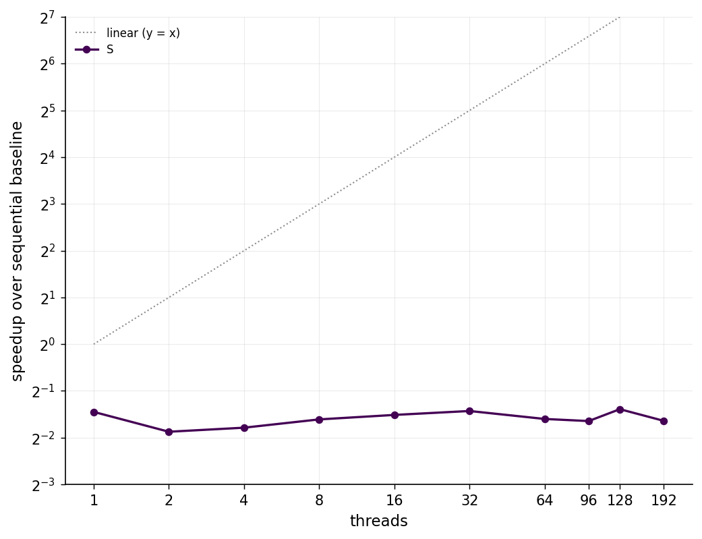
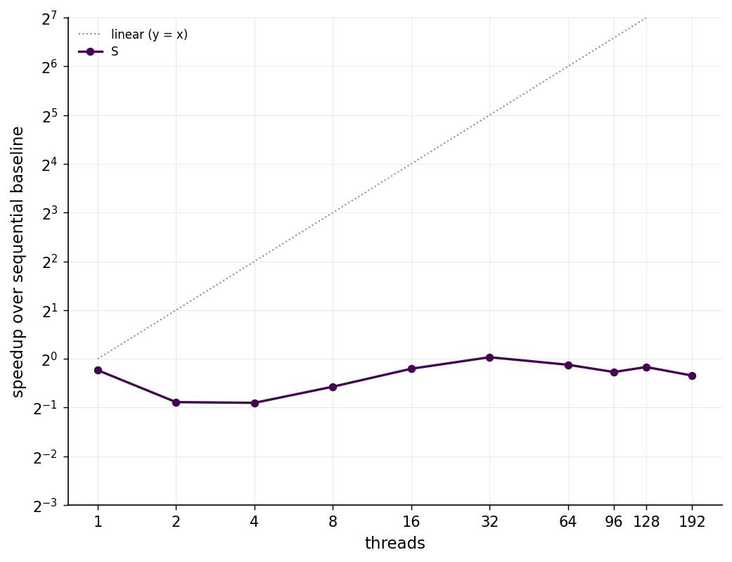
RQ1 — How does the performance scale with the benchmark size?
We generate depth-3 terms from random binary function symbols, then seed closure with random xᵢ = yᵢ leaf equalities.
ParentCC
FilterCC
57

Slide 70
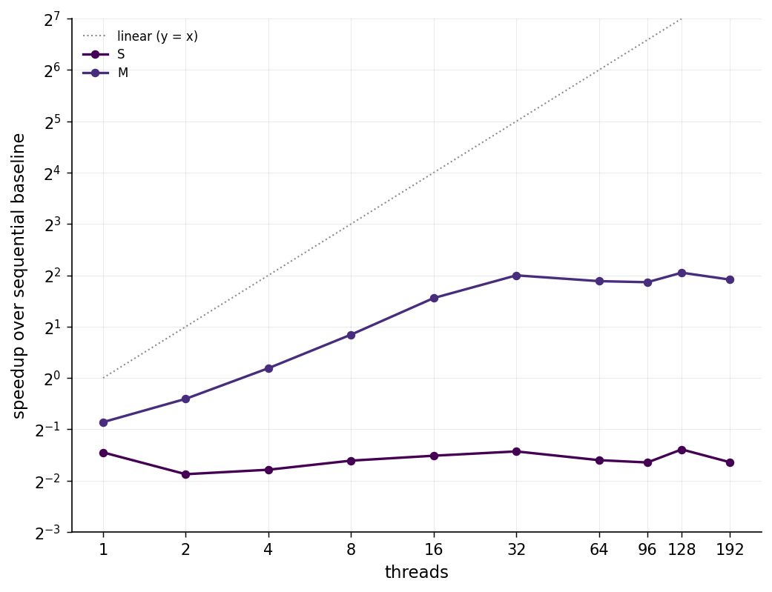
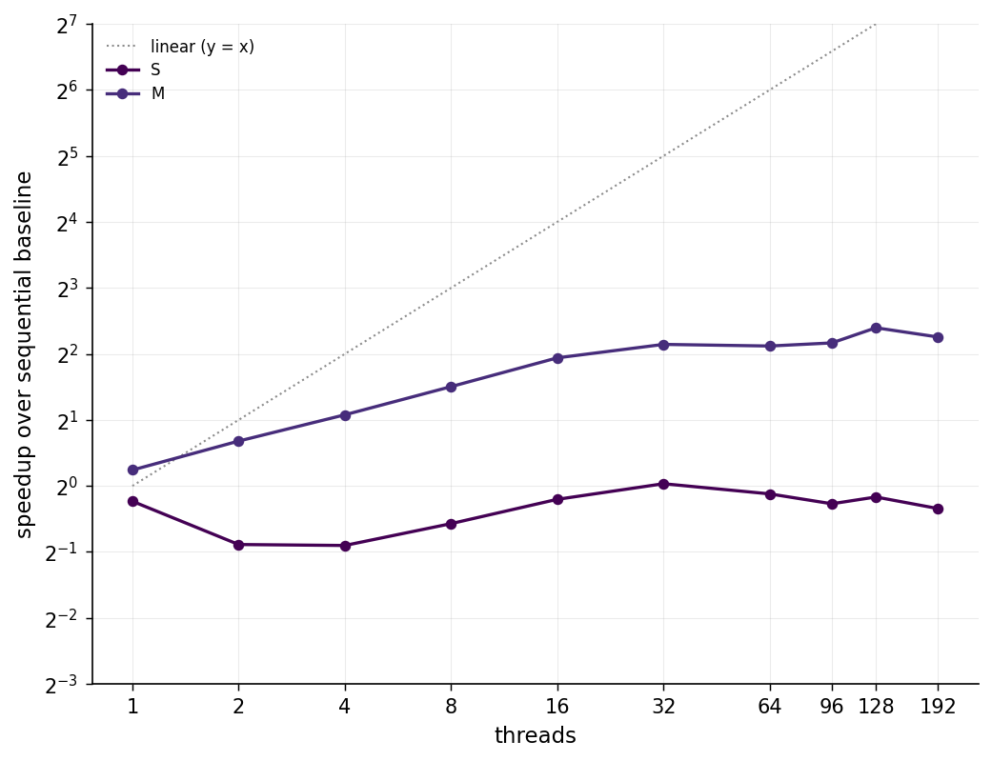
RQ1 — How does the performance scale with the benchmark size?
We generate depth-3 terms from random binary function symbols, then seed closure with random xᵢ = yᵢ leaf equalities.
ParentCC
FilterCC
58

Slide 71
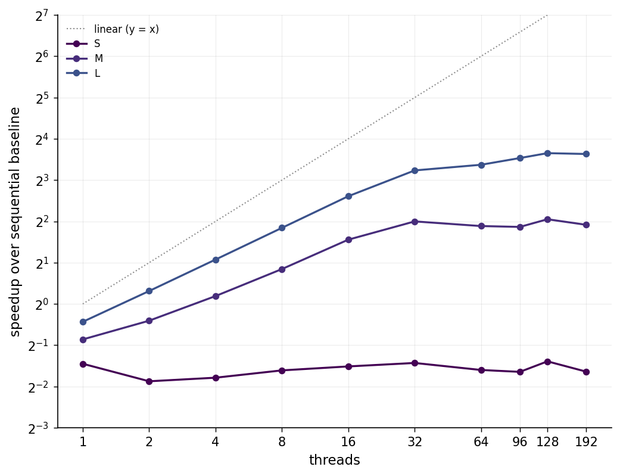
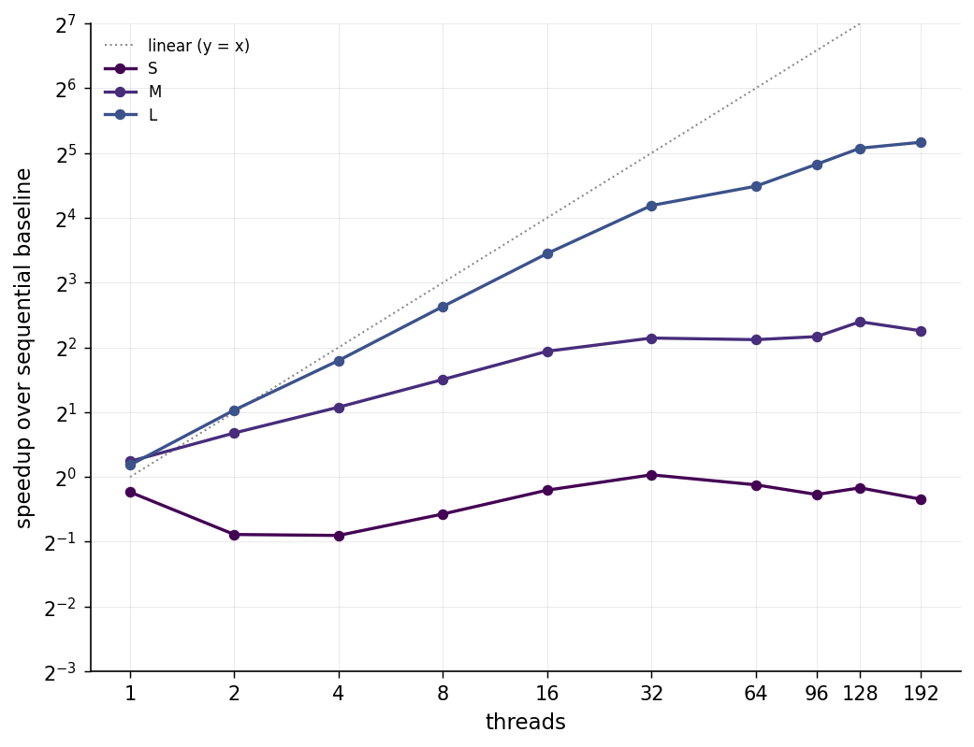
RQ1 — How does the performance scale with the benchmark size?
We generate depth-3 terms from random binary function symbols, then seed closure with random xᵢ = yᵢ leaf equalities.
ParentCC
FilterCC
59

Slide 72
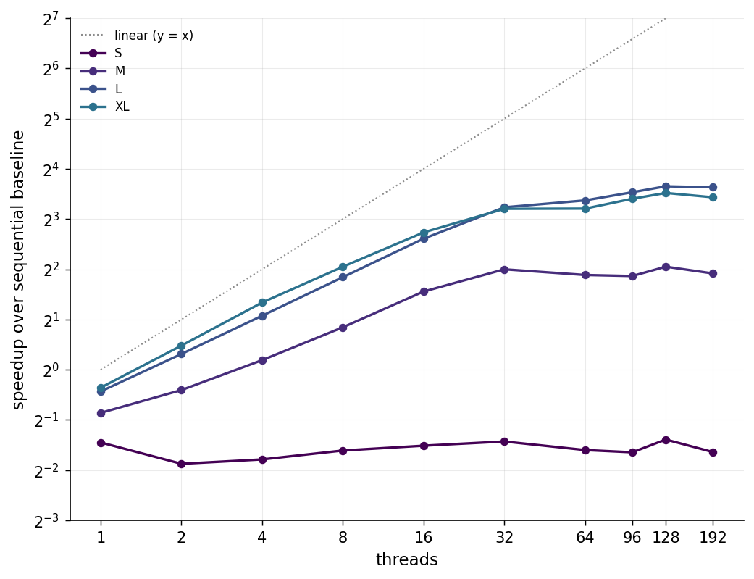
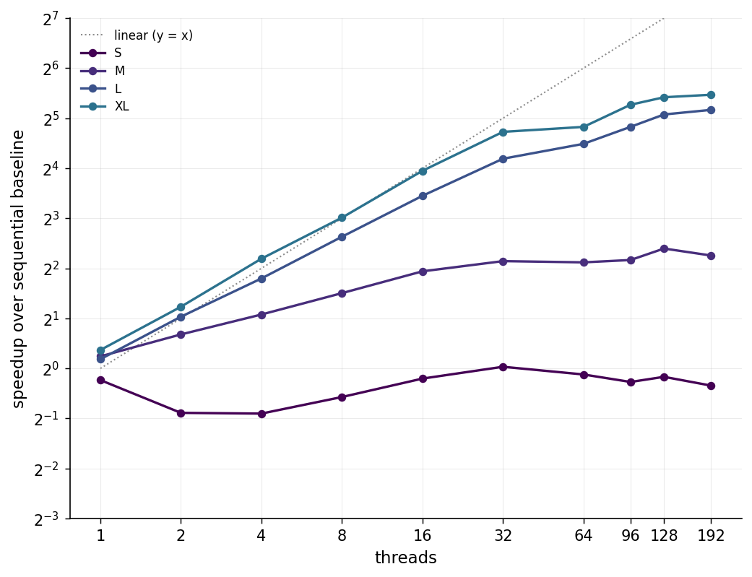
RQ1 — How does the performance scale with the benchmark size?
We generate depth-3 terms from random binary function symbols, then seed closure with random xᵢ = yᵢ leaf equalities.
ParentCC
FilterCC
60

Slide 73
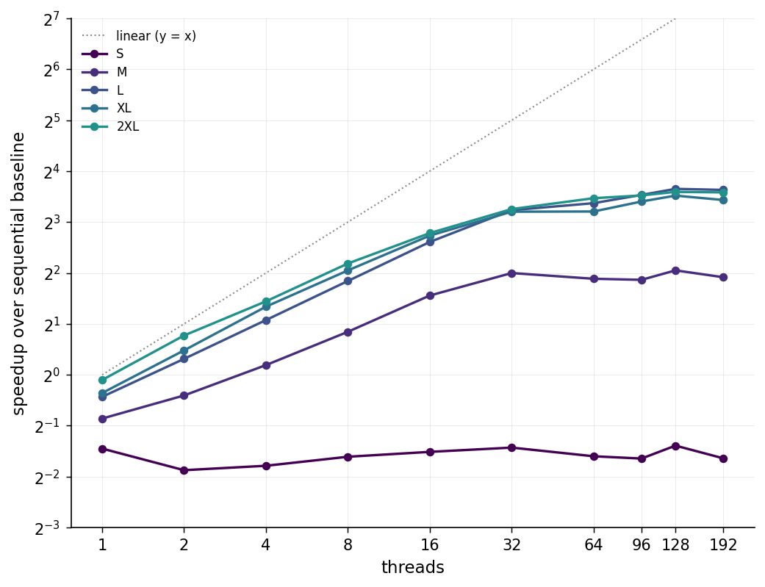
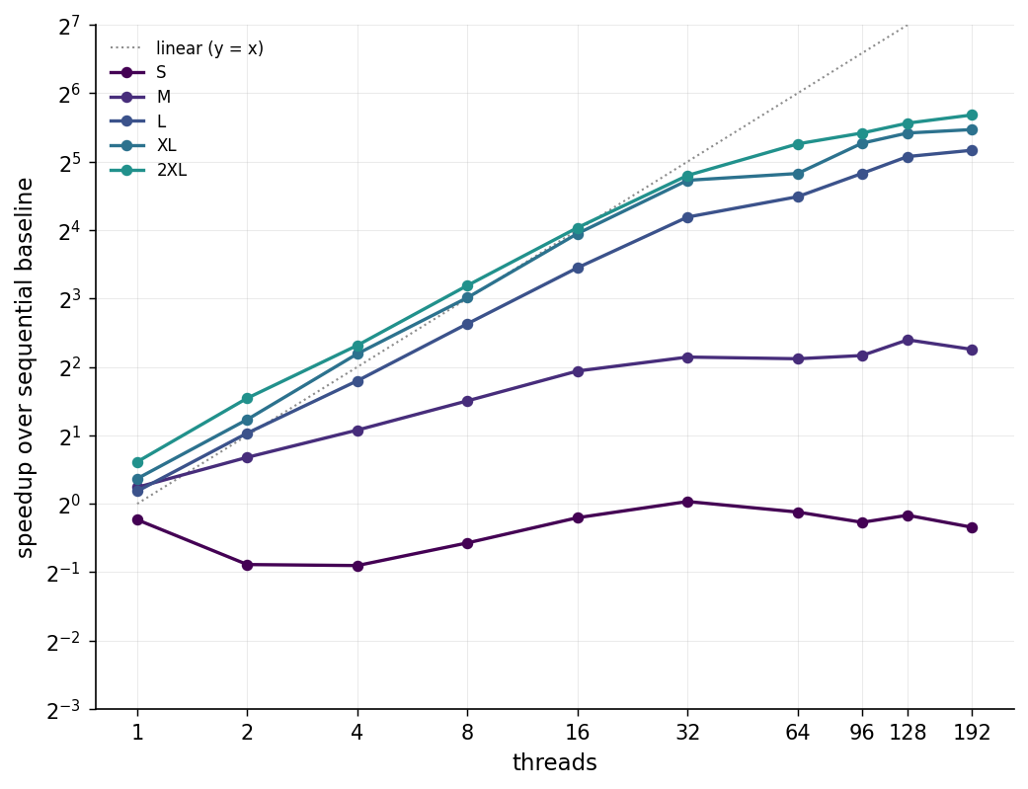
RQ1 — How does the performance scale with the benchmark size?
We generate depth-3 terms from random binary function symbols, then seed closure with random xᵢ = yᵢ leaf equalities.
ParentCC
FilterCC
61

Slide 74
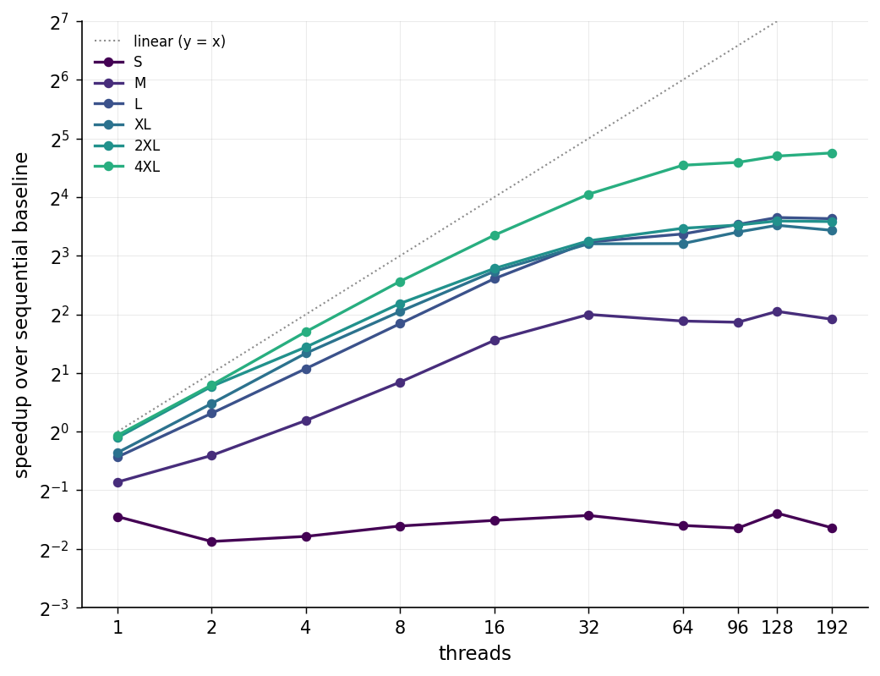
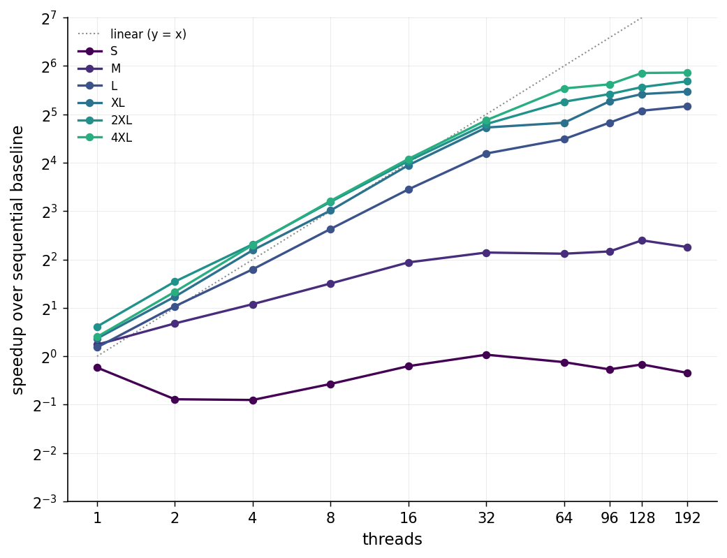
RQ1 — How does the performance scale with the benchmark size?
We generate depth-3 terms from random binary function symbols, then seed closure with random xᵢ = yᵢ leaf equalities.
ParentCC
FilterCC
62

Slide 75
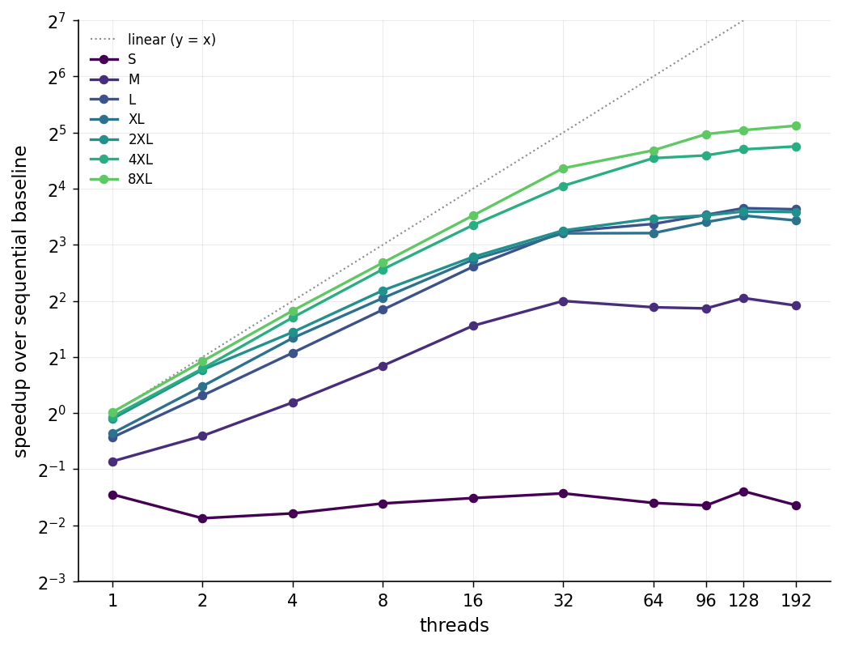
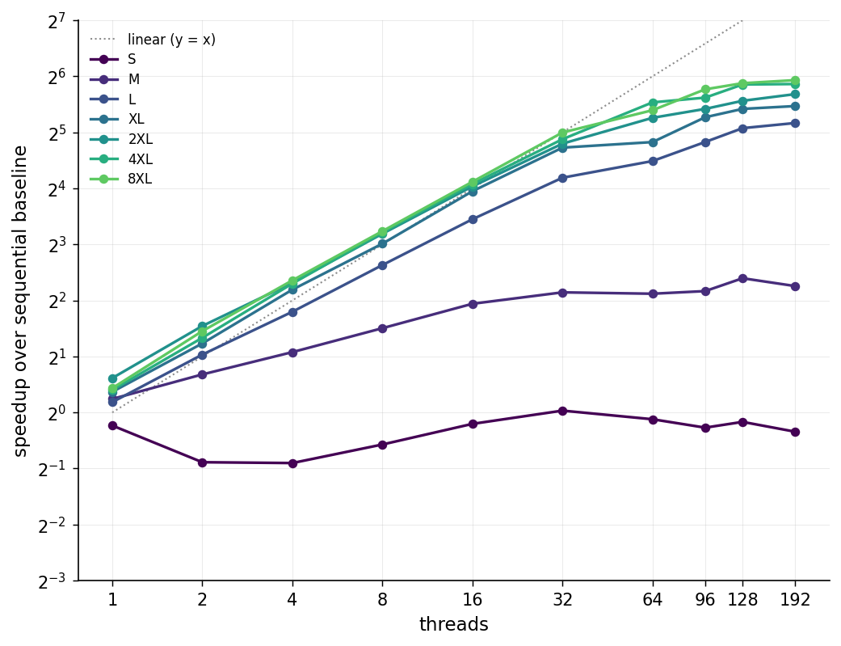
RQ1 — How does the performance scale with the benchmark size?
We generate depth-3 terms from random binary function symbols, then seed closure with random xᵢ = yᵢ leaf equalities.
ParentCC
FilterCC
63

Slide 76
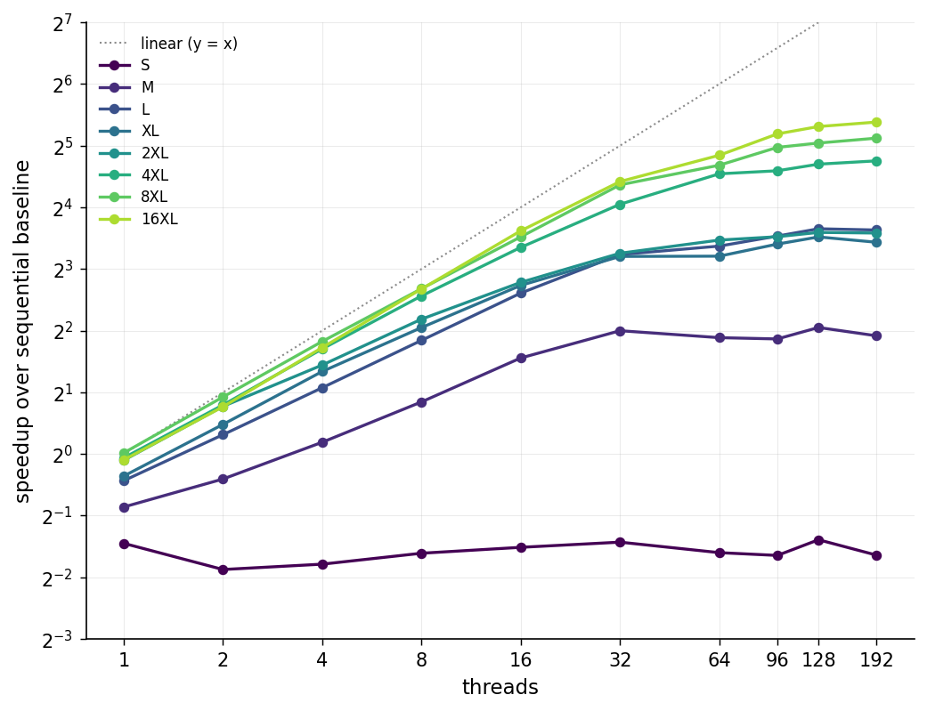
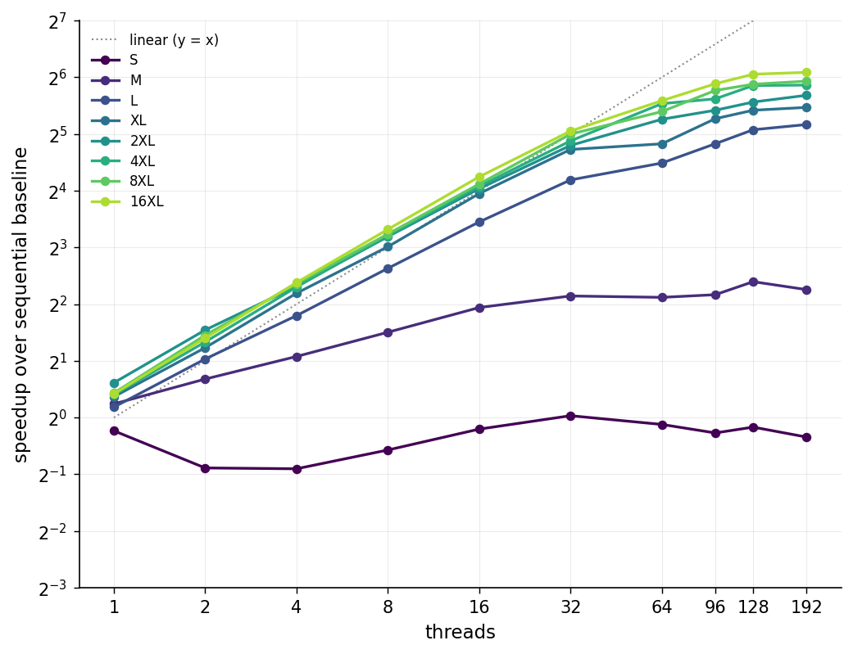
RQ1 — How does the performance scale with the benchmark size?
We generate depth-3 terms from random binary function symbols, then seed closure with random xᵢ = yᵢ leaf equalities.
ParentCC
FilterCC
64

Slide 77
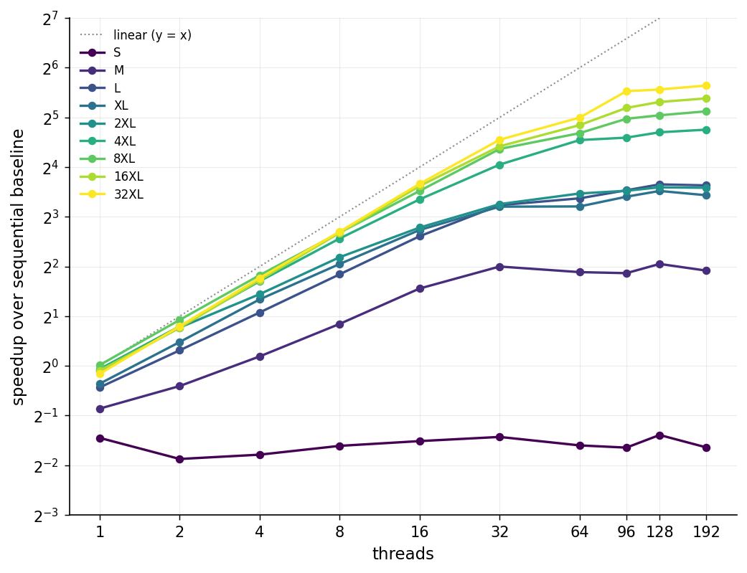
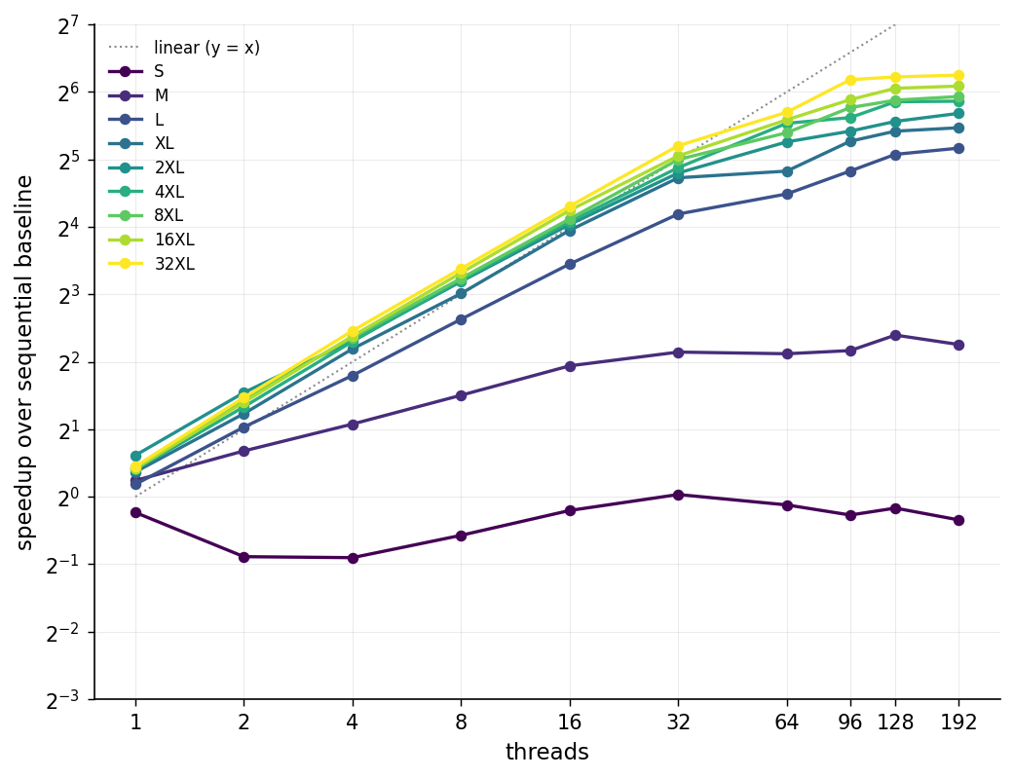
RQ1 — How does the performance scale with the benchmark size?
We generate depth-3 terms from random binary function symbols, then seed closure with random xᵢ = yᵢ leaf equalities.
ParentCC
FilterCC
65

Slide 78
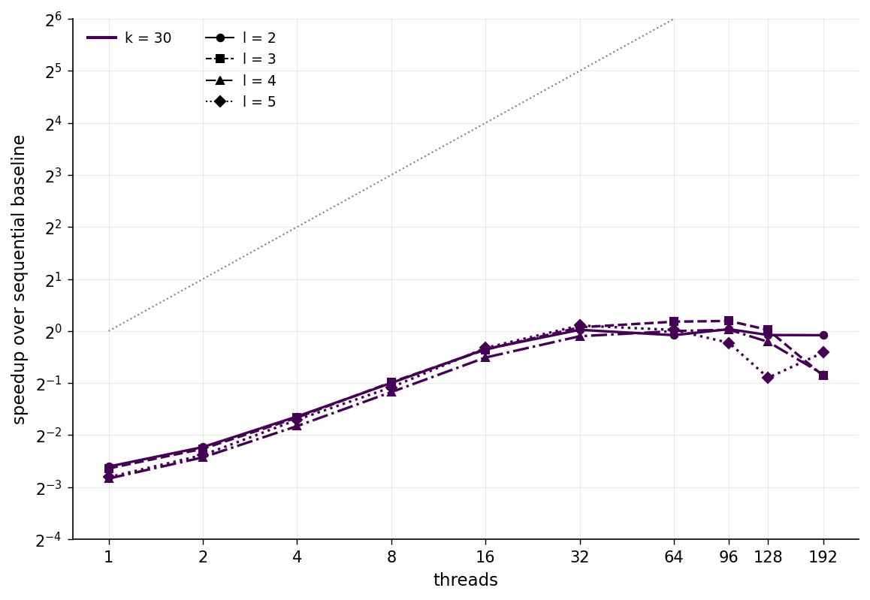
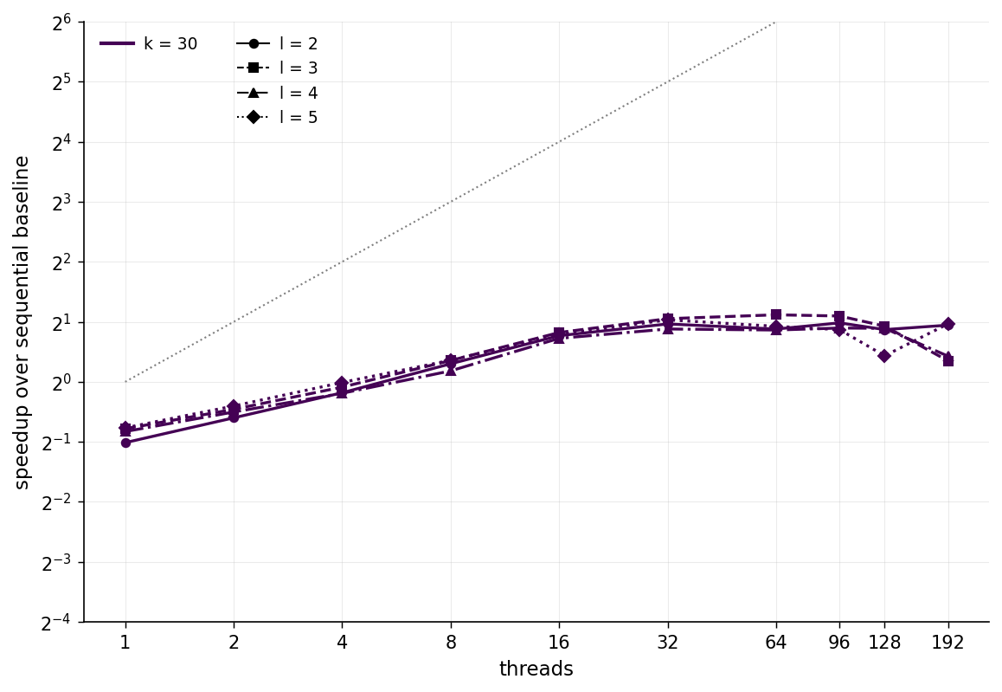
RQ2 — What benchmark characteristics make this work?
Synthetic benchmarks: k controls width: larger k creates a k³-wide merge frontier. l controls depth: smaller l is deeper
ParentCC
FilterCC
66

Slide 79
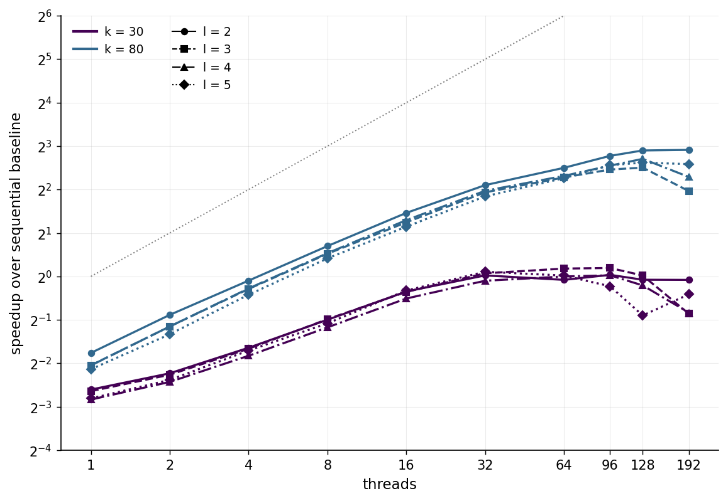
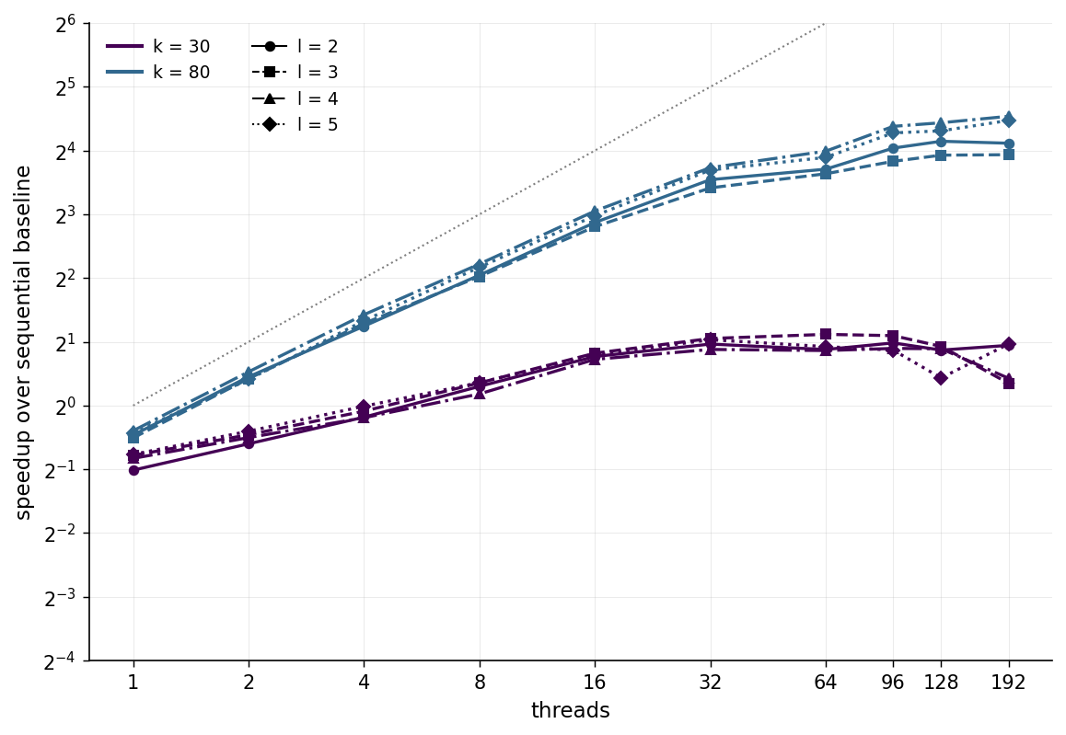
RQ2 — What benchmark characteristics make this work?
Synthetic benchmarks: k controls width: larger k creates a k³-wide merge frontier. l controls depth: smaller l is deeper
ParentCC
FilterCC
67

Slide 80
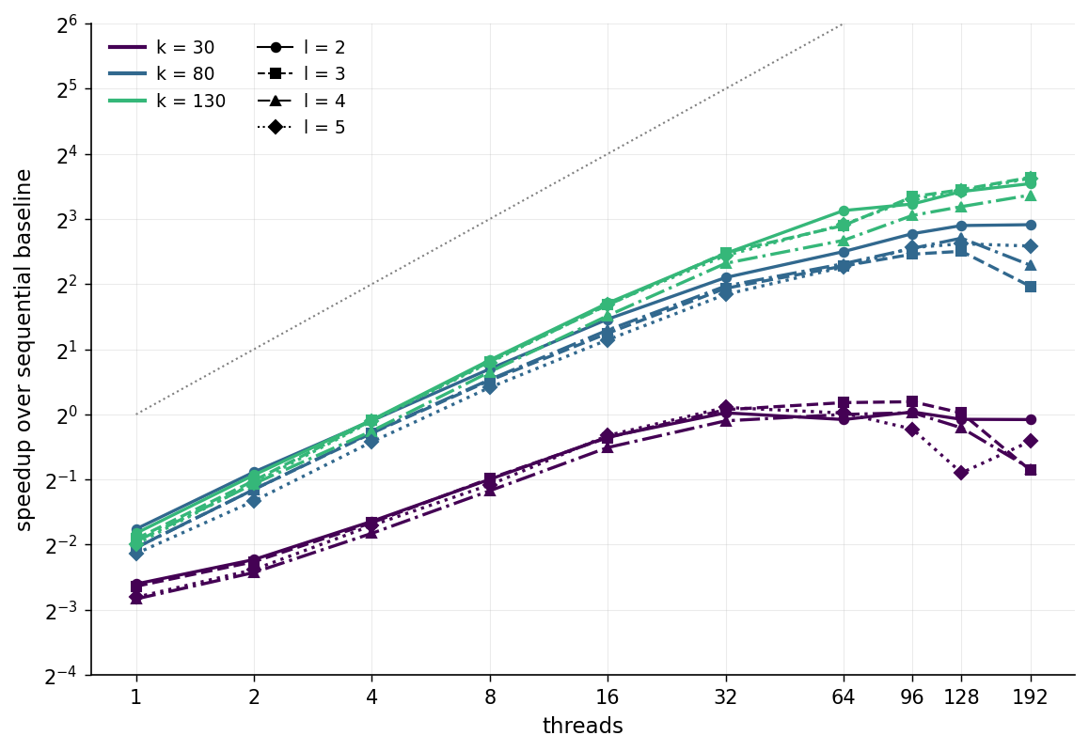
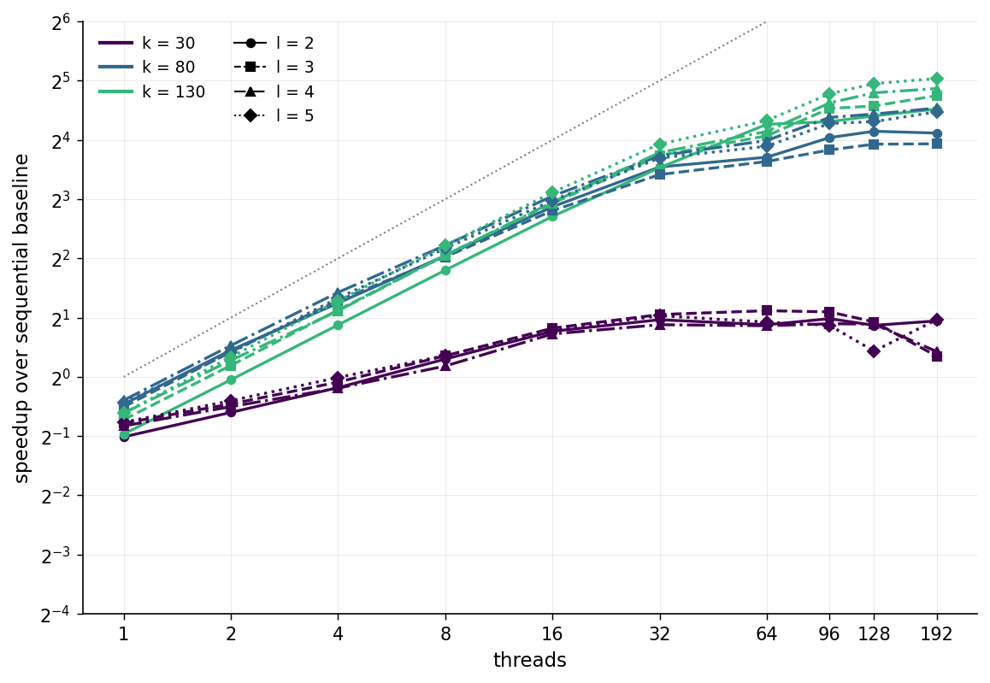
RQ2 — What benchmark characteristics make this work?
Synthetic benchmarks: k controls width: larger k creates a k³-wide merge frontier. l controls depth: smaller l is deeper
ParentCC
FilterCC
68

Slide 81
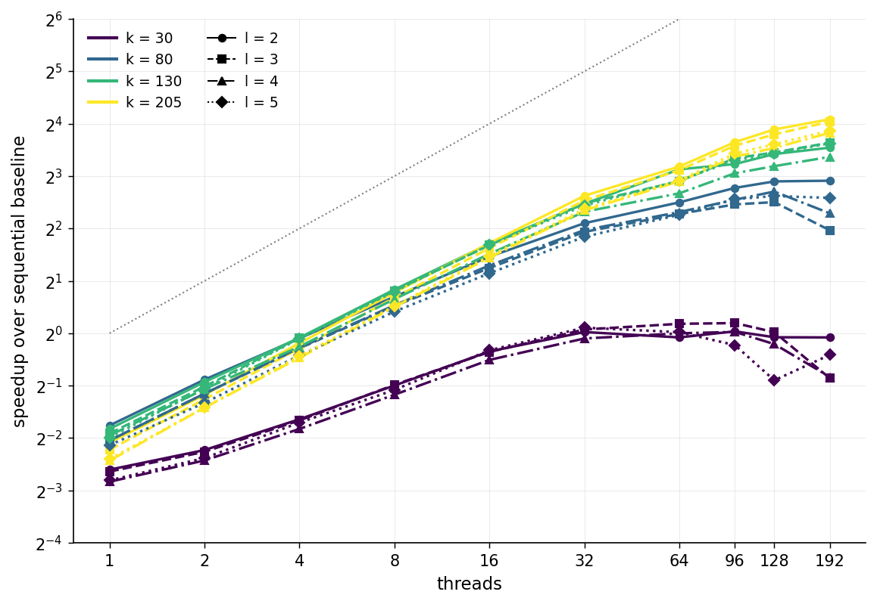
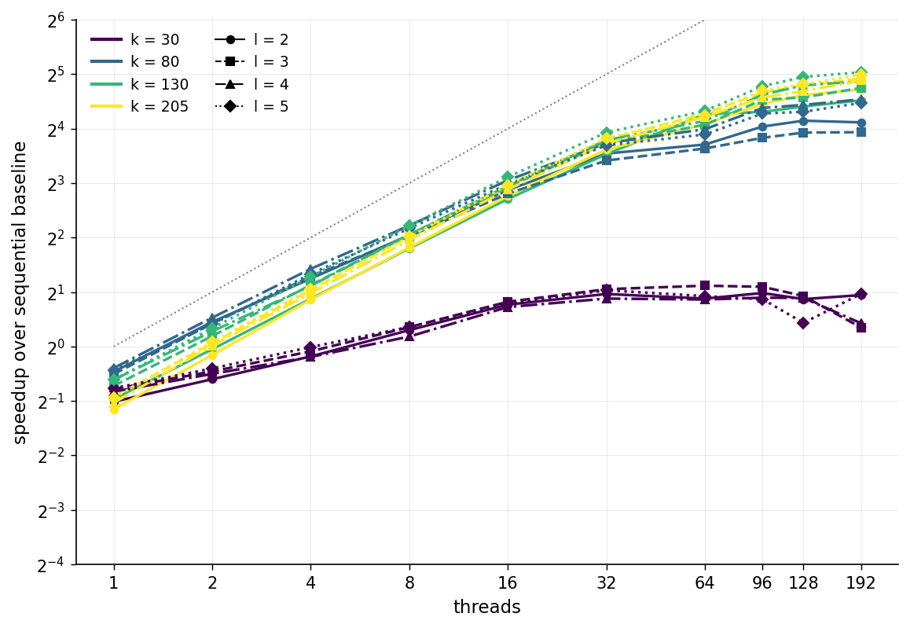
RQ2 — What benchmark characteristics make this work?
k controls width: larger k creates a k³-wide merge frontier. l controls depth: smaller l makes the g-trees taller.
ParentCC
FilterCC
69

Slide 82
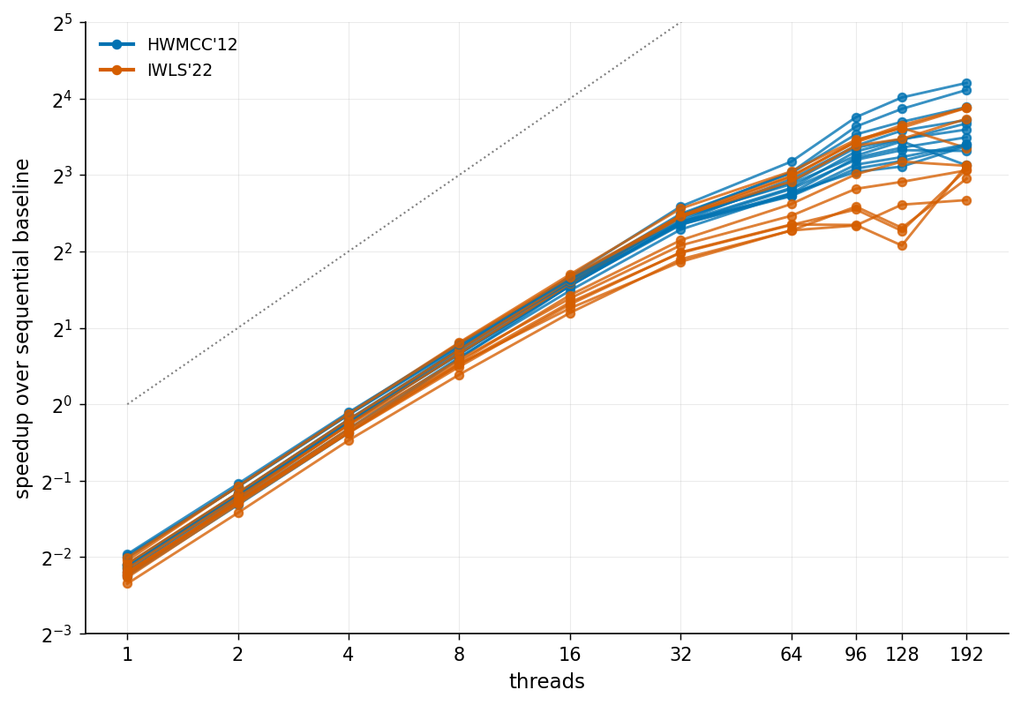
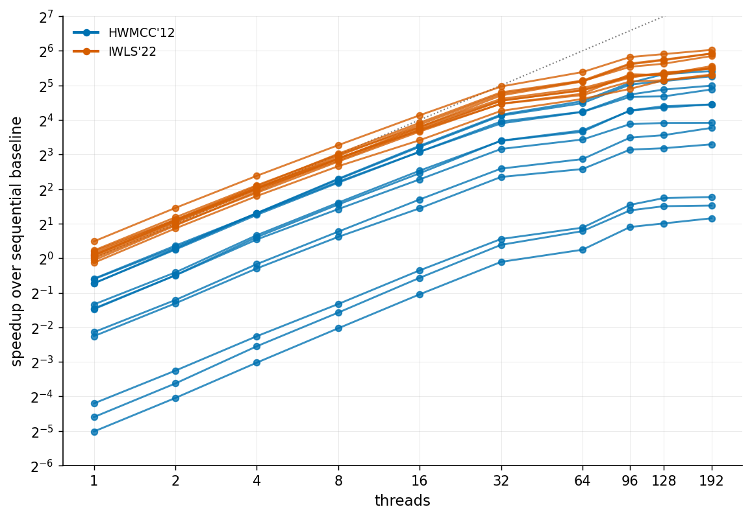
RQ3 — Does this help on real-world benchmarks?
We measure recovered gates from circuit-equivalence miters used by Biere et al.: 10 IWLS’22 and 12 HWMCC’12 instances.
ParentCC
FilterCC
74

Slide 83

Conclusion
TWO PARALLEL ALGORITHMS
ParentCC
f(a)
f(c)
Maintain parent lists; each round revisits only parents of classes merged in the previous round.
a
=
b
=
c
FilterCC
Avoid parent lists; mark merged classes dirty, then filter for terms with a dirty child before grouping and merging.
CONGRUENCE CLOSURE
CODE + BENCHMARKS
BOTTOM LINE
Parallelism follows width, not depth.
ParallelEgraph
github.com/amarshah10
Both algorithms approach linear speedup through 32 cores on wide workloads, including circuit-equivalence benchmarks.

Slide 84
Backup: ParentCC pseudocode
ParentCC(E):
parfor (u = v) ∈ E: Union(u, v)
Work ← terms of E
while Work ≠ ∅:
parfor c ∈ Work with c ≠ Find(c): ▹ fold parent lists
Parents[Find(c)] ← Parents[Find(c)] ∪ Parents[c]
Frontier ← all compound terms on round 0 ▹ seed round
Frontier ← ⋃ Parents[Find(c)] for c ∈ Work otherwise
groups ← GroupBy(Congruent, Frontier) ▹ semisort on sigs
Work ← ∅
parfor g ∈ groups spanning > 1 class:
MergeCongruenceClass(g) ▹ parallel unions
Work ← Work ∪ pre-merge roots of g
MergeCongruenceClass(S): ▹ divide and conquer
if |S| = 1: return the element
l, r ← MergeCongruenceClass(S[0..n/2]) ∥ MergeCongruenceClass(S[n/2..n])
return Union(l, r)
Notes:
The same three phases, precisely. Work is the set of classes that changed last round; the frontier is their parents; groups come from a semisort on signatures; each group merges by divide and conquer. Barriers separate the phases, so signatures are always computed against a union-find no thread is modifying. This slide is for the record; do not read it.

