Slide 1
Parallelizing Congruence Closure
Zak Kent and Amar Shah

Slide 2
Congruence Closure
Given a set of terms and equalities over them, compute the least equivalence relation respecting function symbols

Slide 3


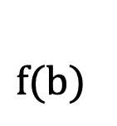

Congruence Closure
Given a set of terms and equalities over them, compute the least equivalence relation respecting function symbols
$f(b)$
$a$
$b$
$f(a)$

Slide 4

Congruence Closure
Given a set of terms and equalities over them, compute the least equivalence relation respecting function symbols
$a≡b$
$f(b)$
$a$
$b$
$f(a)$

Slide 5


Congruence Closure
Given a set of terms and equalities over them, compute the least equivalence relation respecting function symbols
$a≡b$
$f(b)$
$a$
$b$
$f(a)$

Slide 6
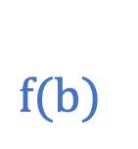

Congruence Closure
Given a set of terms and equalities over them, compute the least equivalence relation respecting function symbols
$a≡b$
$f(b)$
$a$
$b$
$f(a)$

Slide 7
Congruence Closure
Given a set of terms and equalities over them, compute the least equivalence relation respecting function symbols
$a≡b$
$f(b)$
$a$
$b$
$f(a)$
Congruence rule
s₁ ≡ t₁ … sₖ ≡ tₖ
f(s₁, …, sₖ) ≡ f(t₁, …, tₖ)

Slide 8
Use in Practice
Engines
Applications
SMT solvers: Z3, cvc5 (theory of uninterpreted functions)
SAT solvers: Kissat (clausal congruence closure)
Equality saturation: egg, egglog
Type unification
Circuit equivalence checking
Software verification: Dafny, Verus
Hardware design
Theorem proving: Lean grind

Slide 9
State-of-the-Art
Despite ubiquity, algorithms used in practice fully sequential
Unfortunately, CC is P-complete
  Likely inherently sequential in worst case
Question: do practical instances expose enough independent merges for real speedups?

Slide 10
Contributions
Two bulk-synchronous-parallel (BSP) algorithms
Workload characterization for parallelization effectiveness
Evaluation demonstrating effective speedup in practice

Slide 11
Naïve Sequential Algorithm

Slide 13
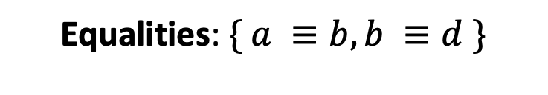
Congruence Closure
Given a set of terms and equalities over them, compute the least equivalence relation respecting function symbols
Equalities: $\{ a ≡b, b ≡d \}$

