Slide 1

Kept Anonymous
1

Slide 2

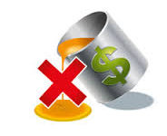















Revenue Assurance Overview
Annually 111 B Records Processed Covering $800 M Cost & $100 M Revenue
Provisioning
B2B EIP Bad Debt , Churn Reporting
Un-carrier Moves
Usage Expenses
ROCRA
Rate plan Management
Usage Profitability
Discounts
SOX Controls
RA
IN
B2B
Fraud
Roaming
Marketing
~ $27 Million Revenue Savings YTD
Analysis
Reports
Data

Slide 3







Key to Operator By MS Operations
First 6 Months
Development Time Reduced Onsite/Offshore Model
Completed More Projects
Expanded Footprints By Providing reports to different teams
Helping Discovery Team
Offshore Model
Managed Services

Slide 4

ANY Thank You !

