Slide 2
Refugia value is high
Infrastructure value is high
Number of buildings is high
Number or comm. towers is high
Habitat value is high
Habitat for important species is present
Uniqueness is high
Invasive species cover is low
Proportion of area of land cover type is low
Stand age is high
Isolation is high

Slide 3
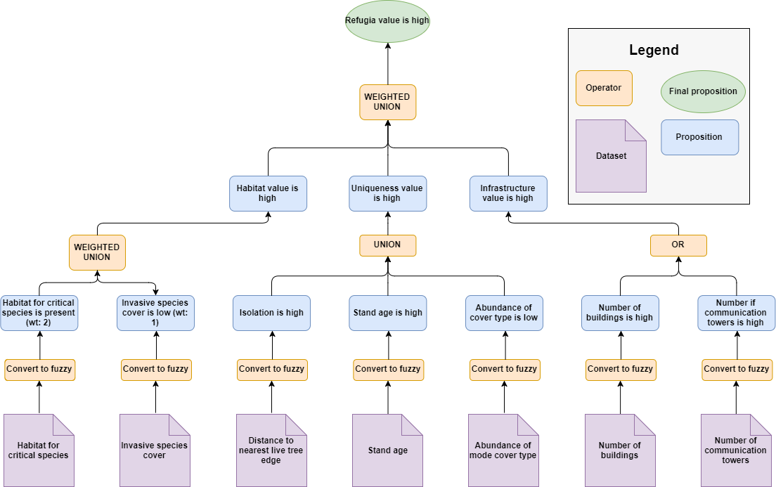
Workflow for EEMS model
Final proposition
(output)
Operator
First-tier propositions
Operators
Fuzzy input
Conversion to
fuzzy numbers
Datasets
Draw.io

Slide 4
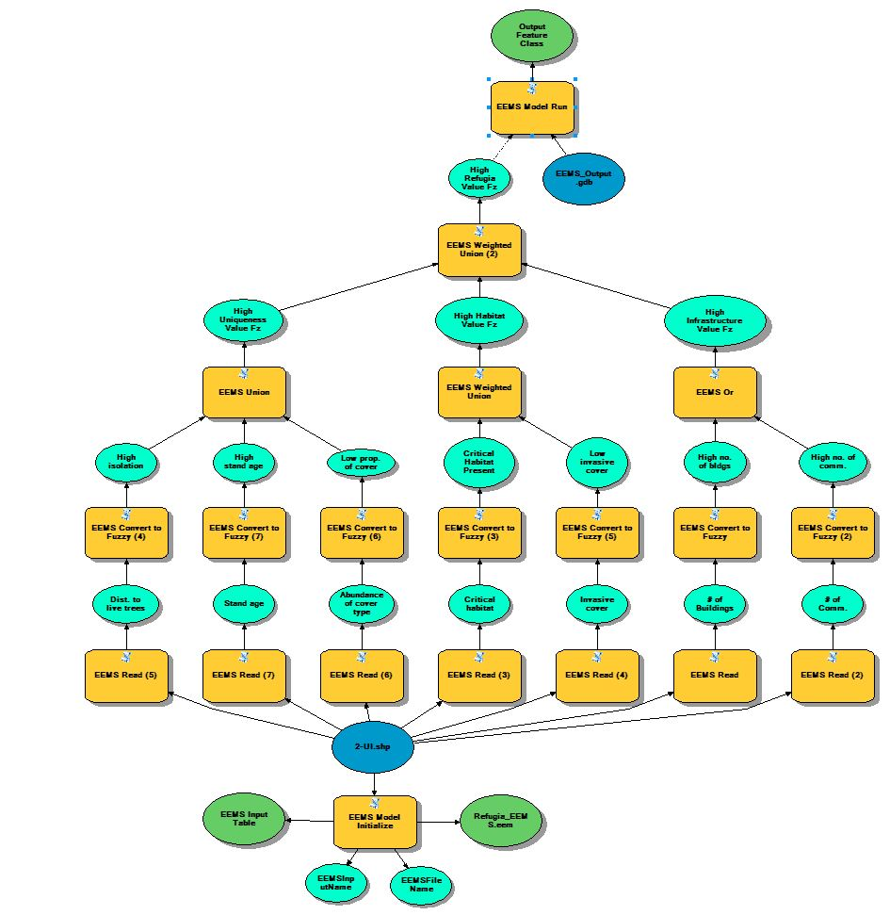
ArcGIS Model Builder

Slide 5
Operators Used
UNION
Returns the average value of the inputs (mean fuzzy value)
Appropriate when each input to exert equal influence on the result.
WEIGHTED UNION
Returns the weighted mean for each row of the inputs
Appropriate when all values exert unequal influence on the result
OR
Returns the truest value of the inputs (highest fuzzy value)
Appropriate when any of the inputs is sufficient for the desired outcome

Slide 6
Is the refugia isolated?
1.0
Fuzzy Value
(Truthness/Falseness)
0.0
-1.0
10
20
40
60
70
Distance to nearest live forest edge (m)

