Slide 2
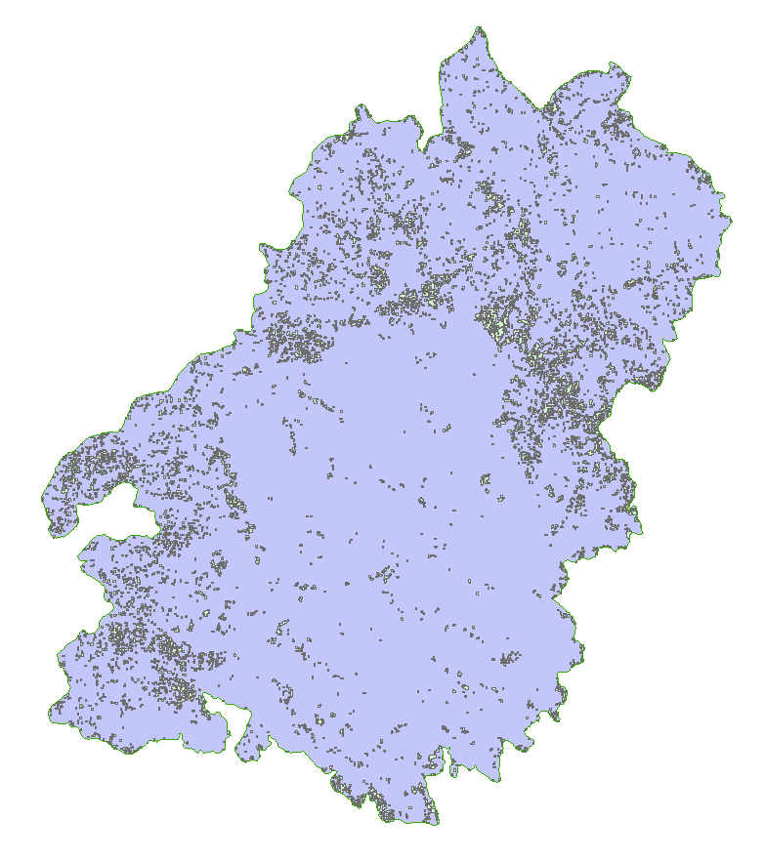
Table Mountain perimeter and unburned islands

Slide 3
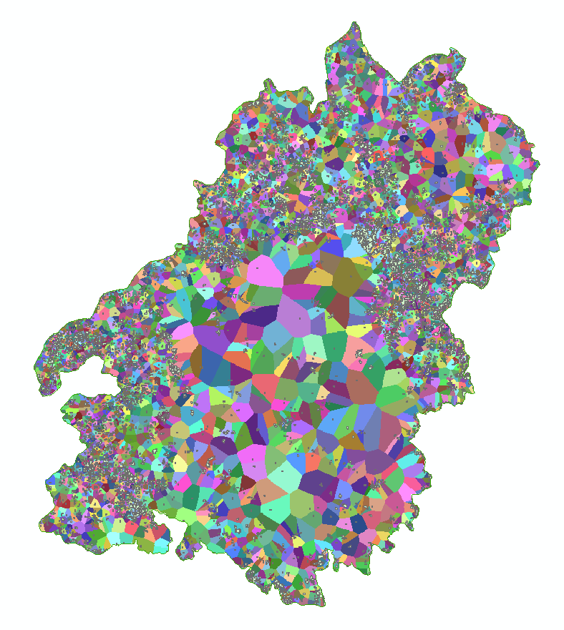
Euclidean allocation –assign each unburned island all the area that is the nearest point to

Slide 4
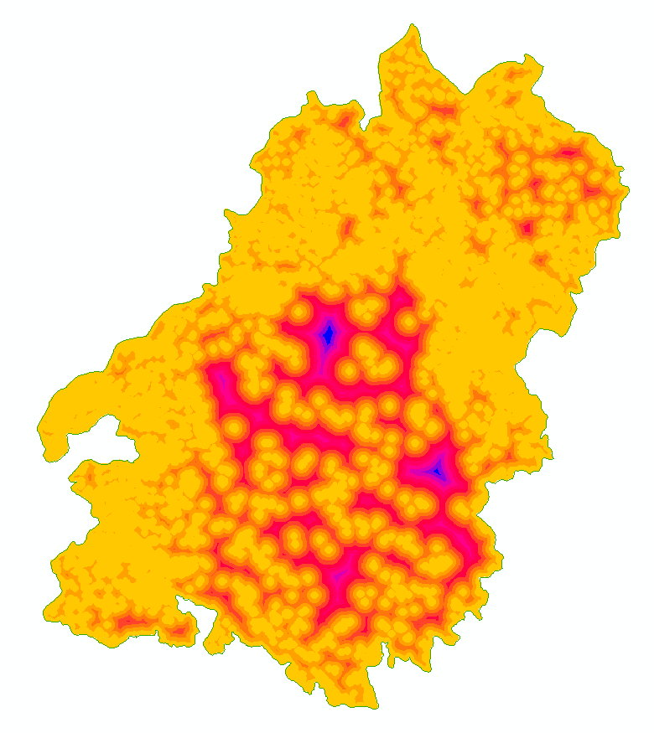
Euclidean distance – distance to nearest live-forest edge

Slide 5
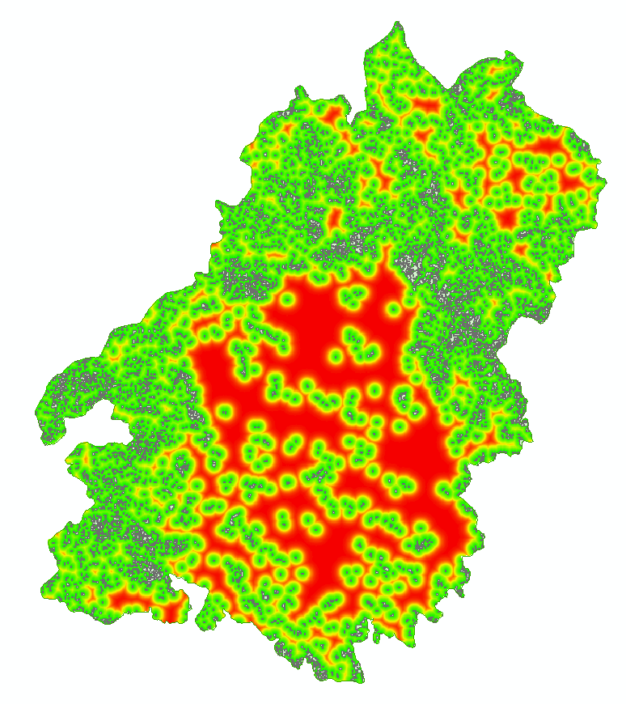
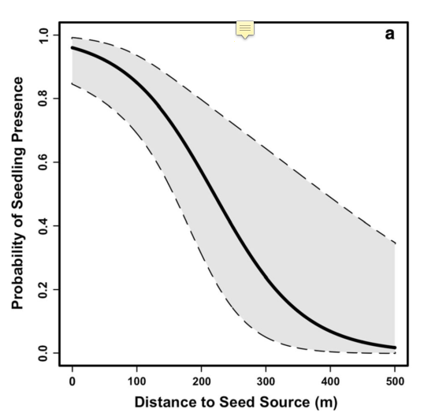
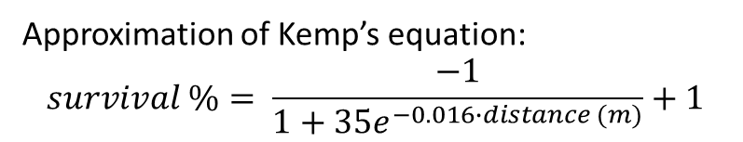
Seedling survival % as a function of distance (Kemp paper)
Approximation of Kemp’s equation:
$$survival \%= \frac{−1}{1+35e^{−0.016∙distance (m)}}+1$$

Slide 6
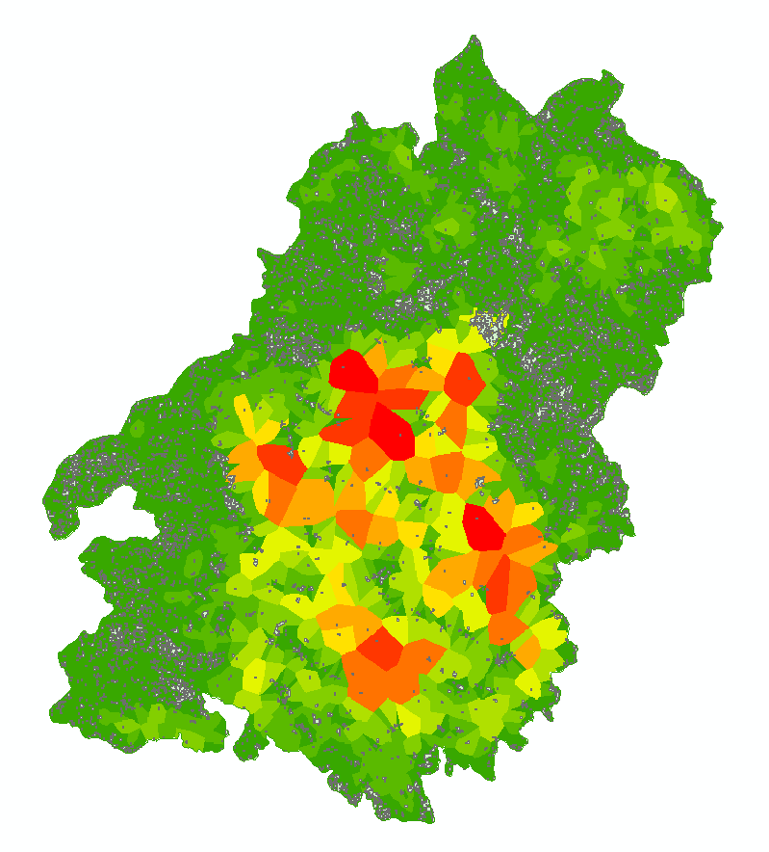
Seeding importance = Sum of survival % pixels for each island’s unique area

