Slide 2
Refugia value is high
Infrastructure value is high
Number of buildings is high
Number or comm. towers is high
Habitat value is high
Habitat for important species is present
Uniqueness is high
Invasive species cover is low
Proportion of area of land cover type is low
Stand age is high
Isolation is high

Slide 3
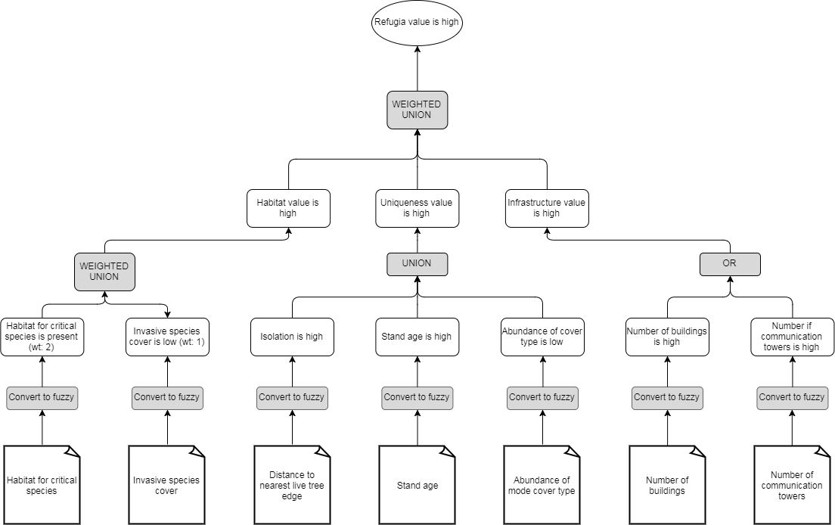
Draw.io

Slide 4
