Slide 1


Look & Dev Session:
Fog lights: Participating Media and Tyndall Effect
Modeling and Simulation of Appearance
Título de la presentación
Luis Calderón Robustillo
Andrés Martínez Silva
20 / 11/ 2023

Slide 2
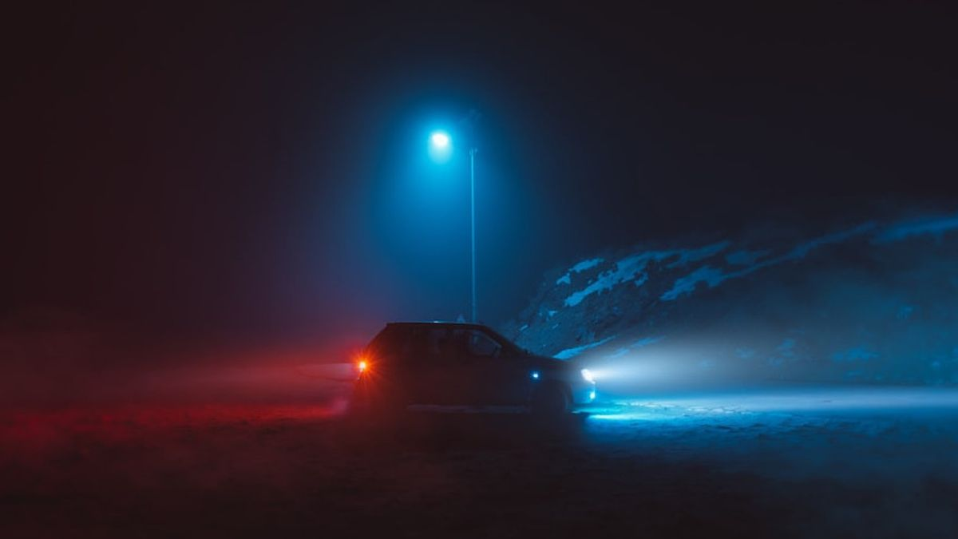
Visual effects
Light sources in a foggy night scene:
Great example of participating media
Scattering and absorption
Blueish glow around light sources.
Reduced visibility
Image from: https://voi.id/en/otomotif/316820
Access date: 20/11/2023
1

Slide 3
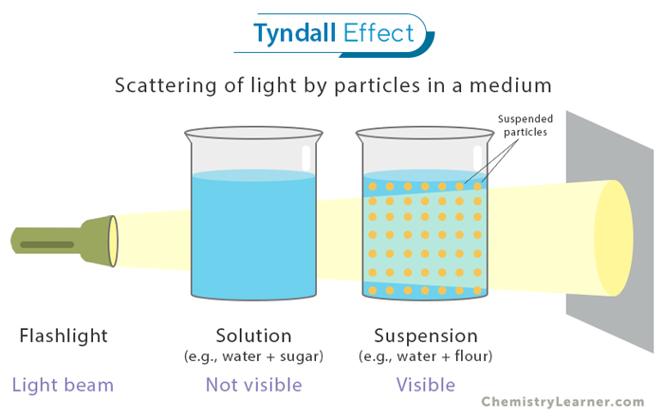
Tyndall effect
A Comprehensive Overview
Caused by light interaction with colloidal particles in suspension.
Suspended particles intensively scatter shorter wavelengths, (e.g. blue color)
Glare effect
Fog lights
Colors corresponding to larger wavelengths (yellow)
Aimed lower, broader distribution
Reduced glare for other drivers
Image from: https://www.chemistrylearner.com/tyndall-effect.html
Access date: 20/11/2023
1

Slide 4
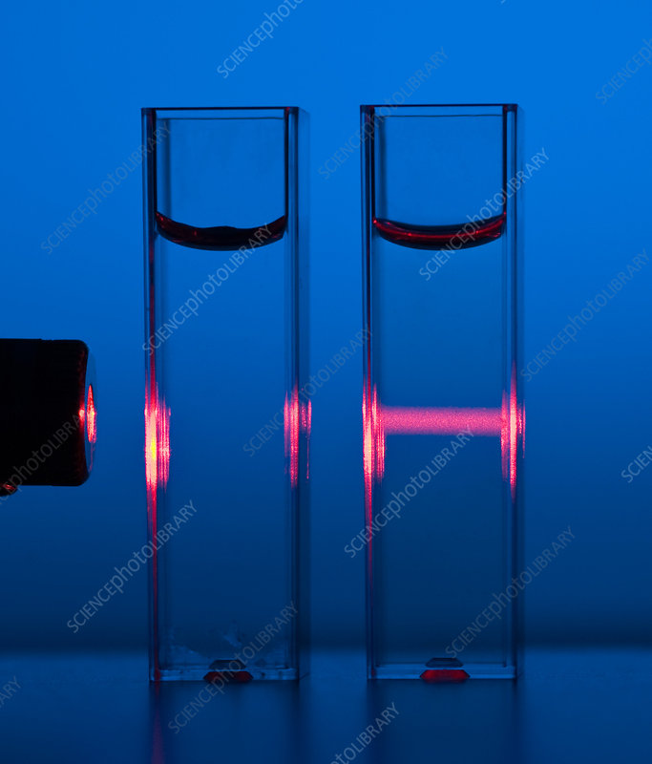
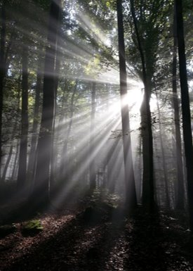
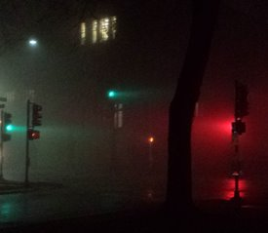
Tyndall effect
Image from: Science Photo Library
Access date: 20/11/2023
Images from Wikipedia ​
Access date: 20/11/2023
1

Slide 5
How to model?
Main rendering techniques
Volumetric rendering
Global ilumination
Refraction models
1

Slide 6
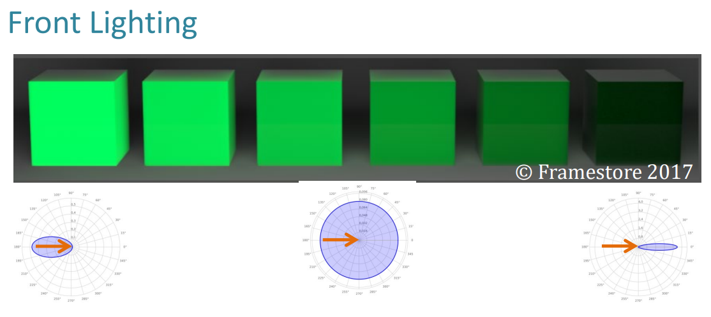
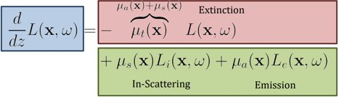
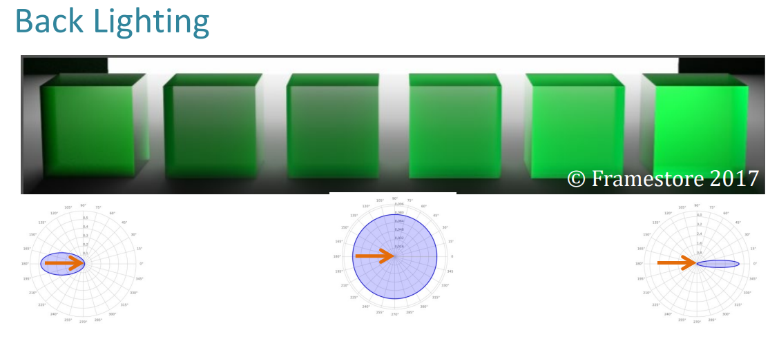
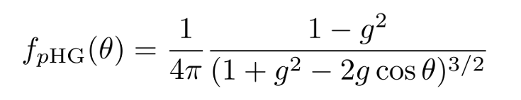
RTE Equation and phase function
Phase function Influences spread and directionality of the scattered light.
Henyey-Greenstein:
1

Slide 7
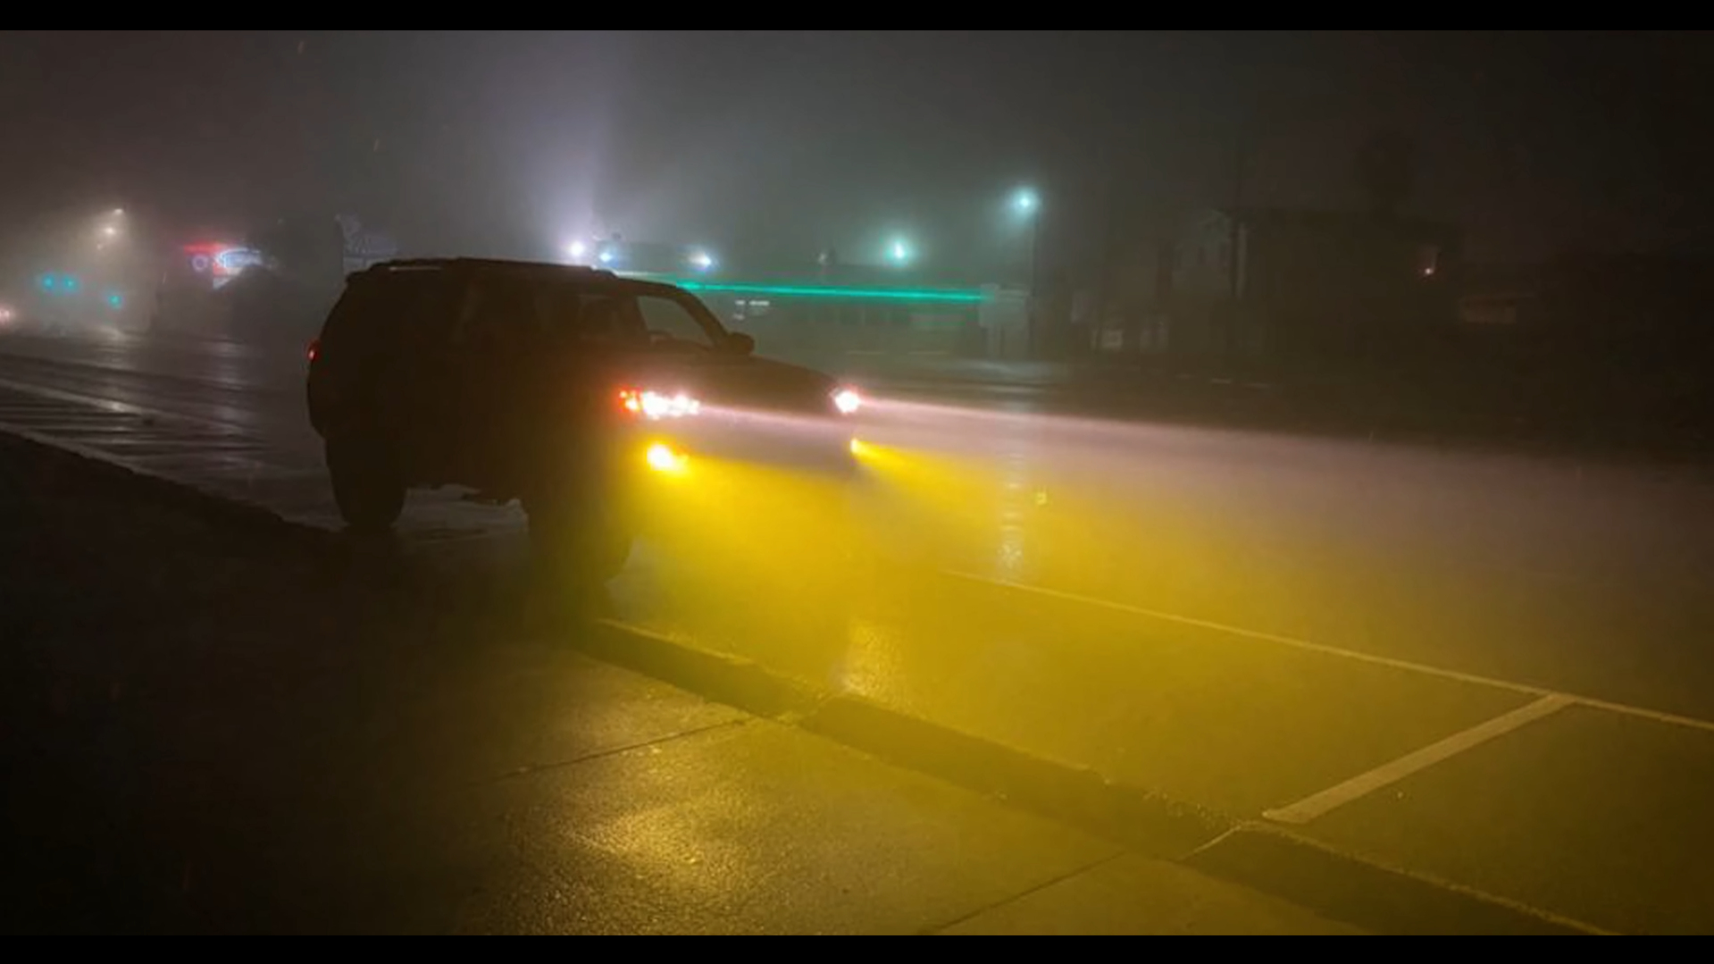
How to model?
Other techniques to consider
Materials (e.g. body of the car)
Textures
Bidirectional methods for car lights
1

