Slide 1


Network Topology Implementation in NS2 EC-446 Summer Internship
Dept. of Electronics & Communication
Prepared By: Amartya Singh
17EC088
CSPIT-EC
Guided By: Prof. Brijesh Kundaliya
Assistant Professor,
CSPIT-EC

Slide 2
Flow Of Presentation
What is Computer Network ?
Why we need Computer Network ?
OSI Model & it’s Different Layer
TCP/IP Model & it’s Different Layer
Hardware Components for Networking
Explanation of a basic TCL Script

Slide 3
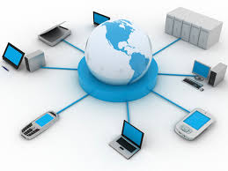
Computer Network
Computer Network is a group of computers connected with each other through wires, optical fibers, wireless medium or optical links so that various devices can interact with each other through a network.
The aim of the computer network is the sharing of resources among various devices.

Slide 4
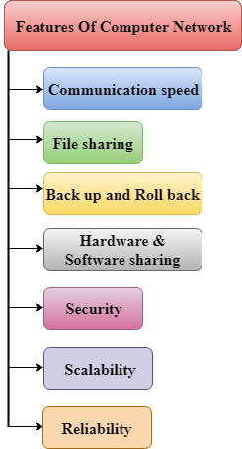
Requirement Of Network

Slide 5
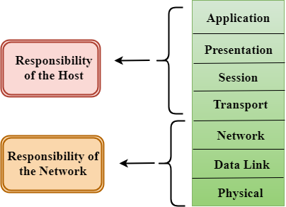
OSI model
OSI stands for Open System Interconnection is a reference model that describes how information from a software application in one computer moves through a physical medium to the software application in another computer.
OSI consists of seven layers, and each layer performs a particular network function.
OSI model was developed by the International Organization for Standardization (ISO) in 1984, and it is now considered as an architectural model for the inter-computer communications.
OSI model divides the whole task into seven smaller and manageable tasks. Each layer is assigned a particular task.
Each layer is self-contained, so that task assigned to each layer can be performed independently.

Slide 6
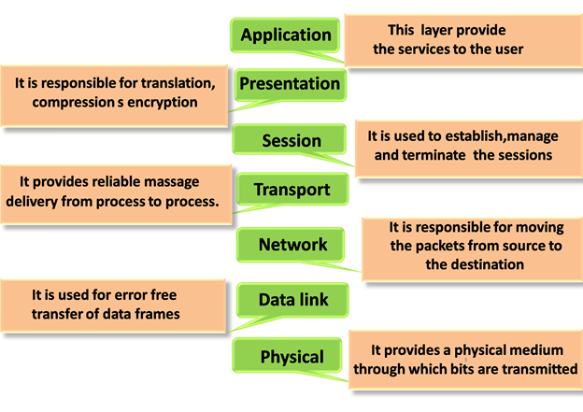
OSI model

Slide 7
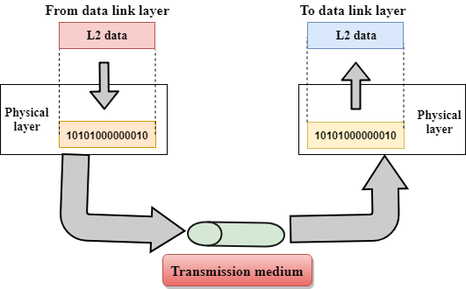
PHYSICAL layer
FUNCTIONS
Line Configuration: It defines the way how two or more devices can be connected physically.
Data Transmission: It defines the transmission mode whether it is simplex, half-duplex or full-duplex mode between the two devices on the network.
Topology: It defines the way how network devices are arranged.
Signals: It determines the type of the signal used for transmitting the information.

Slide 8
DATA LINK layer
FUNCTIONS
Framing: The data link layer translates the physical's raw bit stream into packets known as Frames. The Data link layer adds the header and trailer to the frame. The header which is added to the frame contains the hardware destination and source address.
Physical Addressing: The Data link layer adds a header to the frame that contains a destination address. The frame is transmitted to the destination address mentioned in the header.
Flow Control: Flow control is the main functionality of the Data-link layer. It is the technique through which the constant data rate is maintained on both the sides so that no data get corrupted. It ensures that the transmitting station such as a server with higher processing speed does not exceed the receiving station, with lower processing speed.
Error Control: Error control is achieved by adding a calculated value CRC (Cyclic Redundancy Check) that is placed to the Data link layer's trailer which is added to the message frame before it is sent to the physical layer. If any error seems to occurr, then the receiver sends the acknowledgment for the retransmission of the corrupted frames.
Access Control: When two or more devices are connected to the same communication channel, then the data link layer protocols are used to determine which device has control over the link at a given time.

Slide 9
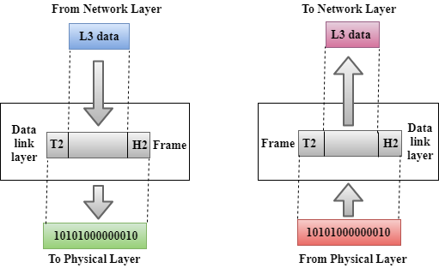
DATA LINK layer

Slide 10
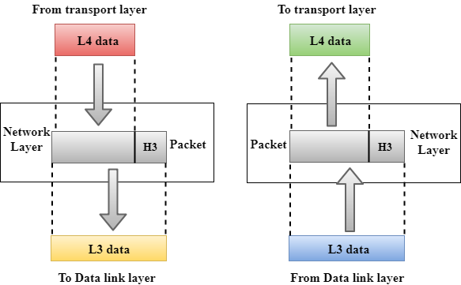
NETWORK layer
FUNCTIONS
Internetworking: An internetworking is the main responsibility of the network layer. It provides a logical connection between different devices.
Addressing: A Network layer adds the source and destination address to the header of the frame. Addressing is used to identify the device on the internet.
Routing: Routing is the major component of the network layer, and it determines the best optimal path out of the multiple paths from source to the destination.
Packetizing: A Network Layer receives the packets from the upper layer and converts them into packets. This process is known as Packetizing. It is achieved by internet protocol (IP).

Slide 11
TRANSPOT layer
FUNCTIONS
Service-point addressing: Computers run several programs simultaneously due to this reason, the transmission of data from source to the destination not only from one computer to another computer but also from one process to another process. The transport layer adds the header that contains the address known as a service-point address or port address. The responsibility of the network layer is to transmit the data from one computer to another computer and the responsibility of the transport layer is to transmit the message to the correct process.
Segmentation and reassembly: When the transport layer receives the message from the upper layer, it divides the message into multiple segments, and each segment is assigned with a sequence number that uniquely identifies each segment. When the message has arrived at the destination, then the transport layer reassembles the message based on their sequence numbers.
Connection control: Transport layer provides two services Connection-oriented service and connectionless service. A connectionless service treats each segment as an individual packet, and they all travel in different routes to reach the destination. A connection-oriented service makes a connection with the transport layer at the destination machine before delivering the packets. In connection-oriented service, all the packets travel in the single route.
Flow control: It is performed end-to-end rather than across a single link.
Error control: It is performed end-to-end rather than across the single link. The sender transport layer ensures that message reach at the destination without any error

Slide 12
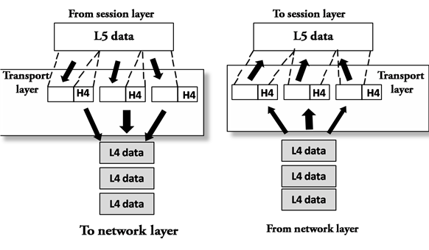
TRANSPOT layer

Slide 13
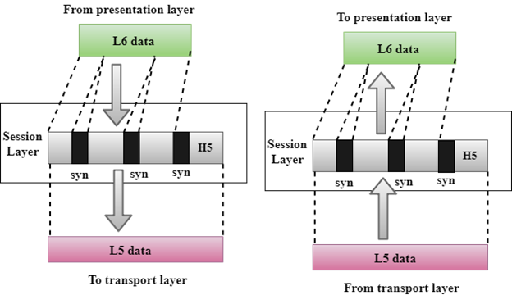
SESSION layer
FUNCTIONS
Dialog control: Session layer acts as a dialog controller that creates a dialog between two processes or we can say that it allows the communication between two processes which can be either half-duplex or full-duplex.
Synchronization: Session layer adds some checkpoints when transmitting the data in a sequence. If some error occurs in the middle of the transmission of data, then the transmission will take place again from the checkpoint. This process is known as Synchronization and recovery.

Slide 14
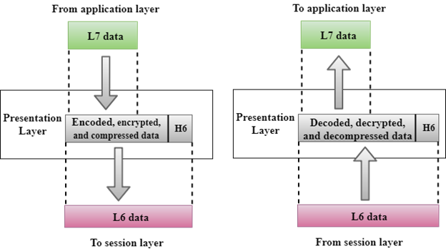
PRESENTATION layer
FUNCTIONS
Translation: The processes in two systems exchange the information in the form of character strings, numbers and so on. Different computers use different encoding methods, the presentation layer handles the interoperability between the different encoding methods. It converts the data from sender-dependent format into a common format and changes the common format into receiver-dependent format at the receiving end.
Encryption: Encryption is needed to maintain privacy. Encryption is a process of converting the sender-transmitted information into another form and sends the resulting message over the network.
Compression: Data compression is a process of compressing the data, i.e., it reduces the number of bits to be transmitted. Data compression is very important in multimedia such as text, audio, video.

Slide 15
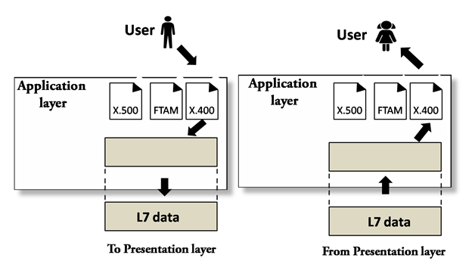
APPLICATION layer
FUNCTIONS
File transfer, access, and management (FTAM): An application layer allows a user to access the files in a remote computer, to retrieve the files from a computer and to manage the files in a remote computer.
Mail services: An application layer provides the facility for email forwarding and storage.
Directory services: An application provides the distributed database sources and is used to provide that global information about various objects.

Slide 16
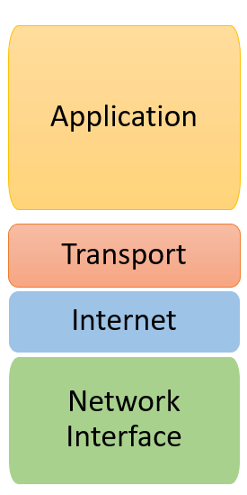
TCP/IP model
TCP/IP stands for Transmission Control Protocol/ Internet Protocol. It is specifically designed as a model to offer highly reliable and end-to-end byte stream over an unreliable internetwork.
CHARACTERISTICS:
Support for a flexible architecture i.e. adding more system to a network is easy.
The network remains intact until the source, and destination machines were functioning properly.
TCP is a connection-oriented protocol.
TCP offers reliability and ensures that data which arrives out of sequence should put back into order.
TCP allows you to implement flow control, so sender never overpowers a receiver with data.

Slide 17
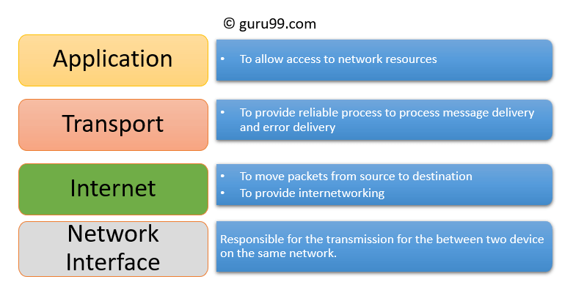
TCP/IP model

Slide 18
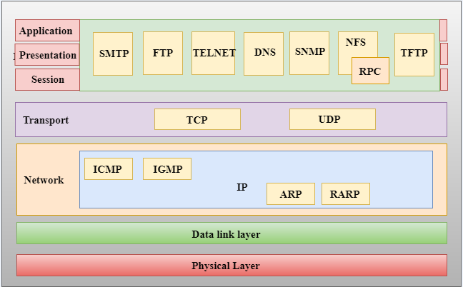
TCP/IP model

Slide 19
APPLICATION layer
FUNCTIONS
Application-layer helps you to identify communication partners, determining resource availability, and synchronizing communication.
It allows users to log on to a remote host
This layer provides various e-mail services
This application offers distributed database sources and access for global information about various objects and services.
TRANSPOT layer
FUNCTIONS
It divides the message received from the session layer into segments and numbers them to make a sequence.
Transport layer makes sure that the message is delivered to the correct process on the destination machine.
It also makes sure that the entire message arrives without any error else it should be retransmitted

Slide 20
INTERNET (Network) layer
FUNCTIONS
The main work of this layer is to send the packets from any network, and any computer still they reach the destination irrespective of the route they take.
The Internet layer offers the functional and procedural method for transferring variable length data sequences from one node to another with the help of various networks
NETWORK INTERFACE layer
FUNCTIONS
It helps you to defines details of how data should be sent using the network.
It also includes how bits should optically be signaled by hardware devices which directly interfaces with a network medium, like coaxial, optical, coaxial, fiber, or twisted-pair cables.

Slide 21
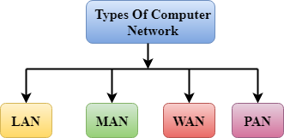
Types Of Computer Network

Slide 22
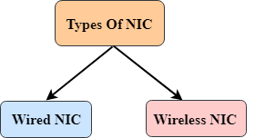
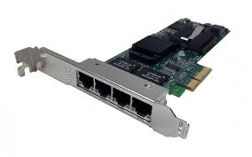
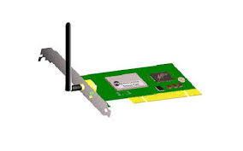
NETWORK INTERFACE CARD (NIC)
NIC stands for network interface card.
NIC is a hardware component used to connect a computer with another computer onto a network
The MAC address or physical address is encoded on the network card chip which is assigned by the IEEE to identify a network card uniquely. The MAC address is stored in the PROM (Programmable read-only memory)

Slide 23
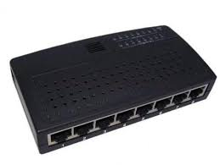
HUB
A Hub is a hardware device that divides the network connection among multiple devices.
When computer requests for some information from a network, it first sends the request to the Hub through cable. Hub will broadcast this request to the entire network. All the devices will check whether the request belongs to them or not. If not, the request will be dropped.
The process used by the Hub consumes more bandwidth and limits the amount of communication. Nowadays, the use of hub is obsolete, and it is replaced by more advanced computer network components such as Switches, Routers

Slide 24
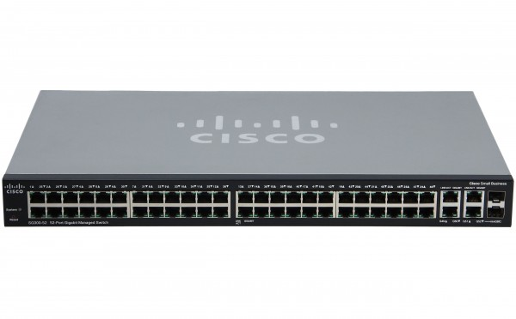
SWITCH
A switch is a hardware device that connects multiple devices on a computer network.
A Switch contains more advanced features than Hub.
The Switch contains the updated table that decides where the data is transmitted or not.
Switch delivers the message to the correct destination based on the physical address present in the incoming message. A Switch does not broadcast the message to the entire network like the Hub. It determines the device to whom the message is to be transmitted.
Therefore, we can say that switch provides a direct connection between the source and destination. It increases the speed of the network.

Slide 25
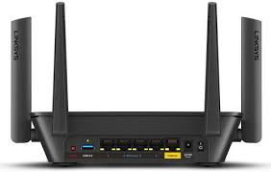
ROUTER
A router is a hardware device which is used to connect a LAN with an internet connection. It is used to receive, analyze and forward the incoming packets to another network.
A router works in a Layer 3 (Network layer) of the OSI Reference model.
A router forwards the packet based on the information available in the routing table.
It determines the best path from the available paths for the transmission of the packet.

Slide 26
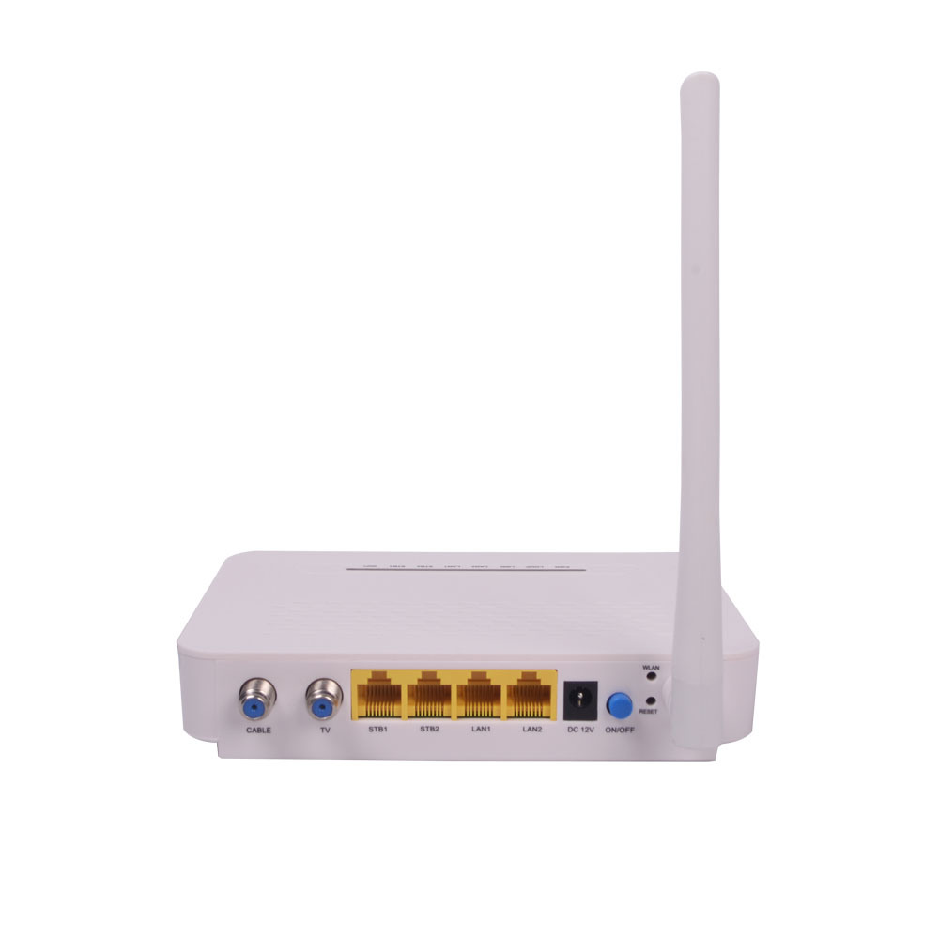
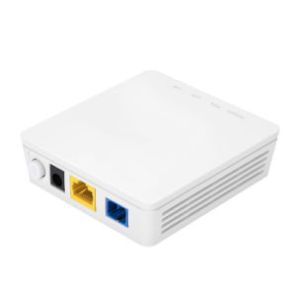
MODEM
A modem is a hardware device that allows the computer to connect to the internet over the existing telephone line.
A modem is not integrated with the motherboard rather than it is installed on the PCI slot found on the motherboard.
It stands for Modulator/Demodulator. It converts the digital data into an analog signal over the telephone lines
Based on the differences in transmission rate, a modem can be classified in the following categories:
Standard PC modem or Dial-up modem
Cellular Modem
Cable modem

Slide 27
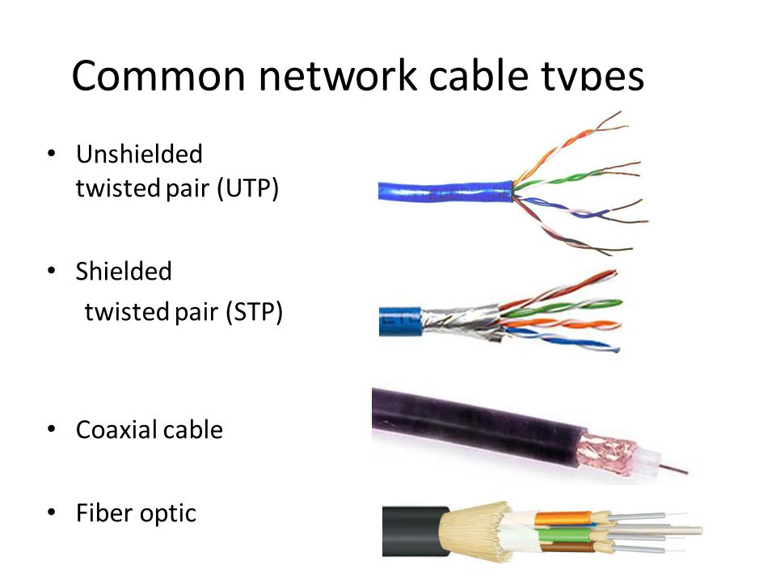
CABLE
Cable is a transmission media used for transmitting a signal.
There are three types of cables used in transmission:
Twisted pair cable
Coaxial cable
Fiber-optic cable

Slide 28
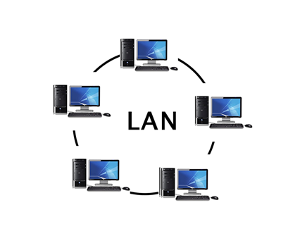
LAN(Local Area Network)
Local Area Network is a group of computers connected to each other in a small area such as building, office.
LAN is used for connecting two or more personal computers through a communication medium such as twisted pair, coaxial cable, etc.
It is less costly as it is built with inexpensive hardware such as hubs, network adapters, and ethernet cables.
The data is transferred at an extremely faster rate in Local Area Network.
Local Area Network provides higher security

Slide 29
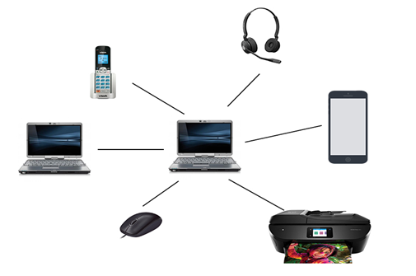
PAN(Personal Area Network)
Personal Area Network is a network arranged within an individual person.
Personal Area Network is used for connecting the computer devices of personal use is known as Personal Area Network.
Personal computer devices that are used to develop the personal area network are the laptop, mobile phones, media player and play stations

Slide 30
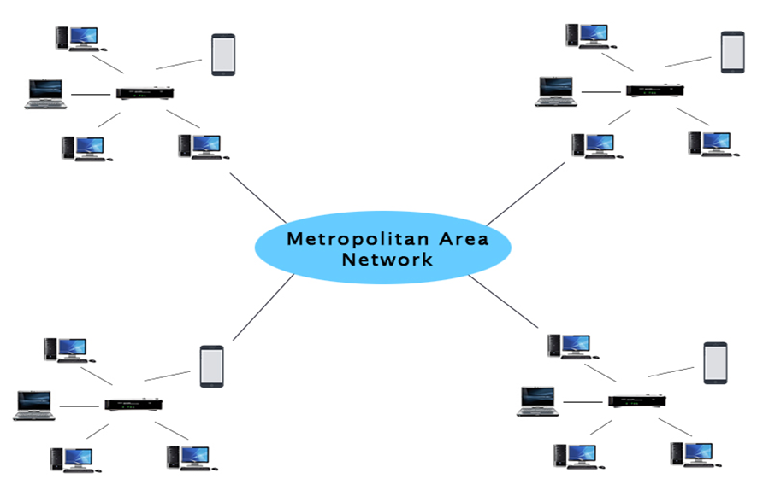
MAN(Metropolitan Area Network)
A metropolitan area network is a network that covers a larger geographic area by interconnecting a different LAN to form a larger network.
In MAN, various LANs are connected to each other through a telephone exchange line.
It has a higher range than Local Area Network(LAN).

Slide 31
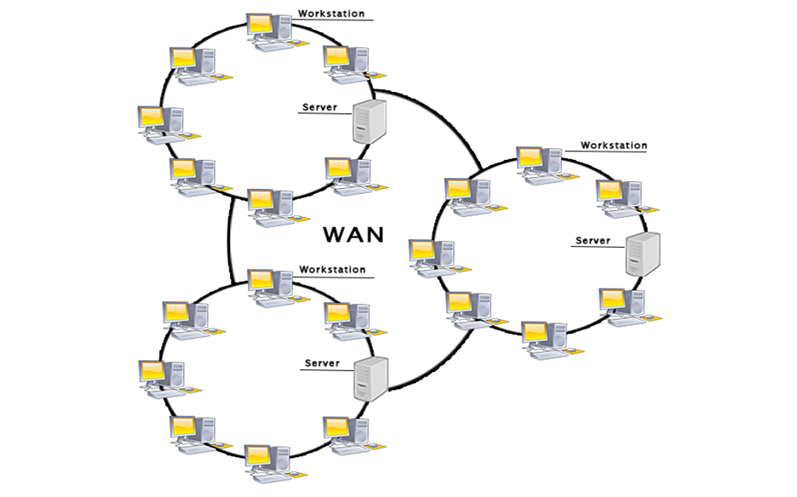
WAN(Wide Area Network)
A Wide Area Network is a network that extends over a large geographical area such as states or countries.
A Wide Area Network is quite bigger network than the LAN.
A Wide Area Network is not limited to a single location, but it spans over a large geographical area through a telephone line, fiber optic cable or satellite links.
The internet is one of the biggest WAN in the world.

Slide 32
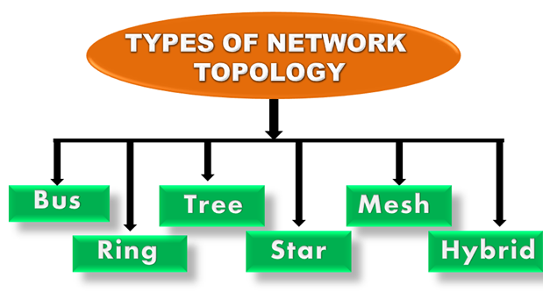
Computer Network Topology

Slide 33
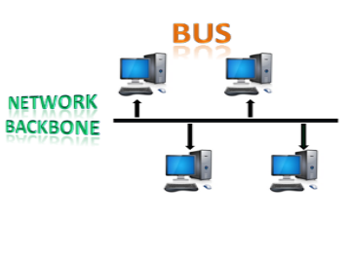
BUS topology
The bus topology is designed in such a way that all the stations are connected through a single cable known as a backbone cable.
Each node is either connected to the backbone cable by drop cable or directly connected to the backbone cable.
When a node wants to send a message over the network, it puts a message over the network. All the stations available in the network will receive the message whether it has been addressed or not.
The bus topology is mainly used in 802.3 (ethernet) and 802.4 standard networks.
The backbone cable is considered as a "single lane" through which the message is broadcast to all the stations.
The most common access method of the bus topologies is CSMA (Carrier Sense Multiple Access).

Slide 34
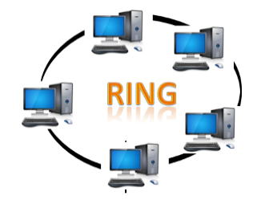
RING topology
Ring topology is like a bus topology, but with connected ends.
The node that receives the message from the previous computer will retransmit to the next node.
The data flows in one direction, i.e., it is unidirectional.
The data flows in a single loop continuously known as an endless loop.
It has no terminated ends, i.e., each node is connected to other node and having no termination point.
The data in a ring topology flow in a clockwise direction.
The most common access method of the ring topology is token passing.

Slide 35
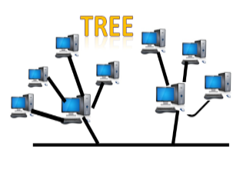
TREE topology
Tree topology combines the characteristics of bus topology and star topology.
A tree topology is a type of structure in which all the computers are connected with each other in hierarchical fashion.
The top-most node in tree topology is known as a root node, and all other nodes are the descendants of the root node.
There is only one path exists between two nodes for the data transmission. Thus, it forms a parent-child hierarchy.

Slide 36
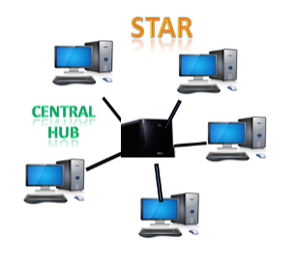
STAR topology
Star topology is an arrangement of the network in which every node is connected to the central hub, switch or a central computer.
The central computer is known as a server, and the peripheral devices attached to the server are known as clients.
Coaxial cable or RJ-45 cables are used to connect the computers.
Hubs or Switches are mainly used as connection devices in a physical star topology.

Slide 37
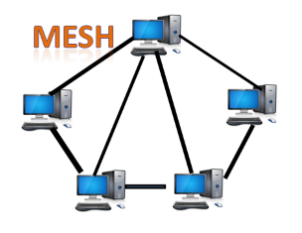
MESH topology
Mesh technology is an arrangement of the network in which computers are interconnected with each other through various redundant connections.
There are multiple paths from one computer to another computer.
It does not contain the switch, hub or any central computer which acts as a central point of communication.
The Internet is an example of the mesh topology.
Mesh topology is mainly used for WAN implementations where communication failures are a critical concern.
Number of cables = (n*(n-1))/2; Where n is the number of nodes that represents the network.

Slide 38
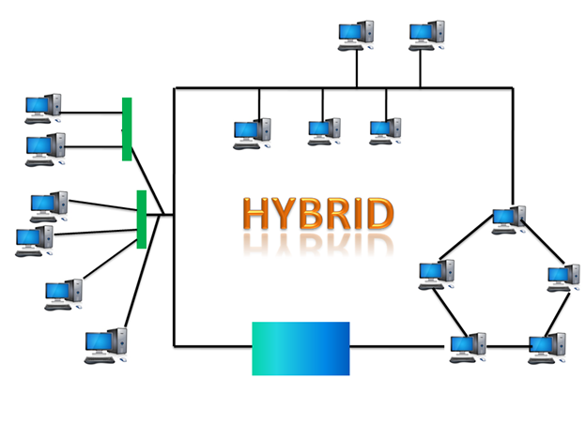
HYBRID topology
The combination of various different topologies is known as Hybrid topology.
A Hybrid topology is a connection between different links and nodes to transfer the data.
When two or more different topologies are combined together is termed as Hybrid topology and if similar topologies are connected with each other will not result in Hybrid topology.

Slide 39
Basic TCL Script Explanation
#creating simulator object
set ns [new Simulator]
#Open NAM file in write mode (nf is NAM file handle)
set nf [open out.nam w]
#to write all details in the file handler i.e. NAM file
$ns namtrace-all $nf
#open trace file in write mode (nt is TRACE file handler)
set nt [open test.tr w]
#to write all detials in the trace file
$ns trace-all $nt

Slide 40
Basic TCL Script Explanation
#define a 'finish' procedure
proc finish {} {
global ns nf nt
$ns flush-trace
#close the NAM & trace file
close $nf
close $nt
#Excute NAM on trace file
exec nam out.nam &
exit 0
}

Slide 41
Basic TCL Script Explanation
#creating four nodes
set n0 [$ns node]
set n1 [$ns node]
set n2 [$ns node]
set n3 [$ns node]
#seting color & shape of nodes
$n0 color blue
$n1 color red
$n2 color green
$n3 color orange
#defining colors for data flow
$ns color 0 Blue
$ns color 1 Red
$ns color 2 Green
$ns color 3 Orange

Slide 42
References
http://www.jgyan.com/ns2/
http://www.ijesrt.com/issues%20pdf%20file/Archive-2016/December-2016/36.pdf
https://www.isi.edu/nsnam/ns/tutorial/
https://www.youtube.com/watch?v=ZAjYDHpVplg&list=PLtRbi3COBc5lx3st89v1Z3Tzpc4wjYx3W
https://www.javatpoint.com/computer-network-tutorial
https://www.tutorialspoint.com/data_communication_computer_network/index.htm
https://www.geeksforgeeks.org/computer-network-tutorials/
https://www.amazon.com/Computer-Networks-Andrew-S-Tanenbaum-ebook/dp/B006Y1BKGC

