Slide 1



Internship at Volansys
EC-448 Project
Prepared By: Amartya Singh
17EC088
CSPIT-EC
Guided By: Prof. Dharmendra Chauhan
CSPIT-EC

Slide 2
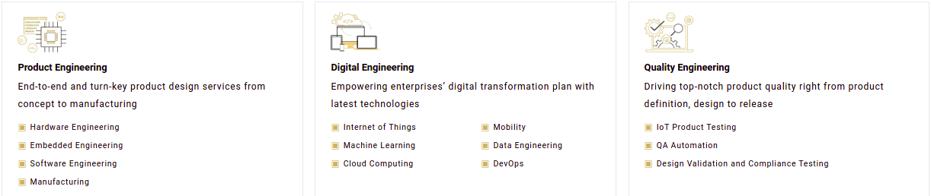
About Volansys
VOLANSYS is a single-stop solution enabler for organizations from roaring start-ups to fortune 500 across diverse domains, delivering design, development, validation and manufacturing capabilities. Having all-in-house expertise for hardware, firmware, cloud, and mobile, we enable our partners and clients to launch intelligent, scalable, and interoperable connected solutions of unmatched quality from idea to realization.

Slide 3
Training Modules
Linux Essentials
Git
C Basics

Slide 4
Linux Essentials
Exercise Set#1 (LinuxEssentialPart-1.pdf) Understanding Shell, Environment Variables, Login/Logout Process, Aliases
Exercise Set#2 File Handling Commands, control operators & Linux file system structure
Exercise Set#3 Management and Network administration basics, usage of advance commands
Exercise Set#4 Pipe, redirection and services (exercise related to FTP/TFTP, NFS, Samba, Telnet, etc.)
Exercise Set#5 The vi Linux Text Editor
Exercise Set#6 Shell script understanding and exercise

Slide 5
Git
Exercise Set#1 Git Introducation & basic command hands on
Exercise Set#2 How to create and manage project in Git
Exercise Set#3 Implement CI for project created in Exercise 2

Slide 6
C Basics
Exercise Set#1 Understand coding guidelines, Doxygen style commenting and document generation
Exercise Set#2 Understand "C program" compilation stages and segements of executable
Exercise Set#3 Understand various data types, operators and variable usage
Exercise Set#4 Understand various storage class, type case and typedef
Exercise Set#5 Decision making and looping
Exercise Set#6 Functions, Function arguments and variable scope

Slide 7
C Basics (continue…)
Exercise Set#7 Basic pointers and array
Exercise Set#8 Structure, Unions & Enumeration
Exercise Set#9 Function Pointers
Exercise Set#10 I/O system and file operation
Exercise Set#11 Static and Dynamic Libraries
Mega Exercise Ask your mentor for mega exercise

Slide 8
Advance C
Exercise Set#1 Makefile
Exercise Set#2 Advance Pointers and Arrays
Exercise Set#3 Dynamic Memory allocation and Valgrind
Exercise Set#4 Know about memory organization and optimization
Exercise Set#5 Debug your program using GDB
Exercise Set#6 Interrupts
Exercise Set#7 Structured programming with C

Slide 9
Mega Exercise
This project will simulate a scenario in which the set and get commands are sent from a mobile (User input on terminal in our case) and get appropriate response from the device (response will be generated from the users system in our case) in BLE command frame (TLV) format.
Users will need to manually enter the BLE command frame (TLV) on the terminal acting as a mobile device. Device response will be simulated by the users system only.
A TLV frame from the terminal will be sent to the system for set or get command then an appropriate response will be generated in the TLV structure itself in the users system and will be sent as a response to the user on the terminal.

Slide 10
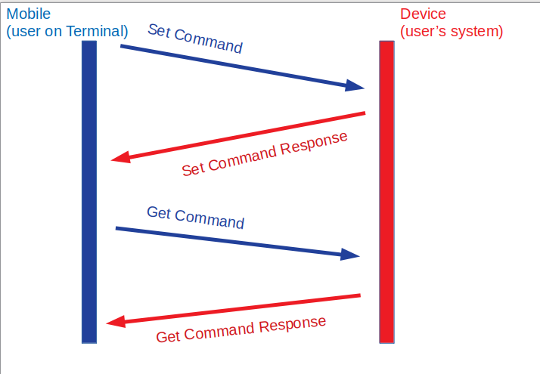
Mega Exercise

Slide 11
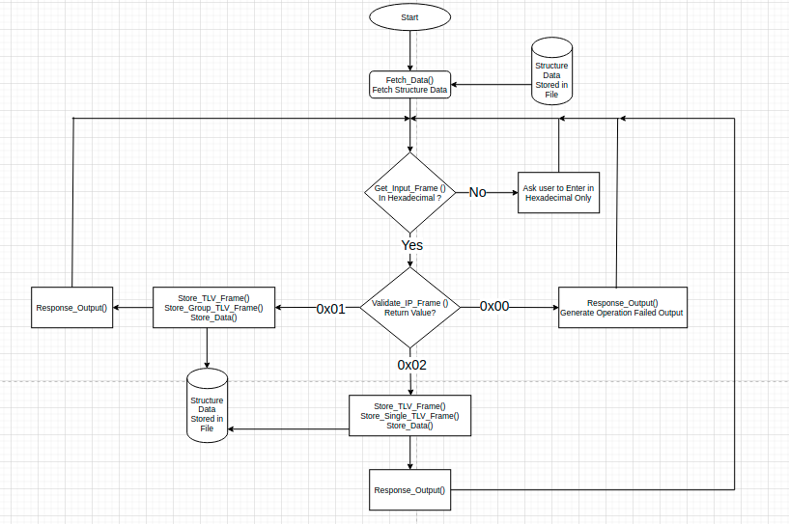

Slide 12
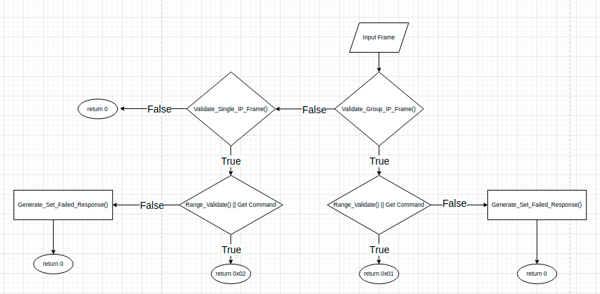

Slide 13
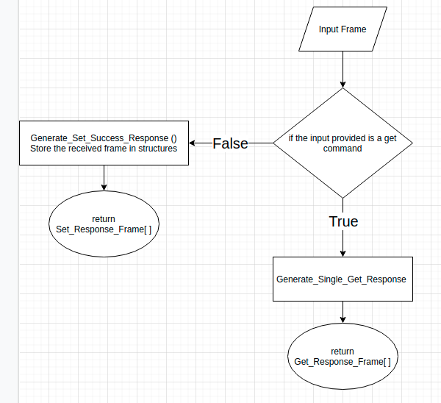

Slide 14
