Slide 1


Training at Volansys EC-448 Project
Prepared By: Shah Swapnil(17EC083)
Amartya Singh(17EC088)
Internal Guide : Dr. Dharmendra Chauhan
Associate Professor
CSPIT-EC
External Guide : Meetali Patel
Noman Cyclewala

Slide 2
Linux
Git
C programming
Training Module
Advanced C
Data Structure
Linux Essential 2
Free RTOS

Slide 3
Linux Essential -1

Slide 4
Exercise Set#1:
Understanding Shell
Environment Variables
Login/Logout Process
Aliases
Exercise Set#2:
File Handling Commands & control operators
Linux file system structure
Exercise Set#3:
Management and Network administration basics
Usage of advance commands
Exercise Set#4:
Pipe, redirection operator
Services (SSH)
Exercise Set#5:
Vim Editor
Exercise Set#6:
Shell script understanding and exercise

Slide 5
Git Training

Slide 6
Exercise Set#1:
Git Introduction & basic command hands on
Basic commands are:
Git add <filename>
Git commit –m “message”
Git push –u origin <branch name>/master
Git pull
Git revert
Git branch <branch name>
Git checkout
Git status
Exercise Set#2:
How to create and manage project in Git
Exercise Set#3:
Implement CI(Continuous Integration) for project

Slide 7
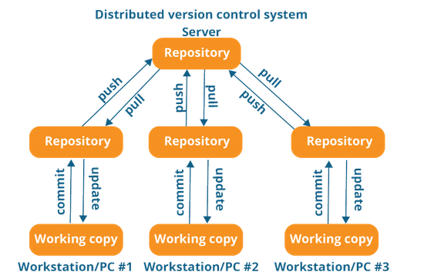
What is Git & why it is required ?
Git is an Open Source Distributed Version Control System.
Version Control System : Version control is a system that records changes to a file or set of files over time so that you can recall specific versions later.
Distributed Version Control System : These DVCS systems do not necessarily rely on a central server to store all the versions of a project file. In Distributed VCS, every contributor has a local copy or “clone” of the main repository i.e. everyone maintains a local repository of their own which contains all the files and metadata present in the main repository.
What is the purpose of Git? : Git tracks the changes you make to files, so you have a record of what has been done, and you can revert to specific versions should you ever need to. Git also makes collaboration easier, allowing changes by multiple people to all be merged into one source.

Slide 8
What is GitLab?
GitLab is a web-based Git repository that provides free open and private repositories, issue-following capabilities. It is a complete DevOps platform that enables professionals to perform all the tasks in a project—from project planning and source code management to monitoring and security. Furthermore, it allows teams to collaborate and build better software.
GitLab helps teams reduce product lifecycles and increase productivity, which in turn creates value for customers. The application doesn't require users to manage authorizations for each tool. If permissions are set once, then everyone in the organization has access to every component.

Slide 9
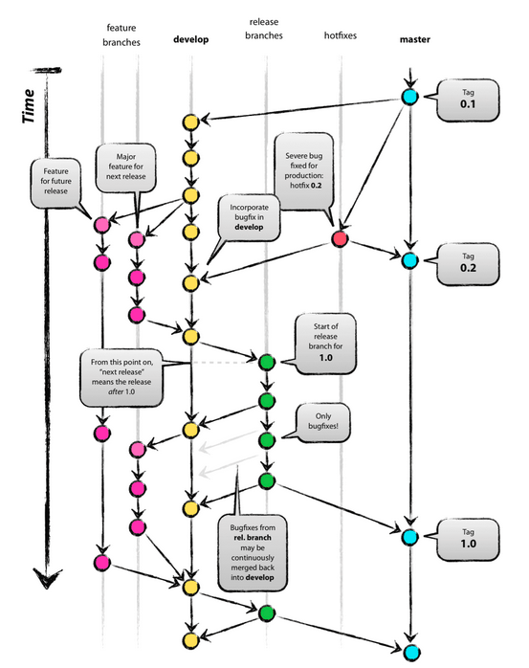
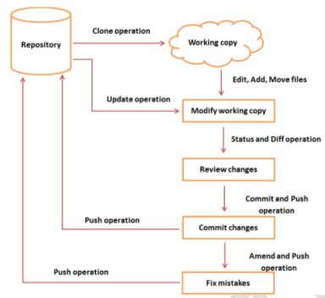
Workflow

Slide 10
C programming

Slide 11
C Basics
Exercise Set#1 Understand coding guidelines, Doxygen style commenting and document generation
Exercise Set#2 Understand "C program" compilation stages and segements of executable
Exercise Set#3 Understand various data types, operators and variable usage
Exercise Set#4 Understand various storage class, type case and typedef
Exercise Set#5 Decision making and looping
Exercise Set#6 Functions, Function arguments and variable scope

Slide 12
C Basics (continue…)
Exercise Set#7 Basic pointers and array
Exercise Set#8 Structure, Unions & Enumeration
Exercise Set#9 Function Pointers
Exercise Set#10 I/O system and file operation
Exercise Set#11 Static and Dynamic Libraries
Mega Exercise Ask your mentor for mega exercise

Slide 13
What is Doxygen?
Doxygen is a document generator designed for multiple programming languages.
Some supported languages include C/C++, Java and Python.
The documentation can be saved as a HTML or LaTeX files.
To generate Configuration file named Doxyfile
doxygen –g
Important variables are to be changed in Doxyfile
PROJECT_NAME
OUTPUT_DIRECTORY
EXTRACT ALL
HTML
Then run doxygen Doxyfile to generate the document in .html format.

Slide 14
Mega Exercise:
Snake Game

Slide 15
System Overview
The most popular classical game named “SNAKE” starts by welcoming on the screen, User is asked whether he/she is a new user or existing user and based on that the information is being stored and retrieved. After registering , the User is asked to select the game mode they want to play.After that, the game starts where the user controls a snake by using arrow keys until it manages to eat food. When you get the food, the Snake grows by an extra block .If, or rather when, the snake bumps into the edge of the boundary or accidentally eats himself the game is over. And the final Score , the User gets is shown.
https://drive.google.com/file/d/1QpI3Ta6bBzpXam-L8RUu_eYVg7KWIv7H/view?usp=sharing
Figure 1: System diagram-1F

Slide 16

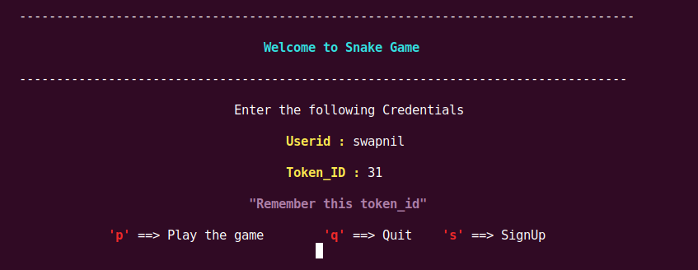

Slide 17
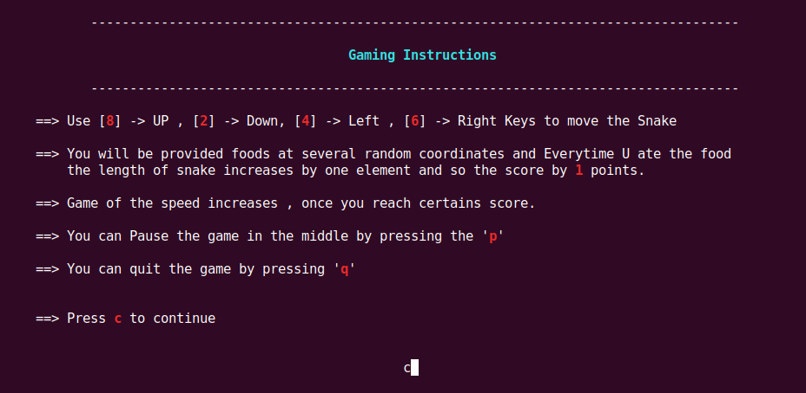

Slide 18
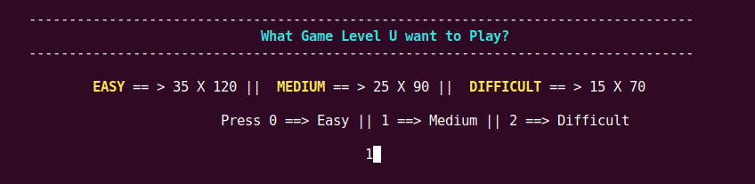


Slide 19
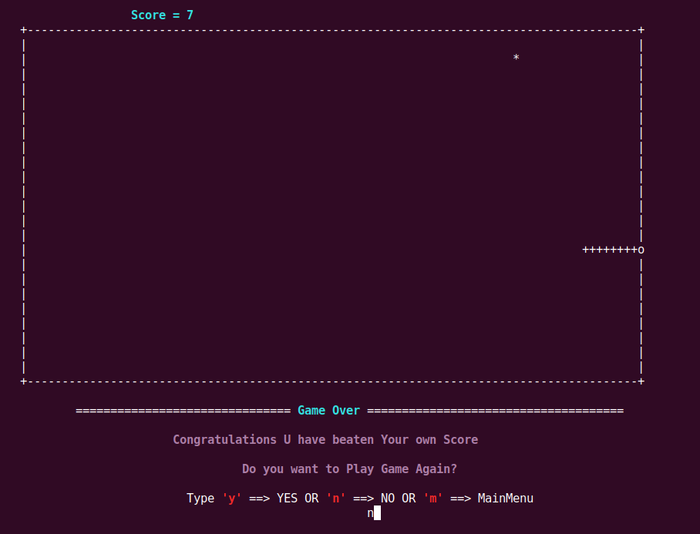

Slide 20

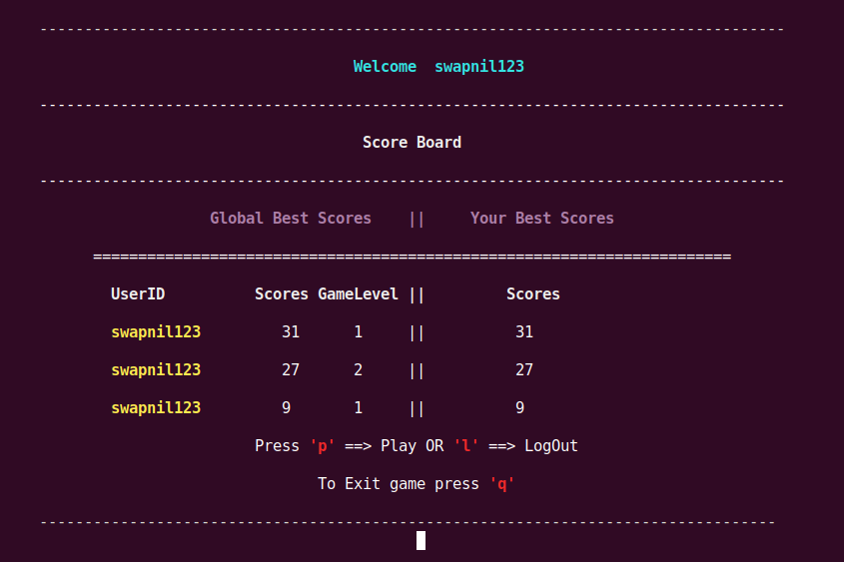

Slide 21
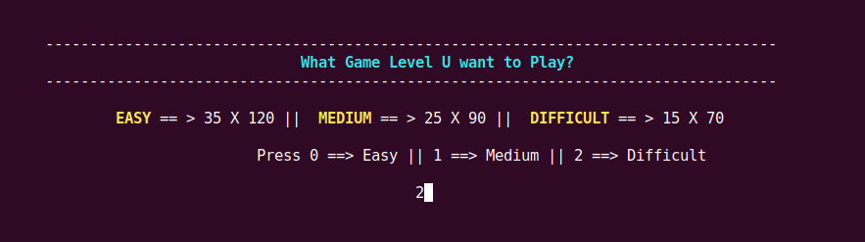
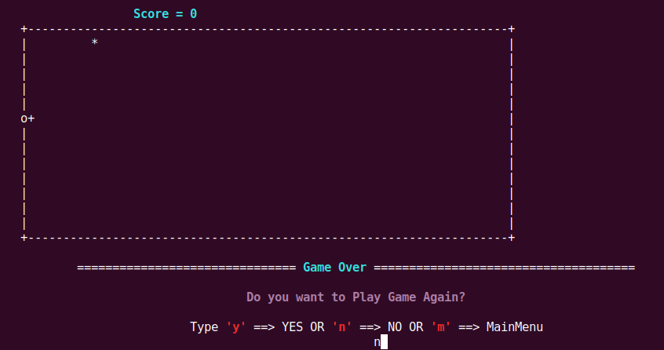

Slide 22
Mega Exercise:
BLE Frame Emulator

Slide 23
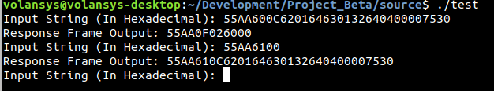
System Overview
This project will simulate a scenario in which the set and get commands are sent from a mobile (User input on terminal in our case) and get appropriate response from the device (response will be generated from the users system in our case) in BLE command frame (TLV) format.
Users will need to manually enter the BLE command frame (TLV) on the terminal acting as a mobile device. Device response will be simulated by the users system only.
A TLV frame from the terminal will be sent to the system for set or get command then an appropriate response will be generated in the TLV structure itself in the users system and will be sent as a response to the user on the terminal.

Slide 24
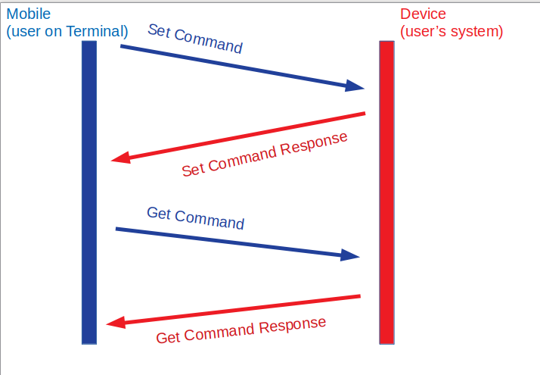

Slide 25
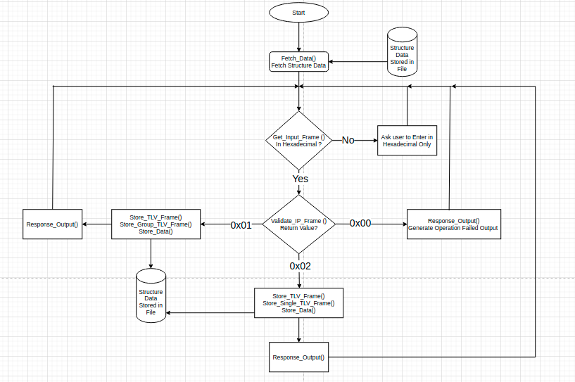

Slide 26
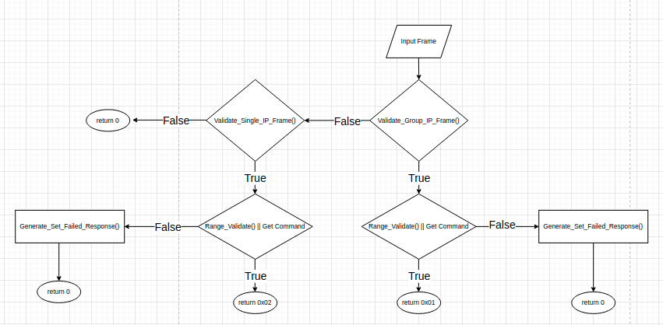
Validate Input Frame

Slide 27
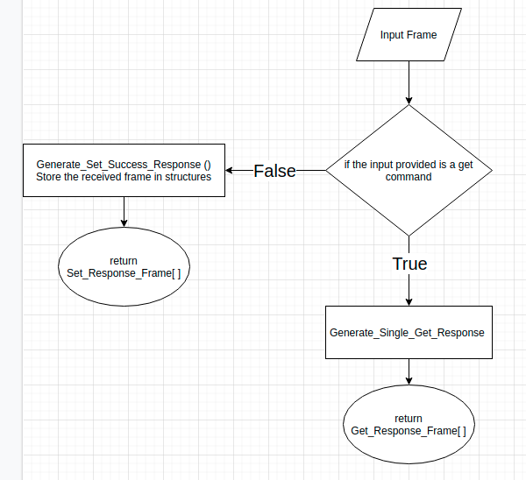
Store Single TLV Frame

Slide 28
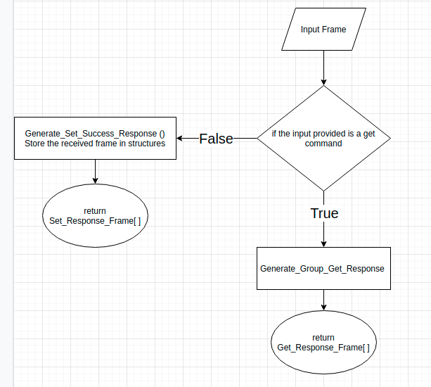
Store Group TLV Frame

Slide 29
Advance C

Slide 30
Exercise Set#1:
MakeFile
Exercise Set#2:
Advance Pointers and Arrays
Linux file system structure
Exercise Set#3:
Dynamic Memory Allocation
Valgrind
Exercise Set#4:
Memory management in C
Exercise Set#5:
GDB debugger
Exercise Set#6:
Interrupts
Exercise Set#7:
Structure programming in C

Slide 31
Data Structures

Slide 32
Exercise Set#1 Singly linked list-part 1: Initializing Link list, operating in queue or stack mode & traversing the list.
Exercise Set#2 Singly linked List-part 2: Inserting & deleting nodes, deleting, reversing & geting size of list
Exercise Set#3 Doubly Linked List: Inserting & deleting nodes, deleting, reversing & geting size of list
Exercise Set#4 Algorithms for data structure: Radix, Bubble & quick sort methods
Exercise Set#5 Tree, Queue, Heap : linear & binary search operation, sorting & inserting based on priority.
Exercise Set#6 Binary search tree : (creating BT & BST), (inlevel, inorder, postorder, preorder traversal), performing search operations in recursive and iterative manner.

Slide 33
Thank You

