Slide 1

DrainFlow
Storm Sewer Design Assistant
CE 206 : Engineering Computation Sessional | MATLAB Project
GROUP 01
Section- B2
2304099
Amartya Halder
2304119
Md. Kawser Ahmed Rakib
2304104
Md. Fahmidul Haq
2304124
Nur Afra
2304109
Md. Jubayer Hasan
2304129
Muhammad Sheikh Akbar Kabir
2304114
Beprojit Das Dipto
1
Notes:
Title slide. State project name, group number and that this is the final presentation. ~20 seconds.

Slide 2
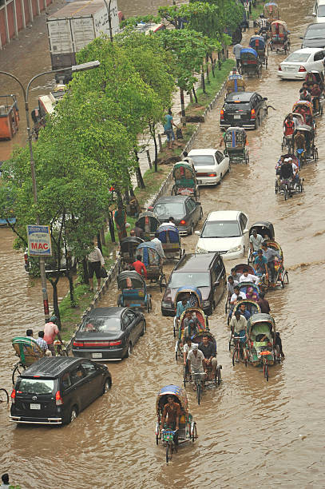
Objectives
Why Urban Storm Sewers Need Better Preliminary Design?
Preliminary sewer design today is largely manual: repeated hand calculation for every trial pipe size and rainfall scenario.
Engineers need a fast, repeatable way to estimate peak runoff and check whether a proposed pipe can safely carry it — before detailed design begins.
Objective: Build an interactive MATLAB app that estimates peak runoff (Rational Method), sizes and verifies storm sewer pipes (Manning's Equation), and visualizes hydraulic performance in real time.
2
Notes:
Read these quickly - they map one-to-one onto the calculation slides later. ~30 seconds.

Slide 3
Problem Statement
Urban stormwater must be carried away safely. A storm sewer fails in four distinct ways:
Insufficient capacity
Excessive velocity
Insufficient velocity
Oversized design
The design engineer must therefore answer two coupled questions:
How much water arrives? Rainfall → runoff → required discharge Q
Can the pipe carry it? Diameter, slope, roughness → capacity, depth, velocity
3
Notes:
Frame the four failure modes early - the design checks later map onto exactly these. ~45 seconds.

Slide 4
Methodology
Program logic, from catchment inputs to design decision
HYDROLOGY
HYDRAULICS
DECISION
Catchment & pipe inputs
Full-pipe capacity
Manning
Capacity check
Q_full vs Q_req
Time of concentration
Kirpich
Partially full geometry
circular segment
Velocity checks
0.6 – 3.0 m/s
Design rainfall intensity
IDF interpolation
Bisection method
root of Q(y) − Q_req = 0
Pipe sizing sweep
smallest adequate D
Required discharge
Rational Method
Normal depth y and velocity V
DESIGN STATUS
OK / WARN / FAIL
4
Notes:
Walk the three phases left to right. Emphasise that bisection is the computational core. ~60 seconds.

Slide 5
Governing Equations
Manning's equation
Peak runoff (Rational Method)
Q_Capacity = (1/n) · A · R²ᐟ³ · S¹ᐟ²
Q_Req = C · i · A / 360
V = Q / A
A flow cross-sectional area (m²)
R hydraulic radius A/P (m)
Q peak discharge (m³/s) ·
C runoff coefficient ·
i intensity (mm/hr) ·
A catchment area (ha) ·
360 unit conversion
S pipe slope (m/m)
n Manning roughness coefficient
P wetted perimeter — wall only
6
Notes:
The note about the free surface matters - it is the reason Q peaks before the pipe is full. ~40 seconds.

Slide 6
Additional Equations
Time of concentration (Kirpich)
tᴄ = 0.0195 · L⁰·⁷⁷ · Sᴄ⁻⁰·³⁸⁵
tᴄ time of concentration (min) · L overland flow length (m) · Sᴄ catchment slope (m/m)
Design rainfall intensity (log–log interpolation)
ln i = ln i₁ + f · ( ln i₂ − ln i₁ ) , f = ln(t/t₁) / ln(t₂/t₁)
i intensity (mm/hr) · t duration (min) · i₁, i₂ tabulated values · f position in log-duration space
Partially full circular pipe
θ = 2 · cos⁻¹ ( 1 − 2y/D )
A = (D²/8) · ( θ − sin θ )
P = Dθ / 2
R = A / P
θ, P, A, R are Partially Fully Circular Pipe Dimensions
5
Notes:
Do not derive anything here - just name each equation and its role. ~35 seconds.

Slide 7
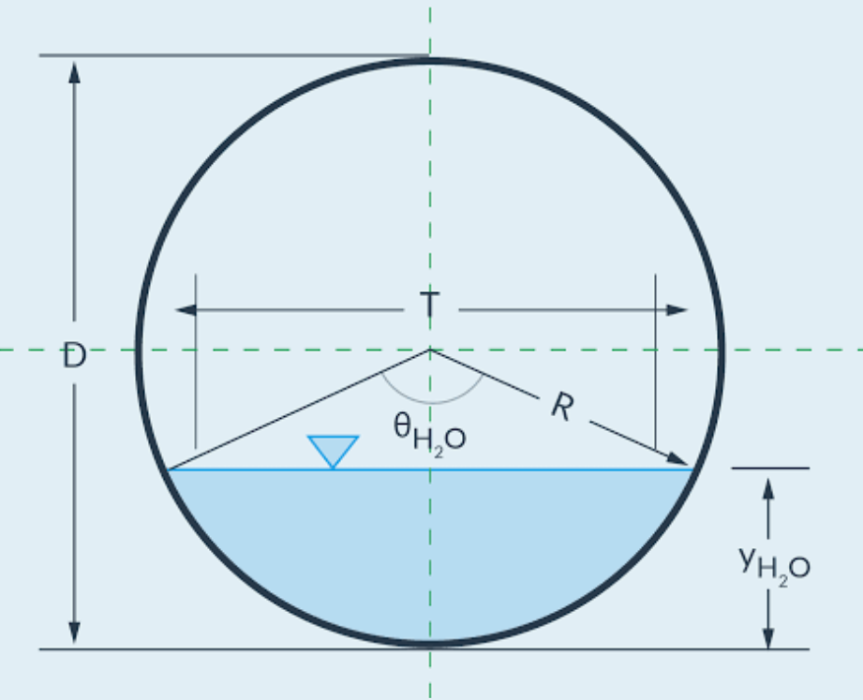
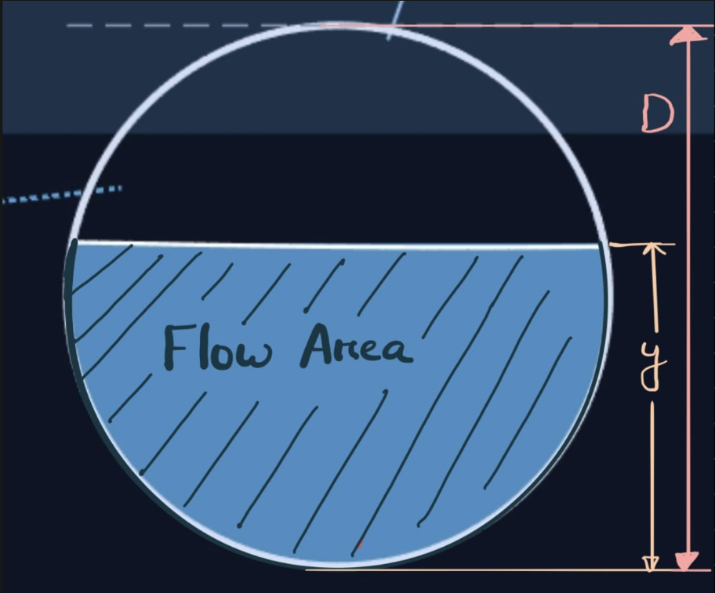
Partially full circular pipe
A = (D²/8) · ( θ − sin θ )
θ = 2 · cos⁻¹ ( 1 − 2y/D )
R = A / P
P = Dθ / 2
θ, P, A, R are Partially Fully Circular Pipe Dimensions
5
Notes:
Do not derive anything here - just name each equation and its role. ~35 seconds.

Slide 8
Assumptions
Rational Method for peak runoff
Storm duration = time of concentration
Valid for small urban catchments; rainfall uniform over the area
The whole catchment contributes simultaneously at this duration
Triangular rainfall pattern
Manning's equation for pipe flow
Used for the live visualisation only, not for the design calculation
Steady, uniform flow; normal depth assumed to be established
Circular pipe cross-section
Normal depth obtained numerically
Flow area treated as a circular segment
The depth equation cannot be rearranged algebraically
Velocity limits 0.6 – 3.0 m/s
Capacity judged on full-bore flow
Self-cleansing at the lower end, scour protection at the upper
The part-full discharge bonus is deliberately not claimed
7
Notes:
These are the assumptions actually coded, not a generic textbook list. ~40 seconds.

Slide 9
Program Structure
How the functions call one another
DrainFlow (main GUI)
recompute() — runs on every input change
time_of_concentration
idf_intensity
rational_Q
manning_capacity
solveDepth
Animation and reporting branch
bisect_root
triangular_hyetograph
drawHero · drawHydro · drawBar
printReport · runoff_volume · pipe_sizing
manning_Q
manning_capacity also calls manning_Q. printReport re-runs every calculation at tight tolerance and prints the full audit trail.
pipe_geometry
8
Notes:
No source code shown, per the instructions - only the call relationships. ~45 seconds.

Slide 10
Program Structure
Engineering functions
time_of_concentration
IN L, Sc
Kirpich travel time
OUT tc (minutes)
idf_intensity
IN duration, return period
Reads the Khulna IDF table
OUT i (mm/hr), exact-or-interpolated flag
rational_Q
IN C, i, A
Peak runoff
OUT Q (m³/s)
pipe_geometry
IN y, D
Circular-segment properties
OUT A, P, R, top width, θ
manning_Q
IN y, D, S, n
Forward Manning solution
OUT Q, V, R, A
9
Notes:
Five core engineering functions. Each is independently testable. ~30 seconds.

Slide 11
Program Structure
Numerical and support functions
manning_capacity
IN D, S, n
Full-bore and maximum discharge
OUT Qfull, Vfull, Qmax, y at Qmax
bisect_root
IN f, xl, xu, tolerance, max iter
General bracketed root finder
OUT root, f(root), error, iterations
solveDepth
IN Q required, D, S, n
Inverts Manning for depth
OUT normal depth y
triangular_hyetograph
IN t, duration, peak intensity
Design storm shape
OUT i(t) (vectorised)
runoff_volume
IN hydrograph Q(t)
Trapezoidal and Simpson integration
OUT storm runoff volume (m³)
pipe_sizing
IN Q required, S, n
Diameter sweep, 0.15 – 2.00 m
OUT smallest adequate D, commercial size
10
Notes:
bisect_root is written as a general-purpose solver, not tied to this problem. ~30 seconds.

Slide 12
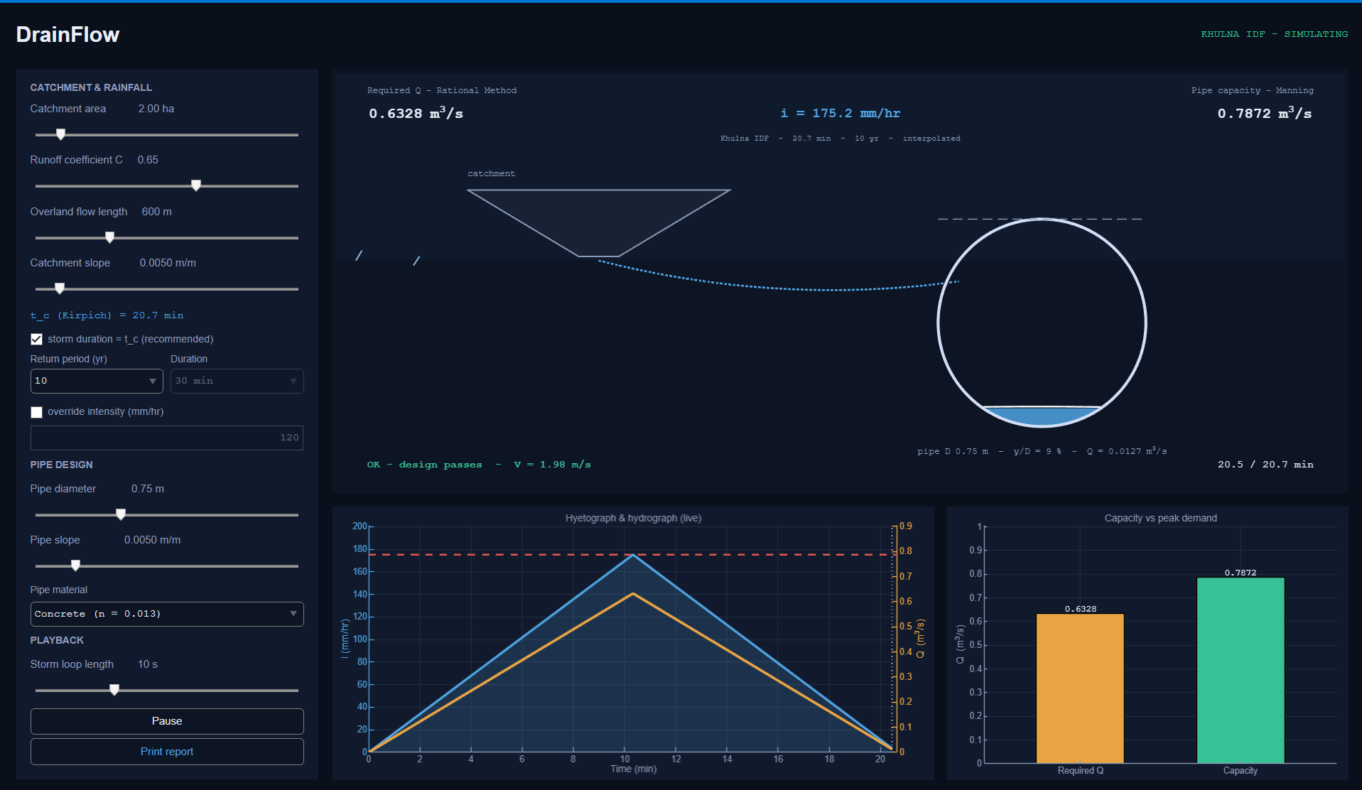
Live Demonstration
The DrainFlow interface
Catchment & rainfall
area, C, length, slope, return period
Pipe design
diameter, slope, material roughness
Live readouts
tᴄ, required Q, pipe capacity
Pipe animation
water depth solved every frame
Hyetograph & runoff
storm shape and discharge
Capacity vs demand
DrainFlow — full interface
the design check, as bars
11
Notes:
Switch to MATLAB here. Point at each region of the window as you name it. ~40 seconds.

Slide 13
Live Demonstration — Design Passes
DESIGN PASSES
CONDITION
Q_Capacity ≥ Q_req
0.6 ≤ V ≤ 3.0 m/s
REQUIRED Q
CAPACITY
VELOCITY
STATUS
0.6328
0.7872
1.98 m/s
OK
12
Notes:
Case 1 of 4. This is the input set every hand calculation that follows is based on. ~25 seconds.

Slide 14
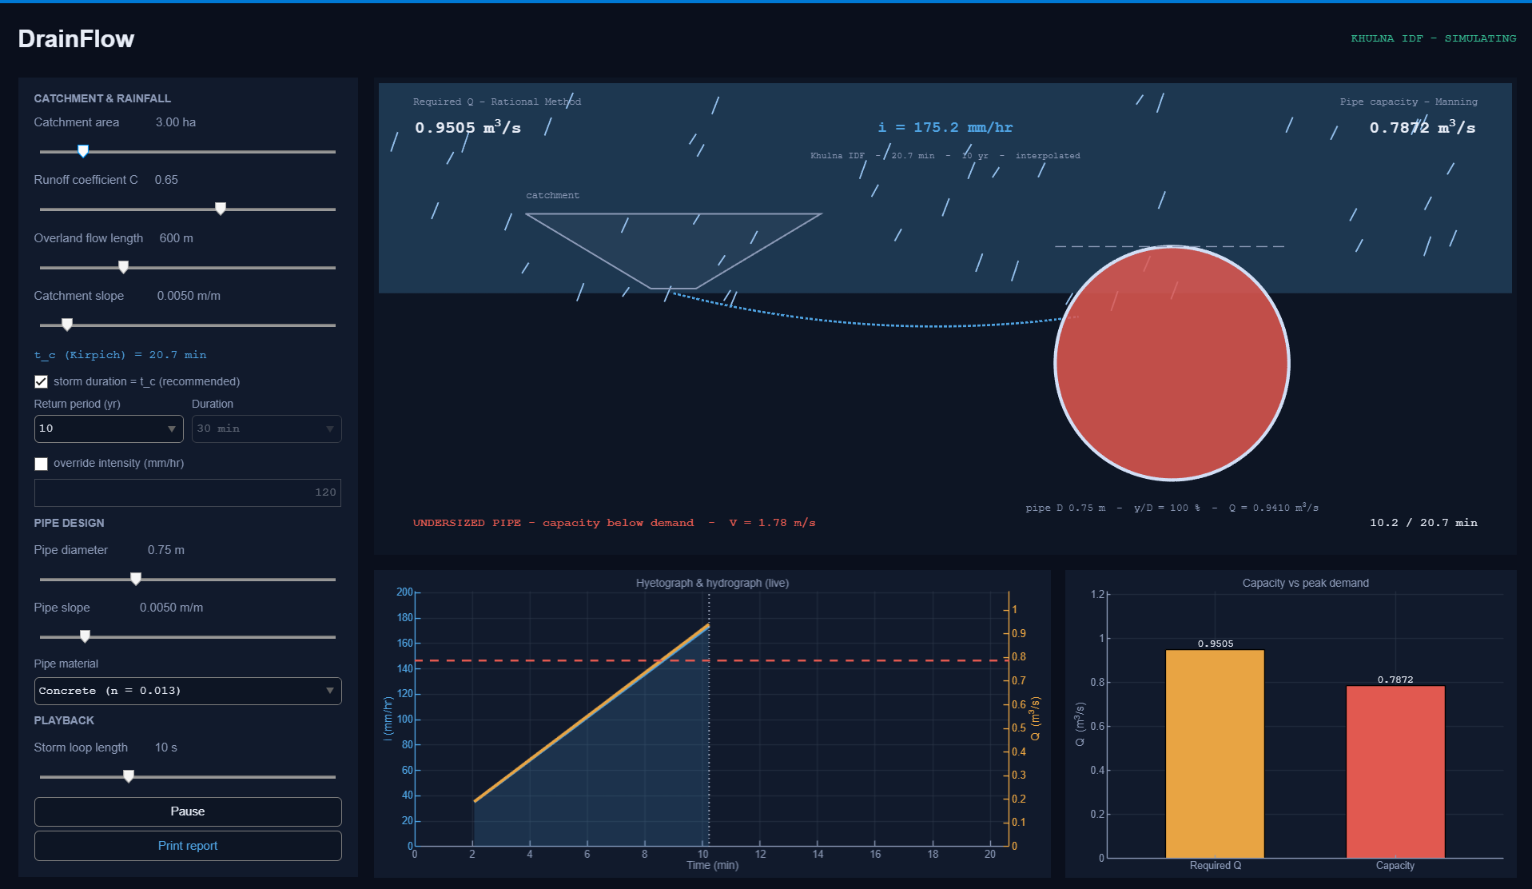
Live Demonstration — Undersized Pipe
UNDERSIZED
CONDITION
Q_Capacity < Q_req
REQUIRED Q
CAPACITY
VELOCITY
STATUS
0.9505
0.7872
1.78 m/s
FAIL
13
Notes:
Case 2. Larger catchment, same pipe. Point out that the drawing goes solid red at y/D = 100 %. ~25 seconds.

Slide 15
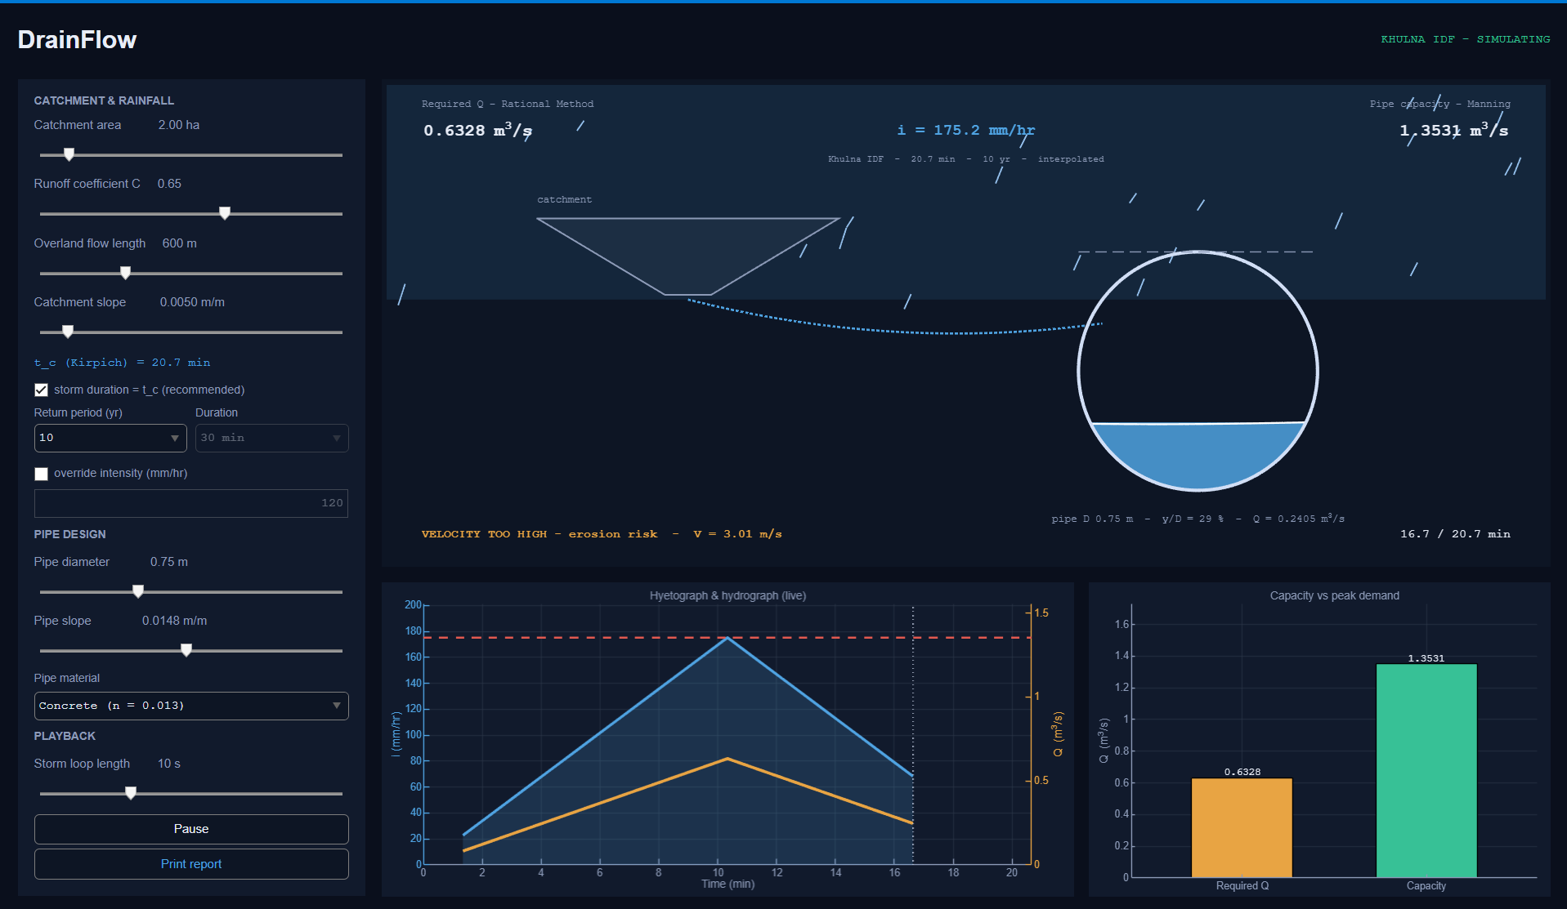
Live Demonstration — Velocity Too High
VELOCITY TOO HIGH
EROSION RISK
CONDITION
V > 3.0 m/s
REQUIRED Q
CAPACITY
VELOCITY
STATUS
0.6328
1.3531
3.01 m/s
WARN
14
Notes:
Case 3. Steeper slope. Q rises as the square root of S, but so does velocity. ~25 seconds.

Slide 16
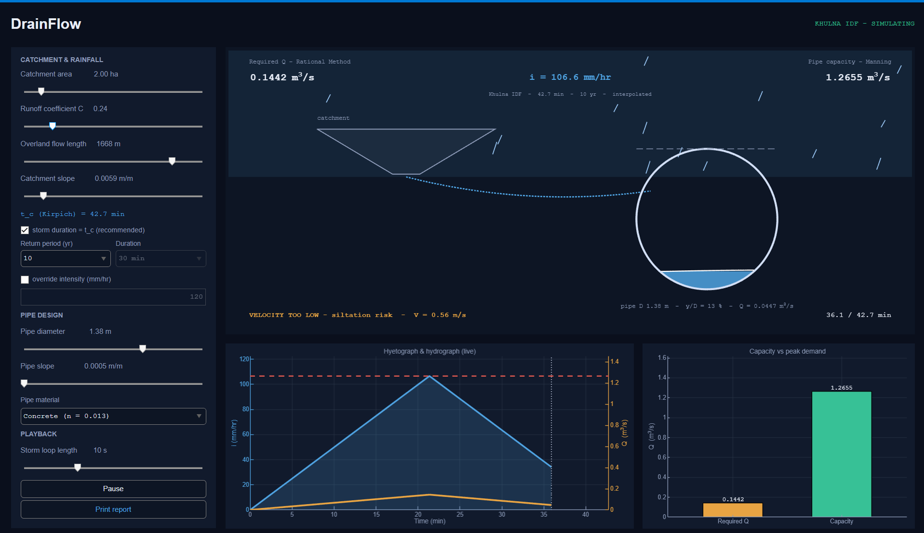
Live Demonstration — Velocity Too Low
VELOCITY TOO LOW
SILTATION RISK
CONDITION
V < 0.6 m/s
REQUIRED Q
CAPACITY
VELOCITY
STATUS
0.1442
1.2655
0.56 m/s
WARN
15
Notes:
Case 4. The important lesson: enlarging a pipe to fix capacity can create this problem. The criteria fight each other. ~30 seconds.

Slide 17
Sample Calculation — Input Data
Every following slide uses this one input set
Catchment area
A
2.00
ha
Return period
T
10
yr
Runoff coefficient
C
0.65
—
Pipe diameter
D
0.75
m
Overland flow length
L
600
m
Pipe slope
S
0.0050
m/m
Catchment slope
Sᴄ
0.0050
m/m
Manning roughness
n
0.013
—
Storm duration is set equal to the time of concentration — concrete pipe, Khulna IDF table
16
Notes:
Establish the sample. Say it matches the default state the program opens with. ~20 seconds.

Slide 18
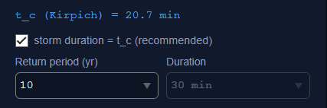
1
Time of Concentration
FORMULA
tᴄ = 0.0195 · L⁰·⁷⁷ · Sᴄ⁻⁰·³⁸⁵
SUBSTITUTION
tᴄ = 0.0195 × (600)⁰·⁷⁷ × (0.0050)⁻⁰·³⁸⁵
tᴄ = 0.0195 × 137.777 × 7.6895
MATLAB output — t_c = 20.7 min
NOMENCLATURE
tᴄ
time of concentration
min
L
overland flow length
m
RESULT
tᴄ = 20.66 min
Sᴄ
catchment slope
m/m
0.0195
Kirpich empirical constant, SI form
17
Notes:
Kirpich. Longer path increases travel time, steeper slope reduces it. ~35 seconds.

Slide 19
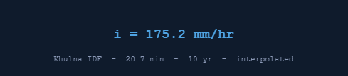
2
Design Rainfall Intensity
FORMULA
ln i = ln i₁ + f · ( ln i₂ − ln i₁ )
SUBSTITUTION
MATLAB output — i = 175.2 mm/hr
15 min → 218.15 mm/hr 30 min → 135.76 mm/hr
Since 15 < 20.66 < 30, interpolate in log–log space:
f = ln(20.66/15) / ln(30/15) = 0.4618
ln i = ln(218.15) + 0.4618 × [ ln(135.76) − ln(218.15) ]
NOMENCLATURE
i
design rainfall intensity
mm/hr
i₁, i₂
tabulated intensities either side
mm/hr
RESULT
i = 175.24 mm/hr
t₁, t₂
bracketing table durations
min
f
position in log-duration space
—
Linear interpolation would give 187.1 mm/hr — 6.8 % high, because IDF curves are convex.
T
return period
yr
18
Notes:
Stress WHY log-log: IDF curves are power laws, straight on log axes. Linear interpolation cuts the corner. ~50 seconds.

Slide 20

3
Required Discharge — Rational Method
FORMULA
Q = C · i · A / 360
SUBSTITUTION
Q = ( 0.65 × 175.24 × 2.00 ) / 360
Q = 227.81 / 360
MATLAB output — Required Q
NOMENCLATURE
Q
peak runoff discharge
m³/s
C
runoff coefficient
—
RESULT
Q_req = 0.6328 m³/s
i
rainfall intensity
mm/hr
A
catchment area
ha
360 is a unit conversion, not an empirical constant: 1 mm/hr over 1 ha = 10/3600 m³/s.
360
unit conversion factor
—
19
Notes:
Be ready for the classic question: where does 360 come from? Derive it in one line. ~35 seconds.

Slide 21
4
Full-Pipe Geometry
FORMULA
A = πD²/4 R = D/4
SUBSTITUTION
NOMENCLATURE
A = π × (0.75)² / 4 = 0.4418 m²
R = 0.75 / 4 = 0.1875 m
A
full-bore flow area
m²
D
internal pipe diameter
m
P
wetted perimeter (= πD when full)
m
R
hydraulic radius, A / P
m
RESULT
A = 0.4418 m² R = 0.1875 m
20
Notes:
Quick slide. The R = D/4 result falls straight out of A/P. ~25 seconds.

Slide 22

5
Full-Pipe Capacity — Manning
FORMULA
Q = (1/n) · A · R²ᐟ³ · S¹ᐟ²
SUBSTITUTION
Q = (1/0.013) × 0.4418 × (0.1875)²ᐟ³ × (0.0050)¹ᐟ²
Q = 76.923 × 0.4418 × 0.32759 × 0.070711
MATLAB output — Pipe capacity
NOMENCLATURE
Q
full-bore discharge capacity
m³/s
n
Manning roughness coefficient
—
RESULT
A
flow cross-sectional area
m²
Q_Cap = 0.7872 m³/s
R
hydraulic radius
m
S
pipe slope
m/m
V
mean flow velocity, Q / A
m/s
21
Notes:
Accumulate the product left to right so each step can be checked against the report. ~35 seconds.

Slide 23
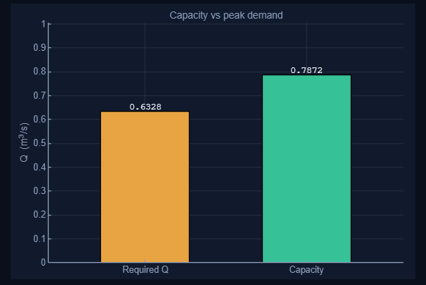
6
Capacity Check
REQUIRED
CAPACITY
0.6328
0.7872
m³/s
m³/s
Capacity / demand = 0.7872 / 0.6328 = 1.244
MATLAB — Capacity vs peak demand
Q_Capacity > Q_req
NOMENCLATURE
CAPACITY CHECK PASSES
Q_req
required peak discharge
m³/s
Q_full
full-bore pipe capacity
m³/s
ratio
Q_full / Q_req, the spare margin
—
22
Notes:
Capacity is tested first because it governs. 24 % spare here. ~30 seconds.

Slide 24
7
Partially Full Pipe — the Inverse Problem
FORMULA
Q(y) = (1/n) · A(y) · R(y)²ᐟ³ · S¹ᐟ²
SUBSTITUTION
θ = 2 cos⁻¹ ( 1 − 2y/D ) A = (D²/8)(θ − sin θ)
P = Dθ / 2 R = A / P
Required: find y such that Q(y) = Q_req
NOMENCLATURE
y
flow depth
m
θ
central angle of the wetted arc
rad
RESULT
y cannot be isolated
A(y)
flow area at depth y
m²
P(y)
wetted perimeter — wall only
m
R(y)
hydraulic radius, A / P
m
y sits inside an arccos, inside a sine, inside a 5/3 power. The equation is transcendental — no algebraic rearrangement exists.
Q_req
discharge that must be carried
m³/s
23
Notes:
This is the honest justification for a numerical method - not 'we were told to use one'. ~40 seconds.

Slide 25
8
Bisection Method
ALGORITHM
ITERATION TRACE
1
Bracket the root: f(yₗ) < 0, f(yᵤ) > 0
it
yₗ
yᵤ
yₘ
eₐ (%)
Midpoint yₘ = ( yₗ + yᵤ ) / 2
1
0.0000
0.7036
0.3518
100.00
2
2
0.3518
0.7036
0.5277
33.33
3
Evaluate f(yₘ) = Q(yₘ) − Q_req
3
0.3518
0.5277
0.4398
20.00
4
0.4398
0.5277
0.4838
9.09
4
Keep the half that still brackets the root
5
0.4838
0.5277
0.5057
4.35
6
0.5057
0.5277
0.5167
2.13
5
Repeat until the relative error ≤ tolerance
7
0.5057
0.5167
0.5112
1.08
⋮
21
0.5092
0.000066
yₗ , yᵤ lower and upper bracket depths (m) yₘ midpoint depth (m)
f(y) Q(y) − Q_req, the residual (m³/s) eₐ approximate relative error (%)
Notes:
Bisection chosen for guaranteed convergence - it runs 20 times a second inside the animation with nobody watching. ~55 seconds.

Slide 26
9
Normal Depth
FORMULA
solve Q(y) = Q_req = 0.6328 m³/s
SUBSTITUTION
Bracket [ 0 , 0.9382 × 0.75 ] = [ 0 , 0.7036 ] m
21 bisection iterations, relative error 6.6 × 10⁻⁵ %
y / D = 0.5092 / 0.75
NOMENCLATURE
y
Flow Depth
m
RESULT
y/D
relative depth ratio
%
y = 0.5092 m y/D = 67.9 %
0.9382 D
depth of maximum discharge
m
Error bound after 21 halvings: 0.7036 / 2²¹ = 3.4 × 10⁻⁷ m.
eₐ
approximate relative error
%
25
Notes:
Make the two numbers the visual focus. ~30 seconds.

Slide 27
10
Flow Area at the Normal Depth
FORMULA
θ = 2 cos⁻¹(1 − 2y/D) A = (D²/8)(θ − sin θ)
SUBSTITUTION
θ = 2 cos⁻¹ ( 1 − 2×0.5092/0.75 ) = 3.8738 rad
A = (0.75²/8) × ( 3.8738 + 0.6628 ) = 0.3194 m²
P = 0.75 × 3.8738 / 2 = 1.4527 m
R = 0.3194 / 1.4527 = 0.2199 m
NOMENCLATURE
θ
central angle of the wetted arc
rad
A_flow
flow area at the normal depth
m²
RESULT
Flow Area = 0.3194 m²
P
wetted perimeter
m
R
hydraulic radius, A / P
m
A/A_full = 72.3 % while y/D = 67.9 % — the pipe is fuller by area than by depth.
D
internal pipe diameter
m
26
Notes:
This is the area the velocity must be divided by - NOT the full-pipe area. ~35 seconds.

Slide 28

11
Flow Velocity and Design Status
FORMULA → SUBSTITUTION
V = Q / Flow Area
V = 0.6328 / 0.3194
V = 1.9814 m/s
NOMENCLATURE
V
mean flow velocity
m/s
Q
discharge carried
m³/s
F.A.
flow area at the normal depth
m²
VELOCITY WINDOW
0.6 ≤ 1.9814 ≤ 3.0 m/s
OK — DESIGN PASSES
MATLAB status line
27
Notes:
The GUI status line reads V = 1.98 m/s. If anyone asks about 1.43, that is Q divided by the full-pipe area - a common slip. ~40 seconds.

Slide 29
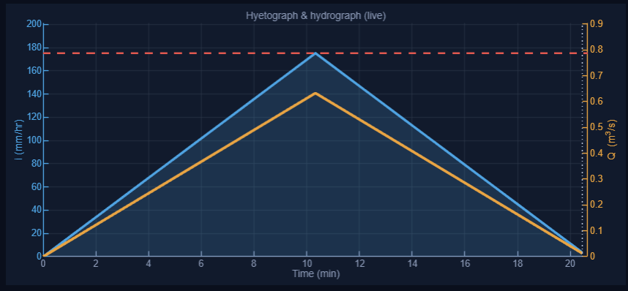
Graph 1 — Hyetograph & Runoff Response
Blue curve
Rainfall intensity i(t) — mm/hr, left axis
Orange curve
Rational Method runoff Q(t) — m³/s, right axis
Dashed red line
Full-pipe capacity Q_full
Thin vertical line
Current simulation time
Shaded area
Area under i(t) = rainfall depth
MATLAB — hyetograph and hydrograph, design-passes case
28
Notes:
If asked why the red capacity line sits exactly on the blue apex: both axes auto-scale to 1.15x their own maximum, so it is an axis-scaling coincidence, not a physical result. ~40 seconds.

Slide 30
Graph 2 — Capacity vs Peak Demand
REQUIRED Q
0.6328 m³/s
PIPE CAPACITY
0.7872 m³/s
Capacity > Required
1.244
capacity / demand ratio
MATLAB — capacity vs peak demand
30
Notes:
The capacity bar turns red automatically when the pipe is undersized. ~25 seconds.

Slide 31
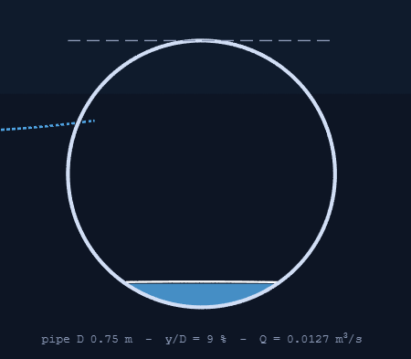
Graphical Pipe Response
Rainfall intensity i(t)
Q(t) = C · i(t) · A / 360
Manning: Q(y) − Q(t) = 0
Bisection every frame
Normal depth y(t)
Water level drawn to scale
MATLAB — pipe drawn at the instantaneous depth, late in the storm
31
Notes:
Strongest single feature of the GUI - say explicitly that bisection runs every frame. ~30 seconds.

Slide 32
Validation — MATLAB vs Hand Calculation
Same sample input set, computed independently by hand
PARAMETER
HAND CALCULATION
MATLAB
% ERROR
Time of concentration
20.659 min
20.659 min
0.00 %
Rainfall intensity
175.24 mm/hr
175.24 mm/hr
0.00 %
Required discharge
0.63281 m³/s
0.63281 m³/s
0.00 %
Full-pipe capacity
0.78721 m³/s
0.78721 m³/s
0.00 %
Full-pipe velocity
1.7819 m/s
1.7819 m/s
0.00 %
Normal depth
0.50924 m
0.50924 m
0.00 %
Flow velocity
1.9814 m/s
1.9814 m/s
0.00 %
32
Notes:
Do not oversell this table - zero error is expected. The next slide is the real validation. ~35 seconds.

Slide 33
CE 206 Topics Applied
MATLAB fundamentals
User-defined functions
Vectorised operations, logical masking, input validation, structured program layout
Every engineering calculation isolated in its own testable function
Roots of equations
Curve fitting & interpolation
Bisection applied to Q(y) − Q_req = 0; bracketing, convergence, tolerance
Log–log interpolation in duration; linear interpolation in the reduced variate
Numerical integration
Plotting & visualisation
Trapezoidal rule and Simpson's 1/3 rule for runoff volume
Dual-axis live plots, bar comparison, animated patch graphics
Not used in this project
Eigenvalues · Fourier analysis · Ordinary differential equations · Numerical differentiation
We claim only the topics the program genuinely uses.
34
Notes:
Naming what was NOT used reads as honesty and usually pre-empts a question. ~30 seconds.

Slide 34
Challenges & How We Resolved Them
CHALLENGE
HOW WE RESOLVED IT
Depth equation cannot be rearranged
Recast as a root problem and solved with bisection
Q(y) is not monotonic — two roots possible
Bracket capped at y = 0.9382 D, where Q(y) is strictly increasing
Circular-segment geometry repeated everywhere
Isolated in one pipe_geometry function returning A, P, R, θ
Solver too slow for a live animation
Loose tolerance for the 20 fps loop, tight tolerance for the printed report
IDF table too coarse for tᴄ = 20.66 min
Log–log interpolation in duration, reduced-variate interpolation in return period
Proving the results are right
Back-substitution residual plus an independent grid search
35
Notes:
These are all post-progress-presentation problems, as the instructions ask. ~45 seconds.

Slide 35
Current Limitations
No rainfall–runoff lag or routing
Triangular storm is a visualisation shape
Rational Method applied instantaneously; hydrograph timing not modelled
The Rational Method's implicit design storm is uniform, not triangular
Animated storm volume is not IDF-consistent
Kirpich is a rural formula, used uncorrected
Triangle peak = IDF intensity, so its average is half. Peak discharge is unaffected
Urban paved catchments normally take a correction factor of about 0.4
Runoff coefficient C is a judgement value
Stored Khulna IDF table only
Q is linear in C; a ±0.1 swing moves the design flow by ±15 %
Short durations were disaggregated from daily records, not gauged directly
Single pipe, no network
No infiltration or catchment storage model
No manholes, junctions, backwater or surcharge analysis
Losses are lumped entirely into the constant C
Numerical precision (10⁻⁷) far exceeds input accuracy (10⁻¹). Precision is not the same thing as accuracy.
36
Notes:
Close on the precision-vs-accuracy line. It is the single best sentence in the deck. ~50 seconds.

Slide 36
Future Work
A staged roadmap beyond this course
Extend to multi-pipe networks
Add manholes, junctions, surcharge
Automated report and drawing export
37
Notes:
Keep this brisk - it is a roadmap, not a commitment. ~25 seconds.

Slide 37
Conclusion & Learning Outcomes
SAMPLE DESIGN SUMMARY
Learning outcomes
Time of concentration
20.66 min
Translating governing engineering equations into structured, testable MATLAB code
Rainfall intensity
175.24 mm/hr
Required discharge
0.6328 m³/s
Recognising when a problem needs a numerical method — and being able to justify it
Pipe capacity
0.7872 m³/s
Choosing robustness over speed: bisection's guaranteed convergence beats Newton's rate here
Normal depth
0.5092 m
Depth ratio y/D
67.9 %
Understanding why a pipe carries more flow when it is not quite full
Flow velocity
1.9814 m/s
Pipe diameter
0.75 m
Validating computational output against hand calculation and an independent method
STATUS — DESIGN PASSES
Distinguishing numerical precision from engineering accuracy
38
Notes:
Land the last learning outcome deliberately - precision is not accuracy. ~45 seconds.

Slide 38
Thank You
Questions & Discussion
DrainFlow · Storm Sewer Design Assistant · CE 206
39
Notes:
Likely questions: why bisection not Newton; where does 360 come from; why does Q peak before full; why no lag in the hydrograph.

