Slide 1
It's a Bird, it's a Plane, it's a Meteor!
CANTOR
SECT
Amartya Hatua
Senior Data Scientist, Fidelity Investments

Slide 2
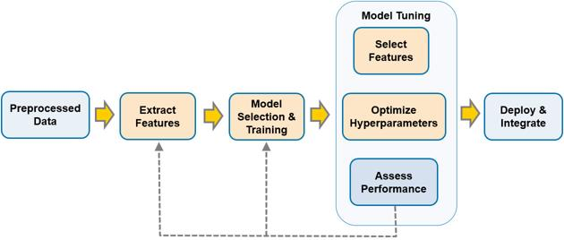
Steps of Data Science Project
Figure 1: Steps of a standard Data Science project

Slide 3
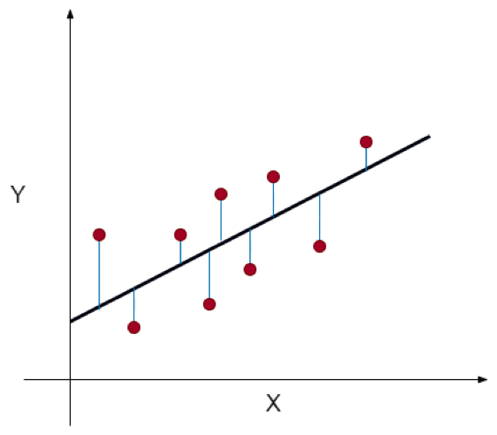
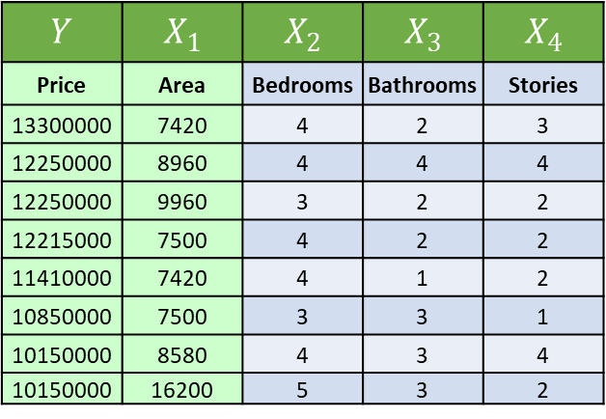
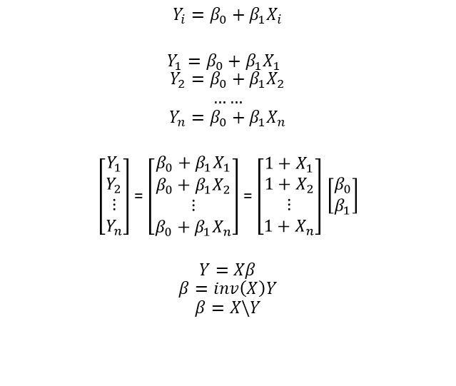

Predict the price of a house
$$Y$$ | $$X_{1}$$ | $$X_{2}$$ | $$X_{3}$$ | $$X_{4}$$
Price | Area | Bedrooms | Bathrooms | Stories
13300000 | 7420 | 4 | 2 | 3
12250000 | 8960 | 4 | 4 | 4
12250000 | 9960 | 3 | 2 | 2
12215000 | 7500 | 4 | 2 | 2
11410000 | 7420 | 4 | 1 | 2
10850000 | 7500 | 3 | 3 | 1
10150000 | 8580 | 4 | 3 | 4
10150000 | 16200 | 5 | 3 | 2
$$Y_{i}=β_{0}+β_{1}X_{i}$$
$Y_{1}=β_{0}+β_{1}X_{1}$
$$Y_{2}=β_{0}+β_{1}X_{2}$$
$$……$$
$$Y_{n}=β_{0}+β_{1}X_{n}$$
$\left[\begin{aligned}Y_{1} \\ Y_{2} \\ ⋮ \\ Y_{n}\end{aligned}\right]$ = $\left[\begin{aligned}\begin{aligned}β_{0}+β_{1}X_{1} \\ β_{0}+β_{1}X_{2}\end{aligned} \\ ⋮ \\ β_{0}+β_{1}X_{n}\end{aligned}\right]$ = $\left[\begin{aligned}\begin{aligned}1+X_{1} \\ 1+X_{2}\end{aligned} \\ ⋮ \\ 1+X_{n}\end{aligned}\right]$ $\left[\begin{aligned}β_{0} \\ β_{1}\end{aligned}\right]$
$$Y=Xβ$$
$$β=inv\left(X\right)Y$$
$$β=X\backslash Y$$
$$J=Loss={\left(Y −Y_{pred}\right)}^{2}$$
Figure 2: Area vs Price plot

Slide 4
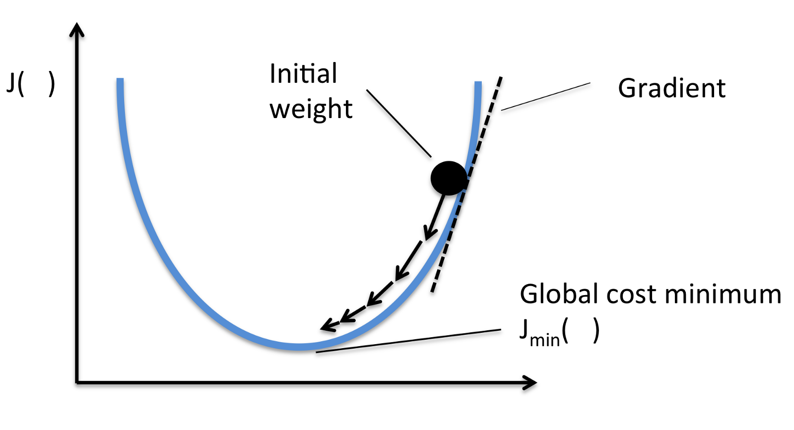

Optimization
$$J=Loss={\left(Y −Y_{pred}\right)}^{2}$$
x
x
x
Figure 3: Visualization of optimization

Slide 5
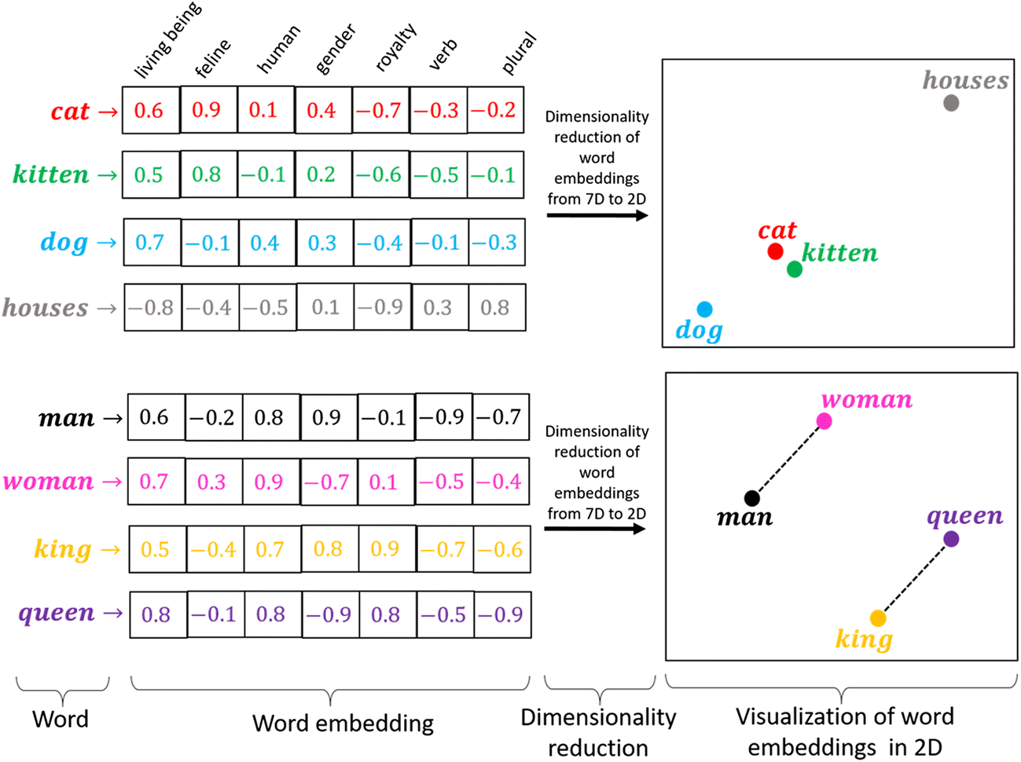
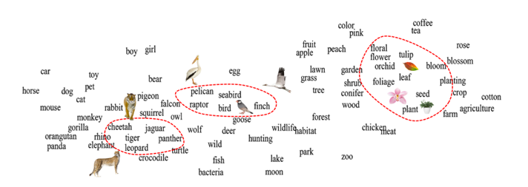
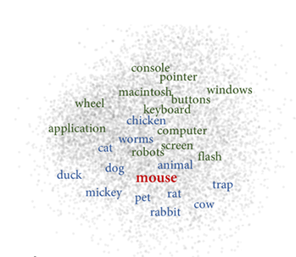
Sentiment Analysis
Dave watched as the forest burned up on the hill, only a few miles from his house. The car had been hastily packed and Marta was inside trying to round up the last of the pets. "Where could she be?" he wondered as he continued to wait for Marta to appear with the pets.
[Dave, watched, as, the, forest, burned, up, on, the, hill, ,, , only, a, few, miles, from, his, house, ., The, car, had, , been, hastily, packed, and, Marta, was, inside, trying, to, round, , up, the, last, of, the, pets, ., ", Where, could, she, be, ?, ", he, wondered, , as, he, continued, to, wait, for, Marta, to, appear, with, the, pets, ., ]
[[ 1.8371646 , 1.4529226 , -1.6147211] ,[ 0.678362 , -0.6594443 , 1.6417935] , [0.5796405 , 2.3021278 , -0.13260496], [0.5750932 , 1.5654886 , -0.6938864] , [-0.59607106, -1.5377437 , 1.9425622] , [ -2.4552505 , 1.2321601 , 1.0434952] , [-1.5102385 , -0.5787632 , 0.12055647], [3.6501784 , 2.6160972 , -0.5710199] , [-1.5221789 , 0.00629176, 0.22760668] ]
Figure 5: Word distribution in a word to vector space [2]
King – Man + Woman ~= Queen
Figure 4: Word to vector example [1]
Figure 6: Word distribution in a word to vector space [2]

Slide 6
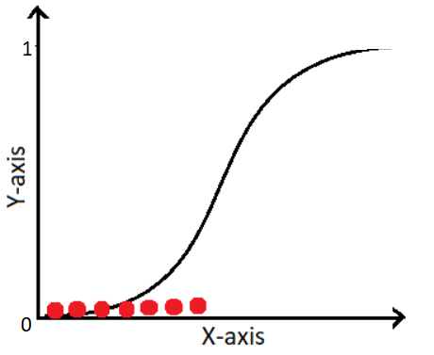
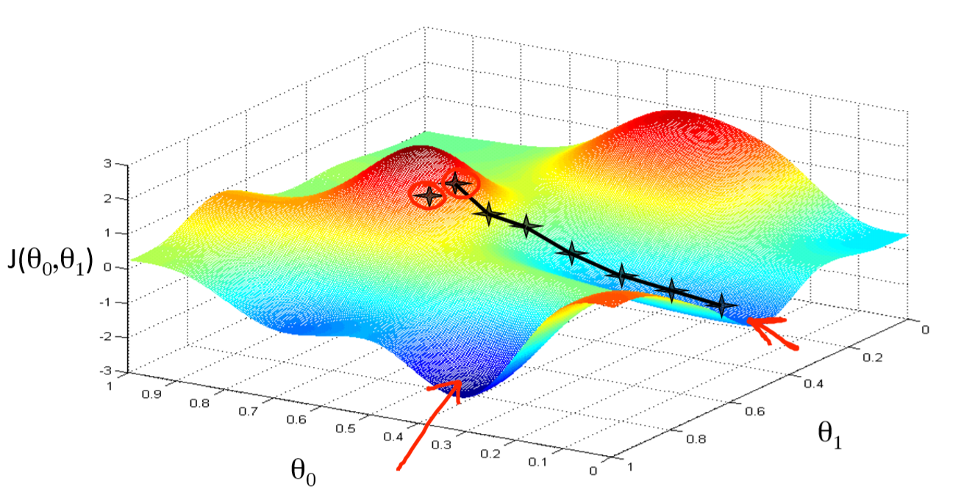
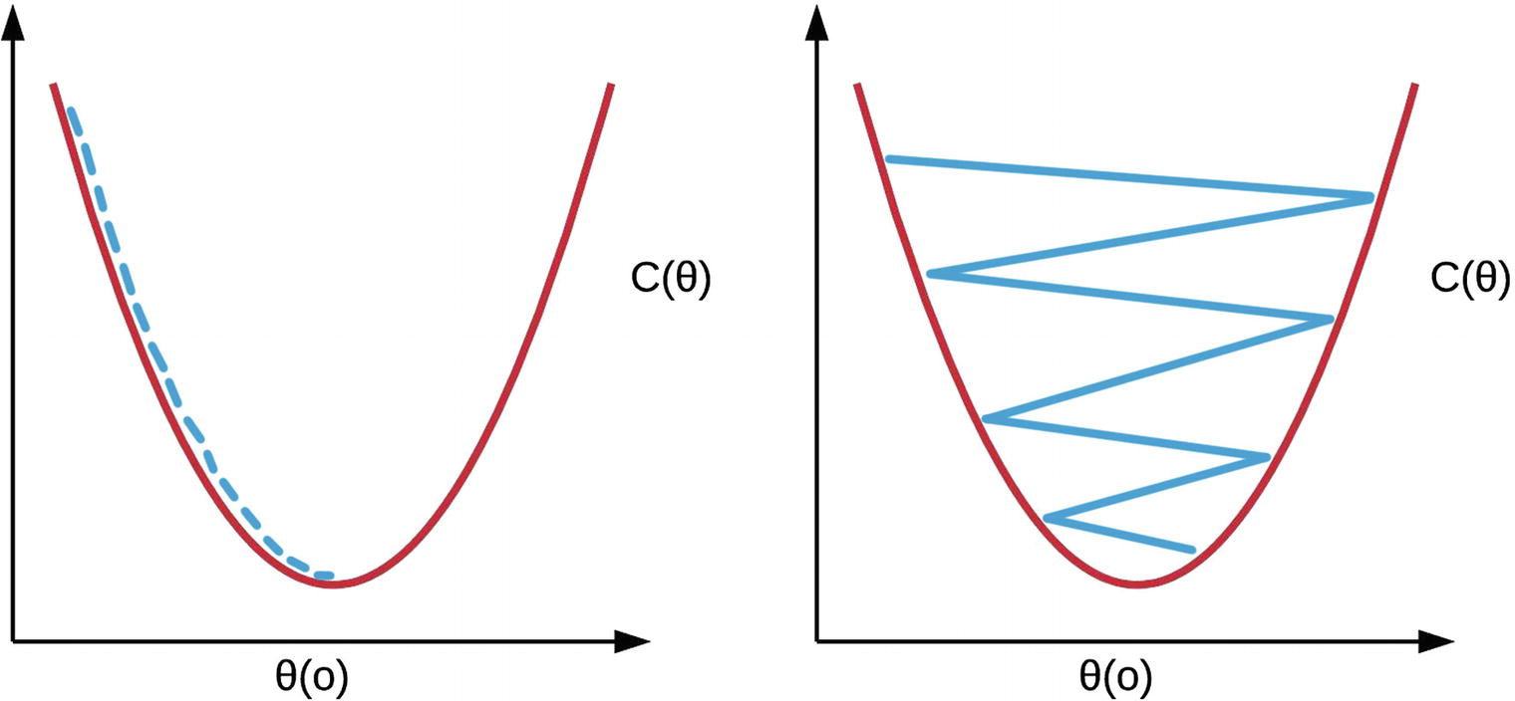
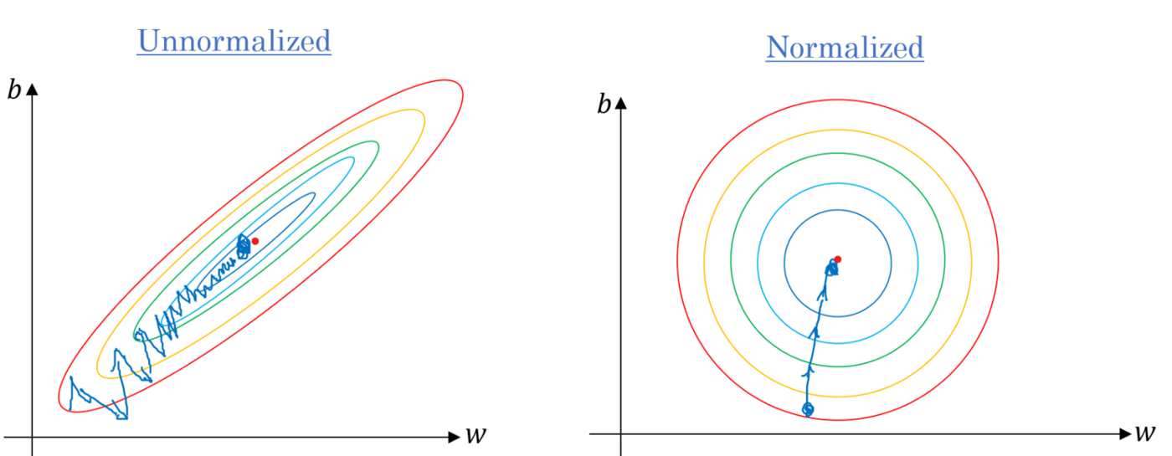

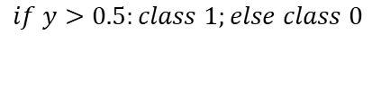
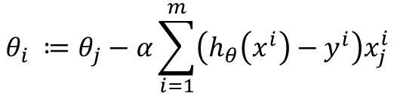
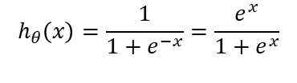

Classification
$$J\left(θ\right)=−\frac{1}{m}∑[y^{i }log\left(h_{θ}\left(x_{i}\right)\right)+\left(1−y^{\left(i\right)}\right)\log{(1−h_{θ}\left(x_{i}\right))]}$$
$$θ_{i} ≔θ_{j}−α\sum_{i=1}^{m}{\left(h_{θ}\left(x^{i}\right)−y^{i}\right)x_{j}^{i}}$$
$$\min_{θ}{J\left(θ\right): }$$
(Simultaneously update all $θ_{j}$)
Figure 7: Sigmoid function
$$h_{θ}\left(x\right)=\frac{1}{1+e^{−x}}=\frac{e^{x}}{1+e^{x}}$$
$$if y>0.5:class 1;else class 0$$
Figure 8: Gradient boosting
Figure 9: Rate of optimization
Figure 10: Normalization

Slide 7
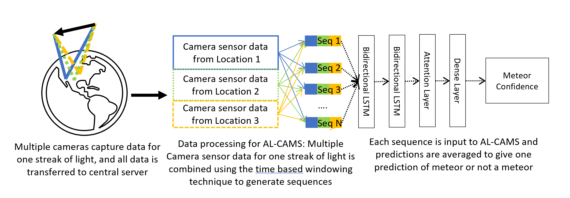
AL-CAMS: Active Learning for Camera Allsky Meteor Surveillance It's a Bird, it's a Plane, it's a Meteor!
NASA CAMS Meteor Shower Portal (seti.org)

Slide 8
References
[1] https://medium.com/@hari4om/word-embedding-d816f643140
[2] Camacho-Collados, J., & Pilehvar, M. T. (2018). From word to sense embeddings: A survey on vector representations of meaning. Journal of Artificial Intelligence Research, 63, 743-788.

