Slide 1
Interpolation using compactly supported RBFs
(CS-RBFs)

Slide 2
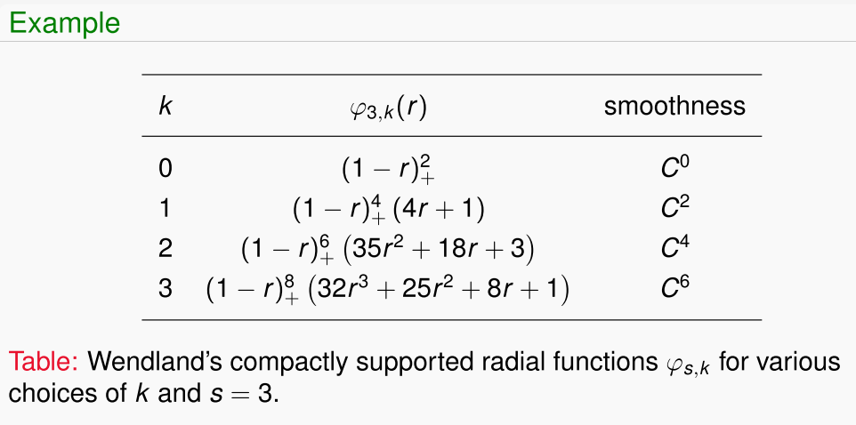
The main difference of the CS-RBFs and other globally supported
RBFs is the interpolation matrix can be made sparse.
CS-RBFs are strictly positive definite.

Slide 3
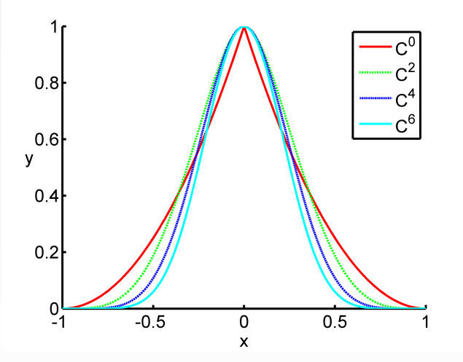

Wendland’s function for various k and s=3.

Slide 4
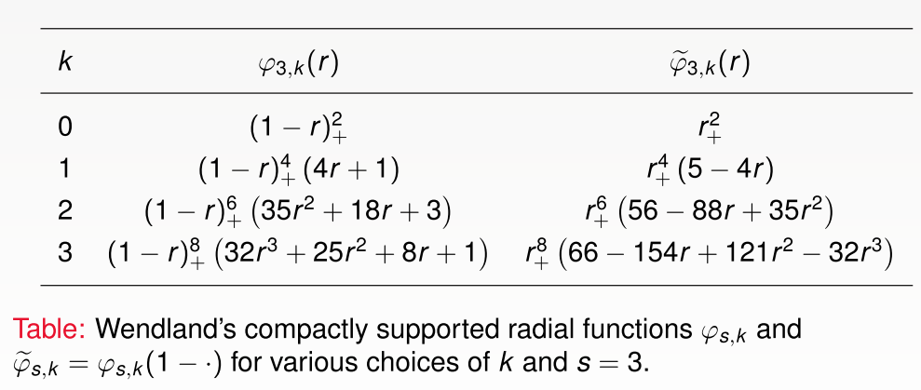
For the Matlab implementation, it would be easier to write
the compactly supported functions in a shifted form.

Slide 5
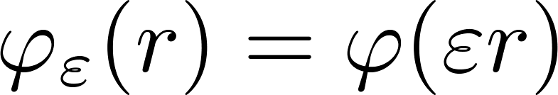

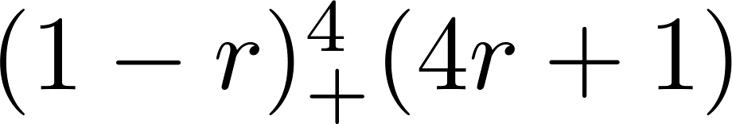
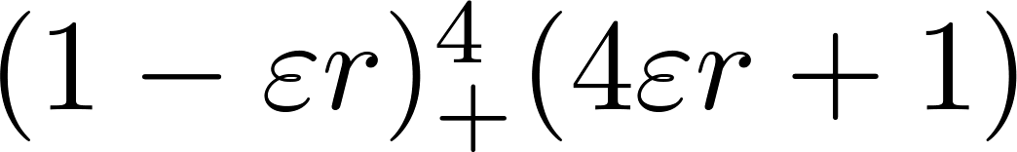
We need to re-scale the support of basis function .
To achieve this we use
A larger value of corresponds to a small support.
Example
Original form
In real application

Slide 6
It is important to know how to write the efficient Matlab
Code to assemble the sparse matrix.
Once the sparse matrix is formulated, Matlab can be used
To solve the system of equations effortless.
We try to avoid to compute the matrix entries for all pairs
of points since all the entries for far away points will be zero.

Slide 7
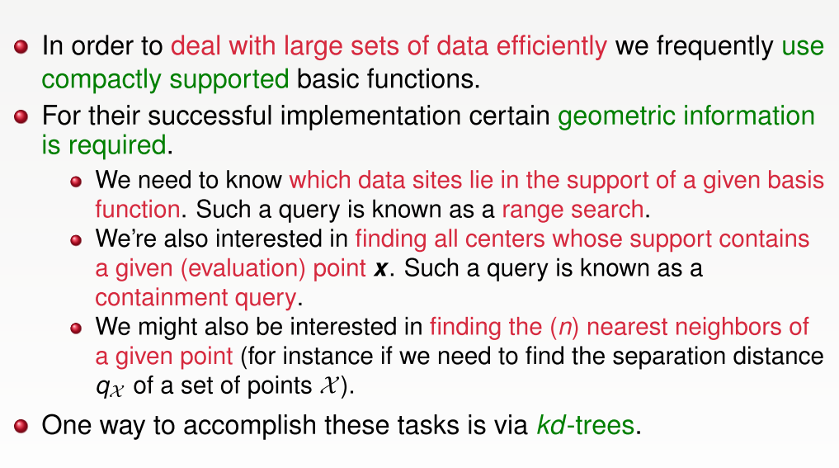

Slide 8
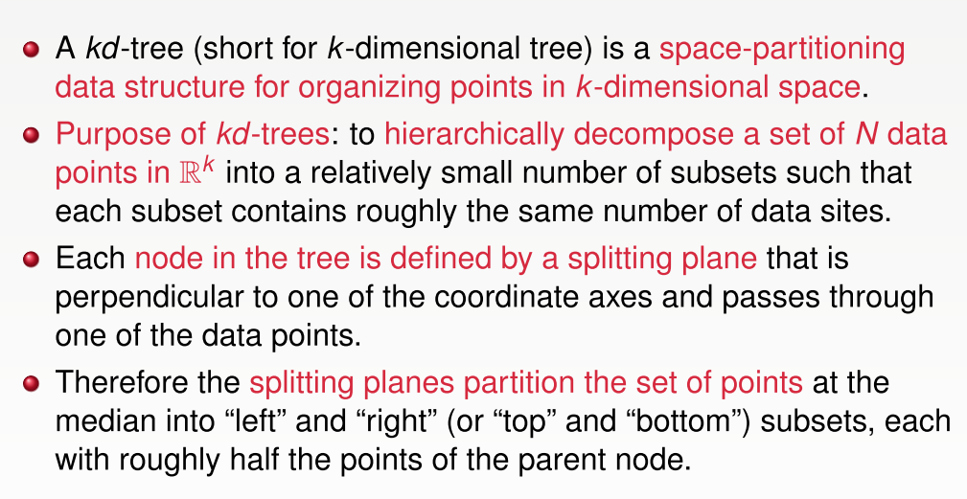
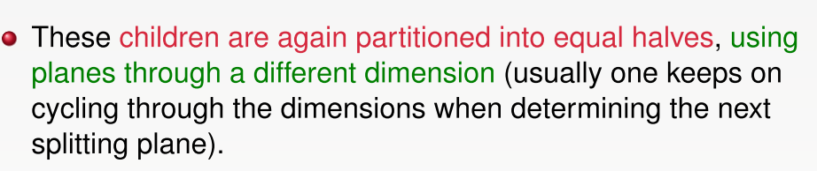
Kd-tree

Slide 9
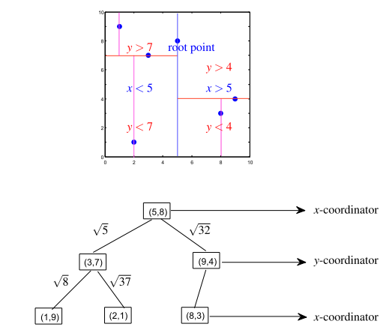
Example
P={(1,9), (2,1), (3,7), (5,8), (8,3), (9,4)}
q=(3,7), find the three nearest neighbors to q in P.

Slide 10
Matlab MEX-files called k-D tree can be download
From the following website:
http://www.mathworks.com/matlabcentral/fileexchange/21512-kd-tree-for-matlab
tree = kdtree_build(int_points)
[id, D]=kdtree_ball-query(tree, q, r)
int_points: a set of points
q : query point
r : radius of local influence domain of q
Id: index of those points inside the influence domain
D: distance from q to all the obtained neighboring points

Slide 11
Assembly of the sparse interpolation matrix
First construct a distance matrix
Apply the anonymous function RBF to obtain the
interpolation/evaluation matrix

Slide 12
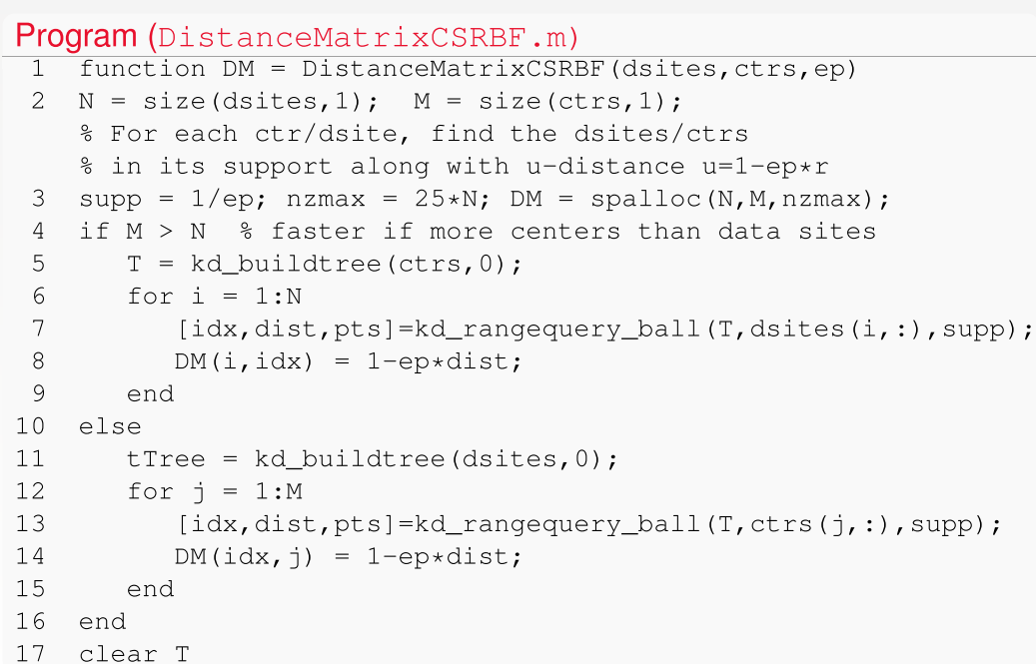

Slide 13
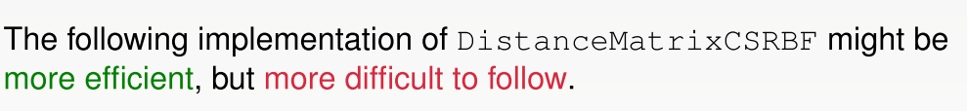

Slide 14
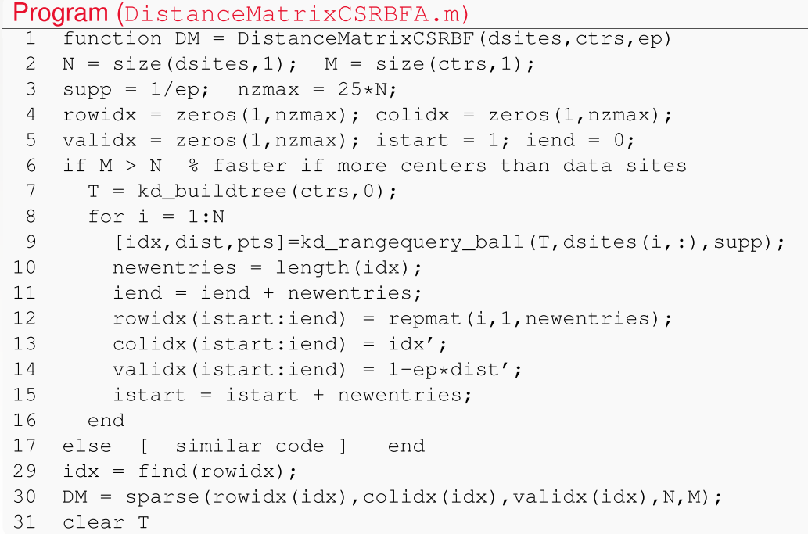

Slide 15
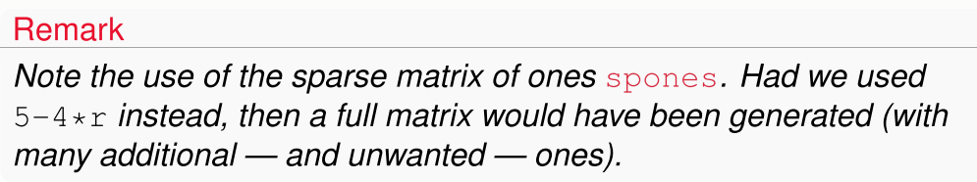

Slide 16
To speed up the solution of the (symmetric positive
Definite) spare linear system, we could use the preconditioned
Conjugate gradient algorithm (pcg in Matlab) instead of the
Basic backslash \ operation.

Slide 17
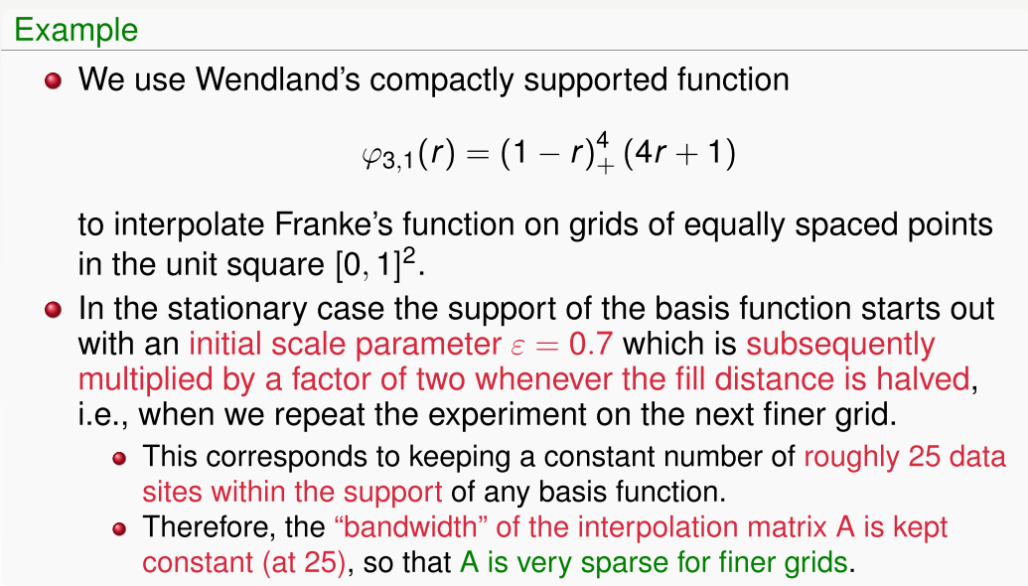

Slide 18
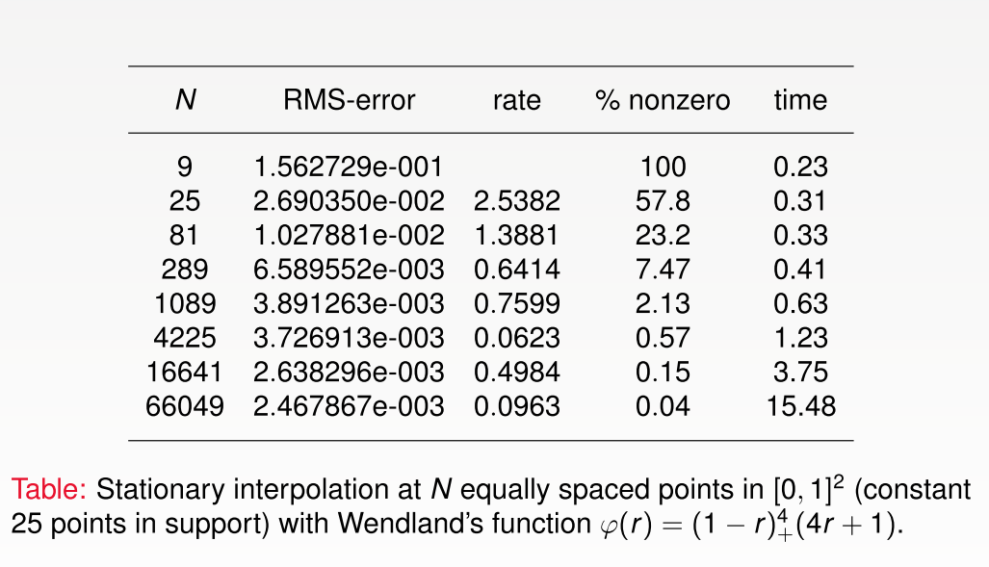

Slide 19
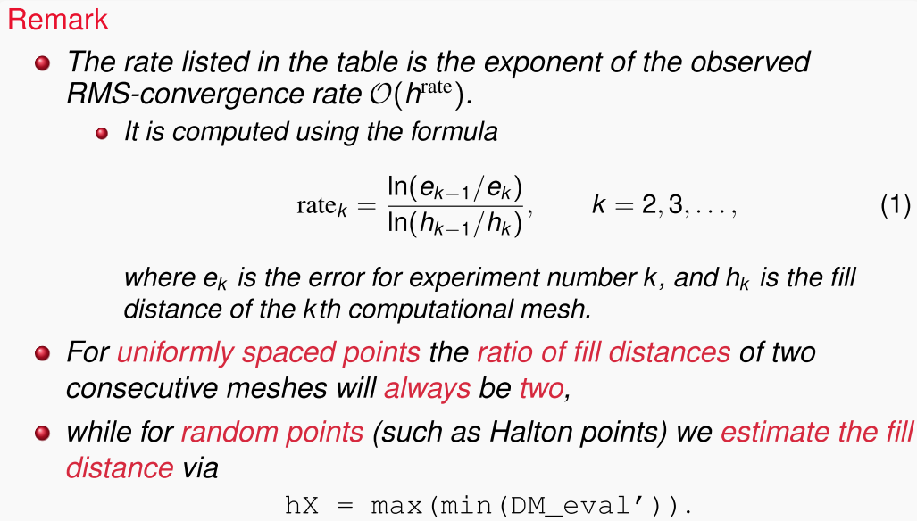

Slide 20
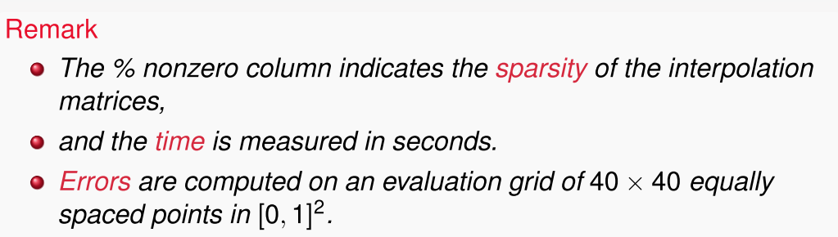
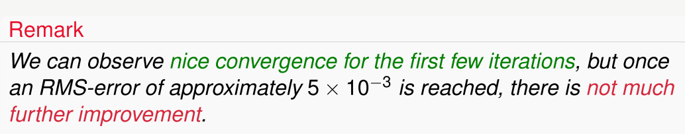

Slide 21
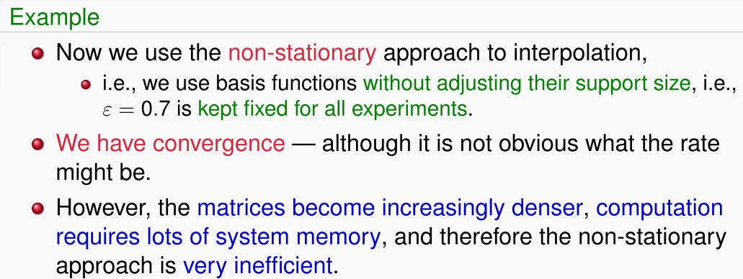

Slide 22
