Slide 1
What is Hadoop?
The Apache Hadoop project develops open-source software for reliable, scalable, distributed computing.
In a nutshell
Hadoop provides: a reliable shared storage and analysis system.
The storage is provided by HDFS
The analysis by MapReduce.

Slide 2
Basic Hadoop Cluster Components
Split up the two major functions of JobTracker
Cluster resource management
Application life-cycle management
Resource Manager
Global resource scheduler
Hierarchical queues
Node Manager
Per-machine agent
Manages the life-cycle of container
Container resource monitoring
Application Master
Per-application
Manages application scheduling and task execution
E.g. MapReduce Application Master

Slide 3
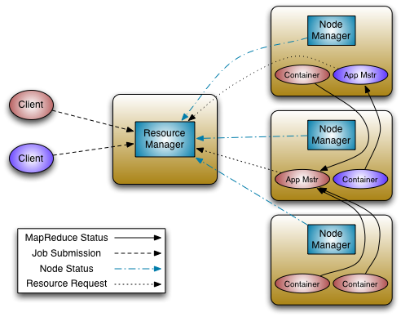
Putting everything together…

Slide 4
What is MapReduce?
HDFS handles the Distributed FileSystem layer
MapReduce is a programming model for data processing.
MapReduce
– Framework for parallel computing
– Programmers get simple API
– Don’t have to worry about handling
• parallelization
• data distribution
• load balancing
• fault tolerance
• Allows one to process huge amounts of data (terabytes and petabytes) on thousands of processors

Slide 5
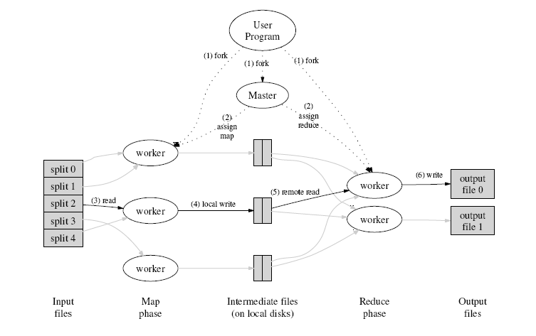
How does parallelization work?
INPUT
FILE(s)

Slide 6
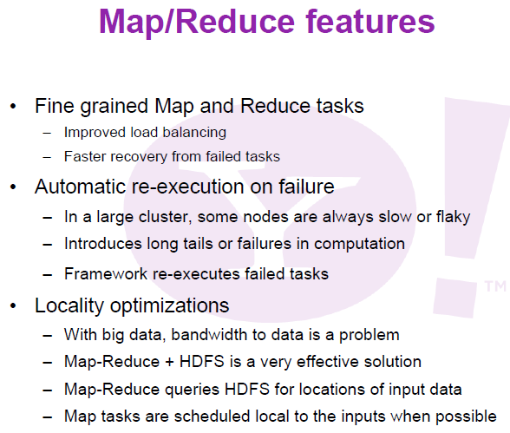

Slide 7
Anatomy of a MR Job
MapReduce program in Hadoop = Hadoop job
Jobs are divided into map and reduce tasks
An instance of running a task is called a task attempt
Multiple jobs can be composed into a workflow
Job submission process
Client (i.e., driver program) creates a job, configures it, and submits it to job tracker
JobClient computes input splits (on client end)
Job data (jar, configuration XML) are sent to JobTracker
Application Manager puts job data in shared location, enqueues tasks
TaskTrackers poll for tasks
Off to the races…

Slide 8
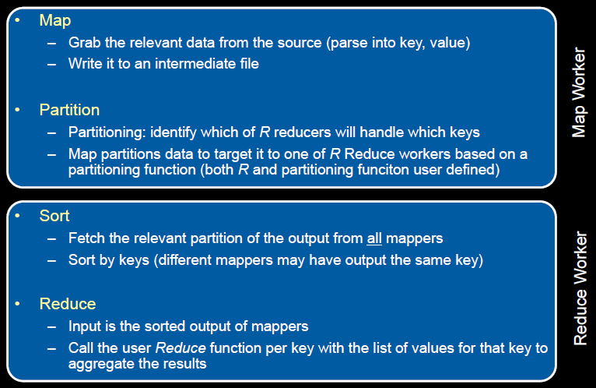
MapReduce - what happens in between?

Slide 9
MapReduce - A Bird’s-Eye View
In MapReduce, chunks are processed in isolation by tasks called Mappers
The outputs from the mappers are denoted as intermediate outputs (IOs) and are brought into a second set of tasks called Reducers
The process of bringing together IOs into a set of Reducers is known as shuffling process
The Reducers produce the final outputs (FOs)
Overall, MapReduce breaks the data flow into two phases, map phase and reduce phase
chunks
C0
C1
C2
C3
Map Phase
M0
M1
M2
M3
mappers
IO0
IO1
IO2
IO3
Shuffling Data
Reduce Phase
Reducers
R0
R1
FO0
FO1

Slide 10
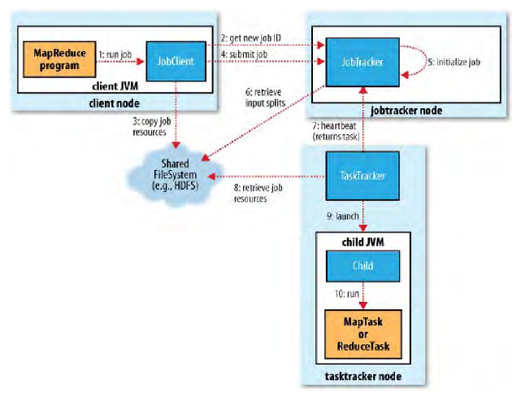
MapReduce - Job Flow
Application Manager

Slide 11
MapReduce Flow - Mapper
Input File
Input File
InputSplit
InputSplit
InputSplit
InputSplit
InputSplit
InputFormat
RecordReader
RecordReader
RecordReader
RecordReader
RecordReader
Mapper
Mapper
Mapper
Mapper
Mapper
Intermediates
Intermediates
Intermediates
Intermediates
Intermediates
Source: redrawn from a slide by Cloduera, cc-licensed

Slide 12
MapReduce Flow – Suffle and Sort
Mapper
Mapper
Mapper
Mapper
Mapper
Intermediates
Intermediates
Intermediates
Intermediates
Intermediates
Partitioner
Partitioner
Partitioner
Partitioner
Partitioner
Intermediates
Intermediates
Intermediates
Reducer
Reducer
Reducer
Source: redrawn from a slide by Cloduera, cc-licensed

Slide 13
MapReduce Flow - Reducer
Reducer
Reducer
Reduce
OutputFormat
RecordWriter
RecordWriter
RecordWriter
Output File
Output File
Output File
Source: redrawn from a slide by Cloduera, cc-licensed

Slide 14
MapReduce - A Closer Look - Complete picture
Node 1
Node 2
Files loaded from local HDFS store
Files loaded from local HDFS store
InputFormat
InputFormat
file
Split
Split
Split
Split
Split
Split
file
file
file
RecordReaders
RR
RR
RR
RR
RR
RR
RecordReaders
Input (K, V) pairs
Input (K, V) pairs
Map
Map
Map
Map
Map
Map
Intermediate (K, V) pairs
Shuffling
Process
Intermediate
(K,V) pairs
exchanged by
all nodes
Intermediate (K, V) pairs
Partitioner
Partitioner
Sort
Sort
Reduce
Reduce
Final (K, V) pairs
Final (K, V) pairs
OutputFormat
OutputFormat
Writeback to local HDFS store
Writeback to local HDFS store

Slide 15
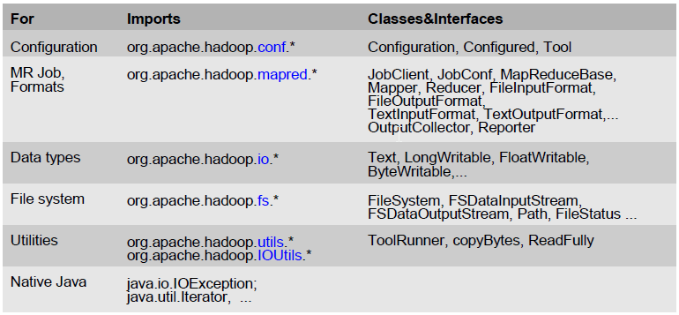
MapReduce API - Overview

Slide 16
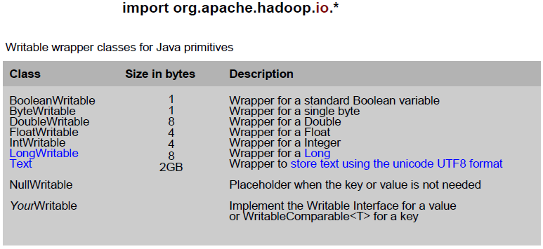
MapReduce API Data Types: Writables

Slide 17
MapReduce - Keys and Values
The programmer in MapReduce has to specify two functions, the map function and the reduce function that implement the Mapper and the Reducer in a MapReduce program
In MapReduce data elements are always structured as key-value (i.e., (K, V)) pairs
The map and reduce functions receive and emit (K, V) pairs
Input Splits
Intermediate Outputs
Final Outputs
(K, V) Pairs
(K’, V’) Pairs
(K’’, V’’) Pairs
Map Function
Reduce Function

Slide 18
MapReduce - Input Files
Input files are where the data for a MapReduce task is initially stored
The input files typically reside in a distributed file system (e.g. HDFS)
The format of input files is arbitrary
Line-based log files
Binary files
Multi-line input records
Or something else entirely
file
file

Slide 19
MapReduce - InputFormat
How the input files are split up and read is defined by the InputFormat
InputFormat is a class that does the following:
Selects the files that should be used for input
Defines the InputSplits that break a file
Provides a factory for RecordReader objects that read the file
Files loaded from local HDFS store
InputFormat
file
file

Slide 20
MapReduce - InputFormat Types
Several InputFormats are provided with Hadoop:
InputFormat | Description | Key | Value
TextInputFormat | Default format; reads lines of text files | The byte offset of the line | The line contents
KeyValueInputFormat | Parses lines into (K, V) pairs | Everything up to the first tab character | The remainder of the line
SequenceFileInputFormat | A Hadoop-specific high-performance binary format | user-defined | user-defined
InputFormat | Description | Key | Value
TextInputFormat | Default format; reads lines of text files | The byte offset of the line | The line contents
KeyValueInputFormat | Parses lines into (K, V) pairs | Everything up to the first tab character | The remainder of the line
SequenceFileInputFormat | A Hadoop-specific high-performance binary format | user-defined | user-defined
InputFormat | Description | Key | Value
TextInputFormat | Default format; reads lines of text files | The byte offset of the line | The line contents
KeyValueInputFormat | Parses lines into (K, V) pairs | Everything up to the first tab character | The remainder of the line
SequenceFileInputFormat | A Hadoop-specific high-performance binary format | user-defined | user-defined
InputFormat | Description | Key | Value
TextInputFormat | Default format; reads lines of text files | The byte offset of the line | The line contents
KeyValueInputFormat | Parses lines into (K, V) pairs | Everything up to the first tab character | The remainder of the line
SequenceFileInputFormat | A Hadoop-specific high-performance binary format | user-defined | user-defined

Slide 21
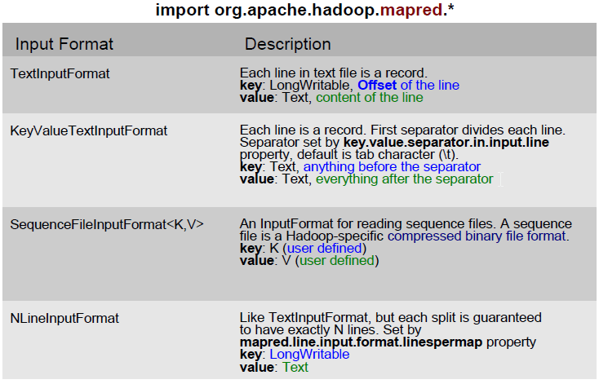
MapReduce API - InputFormats

Slide 22
Input Splits
An input split describes a unit of work that comprises a single map task in a MapReduce program
By default, the InputFormat breaks a file up into 64MB splits
By dividing the file into splits, we allow several map tasks to operate on a single file in parallel
If the file is very large, this can improve performance significantly through parallelism
Each map task corresponds to a single input split
Files loaded from local HDFS store
InputFormat
file
Split
Split
Split
file

Slide 23
RecordReader
The input split defines a slice of work but does not describe how to access it
The RecordReader class actually loads data from its source and converts it into (K, V) pairs suitable for reading by Mappers
The RecordReader is invoked repeatedly on the input until the entire split is consumed
Each invocation of the RecordReader leads to another call of the map function defined by the programmer
Files loaded from local HDFS store
InputFormat
file
Split
Split
Split
file
RR
RR
RR

Slide 24
Mapper and Reducer
The Mapper performs the user-defined work of the first phase of the MapReduce program
A new instance of Mapper is created for each split
The Reducer performs the user-defined work of the second phase of the MapReduce program
A new instance of Reducer is created for each partition
For each key in the partition assigned to a Reducer, the Reducer is called once
Files loaded from local HDFS store
InputFormat
file
Split
Split
Split
file
RR
RR
RR
Map
Map
Map
Partitioner
Sort
Reduce

Slide 25
Partitioner
Each mapper may emit (K, V) pairs to any partition
Therefore, the map nodes must all agree on where to send different pieces of intermediate data
The partitioner class determines which partition a given (K,V) pair will go to
The default partitioner computes a hash value for a given key and assigns it to a partition based on this result
Files loaded from local HDFS store
InputFormat
file
Split
Split
Split
file
RR
RR
RR
Map
Map
Map
Partitioner
Sort
Reduce

Slide 26
Shuffle and Sort
Probably the most complex aspect of MapReduce!
Map side
Map outputs are buffered in memory in a circular buffer
When buffer reaches threshold, contents are “spilled” to disk
Spills merged in a single, partitioned file (sorted within each partition): combiner runs here
Reduce side
First, map outputs are copied over to reducer machine
“Sort” is a multi-pass merge of map outputs (happens in memory and on disk): combiner runs here
Final merge pass goes directly into reducer
Files loaded from local HDFS store
InputFormat
file
Split
Split
Split
file
RR
RR
RR
Map
Map
Map
Partitioner
Sort
Reduce

Slide 27
Shuffle and Sort
Mapper
intermediate files (on disk)
merged spills (on disk)
Combiner
Reducer
circular buffer (in memory)
Combiner
other reducers
spills (on disk)
other mappers

Slide 28
OutputFormat
Files loaded from local HDFS store
The OutputFormat class defines the way (K,V) pairs produced by Reducers are written to output files
The instances of OutputFormat provided by Hadoop write to files on the local disk or in HDFS
Several OutputFormats are provided by Hadoop:
InputFormat
file
Split
Split
Split
file
RR
RR
RR
Map
Map
Map
OutputFormat | Description
TextOutputFormat | Default; writes lines in "key \t value" format
SequenceFileOutputFormat | Writes binary files suitable for reading into subsequent MapReduce jobs
NullOutputFormat | Generates no output files
OutputFormat | Description
TextOutputFormat | Default; writes lines in "key \t value" format
SequenceFileOutputFormat | Writes binary files suitable for reading into subsequent MapReduce jobs
NullOutputFormat | Generates no output files
OutputFormat | Description
TextOutputFormat | Default; writes lines in "key \t value" format
SequenceFileOutputFormat | Writes binary files suitable for reading into subsequent MapReduce jobs
NullOutputFormat | Generates no output files
OutputFormat | Description
TextOutputFormat | Default; writes lines in "key \t value" format
SequenceFileOutputFormat | Writes binary files suitable for reading into subsequent MapReduce jobs
NullOutputFormat | Generates no output files
Partitioner
Sort
Reduce
OutputFormat

Slide 29
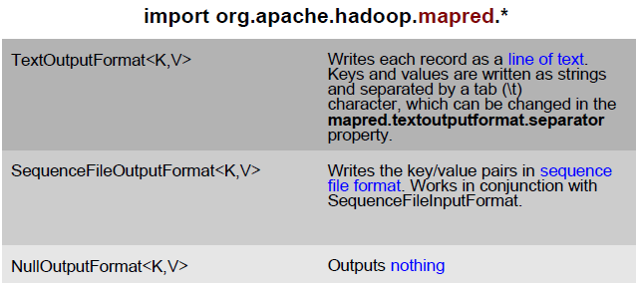
MapReduce API– OutputFormats

Slide 30
MR Additional functionalities - Combiner Functions
MapReduce applications are limited by the bandwidth available on the cluster
It pays to minimize the data shuffled between map and reduce tasks
Hadoop allows the user to specify a combiner function (just like the reduce function) to be run on a map output
Map
output
(Y, T)
Combiner
output
MT
(1950, 0)
(1950, 20)
(1950, 10)
MT
(1950, 20)
N
MT
R
N
MT
LEGEND:
R = Rack
N = Node
MT = Map Task
RT = Reduce Task
Y = Year
T = Temperature
RT
MT
N
MT
R
N
MT

Slide 31
Scheduling and fault-tolerance in MapReduce - Task Scheduling in MapReduce
MapReduce adopts a master-slave architecture
The master node in MapReduce is referred to as Job Tracker (JT)
Each slave node in MapReduce is referred to as Task Tracker (TT)
MapReduce adopts a pull scheduling strategy rather than a push one
I.e., JT does not push map and reduce tasks to TTs but rather TTs pull them by making pertaining requests
TT
Task Slots
JT
Request
Reply
Tasks Queue
T0
T1
Reply
T0
T1
T2
Request
TT
Task Slots

Slide 32
Scheduling and fault-tolerance in MapReduce - Map and Reduce Task Scheduling
Every TT sends a heartbeat message periodically to JT encompassing a request for a map or a reduce task to run
Map Task Scheduling:
JT satisfies requests for map tasks via attempting to schedule mappers in the vicinity of their input splits (i.e., it considers locality)
Reduce Task Scheduling:
However, JT simply assigns the next yet-to-run reduce task to a requesting TT regardless of TT’s network location and its implied effect on the reducer’s shuffle time (i.e., it does not consider locality)

Slide 33
Scheduling and fault-tolerance in MapReduce - Job Scheduling in MapReduce
In MapReduce, an application is represented as a job
A job encompasses multiple map and reduce tasks
MapReduce in Hadoop comes with a choice of schedulers:
The default is the FIFO scheduler which schedules jobs in order of submission
There is also a multi-user scheduler called the Fair scheduler which aims to give every user a fair share of the cluster capacity over time

Slide 34
Scheduling and fault-tolerance in MapReduce - Fault Tolerance
MapReduce can guide jobs toward a successful completion even when jobs are run on a large cluster where probability of failures increases
The primary way that MapReduce achieves fault tolerance is through restarting tasks
If a TT fails to communicate with Application Manager for a period of time (by default, 1 minute in Hadoop), JT will assume that TT in question has crashed
If the job is still in the map phase, JT asks another TT to re-execute all Mappers that previously ran at the failed TT
If the job is in the reduce phase, Application Manager asks another TT to re-execute all Reducers that were in progress on the failed TT

Slide 35
Speculative Execution
A MapReduce job is dominated by the slowest task
MapReduce attempts to locate slow tasks (stragglers) and run redundant (speculative) tasks that will optimistically commit before the corresponding stragglers
This process is known as speculative execution
Only one copy of a straggler is allowed to be speculated
Whichever copy (among the two copies) of a task commits first, it becomes the definitive copy, and the other copy is killed by JT

Slide 36
Locating Stragglers
How does Hadoop locate stragglers?
Hadoop monitors each task progress using a progress score between 0 and 1
If a task’s progress score is less than (average – 0.2), and the task has run for at least 1 minute, it is marked as a straggler
T1
Not a straggler
PS= 2/3
T2
A straggler
PS= 1/12
Time

Slide 37
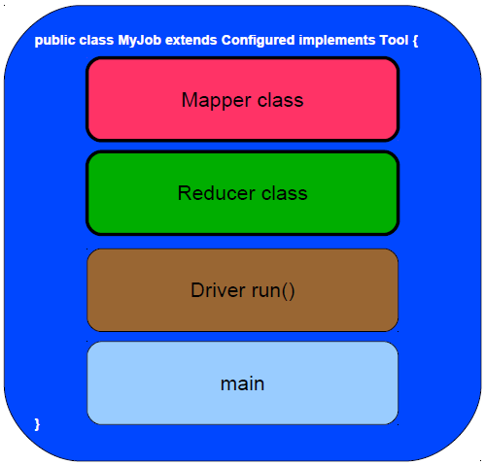
MapReduce program components

Slide 38
Preserving State
Mapper object
Reducer object
one object per task
state
state
configure
API initialization hook
configure
map
one call per input key-value pair
reduce
one call per intermediate key
close
API cleanup hook
close

Slide 39
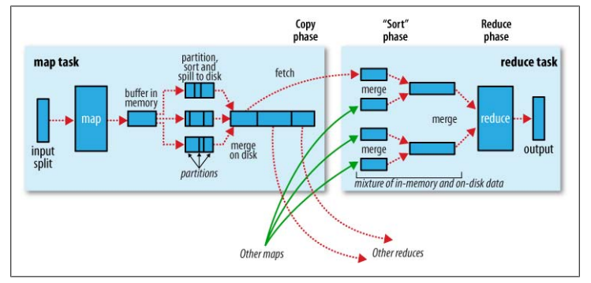
MapReduce Execution - One Picture

Slide 40
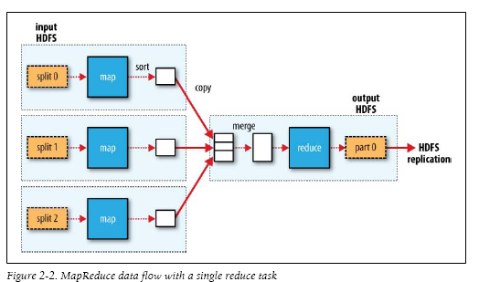
MapReduce Execution – Single Reduced Task

Slide 41
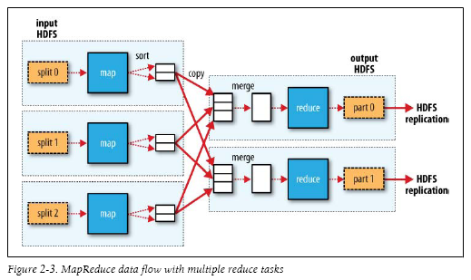
MapReduce Execution – Multiple Reduce tasks

Slide 42
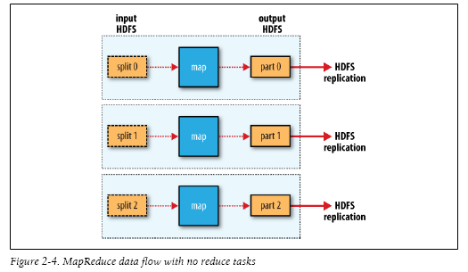
MapReduce Execution – With No Reduce Tasks

Slide 43
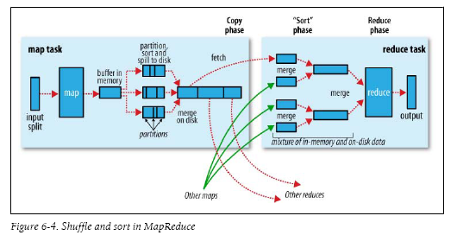
MapReduce Execution – Shuffle and Sort

Slide 44
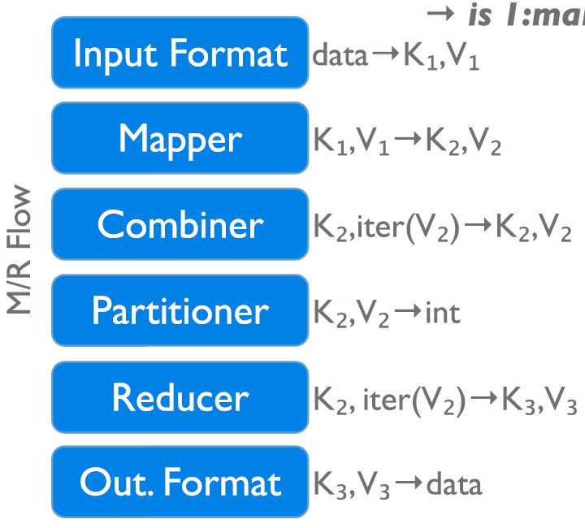
Data Flow in a MapReduce Program
→ 1:many
InputFormat
Map function
Partitioner
Sorting & Merging
Combiner
Shuffling
Merging
Reduce function
OutputFormat

Slide 45
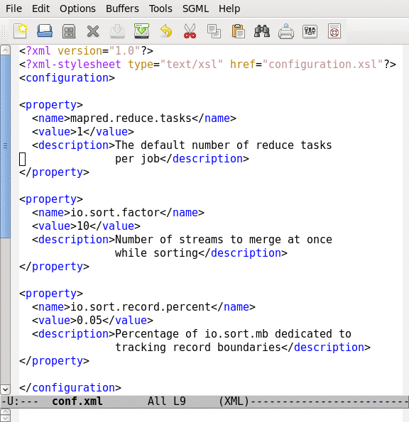
Job Configuration Parameters
190+ parameters in Hadoop
Set manually or defaults are used

Slide 46
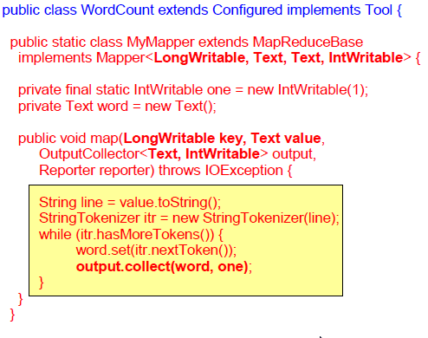
Skeleton of a MapReduce Program

Slide 47
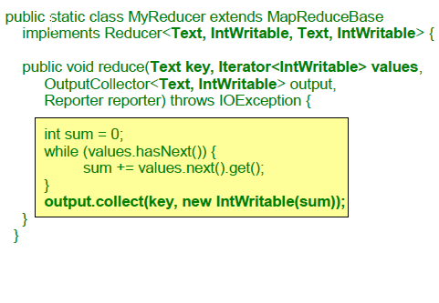
Skeleton of a MapReduce Program

Slide 48
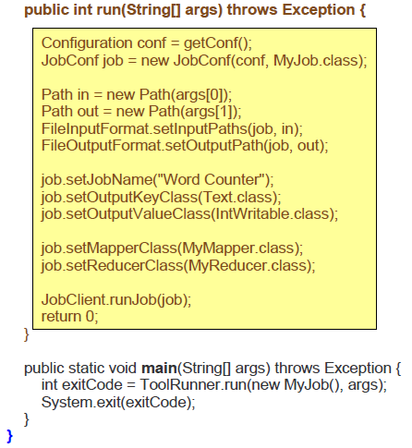
Skeleton of a MapReduce program

Slide 49
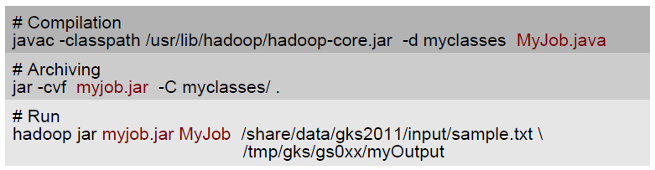
Executing MR Job in Java

Slide 50
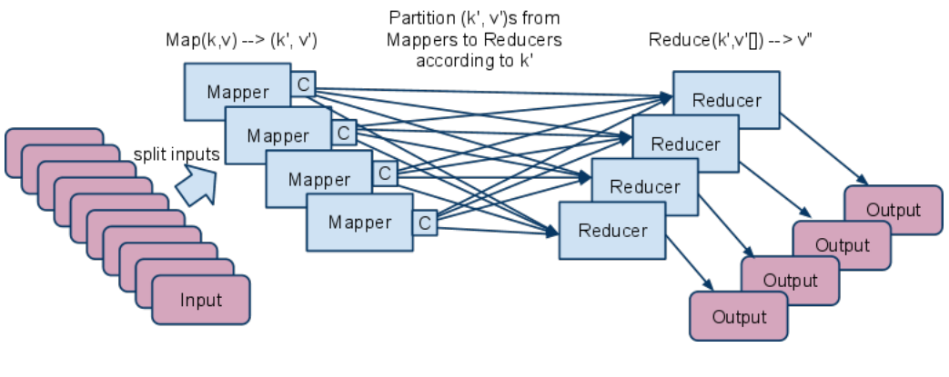
Combiner
Apply reduce function to map output before it is sent to reducer
Reduces number of records outputted by mapper!

Slide 51
Hadoop MR Streaming
Hadoop Streaming: An API to MapReduce to write map and reduce functions in languages other than Java.
It uses STDIN to read text data line-by-line and write to STDOUT.
Map input data is passed to your map function.
A map key-value pair is written as a single tab-delimited line to STDOUT.
The reduce function input is a tab-separated key-value pair passed over STDIN, and writes its results to STDOUT.

Slide 52
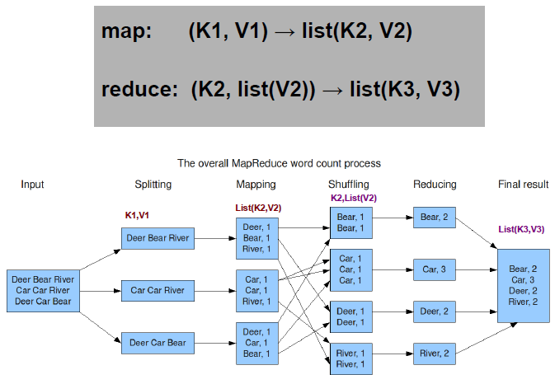
Overall MR Word Count Process

Slide 53
MapReduce
Map: (input shard) → intermediate(key/value pairs)
– Map calls are distributed across machines by automatically partitioning the input data into M "shards".
– MapReduce library groups together all intermediate values associated with the same intermediate key & passes them to the Reduce function
• Reduce: intermediate(key/value pairs) → result files
– Accepts an intermediate key & a set of values for the key
– It merges these values together to form a smaller set of values
– Reduce calls are distributed by partitioning the intermediate key space into R pieces using a partitioning function (e.g., hash(key) mod R).The user specifies the # of partitions (R) and the partitioning function.

Slide 54
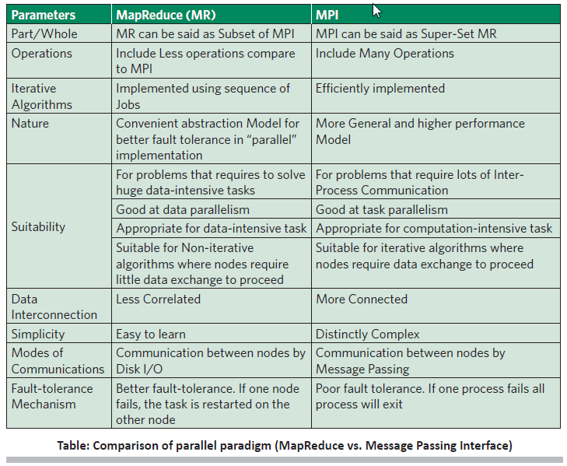

Slide 55
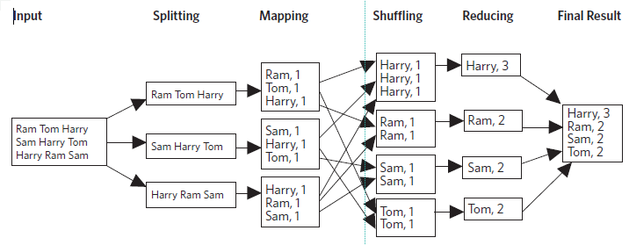
MapReduce word count

Slide 56
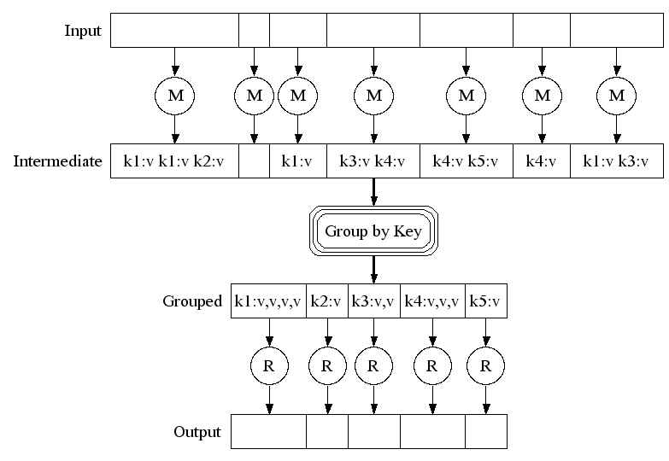

Slide 57
MapReduce: Example

Slide 58
Data Types in Hadoop
Writable
Defines a de/serialization protocol. Every data type in Hadoop is a Writable.
WritableComprable
Defines a sort order. All keys must be of this type (but not values).
IntWritable LongWritable
Text
…
Concrete classes for different data types.
SequenceFiles
Binary encoded of a sequence of key/value pairs

Slide 59
Input and Output
InputFormat:
TextInputFormat
KeyValueTextInputFormat
SequenceFileInputFormat
…
OutputFormat:
TextOutputFormat
SequenceFileOutputFormat
…

Slide 60
Basic MapReduce API
Mapper
void map(K1 key, V1 value, OutputCollector<K2, V2> output, Reporter reporter)
void configure(JobConf job)
void close() throws IOException
Reducer/Combiner
void reduce(K2 key, Iterator<V2> values, OutputCollector<K3,V3> output, Reporter reporter)
void configure(JobConf job)
void close() throws IOException
Partitioner
void getPartition(K2 key, V2 value, int numPartitions)
*Note: forthcoming API changes…

Slide 61
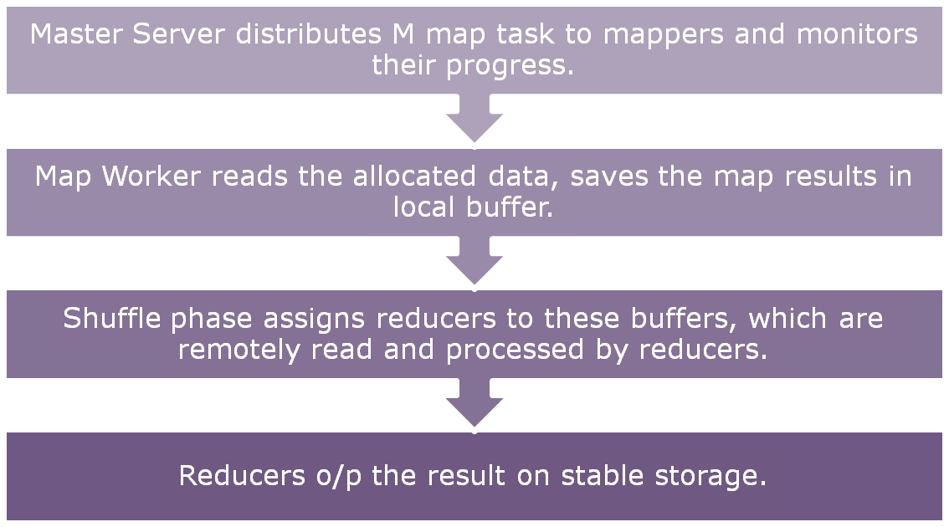

Slide 62
MapReduce: Runtime Environment
MapReduce Runtime Environment
Partitioning the input data.
Scheduling program across cluster of machines, Locality Optimization and Load balancing
Dealing with machine failure
Managing Inter-Machine communication

Slide 63
MapReduce: Fault Tolerance
Handled via re-execution of tasks.
Task completion committed through master
What happens if Mapper fails ?
Re-execute completed + in-progress map tasks
What happens if Reducer fails ?
Re-execute in progress reduce tasks
What happens if Master fails ?
Potential trouble !!

Slide 64
MapReduce: Refinements Locality Optimization
Leverage GFS to schedule a map task on a machine that contains a replica of the corresponding input data.
Thousands of machines read input at local disk speed
Without this, rack switches limit read rate

Slide 65
MapReduce: Refinements Redundant Execution
Slow workers are source of bottleneck, may delay completion time.
Near end of phase, spawn backup tasks, one to finish first wins.
Effectively utilizes computing power, reducing job completion time by a factor.

Slide 66
MapReduce: Refinements Skipping Bad Records
Map/Reduce functions sometimes fail for particular inputs.
Fixing the Bug might not be possible : Third Party Libraries.
On Error
Worker sends signal to Master
If multiple error on same record, skip record

Slide 67
MapReduce: Refinements Miscellaneous
Combiner Function at Mapper
Sorting Guarantees within each reduce partition.
Local execution for debugging/testing
User-defined counters

Slide 68
Combining Phase
Run on mapper nodes after map phase
“Mini-reduce,” only on local map output
Used to save bandwidth before sending data to full reducer
Reducer can be combiner if commutative & associative

Slide 69
Combiner, graphically

Slide 70
Using MapReduce to Construct Indexes: Secondary Sort
So far, we have assumed that Reduce can sort values in memory …but what if there are too many to fit in memory?
Map: (docid₁, content₁) → ([t₁, fd_{1,1}], ilist_{1,1})
Combine to sort and group values
Shuffle by t
Sort by [t, fd], then Group by t (Secondary Sort)
([t₇, fd_{7,2}], ilist_{7,2}), ([t₇, fd_{7,1}], ilist_{7,1}) … → (t₇, [ilist_{7,1}, ilist_{7,2}, …])
Reduce: (t₇, [ilist_{7,1}, ilist_{7,2}, …]) → (t₇, ilist_{final})
Values arrive in order, so Reduce can stream its output
fd_{i,j} is the first docid in ilist_{i,j}

Slide 71
Using MapReduce to Construct Indexes: Putting it All Together
Map: (docid₁, content₁) → ([p, t₁, fd_{1,1}], ilist_{1,1})
Combine to sort and group values
([p, t₁, fd_{1,1}] [ilist_{1,2} ilist_{1,3} ilist_{1,1} …]) → ([p, t₁, fd_{1,27}], ilist_{1,27})
Shuffle by p
Secondary Sort by [(p, t), fd]
([p, t₇], [ilist_{7,2}, ilist_{7,1}, ilist_{7,4}, …]) → ([p, t₇], [ilist_{7,1}, ilist_{7,2}, ilist_{7,4}, …])
Reduce: ([p, t₇], [ilist_{7,1}, ilist_{7,2}, ilist_{7,4}, …]) → ([p, t₇], ilist_{final})

Slide 72
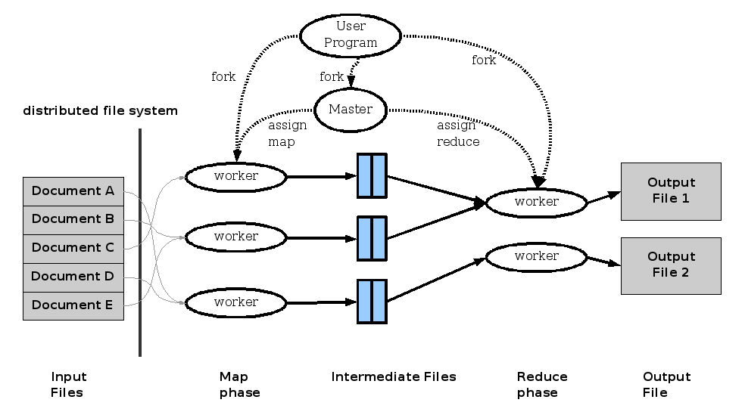
MapReduce: Execution overview

Slide 73
MapReduce: Execution overview
Master Server distributes M map task to mappers and monitors their progress.
Map Worker reads the allocated data, saves the map results in local buffer.
Shuffle phase assigns reducers to these buffers, which are remotely read and processed by reducers.
Reducers o/p the result on stable storage.

Slide 74
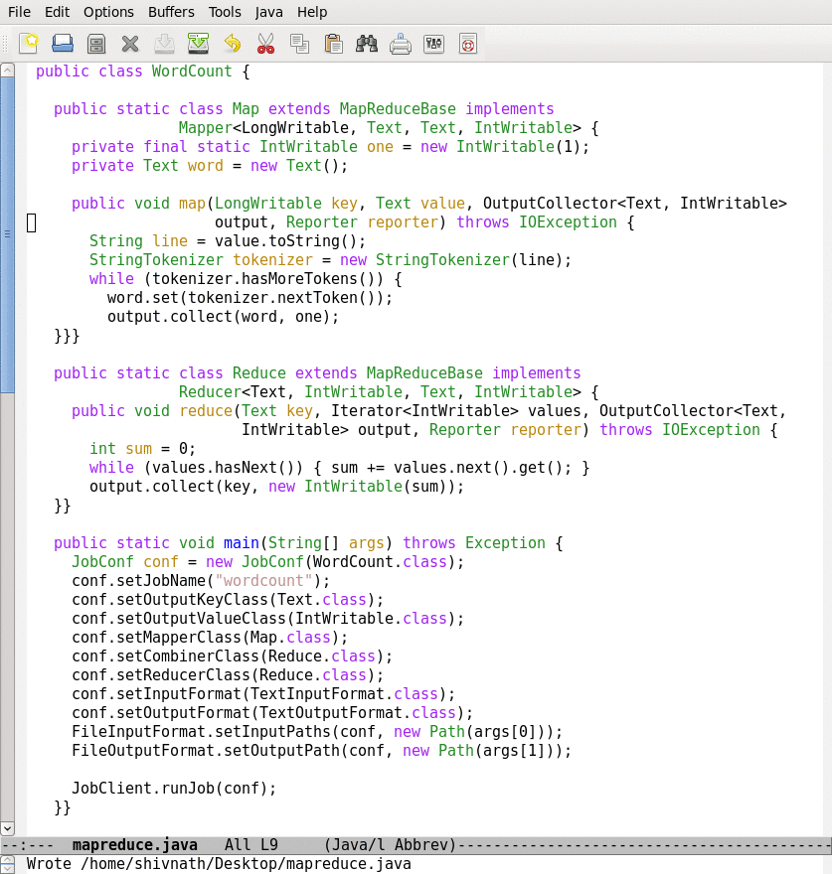
Lifecycle of a MapReduce Job
Time
Input
Splits
Map
Wave 1
Map
Wave 2
Reduce
Wave 1
Reduce
Wave 2
How are the number of splits, number of map and reduce
tasks, memory allocation to tasks, etc., determined?
Notes:
Industry wide it is recognized that to manage the complexity of today’s systems, we need to make systems self-managing. IBM’s autonomic computing, Microsoft’s DSI, and Intel’s proactive computing are some of the major efforts in this direction.
74

