Slide 1
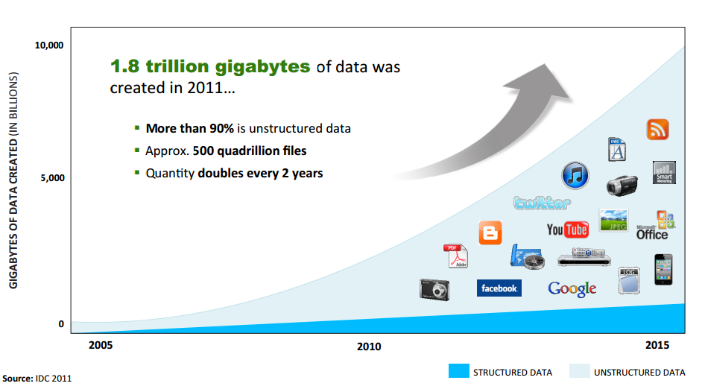
BIGDATA

Slide 2

Orgs using big data

Slide 3
Introduction to Big Data and Hadoop
The underlying Technology was invented by Google and developed by Doug Cutting
Hadoop is designed to efficiently process large volumes of information by connecting many commodity computers together to work in parallel.
Big data is a term applied to data sets whose size is beyond the ability of commonly used software tools to capture, manage, and process the data within a tolerable elapsed time. Big data sizes are a constantly moving target currently ranging from a few dozen terabytes to many petabytes of data in a single data set.
Examples
web logs,
sensor networks,
social networks,
Internet search indexing,
call detail records,

Slide 4
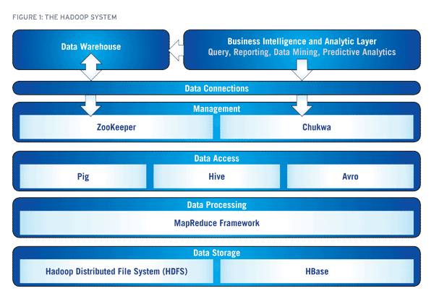
Hadoop and its eco system
.

Slide 5

Notes:
55
55

Slide 6
MapReduce co-located with HDFS
Client submits MapReduce job
JobTracker
JobTracker and NameNode
need not be on same
node
NameNode
Slave node
A
Slave node B
Slave node
C
TaskTracker
TaskTracker
TaskTracker
DataNode
DataNode
DataNode
TaskTrackers (compute nodes) and DataNodes colocate = high aggregate bandwidth across cluster
Notes:
66

Slide 7
Hadoop MapReduce: A Closer Look
Node 1
Node 2
Files loaded from local HDFS store
Files loaded from local HDFS store
InputFormat
InputFormat
file
Split
Split
Split
Split
Split
Split
file
file
file
RecordReaders
RR
RR
RR
RR
RR
RR
RecordReaders
Input (K, V) pairs
Input (K, V) pairs
Map
Map
Map
Map
Map
Map
Intermediate (K, V) pairs
Shuffling
Process
Intermediate
(K,V) pairs
exchanged by
all nodes
Intermediate (K, V) pairs
Partitioner
Partitioner
Sort
Sort
Reduce
Reduce
Final (K, V) pairs
Final (K, V) pairs
OutputFormat
OutputFormat
Writeback to local HDFS store
Writeback to local HDFS store

