Slide 1
Hadoop Fundamentals
Notes:
11

Slide 2
Introduction to Big Data and Hadoop
Big data is a term applied to data sets whose size is beyond the ability of commonly used software tools to capture, manage, and process the data within a tolerable elapsed time. Big data sizes are a constantly moving target currently ranging from a few dozen terabytes to many petabytes of data in a single data set.
Examples include web logs; RFID; sensor networks; social networks; social data , Internet text and documents; Internet search indexing; call detail records; astronomy, atmospheric science etc.

Slide 3
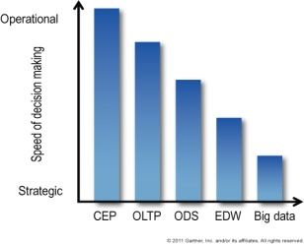
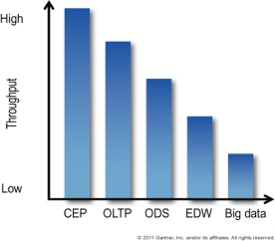
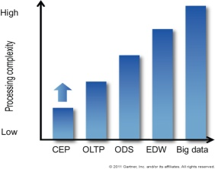
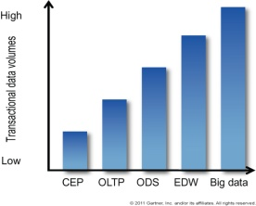
Big Data Contd..
Challenges in Big DATA
Data Storage – Physical storage, Acquisition costs, Space costs, Power costs
Data Management – Skills, People, Time
Data Processing (Information and Content management)
Performance modeling of the new application
Handling Big DATA
Requires exceptional technologies to efficiently process large data
Technologies applied on Big DATA include massively parallel processing(MPP) databases, data mining grids, distributed file systems, scalable storage systems and so on
Decision Speed
Concurrency & Throughput
Processing Complexity
Transactional Data Volume

Slide 4

Big DATA contd..
Exponential data growth (Yahoo, Google etc.)
RDBMS systems unable to handle this growth
Solution - Map-Reduce, Big-Table, GFS
BIG Data Management Problem – Industries have started realizing
Problems in handling Big DATA
Not all MPP relational databases have the ability to store and manage petabytes of data
Ability to load
Monitor processing of large data sets
Backup
Hostile to shared storage
Expectations of Big DATA Analytics
High System Performance
Commodity Infrastructure
Low Cost
Ability to handle large data with ease
Adapts to shared storage

Slide 5
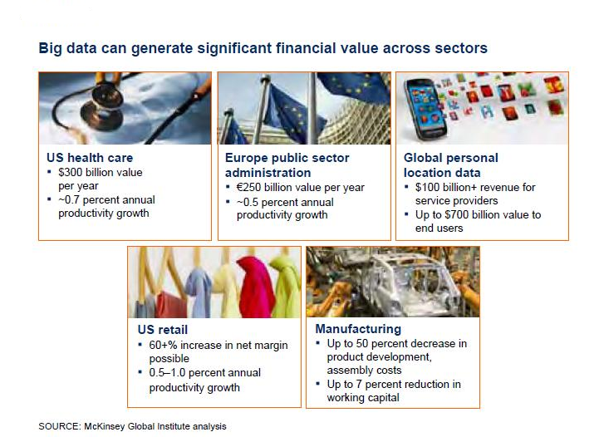
Hadoop – how it can help you
Creates data transparency
Dramatically reduces processing time for large data sets
Enables experimentation to discover needs, expose variability, and improve performance
Notes:
Creating transparency
Simply making big data more easily accessible to relevant stakeholders in a timely manner can create tremendous value
Enabling experimentation to discover needs, expose variability, and improve performance
IT enables organizations to instrument processes and then set up controlled experiments. Using data to analyze variability in performance—that which either occurs naturally or is generated by controlled experiments—and to understand its root causes can enable leaders to manage performance to higher level
Segmenting populations to customize action
Big data allows organizations to create highly specific segmentations and to tailor products and services precisely to meet those needs
Replacing/supporting human decision making with automated algorithms
Sophisticated analytics can substantially improve decision making, minimize risks
and unearth valuable insights that would otherwise remain hidden.
Decision making maynever be the same; some organizations are already making better decisions by analyzing entire datasets from customers, employees, or even sensors embedded in products.
Innovating new business models, products, and services
Big data enables companies to create new products and services, enhance existing ones, and invent entirely new business models.
Manufacturers are using dataobtained from the use of actual products to improve the development of the next generation of products and to create innovative after-sales service offerings.

Slide 6
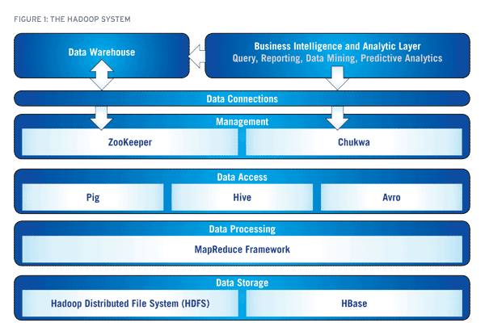
Hadoop and its eco system
.

Slide 7
Design principles of Hadoop
Invented by Yahoo (Doug Cutting)
Process internet scale data (search the web, store the web)
Save costs - distributed workload on massively parallel system build with large numbers of inexpensve computers
New way of storing and processing the data:
Let system handle most of the issues automatically:
Failures
Scalability
Reduce communications
Distribute processing power to where the data is
Make parallelism part of operating system
Relatively inexpensive hardware ($2 – 4K)
Reliability provided though replication
Large files preferred over small
Bring processing to Data!
Hadoop = HDFS + Map / Reduce infrastructure
Notes:
77

Slide 8
Simple Hadoop Cluster
Distributed file system daemons
Map reduce daemons
Job tracker
Namenode
Job Tracker
Secondary Namenode
DN1
TT1
DN2
DN3
DN4
DN 20
TT 20
20
20
20

Slide 9
Introduction to MapReduce Framework
Hadoop uses MapReduce algorithm in order to achieve parallel processing across the cluster.
It helps in moving the computation part to the data location.
MapReduce algorithm is designed to compute large volumes of data by splitting it into various blocks and processing each block in a parallel fashion.
It works on key and value pairs
Hadoop can run map reduce programs in multiple languages like Java, Python, Ruby and C++.

Slide 10
Introduction to MapReduce Framework
Map function:
Operate on set of key, value pairs
Map is applied in parallel on input data set
This produces output keys and list of values for each key depending upon the functionality
Mapper output are partitioned per reducer = No. Of reduce task for that job
Reduce function:
Operate on set of key, value pairs
Reduce is then applied in parallel to each group, again producing a collection of key, values.
No of reducers can be set by the user.
Problem Statement: Find out the maximum score scored by each player in India Australia 2013 test series.
Notes:
1010

Slide 11
How map-reduce algorithm works
Input
Splitting
Map
Shuffle
Reduce
Output
<M.Vijay,(153,167,26)>
<M.Vijay,167>
M.Vijay 153
S.Dhawan 187
C.A.Pujara 1
<M.Vijay,153 11>
<S.Dhawan,187>
<C.A.Pujara,1>
<M.Vijay,167>
<S.Dhawan,187>
<C.A.Pujara,204>
<S.R.Tendulkar37>
M.Vijay 153
S.Dhawan 187
C.A.Pujara 1
S.R.Tendulkar 37
M.Vijay 167
C.A.Pujara 204
S.R.Tendulkar 13
M.Vijay 26
C.A.Pujara 44
<S.Dhawan,187>
<S.Dhawan,187>
S.R.Tendulkar 37
M.Vijay 167
C.A.Pujara 204
<S.R.Tendulkar,37>
<M.Vijay,167 10>
<C.A.Pujara,204>
<C.A.Pujara,(1,204,44)>
<C.A.Pujara,204>
S.R.Tendulkar 13
M.Vijay 26
C.A.Pujara 44
<S.R.Tendulkar,13>
<M.Vijay,26>
<C.A.Pujara,1>
<S.R.Tendulkar,(37,13)>
<S.R.Tendulkar37>

