Slide 2
Mapreduce
task JVM
skipping bad records
distributed cache
task execution
speculated execution

Slide 3
Hive
serdes
thrif
Semantic Analyser
Hive & Hbase integration
how to retrieve the metadata if we change the database from MySQL to any other?
how to delete the metadata from database?
the data is getting overlapped while inserting into buckets. What might be the reason?
while creating partitions we got to change some properties like set dynamic partitions= true. What are those?
major properties to be known in hive-site.xml.
Mapside join and Reduceside Join.

Slide 4
Hadoop MapReduce: A Closer Look
Node 1
Node 2
Files loaded from local HDFS store
Files loaded from local HDFS store
InputFormat
InputFormat
file
Split
Split
Split
Split
Split
Split
file
file
file
RecordReaders
RR
RR
RR
RR
RR
RR
RecordReaders
Input (K, V) pairs
Input (K, V) pairs
Map
Map
Map
Map
Map
Map
Intermediate (K, V) pairs
Shuffling
Process
Intermediate
(K,V) pairs
exchanged by
all nodes
Intermediate (K, V) pairs
Partitioner
Partitioner
Sort
Sort
Reduce
Reduce
Final (K, V) pairs
Final (K, V) pairs
OutputFormat
OutputFormat
Writeback to local HDFS store
Writeback to local HDFS store

Slide 5
Speculative Execution
A MapReduce job is dominated by the slowest task
MapReduce attempts to locate slow tasks (stragglers) and run redundant (speculative) tasks that will optimistically commit before the corresponding stragglers
This process is known as speculative execution
Only one copy of a straggler is allowed to be speculated
Whichever copy (among the two copies) of a task commits first, it becomes the definitive copy, and the other copy is killed by JT

Slide 6
Locating Stragglers
How does Hadoop locate stragglers?
Hadoop monitors each task progress using a progress score between 0 and 1
If a task’s progress score is less than (average – 0.2), and the task has run for at least 1 minute, it is marked as a straggler
T1
Not a straggler
PS= 2/3
T2
A straggler
PS= 1/12
Time

Slide 7
Distributed Cache in Hadoop
Quite often we encounter situation when we need certain files like configuration files, jar libraries, xml files, properties files etc to be present in Hadoops processing nodes at the time of its execution. Quite understandably Hadoop has a feature called Distributed Cache which helps in sending those readonly files to the task nodes. In Hadoop environment jobs are basically map-Reduce jobs and the necessary readonly files are copied to the tasktracker nodes at the beginning of job execution process. The default size of distributed cache in Hadoop is about 10 GB but We can control the size of the distributed cache by explicitly defining its size in hadoop’s configuration file local.cache.size. Thus, Distributed cache is a mechanism to caching readonly data over Hadoop cluster. The sending of readOnly files occurs at the time of job creation and the framework makes the cached files available to the cluster nodes at their computational time.

Slide 8
What is a SerDe?
The SerDe interface allows you to instruct Hive as to how a record should be processed. A SerDe is a combination of a Serializer and a Deserializer (hence, Ser-De). The Deserializer interface takes a string or binary representation of a record, and translates it into a Java object that Hive can manipulate. The Serializer, however, will take a Java object that Hive has been working with, and turn it into something that Hive can write to HDFS or another supported system. Commonly, Deserializers are used at query time to execute SELECT statements, and Serializers are used when writing data, such as through an INSERT-SELECT statement.

Slide 9
HIVE properties
set hive.exec.dynamic.partition=true;
set hive.exec.dynamic.partition.mode=nonstrict;
set hive.exec.max.dynamic.partitions.pernode=300;
set hive.enforce.bucketing = true;
set hive.exec.max.created.files=150000;

Slide 10
Introduction to MapReduce Framework
Map function:
Operate on set of key, value pairs
Map is applied in parallel on input data set
This produces output keys and list of values for each key depending upon the functionality
Mapper output are partitioned per reducer = No. Of reduce task for that job
Reduce function:
Operate on set of key, value pairs
Reduce is then applied in parallel to each group, again producing a collection of key, values.
No of reducers can be set by the user.
Problem Statement: Find out the maximum score scored by each player in India Australia 2013 test series.
Notes:
1010

Slide 11
How map-reduce algorithm works
Input
Splitting
Map
Shuffle
Reduce
Output
<M.Vijay,(153,167,26)>
<M.Vijay,167>
M.Vijay 153
S.Dhawan 187
C.A.Pujara 1
<M.Vijay,153 11>
<S.Dhawan,187>
<C.A.Pujara,1>
<M.Vijay,167>
<S.Dhawan,187>
<C.A.Pujara,204>
<S.R.Tendulkar37>
M.Vijay 153
S.Dhawan 187
C.A.Pujara 1
S.R.Tendulkar 37
M.Vijay 167
C.A.Pujara 204
S.R.Tendulkar 13
M.Vijay 26
C.A.Pujara 44
<S.Dhawan,187>
<S.Dhawan,187>
S.R.Tendulkar 37
M.Vijay 167
C.A.Pujara 204
<S.R.Tendulkar,37>
<M.Vijay,167 10>
<C.A.Pujara,204>
<C.A.Pujara,(1,204,44)>
<C.A.Pujara,204>
S.R.Tendulkar 13
M.Vijay 26
C.A.Pujara 44
<S.R.Tendulkar,13>
<M.Vijay,26>
<C.A.Pujara,1>
<S.R.Tendulkar,(37,13)>
<S.R.Tendulkar37>

Slide 12
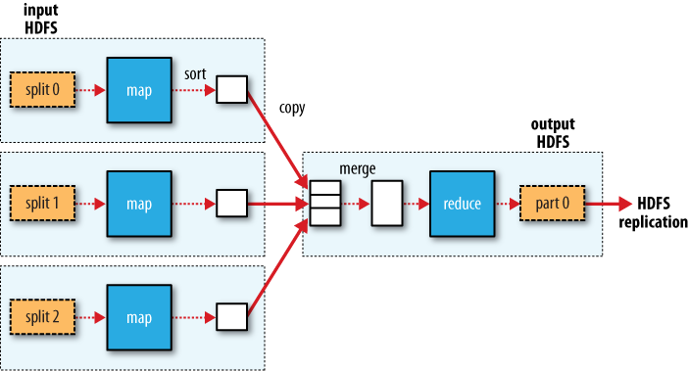
How map-reduce algorithm works

Slide 13
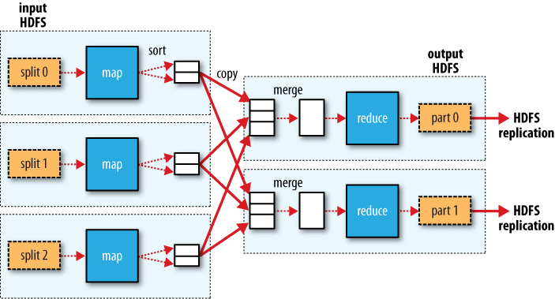
How map-reduce algorithm works
A,1
B,2
C,3
A,5
B,6
C,7
A,8
B,9
C,10

